Slide 1
PROJECT DEVELOPMENT DOCUMENT
AI Financial Analyzer
Automated Payslip-Based Loan Eligibility & AI-Driven Bank Statement Categorization
NAME
UNIVERSITY
Ritam Halder
The Neotia University
UID / ROLL
INTERNSHIP COMPANY
TNUR20241053013
Kognitive
DEPARTMENT
INTERNSHIP DURATION
CSE (AI & ML)
15 Jun – 15 Jul 2026
SEMESTER
SUBMITTED TO
5th
Bikash Bej
01

Slide 2







PROJECT OVERVIEW
Abstract & Key Advantages
Advantages
Abstract
AI Financial Analyzer is a secure, login-protected web application that unites two financial intelligence tools in one dashboard. It reads an uploaded payslip to detect Basic, HRA and other salary components, computes gross and net income, and instantly checks loan eligibility. In parallel, it reads a bank statement, classifies every transaction into a spending category using a BERT language model, and turns the numbers into clear pie charts and bar plots — making financial analysis fast, visual and reliable.
Saves Time
Reduces Errors
Instant results instead of manual review
Consistent, rule-based calculations
Secure Login
Auto Categorization
Access protected behind authentication
BERT classifies every transaction
Instant Eligibility
Clear Visual Insights
Immediate loan decision on upload
Pie & bar charts at a glance
02

Slide 3

MOTIVATION
Problem Statement & Objectives
Objectives
1
Extract salary components (Basic, HRA, Medical, Conveyance) directly from an uploaded payslip
The Problem
2
Automatically compute gross & net income and check loan eligibility against a defined threshold
Manually reading payslips and bank statements to judge loan eligibility or track expenses is slow, inconsistent and requires financial expertise most people don't have. Loan applicants wait longer than necessary, and everyday spending goes untracked simply because categorizing dozens of transactions by hand is tedious — creating a clear need for an automated, accurate, and visual solution.
3
Extract individual transactions from an uploaded bank statement
4
Classify every transaction into a spending category using a BERT model
5
Visualize salary structure and spending pattern through pie charts and bar plots
6
Provide a secure, login-protected dashboard for both tools
03

Slide 4
HOW IT WORKS
System Architecture
User Login
Dashboard
(Select Module)
MODULE 1 — PAYSLIP ANALYSIS
MODULE 2 — BANK STATEMENT ANALYSIS
Upload Payslip
Upload Bank Statement
OCR + Regex Extraction
Transaction Parsing
Eligibility Rule Engine
BERT Classification
Pie Chart + Verdict
Pie Chart + Bar Plot
04

Slide 5







UNDER THE HOOD
Technology Stack
Language
Backend Framework
Frontend
ML Model
Python 3
Flask
HTML5, CSS3, JavaScript
BERT (Transformers, PyTorch)
OCR / Parsing
Data Processing
Visualization
Auth & Storage
Tesseract OCR, pdfplumber, Regex
Pandas, NumPy
Matplotlib
Session Login, SQLite
05

Slide 6

MODULE 01 — PAYSLIP ANALYSIS
Salary Extraction & Loan Eligibility
1
Upload
User uploads a payslip in PDF, JPG or PNG format
2
Extract
OCR + regex parsing detects Basic, HRA, Medical, Conveyance & Other components
Eligibility Rule
3
Compute
₹ 20,000
System calculates Gross and Net monthly income from detected components
4
Decide
minimum net monthly income required for loan eligibility
Net income is checked against the eligibility threshold to approve or reject the loan
5
Visualize
Components Detected
Salary structure is rendered as an interactive pie chart
Basic • HRA • Medical • Conveyance • Other • Gross • Net
06

Slide 7
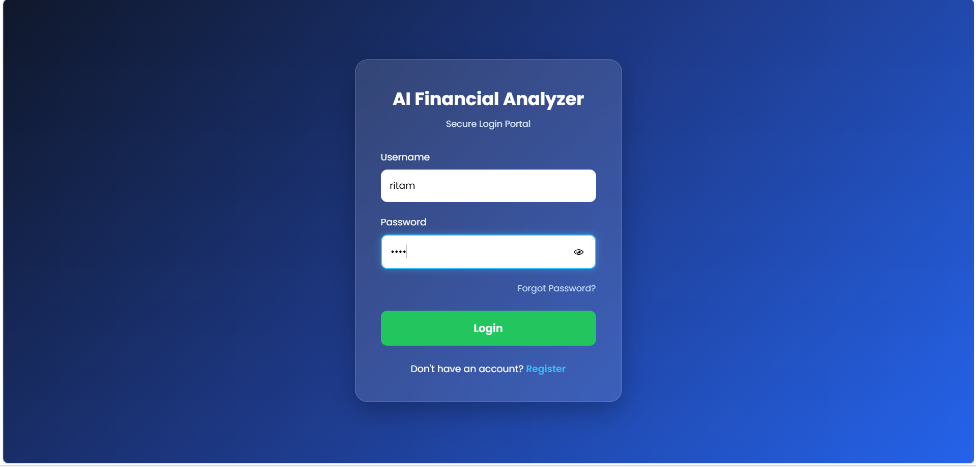
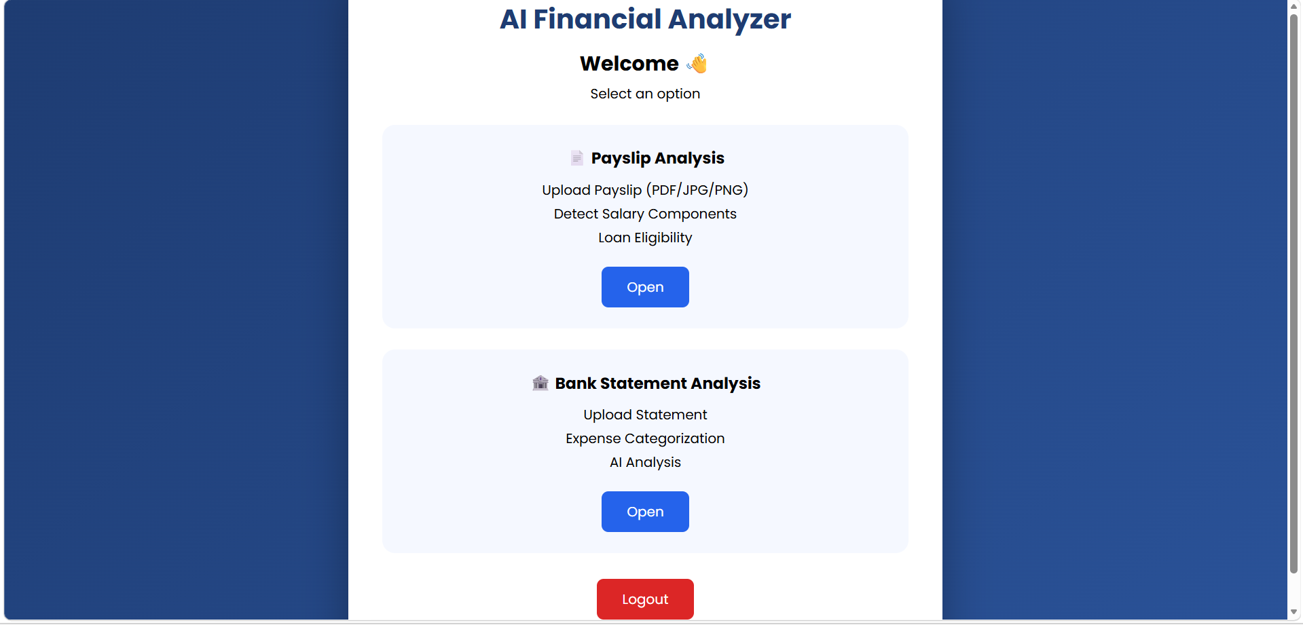

APPLICATION WALKTHROUGH
Secure Login & Module Dashboard
Screenshot 1 — Secure Login Portal
Screenshot 2 — Dashboard: Choose a Module
Username & password protected access
Payslip Analysis module
Bank Statement Analysis module
07

Slide 8
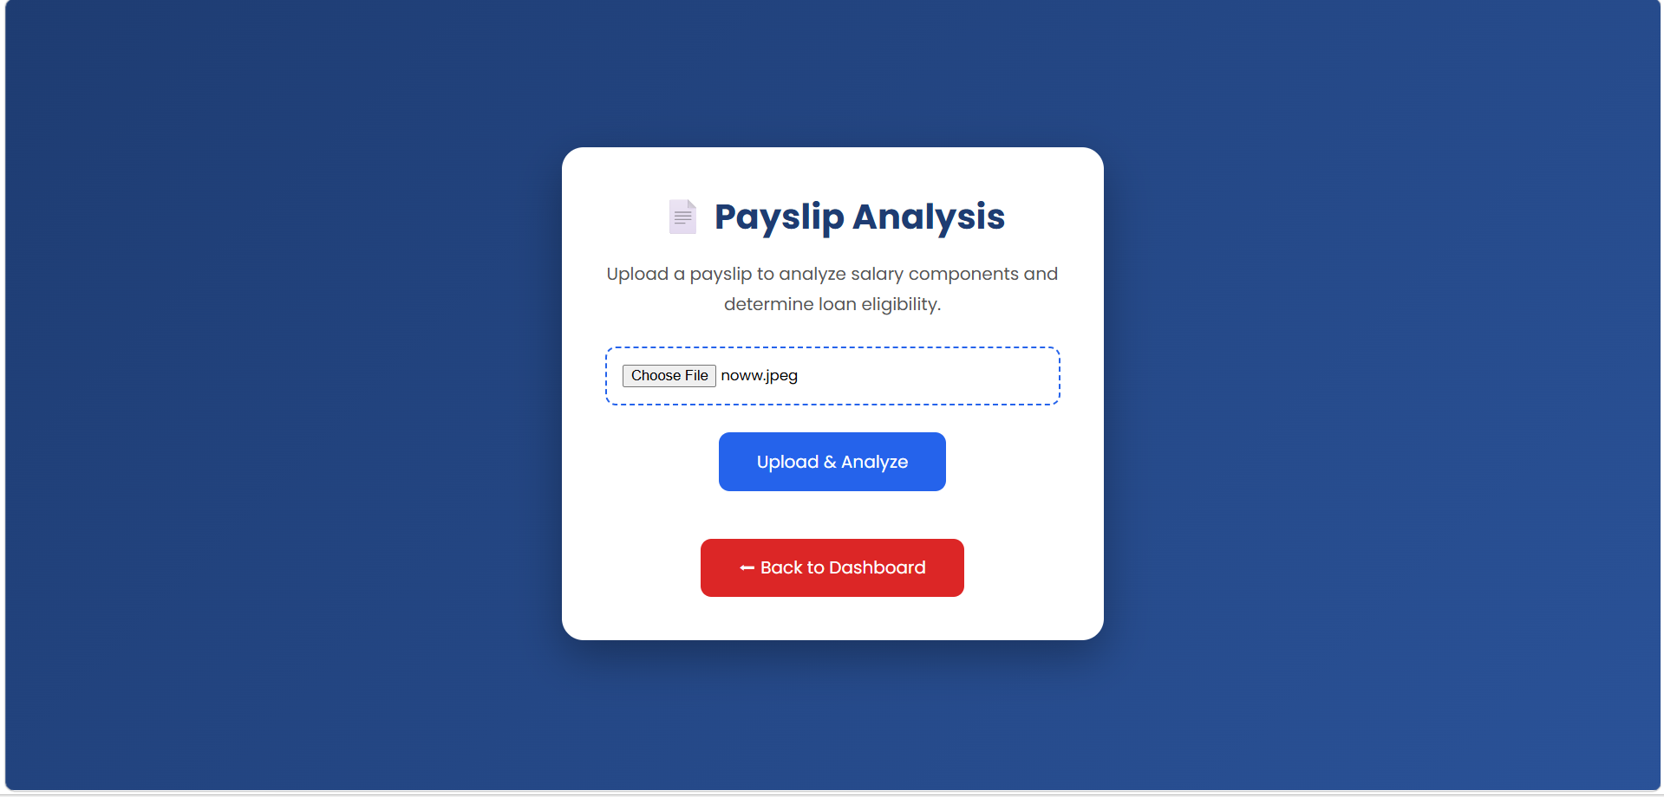
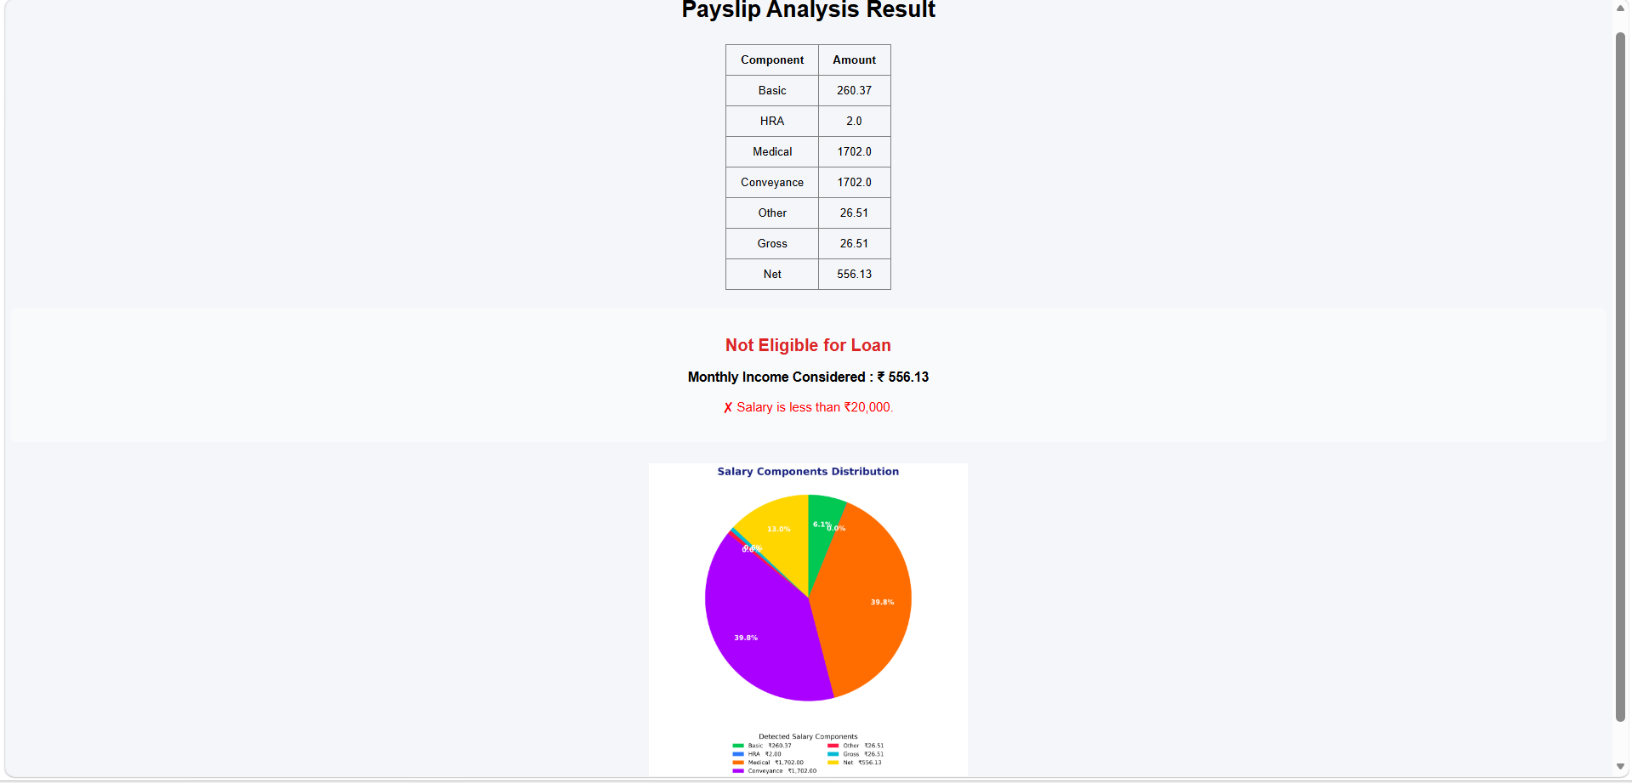
APPLICATION WALKTHROUGH
Payslip Upload & Analysis Result
Screenshot 3 — Payslip Upload
Screenshot 4 — Salary Breakdown, Verdict & Pie Chart
Sample Result: ✗ Not Eligible — Net income below ₹ 20,000 threshold
08

Slide 9
MODULE 02 — BANK STATEMENT ANALYSIS
AI-Powered Expense Categorization with BERT
1
Upload
User uploads a bank statement PDF
2
Parse
Transactions (date, description, amount) are extracted from the statement
BERT in Action
3
Classify
“SWIGGY *ORDER 500”
Each transaction description is passed through a fine-tuned BERT model to predict its category
4
Aggregate
Amounts are summed per category (Food, Transport, Medical, Shopping, etc.)
Category: Food – ₹500
5
Visualize
Results are rendered as a category pie chart and a top-categories bar plot
BERT reads plain transaction text and maps it directly to a spending category — no manual tagging required.
09

Slide 10
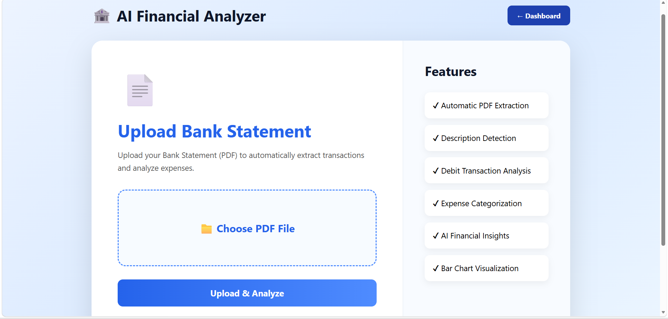
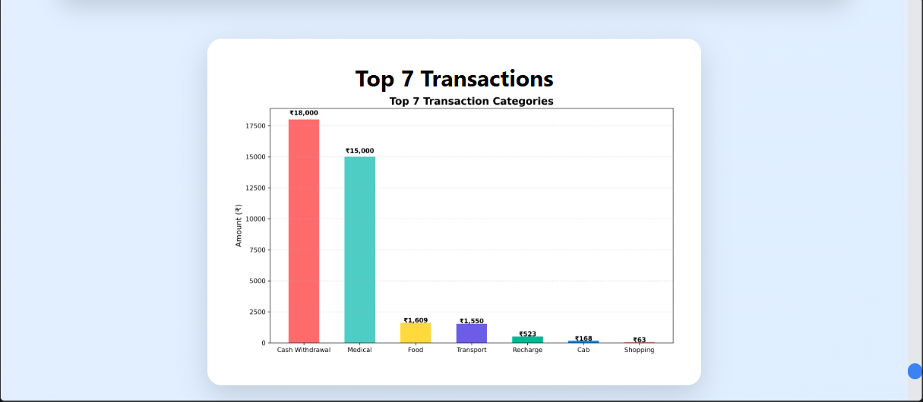
APPLICATION WALKTHROUGH
Statement Upload & Top Transaction Categories
Screenshot 6 — Top 7 Transaction Categories (Bar Plot)
Screenshot 5 — Upload Bank Statement
The bar plot ranks categories by total amount spent, instantly surfacing the largest outflows — here, cash withdrawals and medical expenses dominate the statement.
10

Slide 11
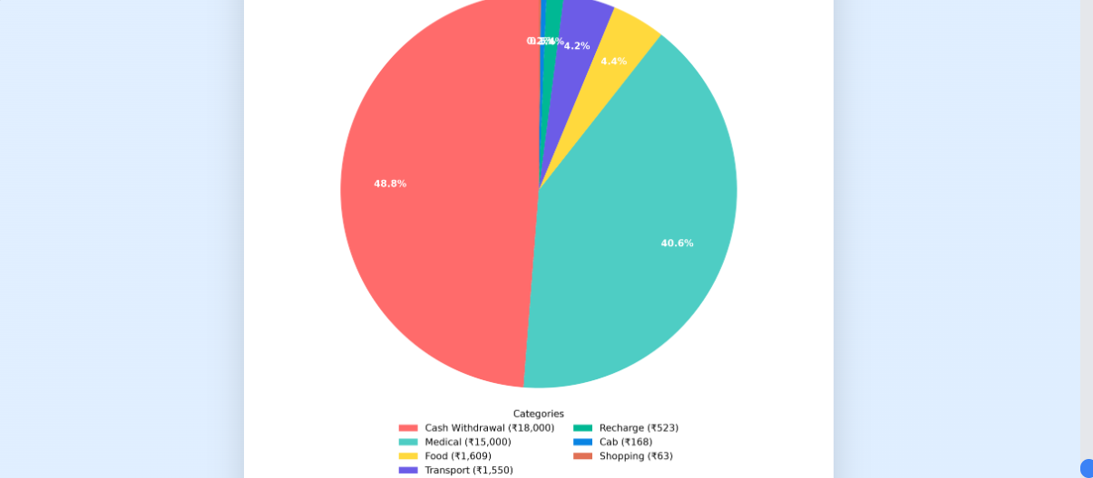
APPLICATION WALKTHROUGH
Spending Distribution by Category
Key Insights
Cash Withdrawal
48.8%
₹18,000
Medical
40.6%
₹15,000
Food
4.4%
₹1,609
Transport
4.2%
₹1,550
Screenshot 7 — Category-wise Expense Pie Chart
Recharge / Cab / Shopping
2.0%
₹754 combined
11

Slide 12
WRAPPING UP
Results, Conclusion & Future Scope
Key Results
Future Scope
Automated salary component extraction from payslips
Multi-bank statement format support
Rule-based, instant loan eligibility decisions
Expense prediction using AI trend analysis
BERT-based classification of bank transactions
Budget recommendation system
Clear pie chart & bar plot visual reporting
Mobile application version
Secure, login-protected multi-module dashboard
Cloud database integration for history & reports
AI Financial Analyzer brings payslip-based loan eligibility and BERT-driven expense categorization together into one secure, visual, and easy-to-use platform — replacing slow manual review with instant, reliable financial insight.
12

