Slide 1


Risk-Aware Deep Reinforcement Learning for Daily Portfolio Allocation
B.Tech Project-I
Ritam Mondal (23IM30018)
Supervisor: Dr. Abhishek Sharma
Department of Industrial and Systems Engineering, IIT Kharagpur
Autumn Semester 2026–27
Notes:
Good morning, sir. My project asks a simple question: when a reinforcement-learning agent allocates a portfolio every day, which design choices actually help? I compare three of them in a controlled way: temporal memory, a risk-aware reward, and a turnover penalty.
1

Slide 2
Background, Motivation & Research Objectives
1. Background :
Daily portfolio allocation is a sequential decision-making problem: observe market conditions, choose portfolio weights, pay transaction costs, and receive returns as prices move.
Observe market
Choose weights
Pay cost
Prices move
Reward
2. Motivation
Return
Risk
Transaction cost
Capture temporal patterns; daily indicators may miss recent trends
Avoid large drawdowns; raw-return rewards ignore volatility.
Frequent reallocation increases costs and erodes net returns
3. Research objectives
Develop and evaluate a four-model PPO ablation (M1–M4), using a Dirichlet allocation policy and realistic costs, with chronological walk-forward testing (2018–2025) against Equal-weight portfolio benchmark
4. Research questions
RQ1 · Temporal memory
RQ2 · Risk-aware reward
Does LSTM improve over MLP? (M1 vs M2)
Does DSR improve risk-adjusted performance? (M2 vs M3)
RQ3 · Turnover control
RQ4 · Benchmark
Does the penalty reduce trading and costs? (M3 vs M4)
RL agents compare with Equal-Weight? (M1–M4 vs EW)
Ritam Mondal (23IM30018) | B.Tech Project-I | IIT Kharagpur
2
Notes:
Portfolio allocation is not a one-shot prediction problem; today's weights affect tomorrow's costs and tomorrow's state. That is why I use reinforcement learning. There is a tension: chasing return can raise risk and trading cost. My project studies three mechanisms that address these tensions, and I study them one at a time.
2

Slide 3
Literature Review and Research Gap
Paper
Contribution used in this project
Temporal memory
Risk-aware reward
Turnover control
Continuous allocation
Controlled ablation
Schulman et al. (2017)
PPO: clipped surrogate objective
✓
Zou et al. (2024)
LSTM + PPO for stock trading (30-day window, 512 hidden units)
✓
Millea (2021)
Survey of RL for trading; reports the Differential Sharpe Ratio for online risk-aware RL
✓
Liu et al. (2024)
FinRL-Meta; chronological walk-forward evaluation
✓
Wang & Liu (2025)
Risk-sensitive RL with turnover control
✓
✓
✓
Yang et al. (2022)
Dirichlet policy: weights on the simplex
✓
This work
One PPO framework; single-factor ablation M1→M4
✓
✓ (DSR)
✓
✓
✓
Gap: these mechanisms are studied in different settings (stocks, costs, periods; several changes at once), so the effect of each one is hard to isolate.
My answer: one common PPO framework and a single-factor ablation, M1 → M4.
Ritam Mondal (23IM30018) | B.Tech Project-I | IIT Kharagpur
3
Notes:
I will keep the literature short. Schulman gives the optimiser, PPO. Zou shows an LSTM with PPO for stock trading. Millea's survey is where I take the Differential Sharpe Ratio from; he attributes it to Moody and Wu. Liu gives the walk-forward evaluation idea. Wang and Liu motivate turnover control. Yang gives the Dirichlet policy. The gap is that these ideas are rarely compared under one setup, so nobody can say which one actually helps. My project fixes everything else and changes one thing at a time. (Table rows appear one by one on click.)
3

Slide 4

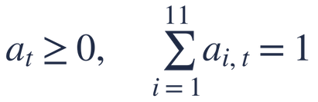




Problem Formulation and Dataset
POMDP: the true market state is hidden; the agent sees prices, volumes and indicators
Universe: 10 NSE large-caps (Reliance, TCS, HDFC Bank, ICICI Bank, ITC, HUL, L&T, Sun Pharma, Maruti, Bharti Airtel) + cash with zero return
Data: daily Yahoo Finance, 2009–2025 (2009–10 burn-in); test period 2018–2025
Action: target weights on the simplex (10 stocks + cash); no short selling
Transaction cost: 0.1% of traded value
Daily state, 30-day window and action
State (13 features × 10 stocks + 11 weights)
LSTM input window (30 days)
Action on the unit simplex
+ 11 current weights
stack last 30 days
Policy network
Dirichlet action
10 stocks × 13 features
encoder + heads
Ritam Mondal (23IM30018) | B.Tech Project-I | IIT Kharagpur
4
Notes:
s_t is today's snapshot; F_t is the last 30 snapshots stacked. M1 reads only the latest row s_t; the LSTM models read all of F_t. The 13 features are things like returns, moving-average gaps, RSI, MACD, ATR, Bollinger measures and ADX, all computed only from past data. Features are standardised using only each fold's training period, so nothing from the test period leaks in. Cash is an explicit asset, so the agent can reduce exposure; cash earns zero return in this study.
5

Slide 5
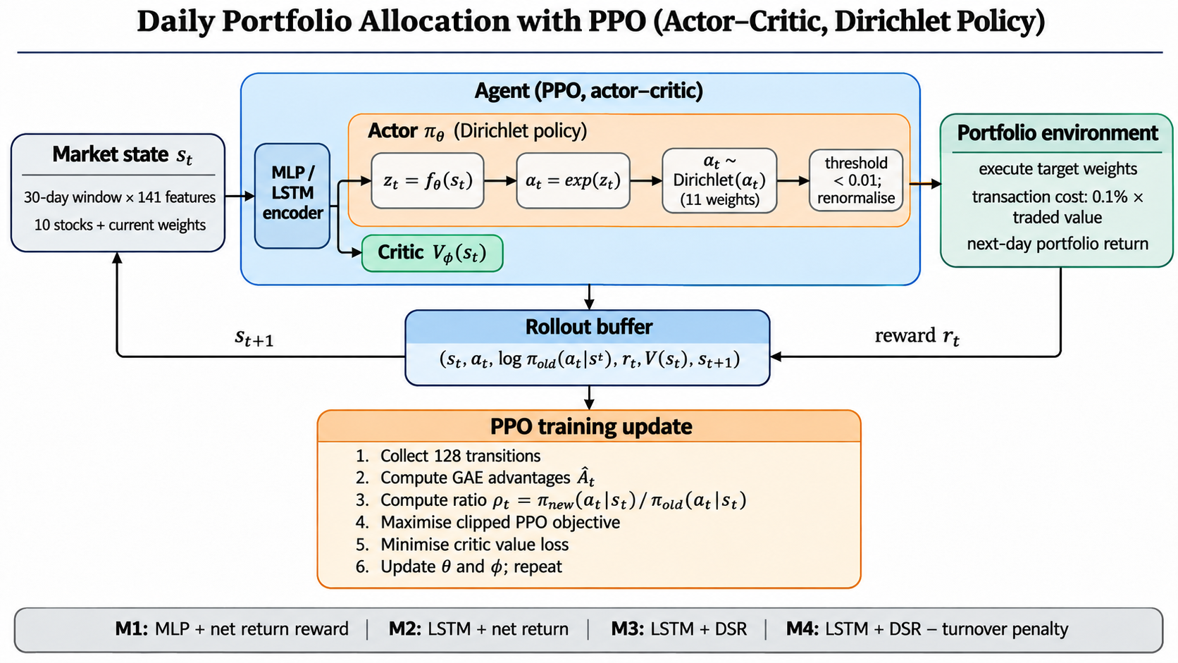
Overall PPO Actor–Critic Architecture
The actor outputs the 11 Dirichlet parameters (the policy); the critic outputs one number, the state value (the baseline for the advantage). Both read the same 512-dimensional encoder output.
Ritam Mondal (23IM30018) | B.Tech Project-I | IIT Kharagpur
5

Slide 6





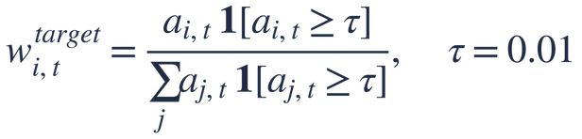







Neural-Network Architecture and Dirichlet Policy
Encoder (shared by actor and critic)
Heads and Dirichlet policy
Actor head (logits, concentration, sampled action)
Critic head (state value)
Dirichlet
τ = 1% + renormalise
Ritam Mondal (23IM30018) | B.Tech Project-I | IIT Kharagpur
6
Notes:
alpha equals exp of z guarantees positive concentration parameters. A Dirichlet sample is automatically non-negative and sums to one, so every sample is a valid portfolio. Large alpha_i means the agent is confident about asset i. There are two different objects here. The raw sampled action a_t is what the PPO probability, ratio and entropy are computed on. The executed weights are obtained from it by dropping positions below 1% and renormalising; this is only an environment step to avoid wasted fees, so it is not part of the policy likelihood, and it is not the PPO clipping. The LSTM is re-run on each 30-day window from its default initial state; I do not carry hidden state from one decision to the next.
7

Slide 7



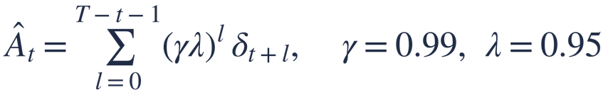
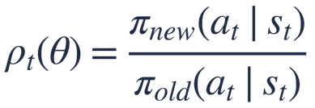
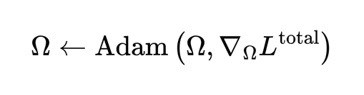

PPO Learning and Neural Network Updates
How PPO learns
How the network updates
1 Temporal-difference error (how surprising was this step)
2 GAE advantage (was the action better than expected?)
Actor improvement + critic error + entropy bonus
Schulman et al. (2017)
Gradient flow
  Actor head : policy and entropy gradients.
  Critic head : value-loss gradients.
  Shared encoder : receives both actor and critic gradients, including the entropy contribution.
3 Probability ratio (new vs old policy, same stored action)
4 Clipped PPO objective
Backpropagation → Adam
Clipping removes the incentive for large policy jumps in one update.
Updated network weights and biases
Ritam Mondal (23IM30018) | B.Tech Project-I | IIT Kharagpur
7
Notes:
The critic's value tells us what to expect from a state. The TD error delta is the surprise at one step. GAE adds up discounted future surprises to give a low-noise advantage: positive means the action did better than the critic expected. The ratio rho compares how likely the stored action is under the policy now versus when it was collected. If rho moves too far from 1 in the direction that raises the objective, the clip makes the objective flat, so the gradient stops pushing. That is how PPO keeps each update small. It is a soft limit, not a strict guarantee. At the end of a segment the implementation bootstraps from the final observation's value and cuts the advantage trace there. The ratio is simply one probability divided by another.
8

Slide 8


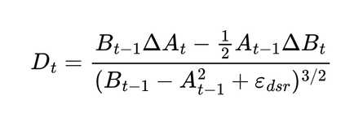
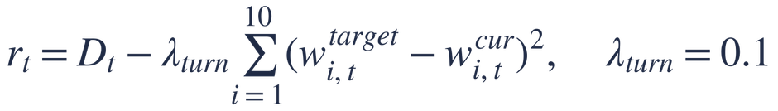
Reward Formulations and Four-Model Ablation
M1, M2 net return after cost
Model | Encoder | Reward | Penalty
M1 | MLP | Net return | None
M2 | LSTM | Net return | None
M3 | LSTM | DSR | None
M4 | LSTM | DSR | Quadratic
M3 Differential Sharpe Ratio (DSR), from running moments of the return
M1 → M2: adds temporal memory
Millea (2021), Deep RL for Trading
M2 → M3: adds risk-aware reward
M4 DSR minus quadratic turnover penalty (risky assets only; reward only)
M3 → M4: adds turnover penalty
Everything else is identical across the four models: stocks, costs, PPO settings, training budget, folds and seeds.
Ritam Mondal (23IM30018) | B.Tech Project-I | IIT Kharagpur
8
Notes:
Each model differs from the previous one in exactly one place, so any change in results can be tied to that change. The DSR rewards risk-adjusted improvement: it measures how a new return changes the running Sharpe ratio, using exponential moving averages of the return and the squared return. The M4 penalty is quadratic in the weight change and only on the ten stocks, not cash. It changes the learning reward only; it is not deducted from wealth. I chose lambda = 0.1 from a small sweep on Fold-1 validation data with two seeds, tried 0.01, 0.03, 0.1 and 0.3, and then froze it. I do not claim it is globally optimal. Everything else is identical across models: stocks, costs, PPO settings, training budget, folds and seeds.
10

Slide 9
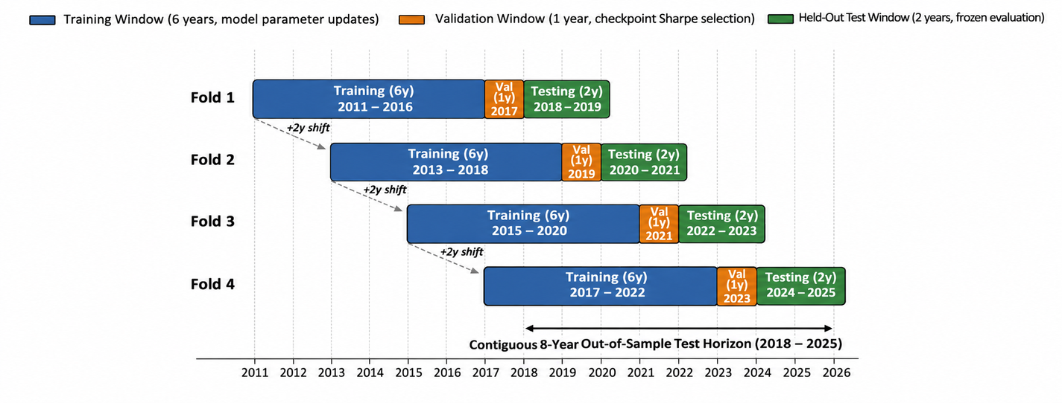
Experimental Setup and Evaluation
Fold | Train | Val. | Test
1 | 2011–16 | 2017 | 2018–19
2 | 2013–18 | 2019 | 2020–21
3 | 2015–20 | 2021 | 2022–23
4 | 2017–22 | 2023 | 2024–25
Window moves forward 2 years per fold; test windows are disjoint and cover 2018–2025.
4 models × 4 folds × 3 seeds = 48 runs
Training: 300,000-step budget per run (2,344 × 128 = 300,032 steps)
Model selection: checkpoint with the best validation Sharpe (checked about every 25,000 steps); then tested once on the unseen test window
Metrics: cumulative return, CAGR, Sharpe, Sortino, maximum drawdown, average turnover, total transaction cost (% of initial capital)
Benchmark: Equal-Weight
Ritam Mondal (23IM30018) | B.Tech Project-I | IIT Kharagpur
9
Notes:
Test windows are disjoint and together cover 2018 to 2025, so the final result is out-of-sample and chronological. I never choose a checkpoint using test data; it is chosen on the validation year. Three seeds per configuration show how stable each model is. Metrics are first computed per fold and then averaged, so 'mean two-year return' in my tables is the average of four two-year fold returns, not a compounded eight-year return.
11

Slide 10
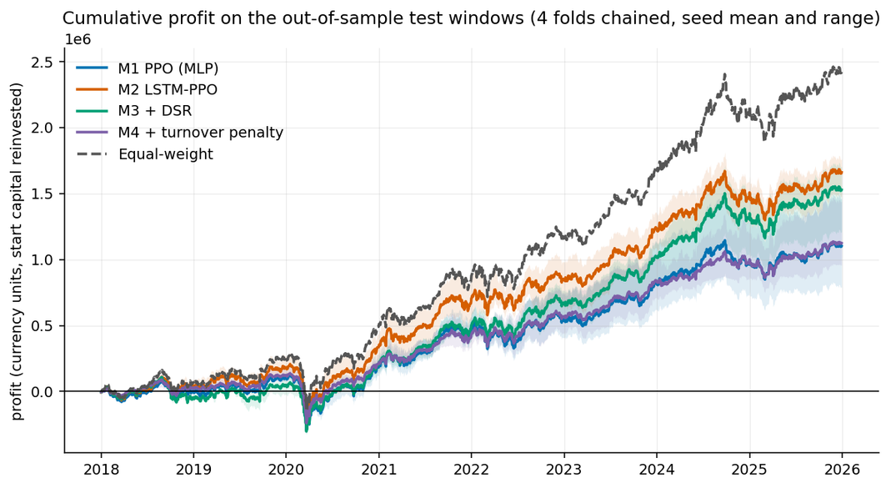
Results and Ablation Analysis
Model | Mean 2-yr return | Sharpe | Max drawdown | Cost (% of V₀)
M1 | 20.62% | 0.71 | −19.50% | 9.68%
M2 | 28.23% | 0.92 | −18.52% | 4.27%
M3 | 26.93% | 0.92 | −19.95% | 4.14%
M4 | 20.97% | 0.92 | −16.04% | 0.97%
Equal-Weight | 36.48% | 1.13 | −18.91% | 0.61%
Equal-Weight is higher in return and Sharpe than every RL model, and leads in all four folds.
M1 → M2 (LSTM)
M2 → M3 (DSR)
M3 → M4 (turnover penalty)
LSTM improved return and Sharpe while reducing turnover and cost.
  ΔSharpe +0.003 (CI [−0.295, +0.222])
  Return 28.23% → 26.93%
  Mixed: no clear advantage
Lower turnover, cost and drawdown, but lower return.
Equal-Weight outperformed all RL models in return and Sharpe in this evaluation
Ritam Mondal (23IM30018) | B.Tech Project-I | IIT Kharagpur
10
Notes:
The honest headline first: the passive Equal-Weight portfolio beats every RL model in return and Sharpe in this setup. Among the RL models, the clearest finding is the LSTM: higher Sharpe, higher return, and far lower turnover and cost than the MLP, with improvement in all four folds. The DSR reward did not give a detectable overall improvement; its confidence interval for the Sharpe change straddles zero. The turnover penalty does what it is designed to do: turnover and cost fall by about three-quarters, and drawdown is the shallowest of all models, but return drops. Fold-wise two-year returns (M1/M2/M3/M4/EW): Fold 1 10.0/17.8/4.4/12.1/24.9; Fold 2 34.0/44.8/44.1/28.5/50.4; Fold 3 23.4/31.6/34.5/28.3/43.4; Fold 4 15.0/18.7/24.7/15.1/27.3. Equal-Weight leads in all four folds; M2 is the best RL model in folds 1 and 2; M3 is the best RL model in folds 3 and 4. The confidence intervals come from bootstrapping only four folds, so I treat them as exploratory, not as formal significance tests.
12

Slide 11
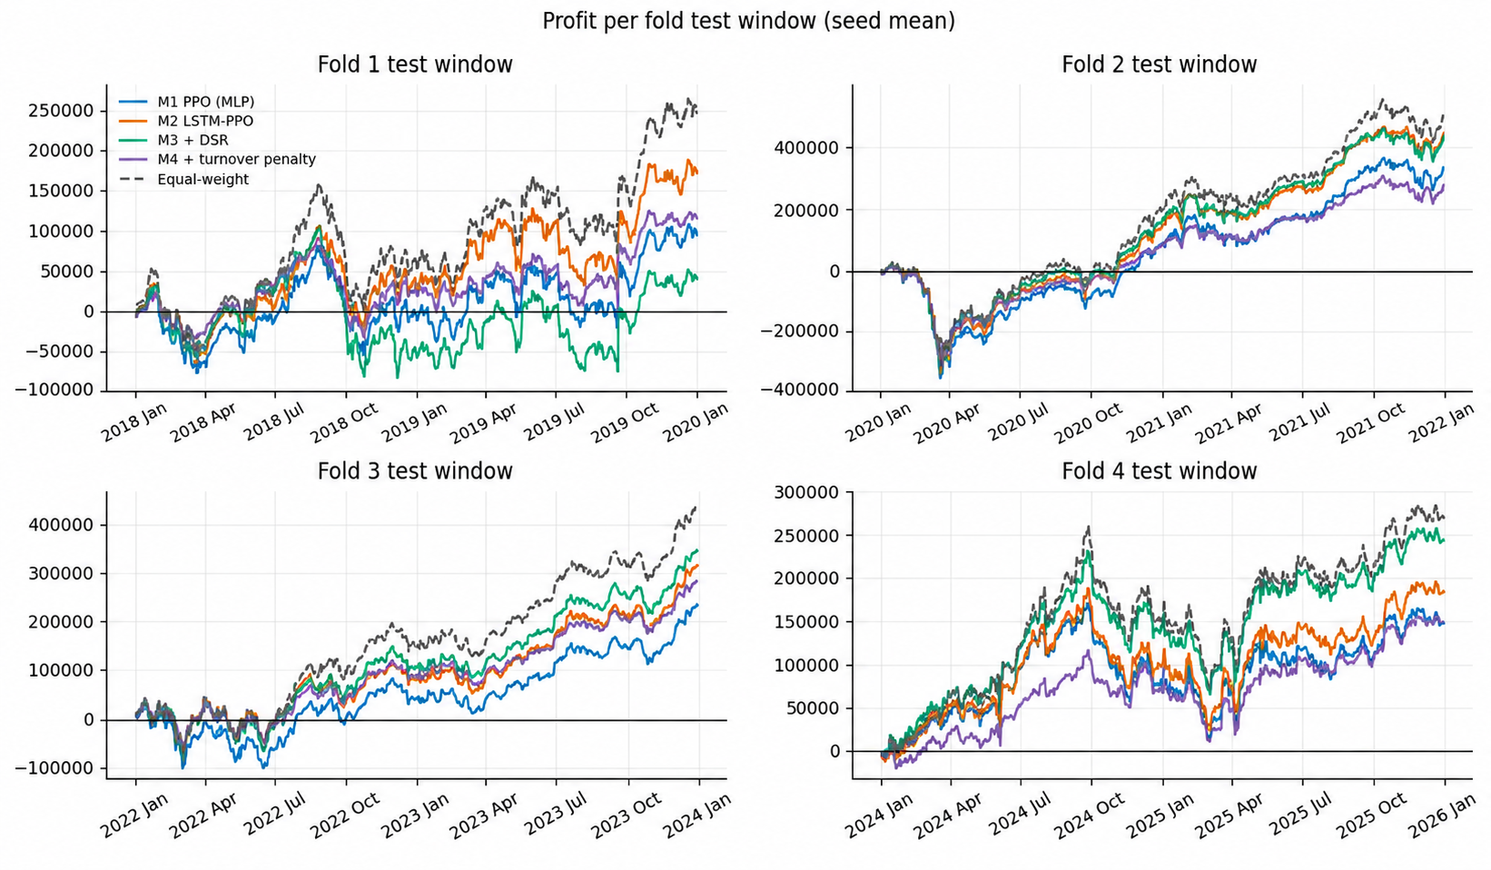
Fold-wise Performance Analysis
Equal-Weight led all four test folds | M2 was the strongest RL model in Folds 1 and 2 | M3 was the strongest RL model in Folds 3 and 4.
Ritam Mondal (23IM30018) | B.Tech Project-I | IIT Kharagpur
11

Slide 12
Research Question Answers, Conclusion and Future Work
RQ | Answer | Key evidence
RQ1 Temporal memory | Yes | LSTM raised Sharpe 0.71 → 0.92 and cut turnover and cost (cost 9.68% → 4.27%)
RQ2 Risk-aware reward | Mixed | DSR gave no clear overall gain (ΔSharpe +0.003, CI spans zero)
RQ3 Turnover penalty | Yes, with a trade-off | Turnover 0.079 → 0.019, cost 0.97%, shallowest drawdown (−16.04%); return 26.93% → 20.97%
RQ4 Benchmark | Not in this setup | Equal-Weight achieved the higher return and Sharpe (36.48%, 1.13) than every RL model; RL was not shown to outperform it
Contributions: controlled four-model ablation · Dirichlet-PPO portfolio agent with costs · 48-run walk-forward evaluation
Limitations
Future work
Why Equal-Weight may have won (possible factors, not proven causes)
  Ten stocks, 2018–2025; four folds, three seeds (CIs exploratory)
  λ Turnover penalty tuned using Fold-1 validation; cash assumed to earn zero return
  Fully invested through the rising 2018–2025 market
  RL agents held zero-return cash (average: M4 32.4%, M3 13.1%, M1 10.1%, M2 8.7%)
  A ten-stock liquid large-cap universe favours passive equal allocation
  Larger universes
  Other market regimes
  Adaptive cash allocation
  Stronger risk control
Ritam Mondal (23IM30018) | B.Tech Project-I | IIT Kharagpur
12
Notes:
Temporal memory helped clearly; the risk-aware reward did not show a detectable effect; the turnover penalty reduced trading and drawdown at the cost of return. And importantly, none of the RL models beat the passive benchmark here. I think the likely reasons are full equity exposure in a rising market, cash held at zero return, and a favourable universe, but I have not proven that cash is the sole cause. The next step is to test larger universes and different market regimes, and to let the agent manage cash more adaptively.
13

Slide 13
Thank you.
Our github: https://github.com/ritammondal2004/Risk-Aware-Deep-Reinforcement-Learning-for-Daily-Portfolio-Allocation.git
Google Colab: https://colab.research.google.com/drive/1Wp4T-XTx_mrlEx9TsRewifnC-BKhciWn#scrollTo=NEAMC56hNzHO
References
  Schulman et al. (2017), PPO
  Zou et al. (2024), LSTM-based stock trading
  Millea (2021), Deep Reinforcement Learning for Trading
  Liu et al. (2024), FinRL-Meta
  Wang & Liu (2025), Risk-sensitive DRL
  Yang et al. (2022), Dirichlet portfolio allocation
  Schulman et al. (2016), Generalized Advantage Estimation

