Slide 1

INDIAN INSTITUTE OF TECHNOLOGY KHARAGPUR
Department of Industrial and Systems Engineering
Risk-Aware Deep Reinforcement Learning
for Daily Portfolio Allocation
A Controlled Single-Factor Ablation of Temporal Memory, Differential Sharpe Ratio, and Turnover Regularization
Candidate: Ritam Mondal (Roll No. 23IM30018)
Supervisor: Dr. Abhishek Sharma
Program: Bachelor of Technology (B.Tech Project-I Evaluation)
Session: Autumn Semester 2026-2027
Notes:
Good morning, sir. My project asks a simple question: when a reinforcement-learning agent allocates an equity portfolio every day, which design choices actually help? I examine three prominent mechanisms in a strictly controlled single-factor ablation: temporal memory via an LSTM encoder, a risk-aware reward using the Differential Sharpe Ratio, and quadratic turnover regularization. All evaluations are conducted across 48 out-of-sample walk-forward runs on the National Stock Exchange.

Slide 2
RESEARCH MOTIVATION AND CONTEXT
Slide 2 of 13
Background: The Trilemma of Daily Portfolio Allocation
Sequential Decision-Making in Financial Markets
* Dynamic Path Dependency: Asset allocation is not a static one-step forecast. Portfolio weights chosen today determine tomorrow's wealth base, liquidity, and frictional costs.
* The Competing Trilemma of Asset Allocation:
1. Return: Compounding capital growth over extended horizons.
2. Risk: Restricting drawdowns, volatility, and downside tail risk during market shocks.
3. Friction: Each reallocation incurs realistic transaction fees (0.1% per trade) that quickly erode gross returns.
* The Research Challenge: Unconstrained agents chase gross returns by trading aggressively, creating massive turnover that destroys net performance after realistic costs.
Why These Three Mechanisms Matter
1. Temporal Information (Memory):
Single-day indicators miss multi-day momentum, volatility clustering, and market regime transitions.
2. Risk-Aware Rewards:
Optimizing raw net returns ignores risk, encouraging destabilizing bets during high-volatility market regimes.
3. Turnover Control:
Explicit friction penalties keep weight transitions smooth and preserve net capital.
Daily Allocation Feedback Loop
Market State (s_t) --> Policy Sample (a_t) --> Execution (w_t)
^ |
| v
Next State (s_t+1) <-- Env Step <-- Cost Paid and Reward (r_t)
Core Goal: Balance Capital Growth vs Downside Risk vs Cost
Notes:
Portfolio allocation is fundamentally a sequential decision-making problem under uncertainty. Today's weights determine tomorrow's starting position and tomorrow's trading costs. There is an inherent trilemma between pursuing return, mitigating risk, and controlling transaction fees. In our environment, every rupee traded costs 0.1%. Without temporal memory, an agent misses market momentum; without risk-awareness, it takes reckless volatility bets; and without turnover control, constant rebalancing destroys performance. This project evaluates solutions to all three tensions.

Slide 3
LITERATURE REVIEW AND RESEARCH GAP
Slide 3 of 13
Related Literature: Disparate Innovations and The Controlled Gap
Key Study | Core Algorithmic Contribution | Temporal Memory | Risk-Aware Reward | Turnover Control
Schulman et al. (2017) | Proximal Policy Optimization (PPO): Clipped surrogate objective | None | Raw Return | None
Zou et al. (2024) | LSTM-based PPO for equity trading (30-day window, 512 hidden) | 30-Day LSTM | Raw Return | None
Millea (2021) / Moody & Wu | Differential Sharpe Ratio (DSR) for online risk-aware RL | None / MLP | DSR (Online) | None
Liu et al. (2024) | FinRL-Meta: Chronological walk-forward evaluation protocol | Varied | Net Return | None
Wang & Liu (2025) | Risk-sensitive RL with turnover regularization | None | Downside Risk | Regularized
This Work (BTP-I) | Unified PPO-Dirichlet framework with 4-model controlled ablation | LSTM (30-Day) | DSR (Online) | Quadratic
The Critical Research Gap and Our Controlled Solution
* The Gap: Prior studies test temporal memory, risk-aware rewards, and turnover penalties under disparate experimental setups (differing asset universes, non-standard costs, divergent test periods, and multiple confounding changes). Consequently, their isolated marginal contributions remain unknown.
* Our Controlled Solution: A unified PPO actor-critic baseline with a single-factor ablation hierarchy (M1 -> M2 -> M3 -> M4). Every component is isolated while data, costs, and hyperparameter budgets remain strictly identical.
Notes:
To keep the literature brief: Schulman gives the PPO optimizer; Zou demonstrates an LSTM with PPO for equities; Millea surveys risk-aware RL and reports the Differential Sharpe Ratio from Moody and Wu; Liu provides the FinRL walk-forward framework; Wang and Liu motivate turnover control; and Yang provides the continuous Dirichlet policy. The research gap is that these ideas are always evaluated in isolated, disparate setups. Our work addresses this gap through a controlled single-factor ablation where we freeze all conditions and vary exactly one mechanism at a time.

Slide 4
PROJECT SCOPE AND DESIGN
Slide 4 of 13
Research Objectives and Four Guiding Research Questions
Core Research Objectives
1. Controlled Single-Factor Ablation:
Construct a unified four-model hierarchy (M1 to M4) to isolate temporal memory, risk-aware reward, and turnover regularization.
2. Rigorous POMDP Formulation:
Formulate continuous daily allocation with Dirichlet policy parameterization, ensuring portfolio weights naturally respect the unit simplex with realistic 0.1% transaction friction.
3. Out-of-Sample Walk-Forward Evaluation:
Execute 48 independent runs across a 4-fold chronological walk-forward setup (2018-2025) and benchmark against passive Equal-Weight.
RQ1: Temporal Memory (MLP vs LSTM)
Does incorporating 30-day temporal sequence history via an LSTM encoder improve Sharpe ratio, total return, and policy stability over a stateless MLP?
[ Model Comparison: M1 -> M2 ]
RQ2: Risk-Aware Reward (Net Return vs DSR)
Does guiding policy optimization with the Differential Sharpe Ratio (DSR) yield superior risk-adjusted performance compared to optimizing raw net return?
[ Model Comparison: M2 -> M3 ]
RQ3: Turnover Regularization (Friction vs Return)
Does an explicit quadratic turnover penalty suppress transaction costs and reduce drawdowns, and what is the return trade-off?
[ Model Comparison: M3 -> M4 ]
RQ4: Benchmark Competitiveness (RL vs 1/N)
Can active deep RL agents beat a fully invested passive Equal-Weight benchmark in the large-cap Indian equity market under realistic costs?
[ Model Comparison: M1-M4 vs Equal-Weight ]
Notes:
We establish three engineering objectives and four research questions. Notice how our experimental architecture maps each research question to a single model transition: RQ1 maps to M1 versus M2; RQ2 maps to M2 versus M3; RQ3 maps to M3 versus M4; and RQ4 maps all RL agents against the passive Equal-Weight benchmark. This 1-to-1 correspondence ensures scientific rigor and unambiguous attribution.

Slide 5




MATHEMATICAL FORMULATION
Slide 5 of 13
Problem Formulation: Simplex POMDP and Dataset Specifications
POMDP Environment and State Space
* POMDP: True market state is latent; agent observes past prices, volumes, and technical features.
* Asset Universe: 10 liquid NSE equities + 1 Cash asset (0% return).
* 13 Technical Indicators per stock = 130 features.
* Daily State Vector (141-dimensional):
Action Space, Execution and Transaction Costs
* Action Space: 11-dimensional unit simplex (10 stocks + Cash):
* Realistic Transaction Cost (0.1% of traded value):
* Temporal History Lookback Matrix (30-day sequence):
* Position Pruning and Renormalization (Environment Only):
* Standardization: Standardized per-fold using training set statistics only (strict zero-lookahead integrity). Cash earns 0% return.
* Academic Distinction: Pruning eliminates fee-destroying micro-trades below 1%. It is strictly an environment step and never enters policy likelihood.
Notes:
We model the portfolio problem as a Partially Observable Markov Decision Process. The state vector contains 130 technical indicators from 10 NSE large-cap equities plus 11 current portfolio weights, giving 141 dimensions. The LSTM models observe a 30-day temporal window, represented by a 30-by-141 matrix. The action space is the 11-dimensional unit simplex. Every trade incurs 0.1% transaction cost. In execution, positions below 1% are pruned and renormalized to prevent micro-trading fees; this is purely an environment step and does not modify the policy distribution.

Slide 6
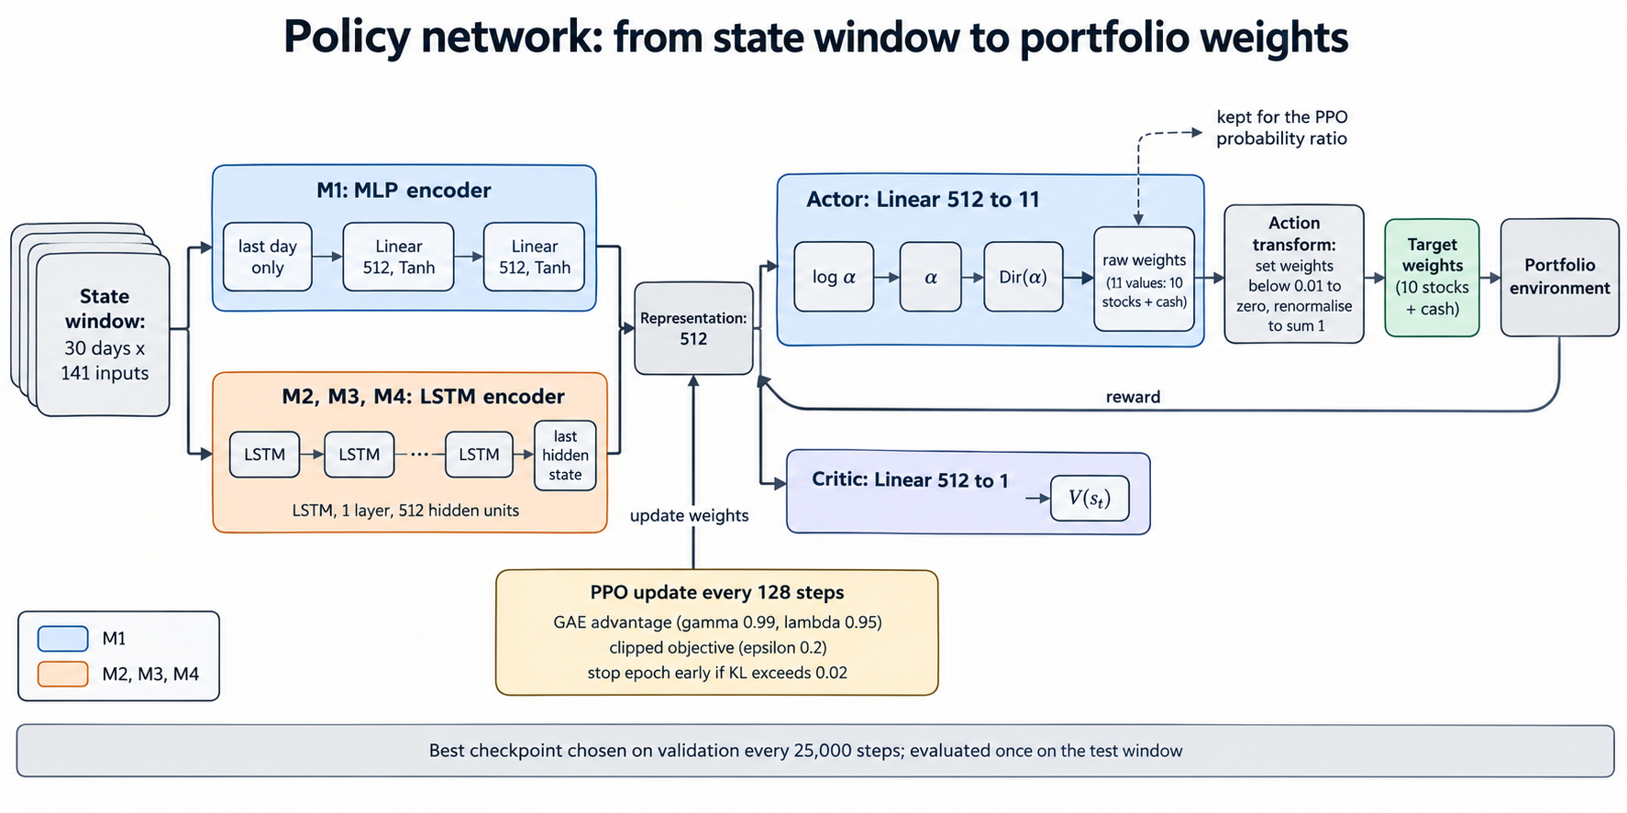
SYSTEM ARCHITECTURE
Slide 6 of 13
Overall PPO Actor-Critic Architecture and Environment Interaction
Agent-Environment Interaction Cycle
1. State Ingestion: Shared encoder processes F_t in R^(30 x 141) (or s_t in R^141 for M1).
2. Latent Representation: Encoder outputs a compressed 512-dimensional vector h_t.
3. Dual Decoupled Heads:
* Actor Head: Outputs Dirichlet parameters alpha_t in R^11.
* Critic Head: Outputs scalar baseline value V(s_t) in R.
4. Execution and Environment: Sampled action a_t is pruned at tau=0.01 and executed. Environment returns net reward r_t and next state s_{t+1}.
5. Rollout Buffer and PPO Update: Stores transitions for T=128 steps, computes GAE advantages, and updates network jointly.
Key Architectural Insights:
* Shared Representation: Actor and critic share the identical feature extractor (MLP or LSTM), enforcing joint state representation.
* Simplex-Constrained Policy: Dirichlet distribution guarantees non-negative weights summing to 1.
* 128-Step Segments: Mini-batch updates occur after every 128 trading transitions.
Notes:
This slide illustrates the full agent-environment architecture. The state window is compressed by a shared encoder into a 512-dimensional summary vector h_t. Two decoupled heads read this vector: the actor head generates Dirichlet parameters for continuous portfolio allocation, while the critic head predicts state value. After 128 trading steps are accumulated in the rollout buffer, PPO computes advantage estimates and updates the entire network jointly via backpropagation.

Slide 7


NETWORK PARAMETERIZATION
Slide 7 of 13
Neural Network Architecture and Continuous Dirichlet Policy
Encoder Parameterization: h_t = f_psi(.)
* Model 1 (Two-Layer MLP, 512 tanh units):
Actor, Critic and Simplex Policy Formulation
* Actor Head (Raw Logits and Concentration):
* Models 2-4 (Single-Layer LSTM, 512 hidden units):
* Critic Head (Baseline State Value):
* 30-day temporal window F_t. Hidden states reset per window (no cross-day state leakage).
Crucial Distinction: Raw Sampled Action vs Executed Weights
* Raw Dirichlet Action a_t: Evaluated directly in policy log-likelihood log pi(a_t|s_t), PPO probability ratio rho_t, and entropy H(pi). Stored in the rollout buffer.
* Executed Weights w_t^target: Obtained by thresholding a_t at tau=0.01 and renormalizing. This is purely an environment step to prevent micro-trading fees; it NEVER enters policy likelihood or PPO clipping.
Notes:
Notice the mathematical precision in our formulation. The actor head outputs unconstrained logits z_t, and we take the exact exponential alpha = exp(z) to ensure strictly positive Dirichlet concentration parameters. A sample from the Dirichlet distribution inherently sums to 1 and is non-negative, naturally respecting the simplex. Crucially, there are two distinct objects: the raw sampled action a_t, which is used for policy evaluation, PPO probability ratios, and entropy; and the executed weights, which are thresholded at 1% and renormalised by the environment. The execution threshold never enters the PPO likelihood.

Slide 8


PPO POLICY OPTIMIZATION
Slide 8 of 13
PPO Policy Optimisation: Advantage Estimation and Clipped Objective
Mathematical Formulation of PPO Learning
1. Temporal-Difference Error (One-step surprise):
Intuitive Mechanics: Why Clipping Works
* Positive Advantage (A^_t > 0, Favourable Action):
Action performed better than expected. The optimizer increases policy probability rho_t. However, once rho_t > 1 + eps = 1.2, clipping flattens the objective, removing the gradient incentive for overly large policy jumps.
* Negative Advantage (A^_t < 0, Unfavourable Action):
Action performed worse than expected. The optimizer reduces policy probability rho_t. Once rho_t < 1 - eps = 0.8, clipping flattens the objective, preventing destructive over-penalization.
* Pessimistic Lower Bound:
Taking the minimum forms a conservative surrogate that guarantees stable, monotonic policy improvements without destructive divergence.
2. Generalized Advantage Estimation (GAE, lambda=0.95):
3. Probability Density Ratio (New vs Old Policy):
4. Clipped Surrogate Policy Objective (epsilon=0.2):
Notes:
Here we detail how PPO learns from transitions. The critic value estimates baseline state return, and the TD error delta represents the unexpected outcome of a single step. GAE aggregates future TD errors with exponential weighting to compute a low-variance advantage estimate. The probability ratio rho compares the current policy against the policy that collected the data. When the advantage is positive, we want to reinforce the action, but clipping halts the gradient push once rho exceeds 1.2. Similarly, when the advantage is negative, clipping stops pushing below 0.8. This pessimistic bound prevents destructive policy collapses.

Slide 9
NEURAL PARAMETER UPDATES
Slide 9 of 13
Combined Multi-Task Loss and Neural-Network Parameter Updates
Combined Loss Function: Actor Improvement + Critic MSE + Entropy Bonus
c_1 = 0.5 (Critic loss coefficient), c_2 = 0.01 (Dirichlet differential entropy exploration bonus)
Parameter Groups: Omega = { psi, theta, phi }
* Shared Encoder psi: Receives Actor + Critic + Entropy!
Optimization and Concrete Network Updates
* Unified Adam Optimizer (lr = 3e-4, Grad Clip = 0.5):
* Actor Head theta and Critic Head phi Gradients:
* What Actually Changes After Each Rollout:
- Encoder psi: 512-d feature summary h_t improves predictive representation.
- Actor theta: Concentration alpha_t shifts towards profitable assets.
- Critic phi: Baseline estimates V_phi become more accurate.
* Gradient Flow Chain:
Total Loss --> Backprop --> Heads --> Shared Encoder --> Adam --> Updated Network
* Actor head receives policy and entropy gradients.
* Critic head receives value prediction MSE loss only.
Notes:
This is a critical slide explaining how the scalar loss translates into neural-network parameter updates. The total loss combines clipped policy ascent, value MSE regression, and an exploration entropy bonus. Notice the gradient routing: the shared encoder receives gradients from all three loss components simultaneously, while each output head receives only its respective gradients. Adam updates all parameter groups with a global gradient norm clip of 0.5. After each update, the encoder refines its latent representation, the actor shifts its allocation logits, and the critic sharpens its baseline values.

Slide 10



ABLATION FRAMEWORK
Slide 10 of 13
Reward Formulations and Controlled Four-Model Ablation Design
* Models 1 and 2 (Net Portfolio Return):
* Model 3 (Differential Sharpe Ratio - DSR Moments):
* Model 3 DSR Differential Update:
* Model 4 (Turnover-Penalized DSR, lambda=0.1 on stocks):
Model | Encoder Architecture | Reward Function | Friction Penalty | Algorithmic Isolation
M1 | Two-Layer MLP | Net Return (R_net) | None | Stateless baseline
M2 | Single-Layer LSTM (512) | Net Return (R_net) | None | M1 -> M2: Adds 30-day temporal memory
M3 | Single-Layer LSTM (512) | Differential Sharpe (DSR) | None | M2 -> M3: Adds risk-aware reward
M4 | Single-Layer LSTM (512) | Differential Sharpe (DSR) | Quadratic (lambda=0.1) | M3 -> M4: Adds turnover regularization
Notes:
Each model in our ablation differs from the preceding one by exactly one architectural component. M1 and M2 optimize net return. M3 introduces the Differential Sharpe Ratio, which calculates the recursive first and second moments of returns using exponential moving averages. M4 adds a quadratic turnover penalty across the 10 risky stocks. Because everything elseâ€

Slide 11
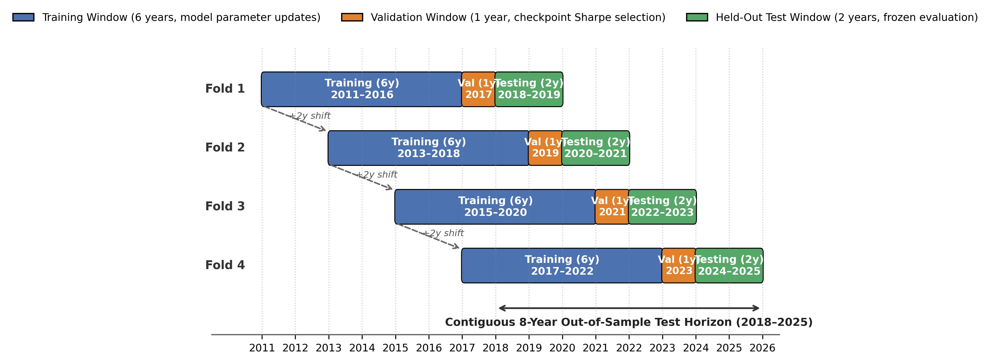
EXPERIMENTAL SETUP
Slide 11 of 13
Walk-Forward Evaluation Protocol and Training Specifications
Chronological Walk-Forward Folds (4 Disjoint Periods)
Fold 1: Train 2011-16 (6y) | Val 2017 (1y) | Test 2018-19 (2y)
Fold 2: Train 2013-18 (6y) | Val 2019 (1y) | Test 2020-21 (2y) [COVID]
Fold 3: Train 2015-20 (6y) | Val 2021 (1y) | Test 2022-23 (2y) [Hikes]
Fold 4: Train 2017-22 (6y) | Val 2023 (1y) | Test 2024-25 (2y) [Bull]
Rigorous Experimental Design:
* Out-of-Sample Integrity: Checkpoints chosen strictly by validation Sharpe ratio (evaluated every ~25k steps). Test data is strictly held-out.
* Scale: 4 Models x 4 Folds x 3 Random Seeds = 48 full training runs.
* Training Budget: 300,000 nominal steps per run (2,344 rollouts x 128 = 300,032 steps).
* Standardized Benchmark: Fully invested Equal-Weight portfolio (10% per equity, 0% cash, subjected to identical 0.1% cost).
Comprehensive Evaluation Metrics:
* Return Metrics: Mean 2-Year Cumulative Return, Compound Annual Growth Rate (CAGR).
* Risk-Adjusted Metrics: Annualized Sharpe Ratio, Sortino Ratio (downside semideviation).
* Capital Preservation: Maximum Drawdown (MDD) peak-to-trough.
* Trading Activity: Daily Portfolio Turnover, Cumulative Transaction Costs (% of initial capital V_0).
Notes:
We implement a strict 4-fold chronological walk-forward validation scheme spanning 2011 to 2025. Each fold uses a 6-year training window, a 1-year validation window, and a 2-year testing window. Across 4 models, 4 folds, and 3 random seeds, we completed 48 training runs of 300,000 steps each. Importantly, no model checkpoint was ever selected using test data; selection was conducted entirely on the validation year. Test windows cover tranquil bull markets, the March 2020 COVID crash, global interest rate hikes, and recent bull phases.

Slide 12
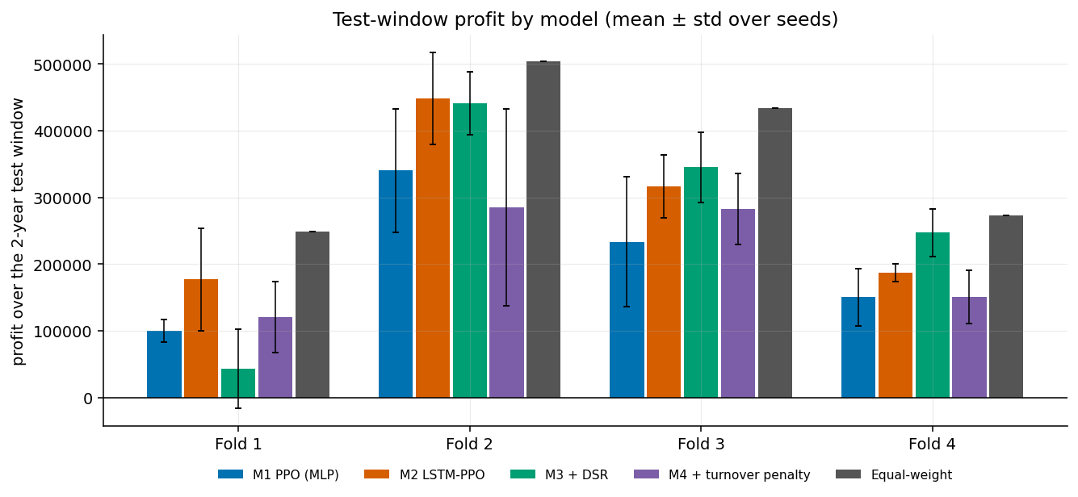
EMPIRICAL FINDINGS
Slide 12 of 13
Experimental Results: Controlled Ablation and Benchmark Comparison
Model | Mean 2-Yr Return | Sharpe | Max Drawdown | Cost (% V0)
M1 (MLP) | 20.62% | 0.71 | -19.50% | 9.68%
M2 (LSTM) | 28.23% | 0.92 | -18.52% | 4.27%
M3 (DSR) | 26.93% | 0.92 | -19.95% | 4.14%
M4 (Penalty) | 20.97% | 0.92 | -16.04% | 0.97%
Equal-Weight | 36.48% | 1.13 | -18.91% | 0.61%
Key Controlled Ablation Findings
* M1 -> M2 (Temporal Memory via LSTM):
Sharpe gains +0.201 (95% CI [+0.156, +0.246], superior in 4/4 folds); return increases +7.61 pp; turnover and cost cut by over 50%. Clear win.
* M2 -> M3 (Risk-Aware DSR):
Sharpe unchanged at 0.92 (Delta = +0.003, CI [-0.295, +0.222] crosses zero); return falls slightly 28.23% -> 26.93%. Inconclusive impact.
* M3 -> M4 (Turnover Regularization):
Turnover falls 76% (0.079 -> 0.019); cost drops to 0.97%; best max drawdown (-16.04%), but sacrifices return (20.97%).
Performance Summary Across Folds:
* Equal-Weight achieved highest return in all 4 folds (Fold 1: 24.9%, Fold 2: 50.4%, Fold 3: 43.4%, Fold 4: 27.3%).
* M2 is the top RL model in Folds 1 and 2 (17.8%, 44.8%).
* M3 leads RL models in Folds 3 and 4 (34.5%, 24.7%).
* Honest Conclusion: Passive Equal-Weight outperformed all RL agents in Sharpe ratio and raw cumulative return.
Notes:
First, the honest conclusion: passive Equal-Weight outperformed all RL models in return and Sharpe ratio. Among the RL models, temporal memory via the LSTM was the clear winner: it raised the Sharpe ratio by +0.201, increased return by 7.6 pp, and cut trading costs in half, showing consistent improvement across all 4 folds. The Differential Sharpe Ratio did not produce a detectable overall improvement; its confidence interval straddles zero. The turnover penalty succeeded at its design objective: trading costs plummeted from 4.14% to 0.97% and maximum drawdown improved to -16.04%, but the conservatism reduced return.

Slide 13
CONCLUSION AND OUTLOOK
Slide 13 of 13
Research Question Answers, Conclusion and Future Directions
Answers to Research Questions
* RQ1 (Temporal Memory): YES.
LSTM significantly outperforms MLP: Sharpe 0.71 -> 0.92, return +7.61 pp, and transaction costs more than halved (9.68% -> 4.27%).
* RQ2 (Risk-Aware Reward): MIXED / NO CLEAR GAIN.
DSR yielded no detectable overall gain over net return (Delta Sharpe = +0.003; 95% CI spans zero).
* RQ3 (Turnover Penalty): YES, WITH TRADE-OFF.
Reduced turnover by 76% (0.019) and trading costs to 0.97%, achieving shallowest drawdown (-16.04%), but capped return.
* RQ4 (Benchmark Competitiveness): NO.
Passive Equal-Weight achieved higher Sharpe (1.13) and return (36.48%) than all RL agents under this experimental setup.
Why Equal-Weight Won and Future Scope
* Plausible Drivers of Benchmark Outperformance:
1. Full Equity Exposure: 2018-2025 was a strong bull market where 100% equity holding naturally rewarded investors.
2. Cash Drag: RL agents held idle cash (M4: 32.4%, M3: 13.1%, M1: 10.1%, M2: 8.7%) which earned zero return.
3. Favourable Universe: 10 blue-chip NSE heavyweights were high-quality winners difficult to beat via active trading.
* Limitations:
Ten stocks; 4 folds; lambda_turn tuned on Fold 1 only.
* Future Research Directions:
1. Yield-Bearing Cash: Model short-term liquid yields to eliminate artificial cash penalty.
2. Broader Universes: Test across mid/small-caps and bear regimes.
3. Transformer Encoders: Multi-head attention for long contexts.
Thank You! Open for Questions.
Notes:
In summary: temporal memory helped clearly; the risk-aware reward did not show a detectable effect; and turnover regularization suppressed friction and drawdown at the expense of return. Passive Equal-Weight won due to full equity exposure in a rising market, zero return on cash held by RL models, and a strong large-cap universe. Future research should introduce yield-bearing cash models, test broader multi-asset universes, and evaluate transformer architectures. Thank you, sir. I look forward to your questions.

