Slide 1
Parallel 2D Stencil Computation
High Performance Computing
Ortese Rita
University of Trieste

Slide 2
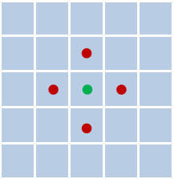
Stencil-Based heat Diffusion Simulation
The application simulates heat diffusion on a 2D grid using a 5-points stencil numerical method:
Domain: grid where each cell represents the energy of the system
At each iteration: energy is injected into specific source points and diffuses through nearest-neighbour interactions
Since the computation is repeated over large grids and many iterations, it becomes computationally expensive and therefore suitable for parallelization.

Slide 3
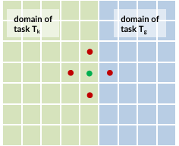
Parallelization strategy
To handle large grids efficiently, the computation is parallelized using a hybrid approach based on:
MPI: parallelization between process
OpenMP: parallelization inside each process (threads)
Problem: When the grid is decomposed among different MPI tasks, some of these neighbors may belong to a different process.

Slide 4
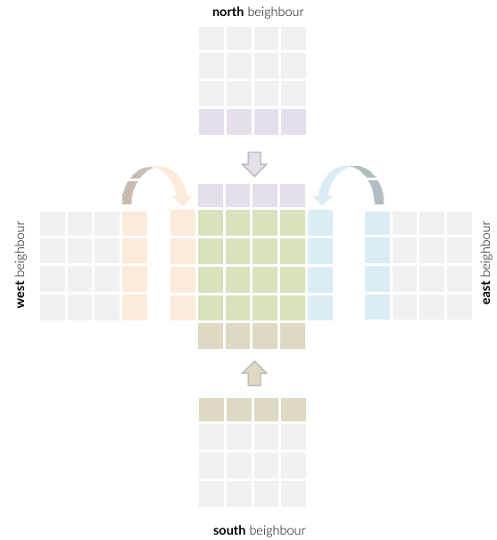
Halo cell Communication
If the values of neighboring cells belong to adjacent MPI tasks, we use the Halo Exchange: each process stores additional boundary layers called halo or ghost cells
Before each iteration, processes exchange their border values with the north, south, east, and west neighbors, filling these ghost cells through MPI communication.
The boundary conditions can be:
Periodic: the grid wraps around and opposite boundaries are connected
Non-periodic: where boundary cells only interact with existing neighbors.

Slide 5
Implementation

Slide 6
Hybrid MPI + OpenMP Implementation
The parallel version uses a hybrid MPI + OpenMP model:
MPI:
responsible for the distributed-memory parallelism
decompose the global grid into subdomains (patches), one per MPI task
processes, at each iterations, exchange halo data using non-blocking communication
OpenMP:
Responsible for the shared-memory parallelism
Parallelizes the main update loops, withing each MPI process
MPI is initialized with MPI_THREAD_FUNNELED, therefore OpenMP threads are used for computation but only the master thread performs MPI communication

Slide 7
Memory and data management
At every iteration, each process must exchange halo data with its north/south/east/west neighbors.
Problem: the grid is stored as a 1D row-major array, therefore rows are contiguous in memory while columns are not. So, halo exchange is implemented differently, to minimize unnecessary data copying:
North/South halos are sent/received by using pointers directly into the grid (no packing needed)
East/West halos require packing/unpacking, so dedicated send/receive buffers are used to copy the boundary columns before communication and to write the received values into the ghost columns.

Slide 8
Overlapping MPI communication and Computation
Halo communication is performed using non-blocking MPI calls (MPI_Isend / MPI_Irecv), that allows overlapping communication with computation, reducing communication overhead.
Post the communications: MPI_Isend / MPI_Irecv (master thread)
Compute internal stencil (OpenMP): it doesn’t depend on halo data
MPI_Waitall: wait for communication completion
Copy E/W received halos into ghost columns
Compute boundary stencil (OpenMP): it requires ghost value

Slide 9
Scaling test

Slide 10
Performance Tests
To evaluate the performance of the parallel implementation, 3 scaling tests were performed:
OpenMP Strong scaling:
Single MPI process
Increasing the number of threads: 1, 2, 4, 8, 16, 32, 64, 112
MPI Strong scaling:
Global size remains fixed
Increasing the number of node: 1, 2, 4, 8, 16
MPI Weak scaling:
Fixed workload per node
problem size increases proportionally with the number of MPI processes
For each test: total time, communication time and computation time were obtained

Slide 11
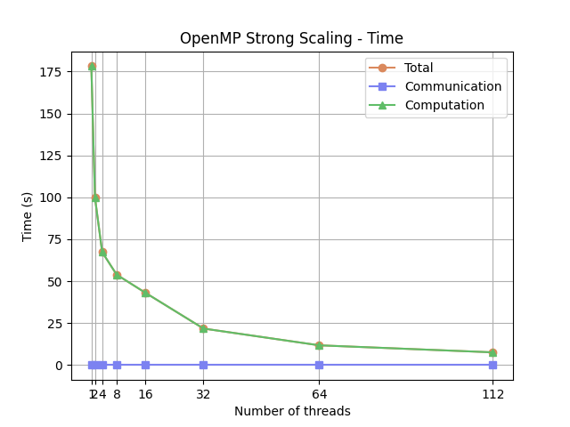
OpenMP scaling: Execution Time
The execution time decreases as the number of threads increases, showing that the stencil computation benefits from shared-memory parallelism.
However, the improvement becomes progressively smaller because the application is memory-bandwidth bound:
As the number of threads increases, multiple cores compete for access to memory, limiting the achievable performance.

Slide 12
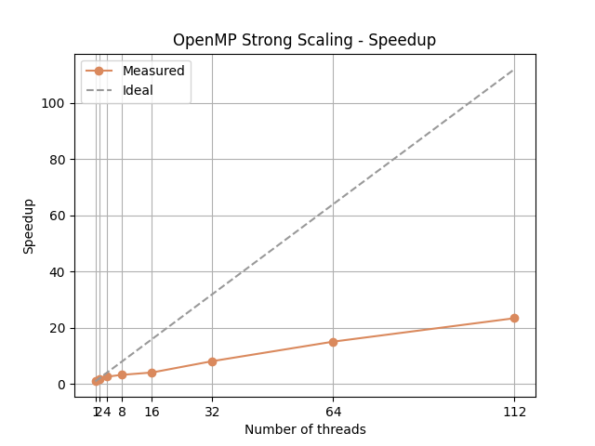
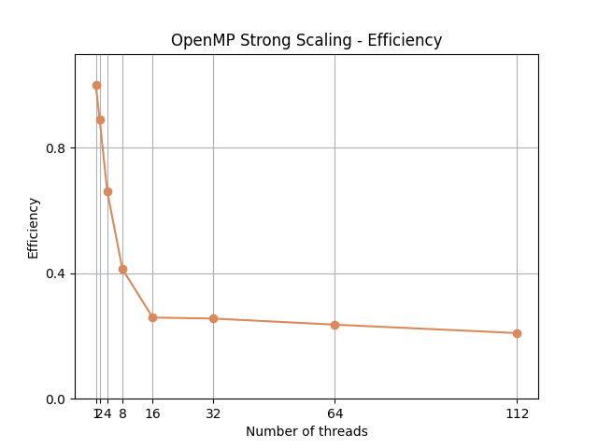
OpenMP scaling: Speedup and Efficiency
Speedup: grows with the number of threads but deviates from the ideal linear scaling; Efficiency: decreases as more threads are used.
Memory bandwidth saturation: as the number of threads increases, multiple cores compete for access to the same memory subsystem;
NUMA regions: When the thread count exceeds the physical cores of a single NUMA node, the workload is distributed across multiple regions. For memory-bound problems, this transition allows threads to utilize parallel memory channels.
Thread affinity was controlled using OMP_PROC_BIND=close, which keeps threads within the same NUMA region to improve memory locality. However, once memory bandwidth becomes saturated, the scaling. behavior remains limited.

Slide 13
MPI Setup
The NUMA architecture was also considered when designing the MPI configuration. Since each node contains 8 NUMA regions and each region provides 14 cores, it is used the following hybrid configuration:
TASKS_PER_NODE = 8
CPUS_PER_TASK = 14
This setup assigns one MPI process to each NUMA region, while OpenMP threads exploit the cores within that region. This mapping improves memory locality, reduces remote NUMA memory accesses, and therefore lowers memory access latency and overhead.

Slide 14
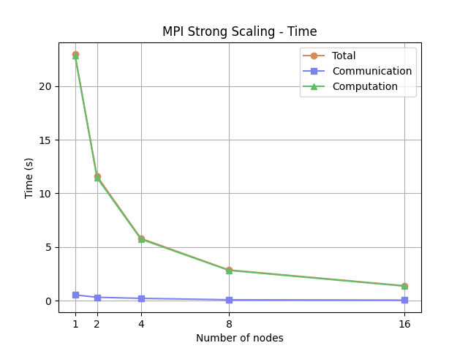
MPI Strong scaling: Execution Time
Strong scaling evaluates how the execution time decreases when increasing the number of computing resources while keeping the global problem size fixed.
It measures how efficiently the workload can be distributed across multiple nodes.
The execution time decreases significantly: the computation time decreases almost proportionally with the number of nodes, and the communication overhead is limited.

Slide 15
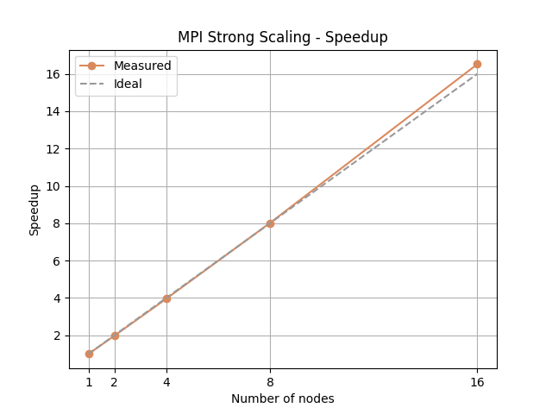
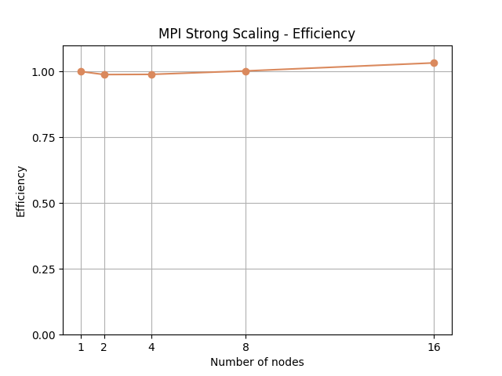
MPI Strong scaling: Speedup and Efficiency
Speedup: follows closely the ideal linear scaling and even shows a slightly superlinear behavior at higher node counts;
Efficency: remains close to 1, so the workload is well balanced.
cache utilization: when the domain is distributed across more nodes, each process works on a smaller portion of the grid, allowing a larger fraction of the data to fit into the caches and reducing memory accesses.

Slide 16
MPI Weak Scaling: details
In the weak scaling experiments, the workload per process is kept constant while the global problem size increases proportionally to the number of nodes.
Grid dimensions are chosen as powers of two to simplify domain decomposition and ensure balanced partitions.
The simulation starts from a base grid of 8192 × 8192
As the number of nodes increases, the grid is expanded alternately along the two axes: this keeps the domain close to a square shape, maintaining a balanced aspect ratio.

Slide 17
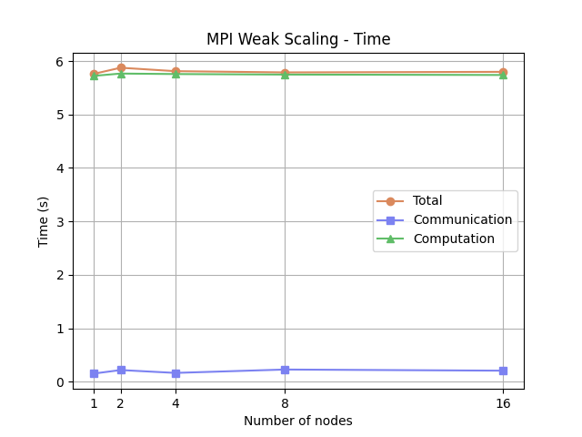
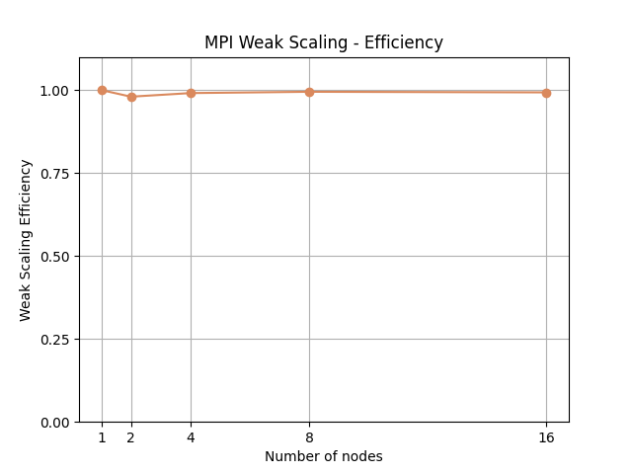
MPI Weak scaling: Execution Time and Efficiency
Execution time: remains approximately constant as the number of nodes increases.
Efficiency: stays close to 1, indicating good scalability of the application.
The behavior is expected, since each MPI process handles a similar local domain size;
Small fluctuations may be caused by system noise, runtime variability, or compiler optimizations.

Slide 18
Conclusions

Slide 19
Performance Summary
The hybrid MPI + OpenMP parallelization efficiently exploits both node-level and cluster-level parallelism.
OpenMP strong scaling shows good performance at low thread counts, but scalability is limited by memory bandwidth and NUMA effects.
MPI strong and weak scaling show very good results, with near-ideal speedup, efficiency close to 1, and nearly constant execution time in weak scaling.
Overall, the parallel implementation demonstrates good scalability and efficient use of computational resources.

Slide 20
Thank you!

