Slide 1
DECORATOR DESIGN PATTERN
_______________________________
MIRELA SORUNGA

Slide 2

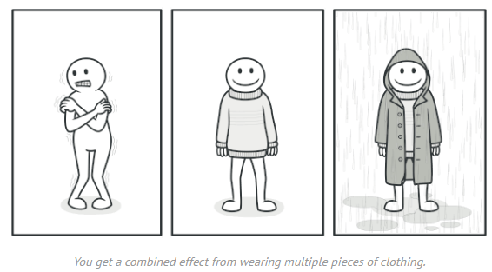
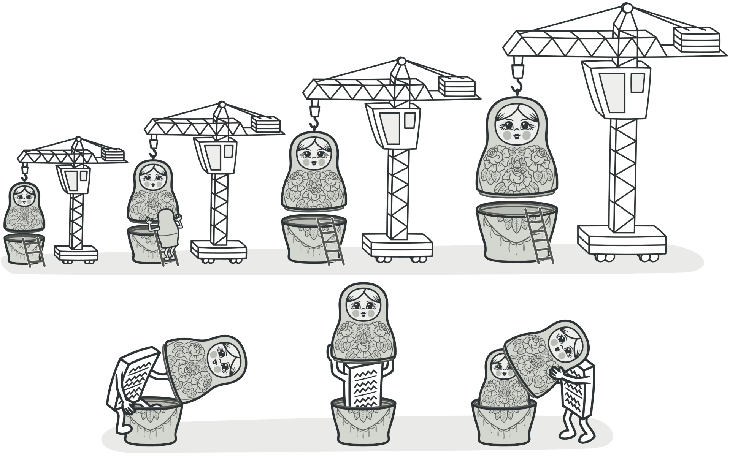
DEFINITION
Decorator Design Pattern - a structural pattern, used to extend or alter the functionality of objects at run-time by wrapping them in an object of a decorator class; a flexible alternative to using inheritance to modify behaviour.
Identification: Decorator can be recognized by creation methods or constructor that accept objects of the same class or interface as a current class.
Notes:
Decorator Design Pattern is a structural pattern, which is used to extend or alter the functionality of objects at run-time. It does this by wrapping them in an object of a decorator class leaving the original object w/o modification. [This provides a flexible alternative to using inheritance to modify behaviour.]
We have here some pictures, some examples that demonstrate the usefulness of DDP.
For instance, wearing clothes is an example of using decorators. When you’re cold, you wrap yourself in a sweater. If you’re still cold with a sweater, you can wear a jacket on top. If it’s raining, you can put on a raincoat. All of these garments “extend” your basic behavior but aren’t part of you, and you can easily take off any piece of clothing whenever you don’t need it.

Slide 3
INTENT
Add functionality to existing objects dynamically
Alternative to sub classing
Flexible design
Support Open Closed Principle
Notes:
What does the DDP do for us?
> Well, for one, it allows us to (1 point) at runtime. Meaning that as the application is running, and the user is interacting with your application, u can have logic that determines what type of functionality to add to an object.
> It also provides an (2 point). It is easy to add functionality to an entire class of objects by subclassing it, but it is impossible to extend a single object this way. With the DP, you can add functionality to a single object and leave others like it unmodified.
> It also encourages a (3 point). We want out applications flexible enought to take on new functionality to meet changing requirements. We also want to prevent modifying a base class that isn’t appropiate for some subclasses.
> The DP also naturally supports the (4 point). that states that classes should be open for extension, but closed for modification.

Slide 4
APPLICABILITY
Legacy systems
Sealed classes
Notes:
There are some common scenarious in which we can utilize the DDP.
> The most common scenario is when we’re dealing with legacy systems. When we need to maintain some systems, that are pretty nasty, but we often have to add new functionality to these systems. Using DDP we can add new functionality w/o having to worry about touching the current spaghetti code that’s probably in there.
> Another scenario is when we’re dealing with sealed classes, which may be in a third party DLL, or possibly the .NET Framework itself. And THE DDP allows us to add new functionality, even if they’re sealed.

Slide 5
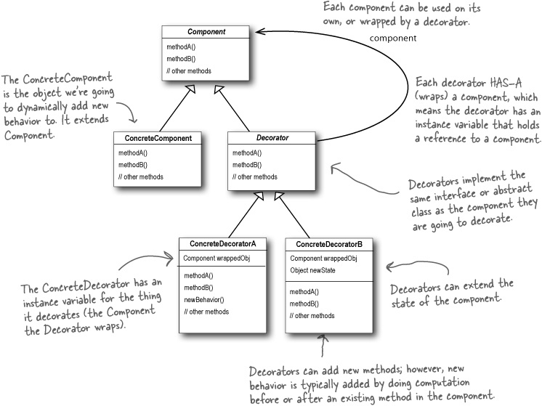
Notes:
But due to lack of time we will get over this topic.
And so, ...
Let’s look at an example in which the decoator DP could really help us out a lot.

Slide 6
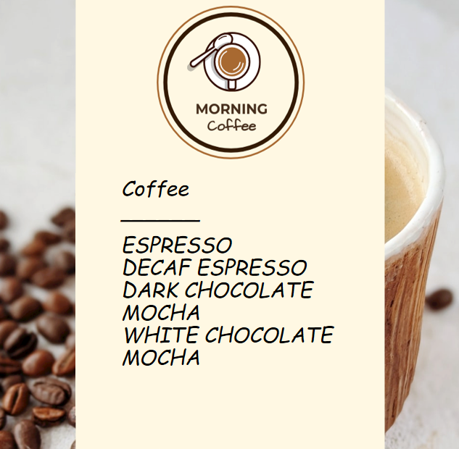
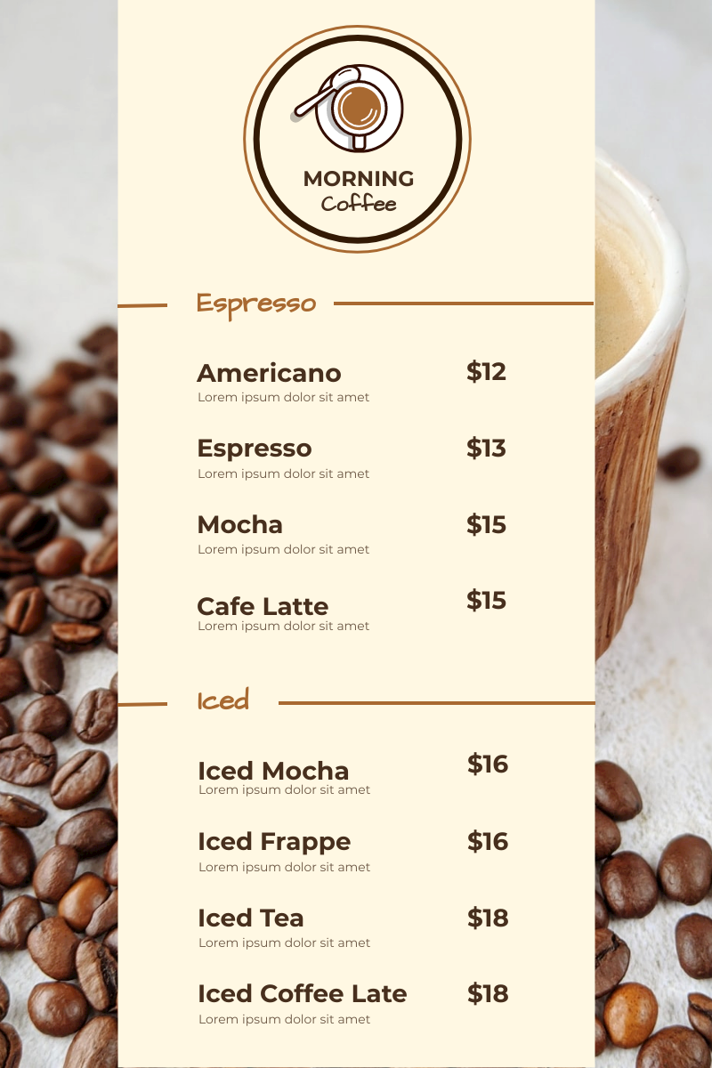
PROBLEM STATEMENT
Coffee chain
We develop software for a chain of coffee shops. The chain is developing rapidly, so the management cannot bring the order payment system in line with the assortment.
The main task
Generate a check with a product name and its cost.
200 300 400 150
50
Notes:
And so, setting the task.
So, let's say we are developing a program for a chain of coffee shops. There are some cafes in which we mainly sell coffee. And in this context, we have some options/or toppings if u will for coffee drinks. The main task is to generate a check with the cost of coffee. Well, for example, some such check.

Slide 7
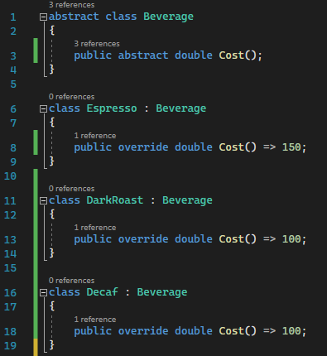
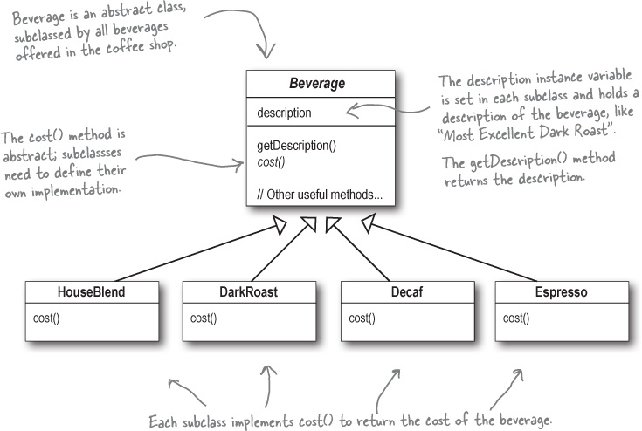
INHERITANCE APPROACH
Notes:
obviously, a simple and logical solution is to develop a basic class called a beverage and to inherit from it other classes, that actually represent drinks.
And everything will work great because we just add a new class and get a new type of coffee in our system. everything is wonderful. but, first of all, we must not forget that any software solution, if anyone uses it, is constantly improved.
And therefore, even if we can now make coffee in normal mode, we may be told to add some extras, for example, add whipped cream, chocolate, etc. to coffee. and then there is a problem.
откуда класс возьмет цену, в нашем случае мы просто ее возвращаем. в каком-то хорошем методе он будет это считать, откуда-то выдергивать из базы и тд, но нас это не интересует сейчас.

Slide 8
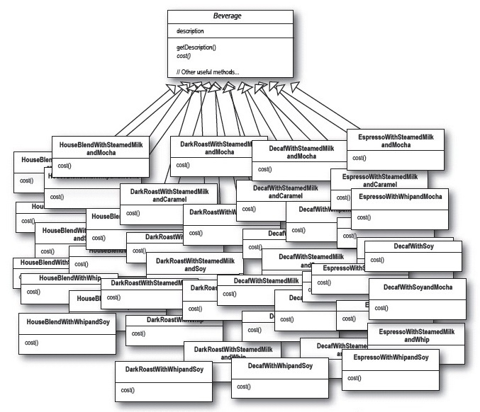

Notes:
Cause then we can end up in a situation like this. we can simple find ourselfs dealing with a nightmare of maintenance. A new class is need to be created for each possible combination, resulting in a class explosion.

Slide 9
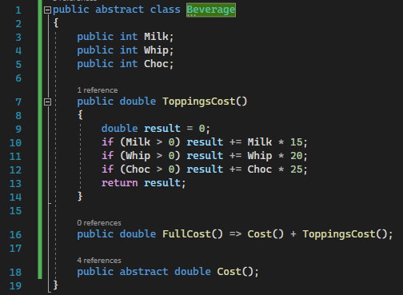

ATTRIBUTES IN THE BASE CLASS
Notes:
The second option, how to implement it, is to add attributes to the base class that will be responsible for the presence of one or another topping.
And such a scheme is actually quite beautiful in terms of understanding how classes work, but the problem is that when you will add new toppings, you will have to climb into the base class and change something there. which we really don't want to do.

Slide 10
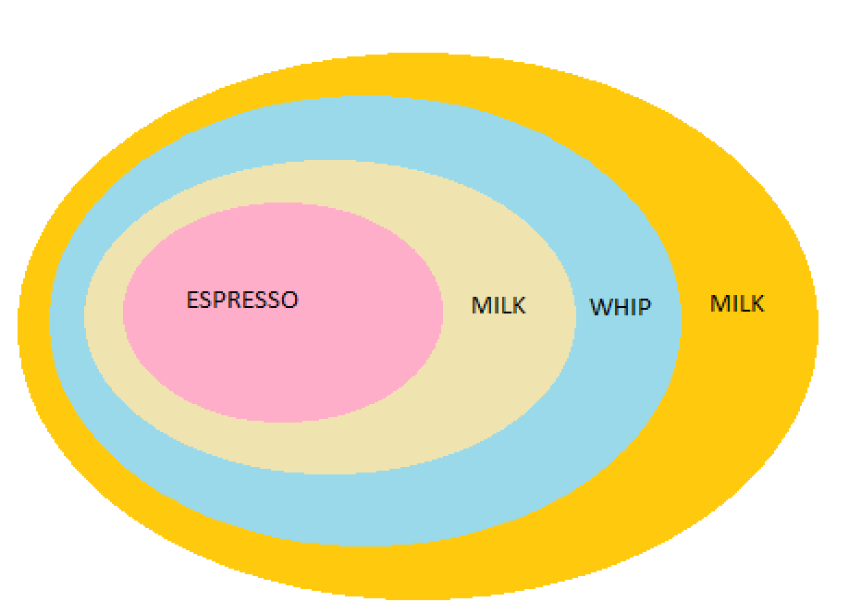
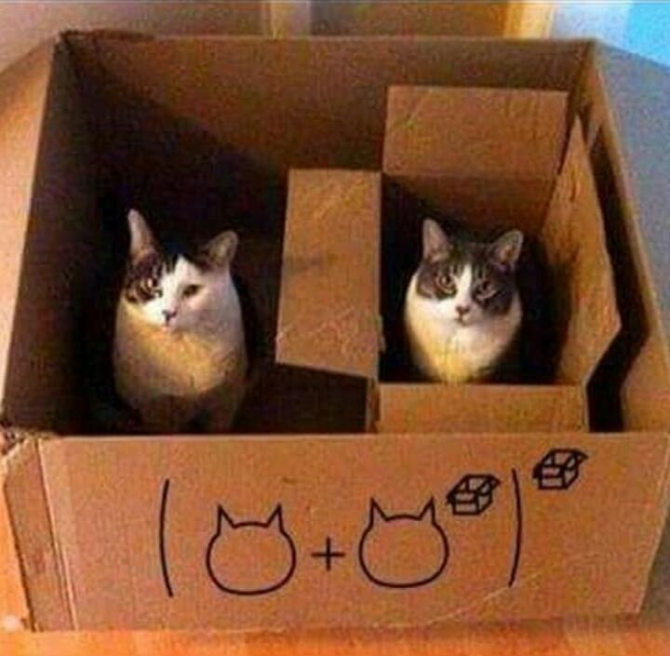
DECORATOR PATTERN
Notes:
An alternative solution, as you might guess, is the decorator design pattern.
His idea is that we take some basic drink, for example, espresso coffee, and start adding to it, for example, milk, whipped cream, etc.
But we will not add toppings to the drink, but we will wrap the base drink with toppings. I will take the base espresso, then I will wrap it in milk, I will put the base class espresso in the milk, then I will put the espresso with milk in the whipped cream and the whipped cream in which the milk is located I will put again in the milk.

Slide 11
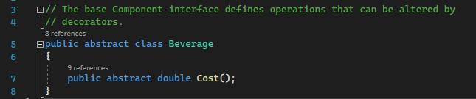
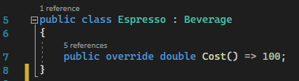
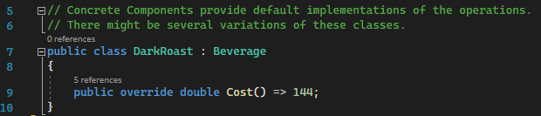
IMPLEMENTATION IN C# 1 Step. Coffee classes
We will calculate the price of drinks in derived classes
Method returns the price of the base drink

Slide 12
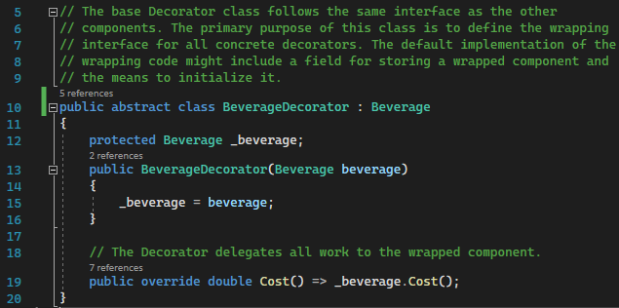
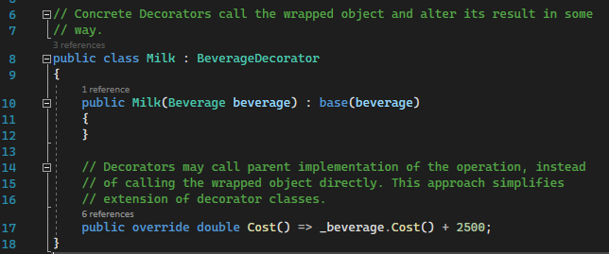
2 Step. A branch for toppings
The topping always contains some kind of drink
For convenience, we will set the drink that the topping "wraps" through the constructor
The cost of the "wrapped object" = the cost of the object that the topping wraps + the cost of the topping

Slide 13
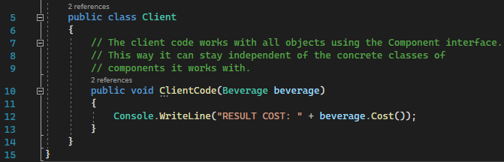
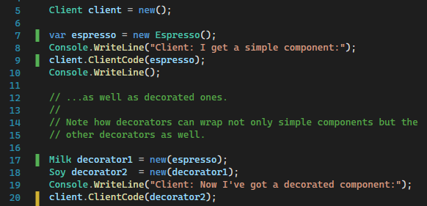
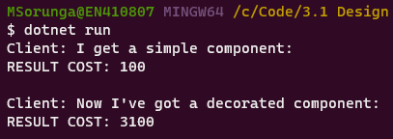
3 Step. Testing
OUTPUT:

Slide 14
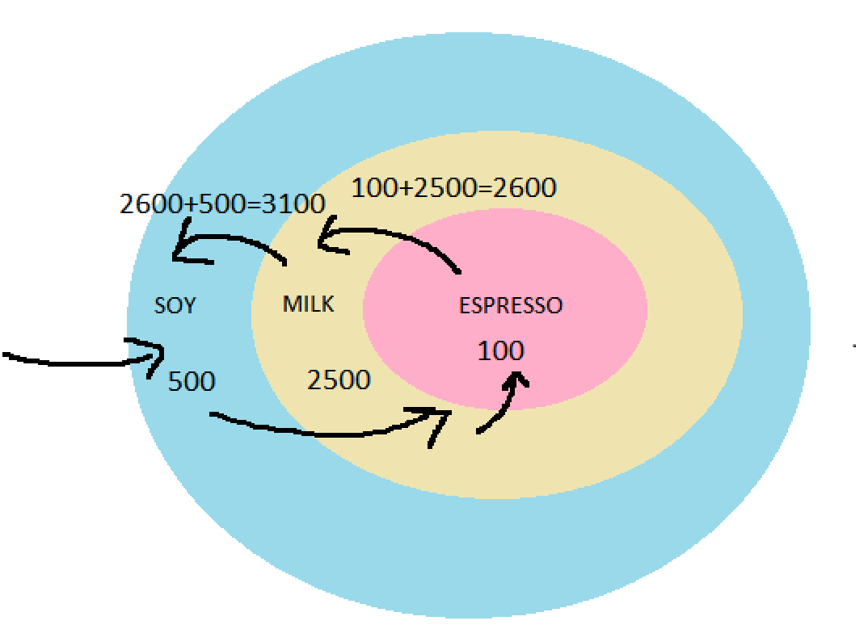

Slide 15
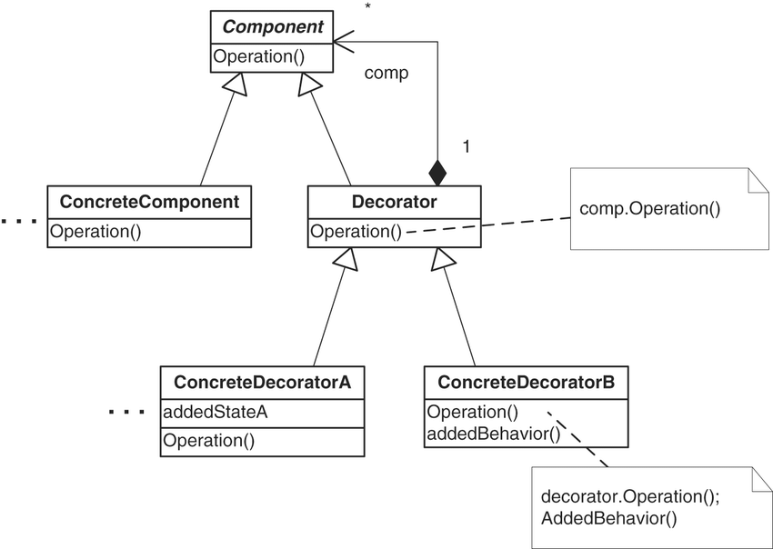
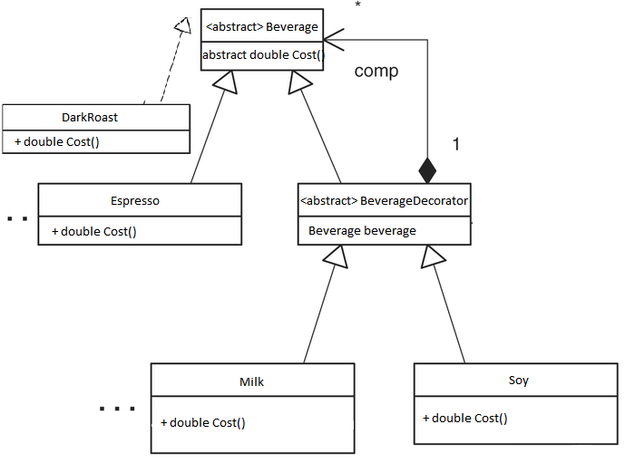

Slide 16
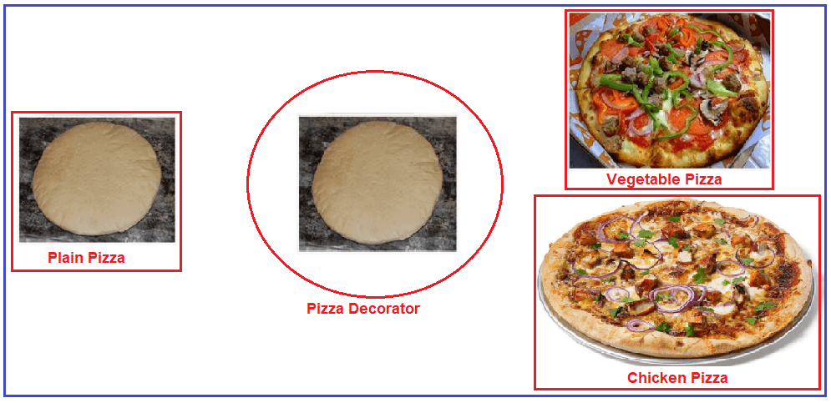
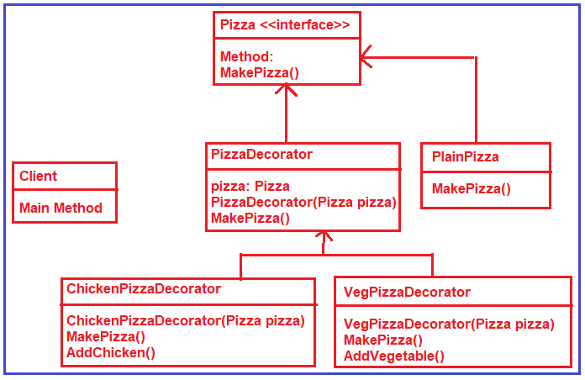
// ref: https://dotnettutorials.net/lesson/decorator-design-pattern-real-time-example/

Slide 17
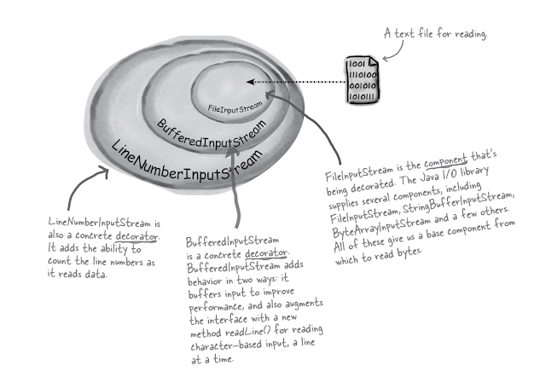
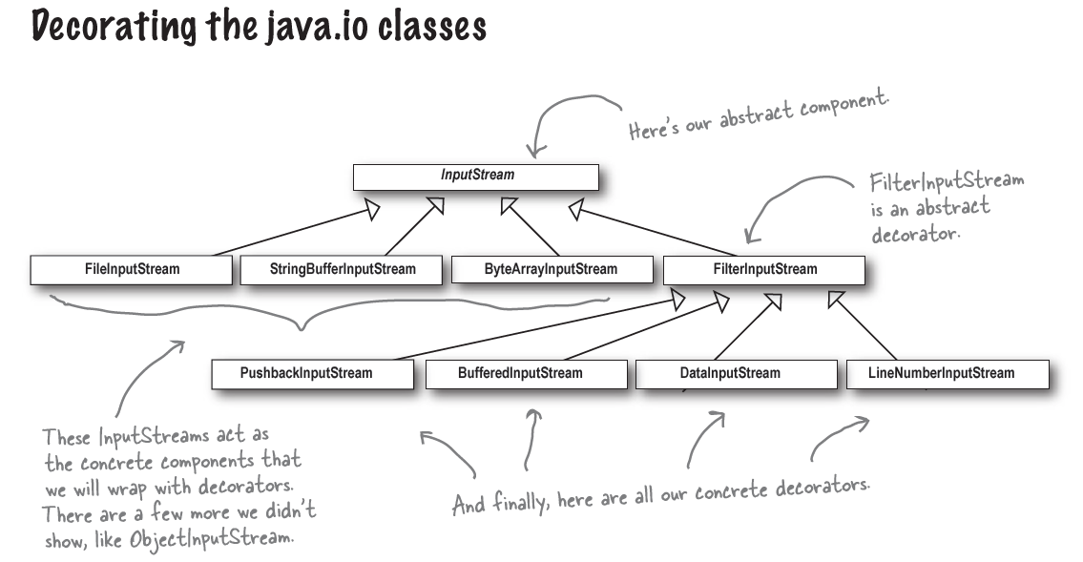
REAL WORLD DECORATORS: JAVA I/O
// ref: Java Philosophy, by Bruce Eckel

Slide 18
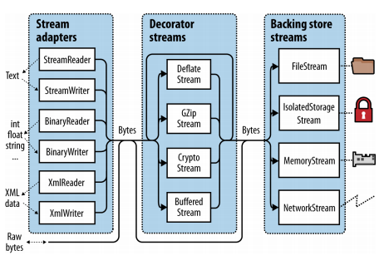
C# I/O
Decorator pattern is used by C# language itself. It is used to to decorate the Stream I/O class of C#. The decorated versions are BufferedStream, FileStream, MemoryStream, NetworkStream and CryptoStream classed.
These subclasses inherit from the Stream class and also contain an instance of the Stream class.
// ref: C# 9.0 in a Nutshell, by Joseph Albahari

Slide 19
References
https://refactoring.guru/design-patterns/decorator/csharp/example#:~:text=Decorator%20is%20a%20structural%20pattern,decorators%20follow%20the%20same%20interface.
https://www.dofactory.com/net/decorator-design-pattern
https://dotnettutorials.net/lesson/builder-design-pattern-real-time-example/
https://sourcemaking.com/design_patterns/decorator
https://refactoring.guru/design-patterns/decorator

Slide 20
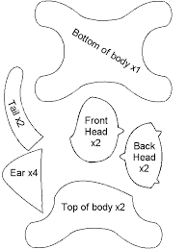



TEMPLATE METHOD DESIGN PATTERN
_______________________________
MIRELA SORUNGA

Slide 21
DEFINITION
Model a process or algorithm of several steps
Allow variation of the details of each step, while enforcing the structure and order of the steps themselves
Notes:
Template Method is a behavioral design pattern that is used when you have a process or algorithm of several steps
But you want to allow different implementations of this algorithm.
[For instance, if you need to allow variation of the details of each step or certain steps, while enforcing the structure and order of the steps themselves, then the Template Method may be appropriate.]

Slide 22
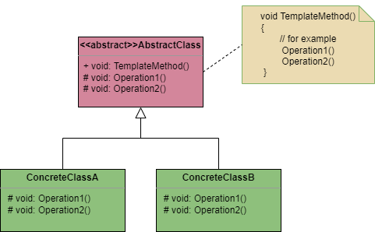
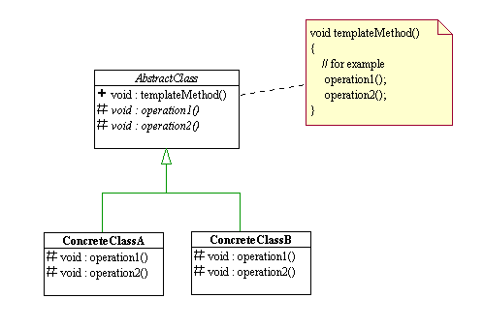
UML Diagram. Template Method
Notes:
The TMP consist of a base class, that defines a TM, and that TM calls one or more steps in algorithm. This methods are either abstract or virtual and tipically are not public, but they may be.
The Concrete classes then are responsible for implementing one or more of these steps and then client will call the concrete class.

Slide 23
Motivating Example
For instance, we are cosidering an algorithm to play a game.
Game
// hooks public abstract void Initialize(); public abstract void StartPlay(); public abstract void EndPlay(); // our template method public void PlayGame()
public void PlayGame() { Initialize(); StartPlay(); EndPlay(); }
Given this structure, specific games like Tic-Tac-Toe Chess, Monopoly, etc could be implemented as subclasses.
Notes:
Let’s discuss template design pattern with below example.
We are considering here an algorithm to play a game. To play a game steps will be common like initialize, start play and end play.
Here we have to note that operations invocation should be in the same way as they are defined in the abstract class because start play cannot be called before initialize operation.
Given this structure, specific games like Tic-Tac-Toe, Chess, Monopoly, etc could be easily implemented as subclasses.
A hook is a method that is declared in the abstract class, but only given an empty or default implementation. This gives subclasses the ability to “hook into” the algorithm at various points, if they wish; a subclass is also free to ignore the hook.

Slide 24
INTENT
Define the skeleton of an algorithm, encapsulate and enforce the workflow or process that is invariable
Allow subclasses to redefine certain steps of an algorithm without changing the algorithm's structure
Base class declares algorithm 'placeholders', and derived classes implement the placeholders
Notes:
The intent of TM is to (1). This allows (2). The initial base algorithm can have empty stub methods or it can have actual implementation that are then shared among various implementations of this algorithm. Allowing for greater code reuse and following the DRY principle.

Slide 25
APPLICABILITY
Use the pattern when:
Two or more classes contain almost identical algorithms with some minor differences, but common workflow
The workflow/algorithm is invariant. Subclasses may redefine CERTAIN steps, but may not change the algorithm’s structure
Some workflow steps may be encapsulated in the base class with a default implementation, and only overriden if necessary (you can have both virtual or/and abstract methods)
Notes:
Use the pattern when
(1). This workflow is invariant and while subclasses may redefine certain steps, they may not change the algorithm stucture. (3)

Slide 26
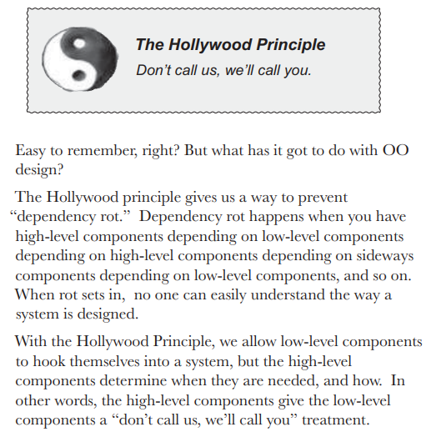
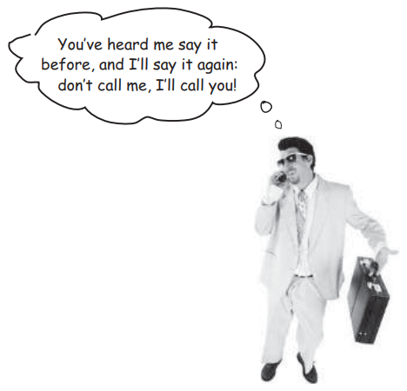
The Hollywood Principle
Notes:
The interesting thing is that the usual control structure of object calls and relations is reversed. It is the parent class that calls the method in the subclass, a behavior which Richard E. Sweet refers to as the "Hollywood Principle" — "Don't call us, we'll call you." [The Template Design Pattern is of particular use in the Factory Design Pattern.]
[The base class with the template method is considered a high-level component - clients should depend on this class. the subclasses of the template method base class are low-level implementation - they dont cll anything themselves and are only called by the high-level template method.]

Slide 27
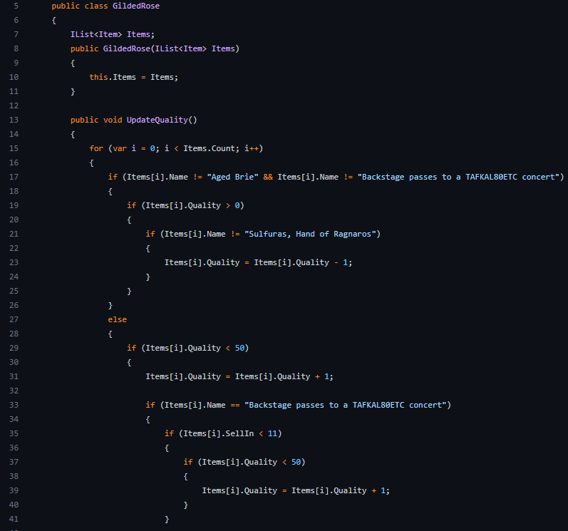
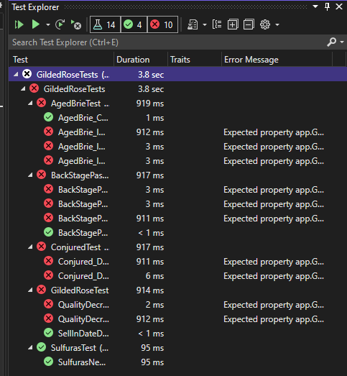
Notes:
I hope you all remember our homework on refactoring gilded rose kata.
Were we have a system that could update its inventory of items, but our task was to add the new feature to the system so that the company can begin selling a new category of items (conjured item).
there we were given a horrible monolithic code and if we tried to add new functionality to existing code, we would just end up in terrible pain of maintenance, where we run in agony to QA and complain that we broke all the tests

Slide 28
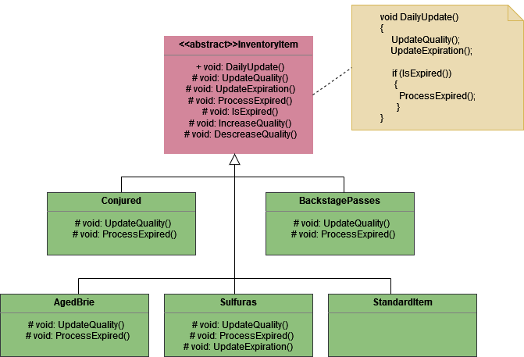
GildedRoseKata. Template Method
Notes:
I had refactored this code usig the template method and here we have the uml diagram of code that i obtained.

Slide 29
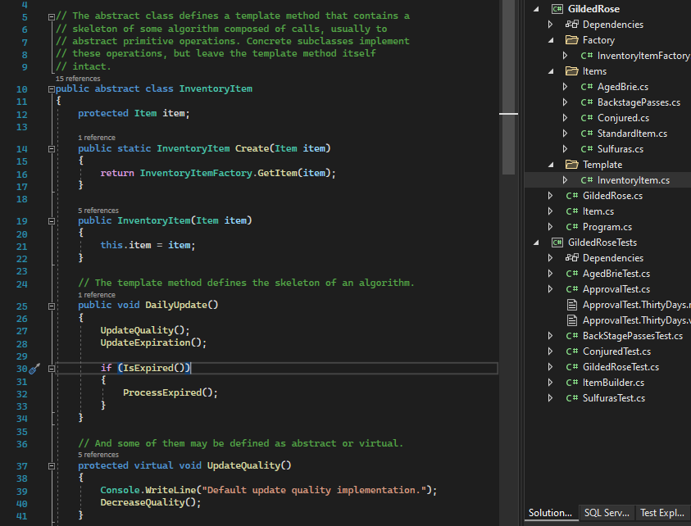
Abstract class implementation

Slide 30
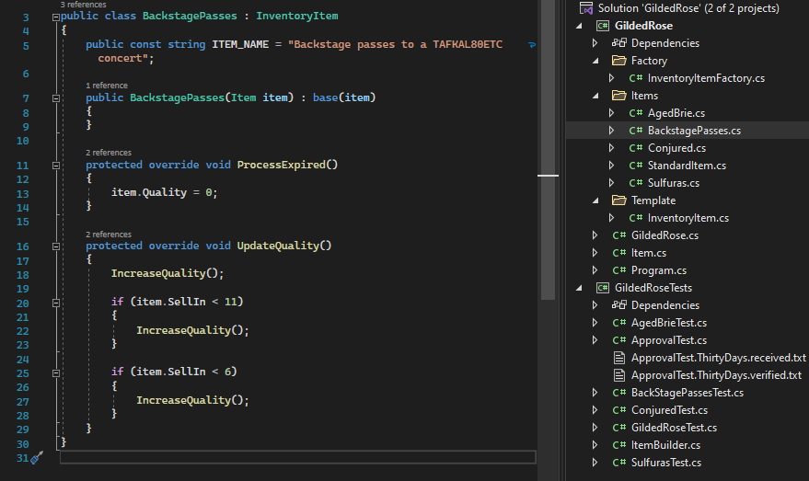
One child class implementation

Slide 31
But .. there are some consequences
Relies on inheritance, rathen than composition
We can use Strategy pattern for a composition-based solution
Single inheritance makes it difficult to merge 2 child algorithms into one
We can use Decorator pattern for a possible solution to this problem
Notes:
The are some consequences on choosing to use TMP. The first is that TM (1), which can be a limitation, wheт you for eg already inherit some class within the child class .
(2)

Slide 32
References
https://stackoverflow.com/questions/1553856/where-should-we-use-template-method-pattern
https://sourcemaking.com/design_patterns/template_method
https://medium.com/deciphering-deadlocks/what-is-template-method-design-pattern-cf99389c8658
https://www.decipherzone.com/blog-detail/template-method-design-pattern

Slide 33
The ppt itself and code sources
https://github.com/ritartha017/PPT-Decorator-TemplateMethod-Endava

Slide 34

Thank You For Your Attention

