Slide 1
Windows on The Raspberry Pi

Slide 2
About the Raspberry Pi
Released in February 2012 the Raspberry Pi is a credit card sized computer that has enabled people of all ages to learn programming and get into computing.
This compact device is capable of doing everything you would expect from a desktop, from browsing the internet to playing games. But unlike regular computers the Raspberry Pi can be used to interact with the outside world.
The Raspberry Pi has been used to build robots, record weather information and power twitter pet feeders.
To start using the Raspberry Pi you will also need to a monitor (with HDMI input), a USB keyboard and mouse and a 5v USB mirco power supply.

Slide 3
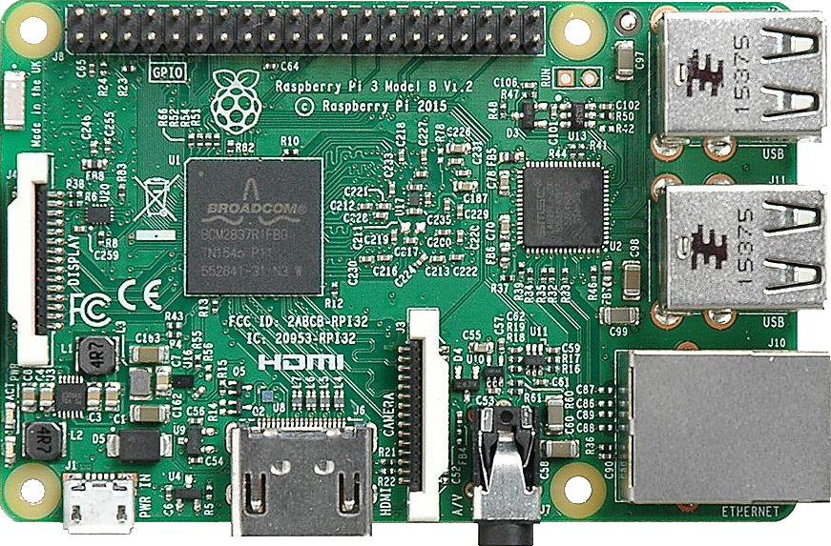
Tour of the board

Slide 4
Windows 10 IoT
On the 30th April 2015 Microsoft and the Raspberry Pi foundation announced the IoT edition of Windows 10 which can be installed on the RPi.
Installation of Windows 10 IoT Core
Video
The setup of Windows on the RPi has been made a lot easier since it was first introduced.
Before you start you need to be running a fully licensed copy of Windows 10 on a PC.
Head over to http://windowsondevices.com and click the “Get Started Now” button.
Download and install the Windows 10 IoT Core Dashboard.
Once installed launch the Iot Dashboard and click the “Set up a new device” button.
Select the “Raspberry Pi 2” option from the Device Type menu (if you are setup a RPi 3 will need to select custom and navigate to the image file).
If you haven’t already inserted your SD card then insert it now and select it from the Drive menu.
Finally accept the T&Cs and click the “Download and install” button. And wait.

Slide 5
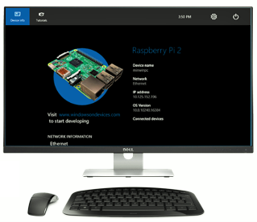
Setup and Configuration
Now the SD card has been flashed insert it into the RPi and power it on. The first boot will take several mins as the OS does its initial installation.
When you see the following screen, you now have Windows running on your RPi.
On this screen you can see some system info like OS version, device name and IP address.
Across the top is a menu that gives you access to tutorials and samples from the “windows on devices” website. Device settings and the power button on the left.

Slide 6
You can connect to and configure your RPi a number of ways. (demo of all of these)
Powershell via a PsSession command
The IoT Core Dashboard
The build in webpage (my fav as it has lots of info).
You should change the default password at this point (do this via the website).
Setting up Visual Studio
The project you will use to write apps for the RPi will be Universal Windows Projects (UWP) and you will have to enable developer mode on your Windows 10 desktop.
Simply, go to Settings > Update & Security > For Developers and select the “Developer Mode” option.
The MS IoT team have also provided a project template for building headless apps. You can get this from the Visual Studio Gallery by searching “Windows IoT Core Project Templates”.

Slide 7
Hello, World! Demo
Create a new project
Add the XMAL
Debug, Run
Deploy
Start/stop from web portal

Slide 8
Basic Input and Output
While the RPi is a very inexpensive computer there are a few things the distinguish it from a regular laptop or desktop. The main difference is that the RPi can be used directly in electronics projects because it has General Purpose Input and Output or GPIO pins.
The GPIO pins can be used to access hardware such as LEDs, motors and relays, which are examples of outputs. Or read the status of button, switches and sensors such as light, temperature and proximity.
Additional Electronics Equipment
Solderless breadboard – If you have never seen or used a breadboard…
Jumper wires
Electronic components
A GPIO breakout board is not necessary but is quite useful.

Slide 9
GPIO Pin Layout
17 GPIO …
ADC
RPi doesn’t come with a ADC. You will have to use an external one and connect it to the SPI ports.
MCP3008 example.
PWM
While available on the RPi, MS haven’t implemented the drivers yet. So you will have to simulate it.
Theremin – Is a digital musical instrument.
Demo
Using a background task this time.
Included a library from GitHub, for PWM simulation.
Setup the SPI, setup PWM.
Loop through reading the sensor, then changing the PWM signal.

Slide 10
The RPi has one additional input and output, the Ethernet port.
The Ethernet port give the RPi the ability to send and receive messages to and from anywhere in the world.
Azure IoT Hub
Azure IoT Hub is a fully managed service that enables reliable and secure bidirectional communications between millions of IoT devices and a solution back end. Azure IoT Hub:
Provides reliable device-to-cloud and cloud-to-device messaging at scale.
Enables secure communications using per-device security credentials and access control.
Provides extensive monitoring for device connectivity and device identity management events.
Includes device libraries for the most popular languages and platforms.
Why use Azure IoT Hub
Device Security – Each device get its own security key to connect to Azure. And Azure has a registry of devices, which allows you to grant/deny access.
Device Monitoring – You can get operation logs from your device, which could be used to alert you to failures.
Device Libraries – There is an extensive list of libraries available support a multitude of devices.
Common Protocols Available – The IoT Hub also exposes common protocols such as HTTP, MQTT & AMQP.

Slide 11
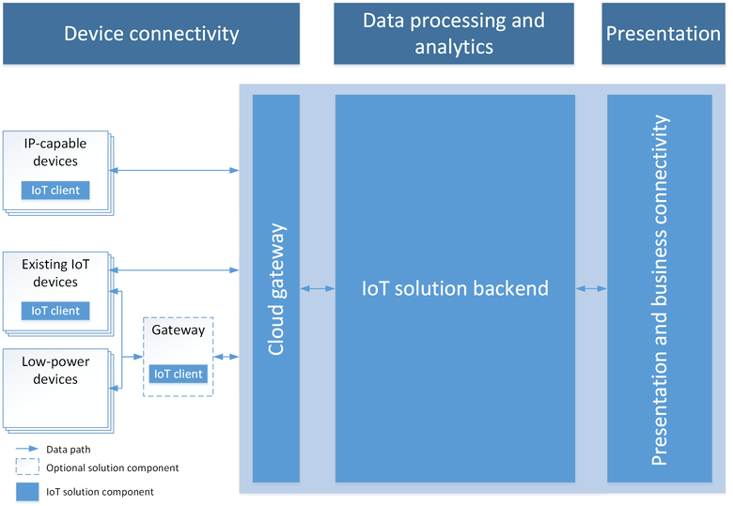
Common Architecture
A common IoT architecture may look something like this.
We have devices out in the field collecting data, and they connect to the Cloud Gateway.
Most of the data processing and analytics will happen in the IoT solution backend. You may want to filter and aggregate the data coming in or react to an alert by sending out a command or notification.
The presentation layer could allow users to interact with the devices in the field or display the aggregated data in a dashboard or as a data feed for external systems to consume.

Slide 12
Azure IoT Hub Demo
Create and IoT Hub
Sign into your Azure account
Click New > Internet of Things > Azure IoT Hub
Finish the setup of your hub by giving it a Name, a Resource Group & Location
Once the Hub has been setup in Azure, take note of the Hostname and Access Key.
Create a Backend Processor
In Visual Studio, Create a new Console Application Project.
Add the WindowsAzure.ServiceBus Nuget Package
Connect to Azure using the connection string generated in the previous step.
Now we can use an EventHubReciever to read messages from our device.
Simulate an IoT Device
In Visual Studio, Create another Console Application
And install the Microsoft.Azure.Devices.Client Nuget Package
Again, insert the connection string we created earlier
This application send random wind speed data to out IoT Hub using a DeviceClient

Slide 13
The Big Finish
Lets combine everything I have shown you today into a intruder alarm system.
We will use two RPis,
One will detect movement using a PIR sensor.
The other will be the alarm system, were we will activate the alarm and sound a warning if an intruder is detected.
There will be an IoT Hub in Azure. The idea is the when we arm the system a command will be set to the Hub telling the other device to arm, and send an alert message when movement is detected. The other device will subscribe to the alert message and raise the alarm if it receives a message.
Stretch goal, the detection device will have a web cam attached and will capture an image and save it to Blob Storage. A background app will then send me a text message containing the pic.

Slide 14
Resources
http://windowsondevices.com – to download Windows 10 for your RPi, plus documentation & samples.
http://insider.windows.com – to register for the insider program to gain access to pre-release Windows 10 images.
http://adafruit.com & http://sparkfun.com – Have lots of tutorials for RPi projects.
But by your electronics from rs-online.com.
http://hackerday.io & http://hackster.io are places where you can share your projects with the community.
Make: Electronics - http://www.amazon.co.uk/Make-Electronics-Learning-Discovery-Technology/dp/1680450263 is a good beginners guide.
Search Amazon for “Raspberry Pi Projects” to get a list of good project ideas books.
http://www.amazon.co.uk/s/ref=nb_sb_noss_2?url=search-alias%3Dstripbooks&field-keywords=Raspberry+Pi+projects

