Slide 1

Richard Tasker
Twitter: @ritasker
Email: richard@pier8software.co.uk
Blog: richardtasker.co.uk

Slide 2


Slide 3
Carter & ASP.Net Core Routing

Slide 4
Light Weight HTTP APIs With Carter
Endpoint Routing
Build An API Using Endpoint Routing
Build an API Using Carter

Slide 5
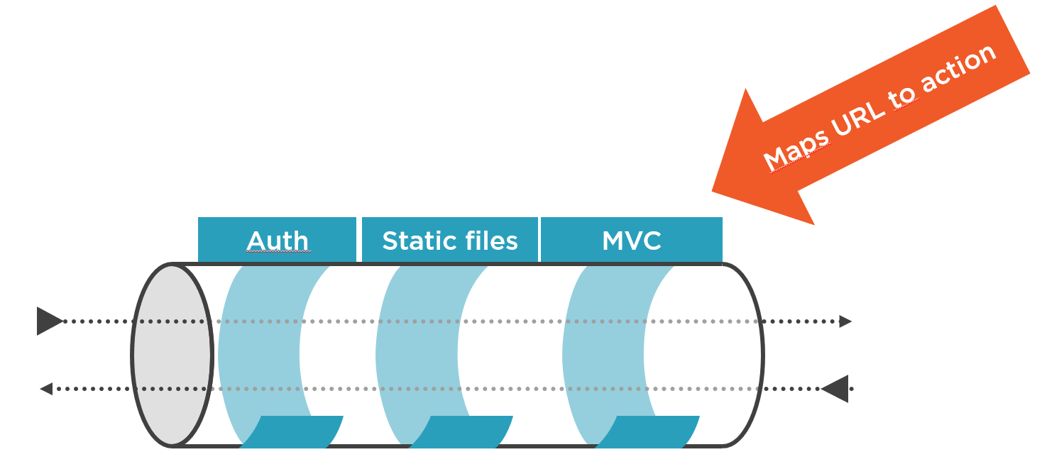
Endpoint Routing
https://rolandguijt.com/content/images/2018/11/2018-11-12_14-23-49.png

Slide 6
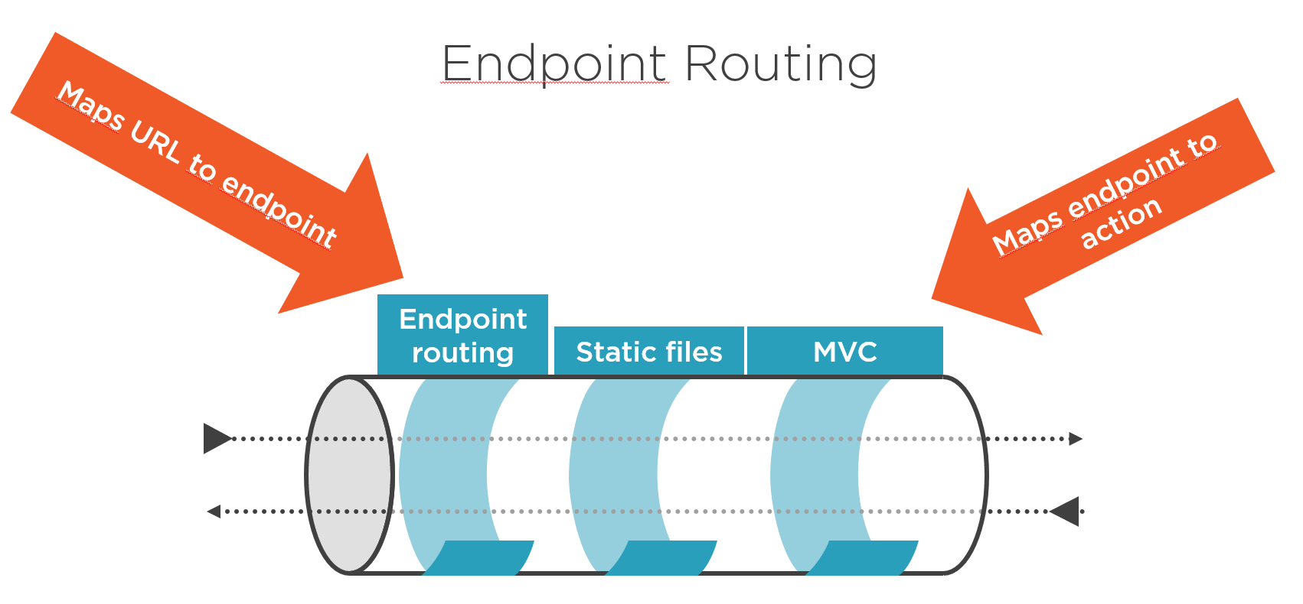
Endpoint Routing
https://rolandguijt.com/content/images/2018/11/2018-11-12_14-24-43.png

Slide 7
Endpoint Routing
MapDelete
MapGet
MapPost
MapPut
MapRoute
MapVerb
Map
MapAssembly<>
MapApplication
MapRazorPages
MapHealthChecks
MapControllerRoute

Slide 8
Light Weight HTTP APIs With Carter
Looked At Endpoint Routing
Built An API Using Just Endpoint Routing
Built An API Using Carter

Slide 9

Thanks For Listening
Twitter: @ritasker Email: richard@pier8software.co.uk Blog: richardtasker.co.uk

