Slide 1
High-accuracy long-read amplicon consensus reconstruction with Nanopore sequencing data
Nanopore Sequencing for Biosecurity Workshop 2022
Rita Tam (Schwessinger Lab)

Slide 2
Session outline
What is amplicon sequencing?
Why long-read amplicon sequencing?
Workflow to reconstruct consensus sequence from Nanopore amplicon sequencing
Amplicon library preparation
Bioinformatic pipeline
Two case studies – fungal identification, pathogen lineage genotyping

Slide 3
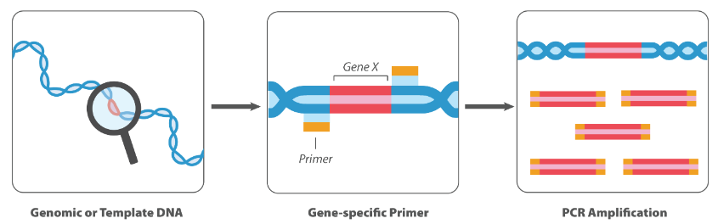
What is amplicon sequencing?
A highly targeted NGS approach that enables analyses of genetic variations in specific genomic regions
Amplicons = DNA fragments from PCR amplification
Deeper sequencing → higher sensitivity to capture variants
Applications:
Disease diagnostics, metagenomics, agrigenomics, microbial genomics etc.
Image source: abm, “Amplicon Sequencing Service”

Slide 4
Why long-read amplicon sequencing?
Short-read amplicon sequencing is useful due to its high throughput and low error rate, yet limited by read length
Lose important long-range information (Karst et al., 2021)
Long-read amplicon sequencing can:
cover more informative regions → higher resolution
resolve longer structural variations
offer better phasing…
Drawback of Nanopore sequencing → higher error rates (5-25%)
Bioinformatic tools are available to improve accuracy to 99% (Hoang et al., 2022)
Notes:
Synthetic long reads via assembling short reads → cannot resolve amplicons with repeats longer than short read length

Slide 5
Why long-read amplicon sequencing?
Short-read amplicon sequencing is useful due to its high throughput and low error rate, yet limited by read length
Lose important long-range information (Karst et al., 2021)
Long-read amplicon sequencing can:
cover more informative regions → higher resolution
resolve longer structural variations
offer better phasing…
Drawback of Nanopore sequencing → higher error rates (1-10%)
Bioinformatic tools are available to improve accuracy to 99.99% (Hoang et al., 2022)
Notes:
Synthetic long reads via assembling short reads → cannot resolve amplicons with repeats longer than short read length

Slide 6


Overview: reconstructing amplicon consensus sequence with Nanopore sequencing data
Nanopore sequencing
Read processing
Consensus sequence reconstruction
Amplicon library preparation

Slide 7
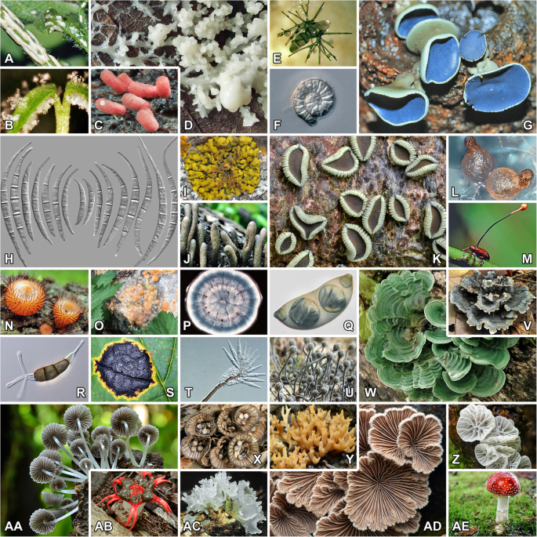
Case study 1 Fungal identification by generating consensus sequences of full-ITS regions
(Lücking et al., 2020)

Slide 8
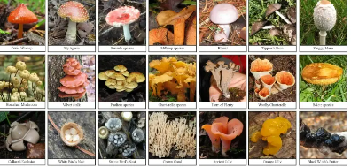
Fungal identification with ITS
DNA barcoding
makes use of short, standardised and highly diverse DNA sequences (= barcodes) for rapid species-level identification
Internal transcribed spacer (ITS) regions among nuclear rRNA genes have become the most popular fungal barcode
Routinely used by fungal systematics, phylogenetics, species identification, diversity studies, etc.

Slide 9
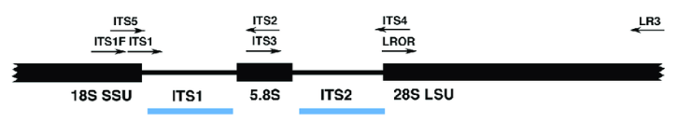
ITS region contains two hypervariable spacers, ITS-1 and ITS-2, separated by the 5.8S rRNA gene
Variations in ITS-1 and ITS-2 are species-specific
Flanked by 18S and 28S rRNA genes
rRNA genes are highly conserved → allow the design of “universal primers” for ITS amplification
(Raja et al., 2017)

Slide 10
Aim
Reconstruct consensus sequences of full-ITS regions for a set of fungal samples, using long-read amplicon sequencing
Nanopore sequencing
Demultiplexing read data
Read QC
Consensus sequence reconstruction
Amplicon library preparation

Slide 11
primer
Amplicon library preparation
gDNA
primer
PCR to amplify region of interest
Amplicons
A-tailing end prep
P
A
A
P
Ligation of barcodes
Ligation of sequencing adapters
Adapter
Barcode
Target Primer
Target Primer
Barcode
Adapter

Slide 12

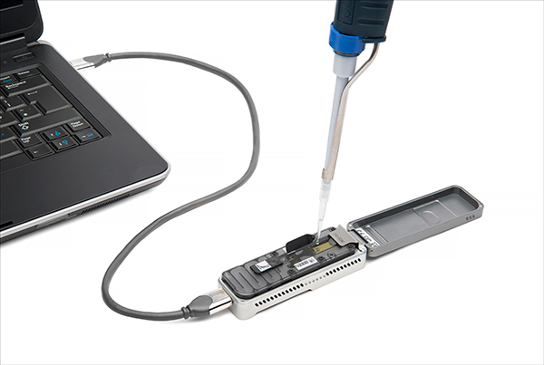
Amplicon library preparation
Mix all barcoded sample reads into one pool (= multiplexing)
Nanopore sequencing

Slide 13
Nanopore sequencing data processing
Nanopore sequencing
Demultiplexing read data
Read QC
Consensus sequence reconstruction
Amplicon library preparation
Multiplexed reads from all samples
(Karst et al., 2021)

Slide 14
Nanopore sequencing data processing
Nanopore sequencing
Demultiplexing read data
Read QC
Consensus sequence reconstruction
Amplicon library preparation
Multiplexed reads from all samples
(Karst et al., 2021)

Slide 15
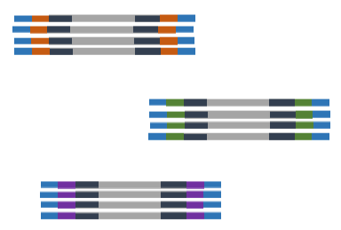
Nanopore sequencing data processing
Nanopore sequencing
Demultiplexing read data
Read QC
Consensus sequence reconstruction
Amplicon library preparation
sample A
sample B
sample C
Multiplexed reads from all samples
Demultiplex by barcodes
(Karst et al., 2021)

Slide 16

Nanopore sequencing data processing
Nanopore sequencing
Demultiplexing read data
Read QC
Consensus sequence reconstruction
Amplicon library preparation
sample A
Length filtering
sample B
sample C
Quality filtering
Multiplexed reads from all samples
Demultiplex by barcodes
Adapter & barcode trimming
Raw read processing
(Karst et al., 2021)

Slide 17
Nanopore sequencing data processing
Nanopore sequencing
Demultiplexing read data
Read QC
Consensus sequence reconstruction
Amplicon library preparation
sample A
Length filtering
sample B
sample C
Quality filtering
Multiplexed reads from all samples
Demultiplex by barcodes
Adapter & barcode trimming
Raw read processing
(Karst et al., 2021)

Slide 18
Nanopore sequencing
Demultiplexing read data
Read QC
Consensus sequence reconstruction
Amplicon library preparation
Filtered & trimmed long reads
Generate draft sequence
Align reads to draft sequence
Run consensus algorithm
Generate consensus sequence
Pipeline for consensus sequence construction
consensus polishing 4x

Slide 19
Pipeline for consensus sequence construction
Generated the first draft sequence using USEARCH
→ cluster reads based on sequence identity
Generate draft sequence
Align reads to draft sequence
Run consensus algorithm
Generate consensus sequence
Sequences (e.g. reads)
USEARCH
Identity threshold (T) = 0.75
(Edgar, 2010)

Slide 20
Pipeline for consensus sequence construction
Generated the first draft sequence using USEARCH
→ cluster reads based on sequence identity
Generate draft sequence
Align reads to draft sequence
Run consensus algorithm
Generate consensus sequence
Sequences (e.g. reads)
USEARCH
Identity threshold (T) = 0.75
centroid sequence (representative)
member sequence
(Edgar, 2010)
Notes:
A cluster is defined by one sequence, known as centroid
Every sequence in the cluster must have similarity above a certain threshold, e.g. 75%
Can be seen as the radius of a cluster

Slide 21
Pipeline for consensus sequence construction
Generated the first draft sequence using USEARCH
→ cluster reads based on sequence identity
Generate draft sequence
Align reads to draft sequence
Run consensus algorithm
Generate consensus sequence
Draft sequence
Sequences (e.g. reads)
USEARCH
Identity threshold (T) = 0.75
centroid sequence (representative)
member sequence
(Edgar, 2010)
Notes:
A cluster is defined by one sequence, known as centroid
Every sequence in the cluster must have similarity above a certain threshold, e.g. 75%
Can be seen as the radius of a cluster

Slide 22
Pipeline for consensus sequence construction
USEARCH
Most abundant centroid
Align reads to draft sequence
Run consensus algorithm
Generate consensus sequence
Generate draft sequence
minimap2
Generate draft sequence
Draft sequence
Long reads
(Li, 2018)
Notes:
A cluster is defined by one sequence, known as centroid
Every sequence in the cluster must have similarity above a certain threshold, e.g. 75%
Can be seen as the radius of a cluster

Slide 23
Pipeline for consensus sequence construction
USEARCH
Most abundant centroid
Align reads to draft sequence
Run consensus algorithm
Generate consensus sequence
Generate draft sequence
minimap2
Generate draft sequence
Draft sequence
Long reads
Uses recurrent neural network
Sequencing errors are averaged and “cancelled” out
Predict consensus sequence
medaka consensus
Polish
Consensus sequence
Notes:
A cluster is defined by one sequence, known as centroid
Every sequence in the cluster must have similarity above a certain threshold, e.g. 75%
Can be seen as the radius of a cluster

Slide 24
Pipeline for consensus sequence construction
Align reads to draft sequence
Run consensus algorithm
Generate consensus sequence
Generate draft sequence
Generate draft sequence
medaka consensus
minimap2
Polish
Long reads
polish 4x
Polished consensus sequence
Consensus sequence
Notes:
A cluster is defined by one sequence, known as centroid
Every sequence in the cluster must have similarity above a certain threshold, e.g. 75%
Can be seen as the radius of a cluster

Slide 25
Nanopore sequencing
Demultiplexing read data
Read QC
Consensus sequence reconstruction
Amplicon library preparation
Pipeline for consensus sequence construction
Generate draft sequence
Align reads to draft sequence
Run consensus algorithm
Generate consensus sequence
Obtain final polished consensus sequence of full-ITS region for each fungal sample
polish 4x
BLAST against rRNA/ITS databases

Slide 26
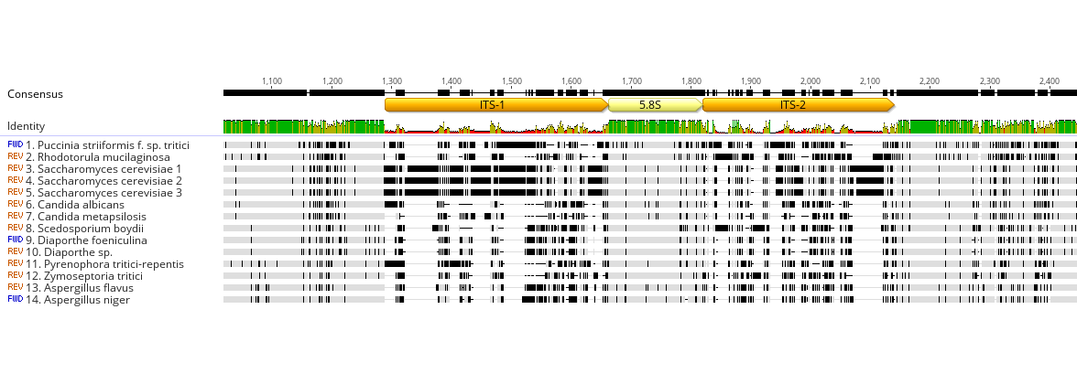
Multiple sequence alignment of full-ITS consensus sequences of 14 fungal samples

Slide 27
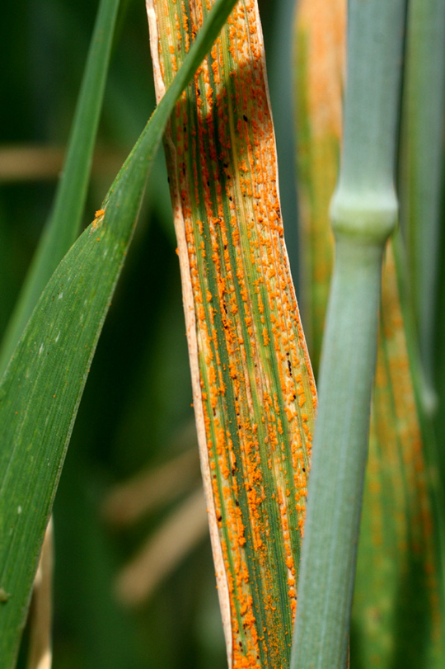
Case study 2 Genotyping lineages of a pathogen species by generating consensus sequences of multiple genes

Slide 28
Stripe rust disease
Puccinia striiformis f. sp. tritici (Pst)
A fungal pathogen of wheat
One of the biggest epidemic in Australia
Significant economic loss

Slide 29
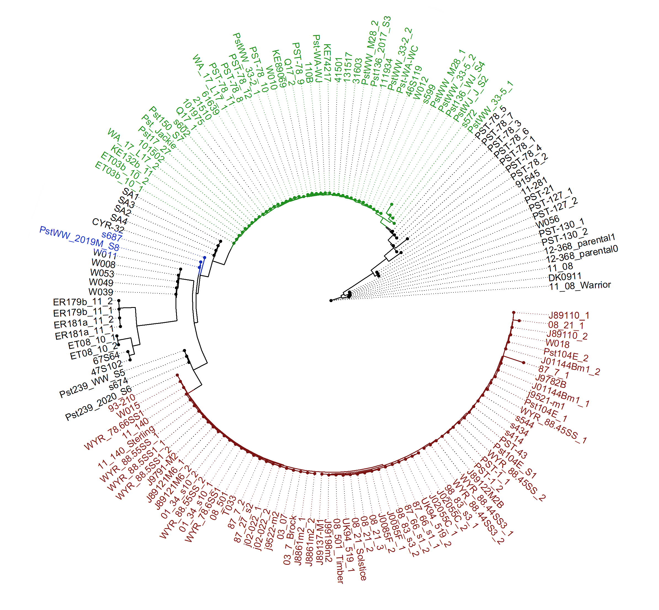
Lineage genotyping
Lineages: Genetically distinct pathogen populations
Lineage identification allows for effective disease monitoring
Major Australian stripe rust lineages (genetic groups) with varying virulence:
“134”
“198”
Perform lineage genotyping using multiple genes
“104”

Slide 30
Aim
Reconstruct consensus sequences of multiple genes for genotyping stripe rust lineages, using long-read amplicon sequencing
Nanopore sequencing
Read QC
Consensus sequence reconstruction
Amplicon library preparation
Demultiplexing read data

Slide 31
Sample 1: Pst198
primer
primer
primer
primer
primer
primer
Gene1
Gene2
Gene3
PCR amplification
Amplicons
These amplicons will share the same barcode. How do we demultiplex them?
Pool amplicons together
A-tailing end prep, barcoding, adapter ligation
Nanopore sequencing

Slide 32
Nanopore sequencing
Read QC
Consensus sequence reconstruction
Amplicon library preparation
Demultiplexing read data
Raw read filtering & trimming
Map reads to reference gene sequences
Gene1
Gene2
Gene3
Filtered amplicon reads
Extract reads from each alignment
Demultiplexed amplicon reads

Slide 33
Nanopore sequencing
Read QC
Consensus sequence reconstruction
Amplicon library preparation
Demultiplexing read data
Demultiplexed amplicon reads
Pipeline for consensus sequence construction
Generate draft sequence
Align reads to draft sequence
Run consensus algorithm
Generate consensus sequence
polish 4x
Polished consensus sequences
Gene1
Gene2
Gene3

Slide 34
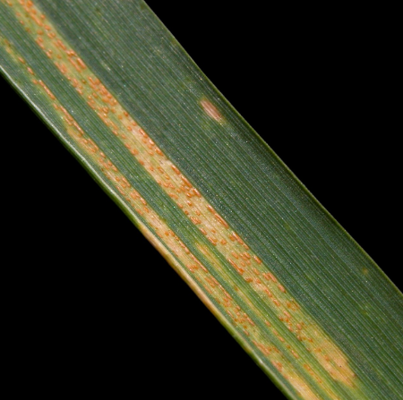
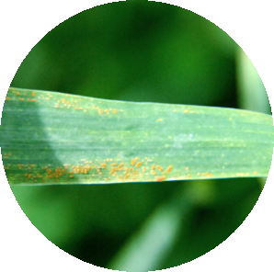
Pst198
Pst134
Pst104
Gene1
Gene1
Gene1
Gene2
Gene2
Gene2
Gene3
Gene3
Gene3

Slide 35
Pst198
Pst134
Pst104
Gene1
Gene1
Gene1
Gene2
Gene2
Gene2
Gene3
Gene3
Gene3

Slide 36
Genotyping lineages using reconstructed amplicon consensus of Gene3
Pst198
Pst134
Pst104
Gene3
Gene3
Gene3
Consensus sequences yielding representative variants of each lineage
Downstream analyses:
Variant calling
Phasing
Gene tree
…

Slide 37
Summary
Amplicon sequencing is a highly targeted approach that enables analyses of genetic variations in specific genomic regions
Long-read amplicon sequencing allows for capturing long-range information → higher discriminatory power, better phasing, etc.
Two case studies – fungal identification, pathogen lineage genotyping
Workflow to reconstruct consensus sequence from Nanopore amplicon sequencing
Amplicon library preparation
Bioinformatic pipeline

