Slide 1
Clash of Clans
Presented by Ritchel

Slide 2
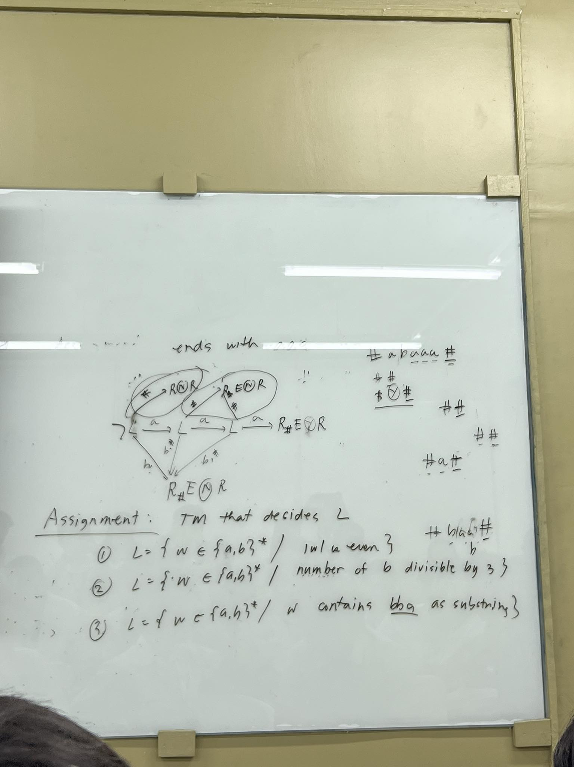

Clash of Clans features a variety of unique heroes with special abilities.
These heroes play a crucial role in attacking, defending, and leading battles in the game.
Let's explore the different heroes available in Clash of Clans and their unique characteristics.
Introduction to Clash of Clans Heroes

Slide 3
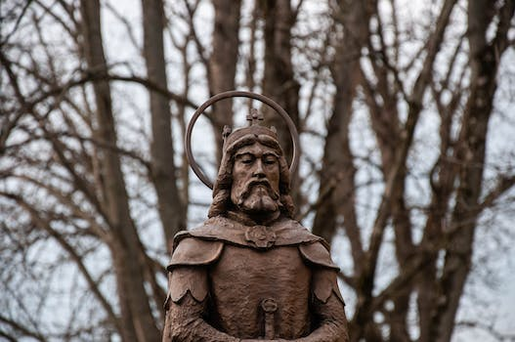
Barbarian King is the first hero unlocked in COC.
He has a powerful iron fist ability that deals massive damage to buildings.
Barbarian King - The Mighty Warrior

Slide 4

Archer Queen shoots deadly arrows at enemies from a distance.
She can summon a group of archers to aid her in battle.
Archer Queen - The Ranged Assassin

Slide 5

Grand Warden - The Master Support
Grand Warden provides healing and defensive abilities to troops.
He can also make nearby troops temporarily invulnerable.

Slide 6
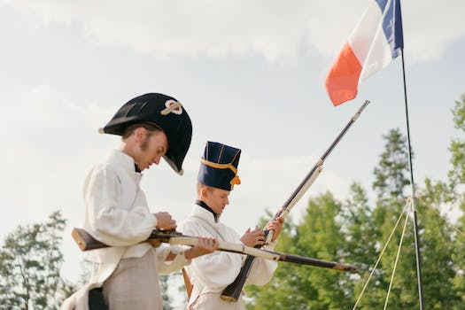
Battle Machine - The Fearless Attacker
Battle Machine is exclusive to the Builder Base in COC.
It withstands heavy damage and deals devastating blows with its hammer.

Slide 7
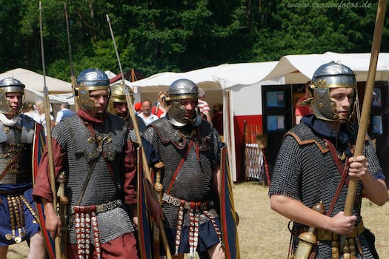
Royal Champion - The Versatile Warrior
Royal Champion is the newest hero introduced in Clash of Clans.
She targets defenses and delivers powerful area-of-effect attacks.

Slide 8
Special Abilities of the Heroes
Each hero has a special ability that can turn the tide of battle.
Ability levels and upgrades enhance the heroes' effectiveness.

Slide 9
Hero Upgrades and Progression
Heroes can be upgraded using Dark Elixir to increase their strength.
Higher hero levels unlock new abilities and increase health and damage.

Slide 10
Strategic Uses of Heroes in Attacks
Heroes can be deployed strategically to support the attacking troops.
Their abilities can be timed to maximize their impact during battles.

Slide 11

Heroes in Clan Wars and Clan Castle Defense
Heroes are deployed in Clan War attacks to secure victories.
Placing heroes in the Clan Castle during defense enhances the base's strength.

