Slide 1
Baking Tools
Presented by Airi

Slide 2
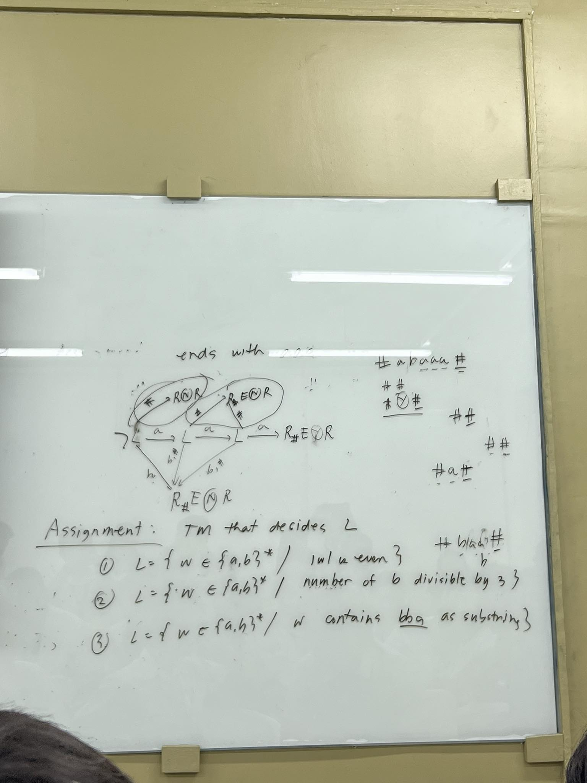
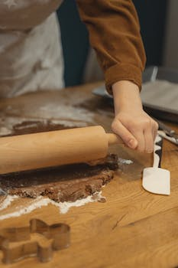
Baking tools are a must-have for every baker.
They are vital for precise measurement, mixing, and shaping of ingredients.
Examples include measuring cups, mixing bowls, and baking pans.
Knowing the purpose of each tool is key to achieving baking success.
Introduction to Baking Tools

Slide 3
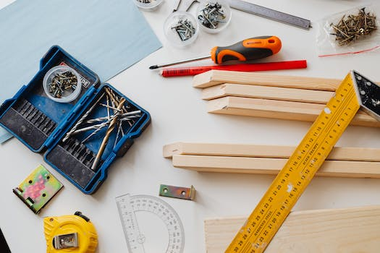

Baking tools are a must-have for every baker.
They are vital for precise measurement, mixing, and shaping of ingredients.
Examples include measuring cups, mixing bowls, and baking pans.
Knowing the purpose of each tool is key to achieving baking success.
Measuring Tools

Slide 4
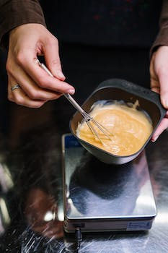
Mixing Tools
The quick brown fox
jumps over the lazy dog.

Slide 5
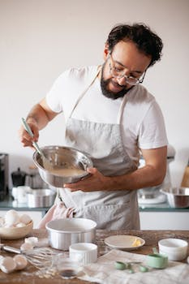
Baking Pans and Molds
Baking pans come in different shapes and sizes for various recipes.
Cake pans are round and can be used for layer cakes or bundt cakes.
Loaf pans are rectangular, perfect for making bread.
Muffin tins are used for making cupcakes or muffins.

Slide 6
Rolling Pins and Pastry Tools
Rolling pins are used to flatten dough for pies, pastries, and cookies.
Pastry brushes are used to brush egg wash or glaze onto baked goods.
Pastry cutters and pastry blenders are used to cut and blend butter into dough.
Tart pans and pie weights help create perfect crusts for tarts and pies.

Slide 7
Decorating Tools
Piping bags and tips are used for creating intricate designs on cakes and cupcakes.
Offset spatulas are used for spreading frosting and smoothing surfaces.
Pastry bags and couplers allow for controlled frosting application.
Decorating combs and stencils help create professional-looking patterns on cakes.

Slide 8

Conclusion
Baking tools are essential for successful baking.
They help measure, mix, shape, and decorate various baked goods.
Understanding the purpose of each tool enhances baking skills.
Investing in quality baking tools will lead to better results in the kitchen.

