Slide 1
Java
Presented by Micro

Slide 2
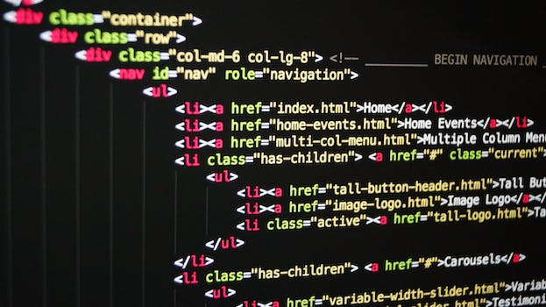
Java is a high-level programming language known for its platform independence.
Its key feature is the Java Virtual Machine (JVM) that allows code to run on any machine with a JVM installed.
Java is widely used for developing desktop, web, and mobile applications.
Introduction to Java

Slide 3

Object-Oriented Programming
Java follows the principles of Object-Oriented Programming (OOP).
OOP is based on the concept of objects and classes.
Classes define the blueprint for objects, which encapsulate data and behavior.

Slide 4
Java Development Tools
Java has a rich set of development tools, including the Java Development Kit (JDK) and Integrated Development Environments (IDEs) like Eclipse and IntelliJ IDEA.
The JDK includes the Java compiler, debugger, and runtime environment.
IDEs provide features like code completion, debugging, and automated build tools for efficient Java development.

Slide 5

Java Ecosystem
The Java ecosystem offers a vast array of libraries and frameworks that enhance productivity and simplify development tasks.
Some popular Java frameworks include Spring, Hibernate, and Apache Struts.
The Java community is constantly evolving and contributing to the development of new libraries and frameworks.

