Slide 1
Semen Analysis
Ritchie Chan Lu Jie 2609774C/2002010

Slide 2
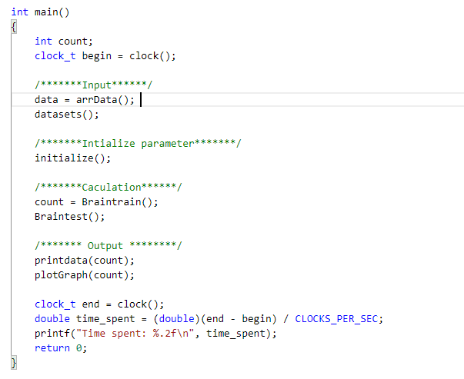
Main
Inputs/Initialize Functions
Initialize the inputs (text file) onto arrays
Initialize the values (weight and bias) through calculation
Calculation Functions
Perform training on the training set and calculating the MAE, MMSE and confusion matrix
Display Functions
Print out all the iterations, MAE, MMSE and confusion matrix values
Plot on the graph

Slide 3
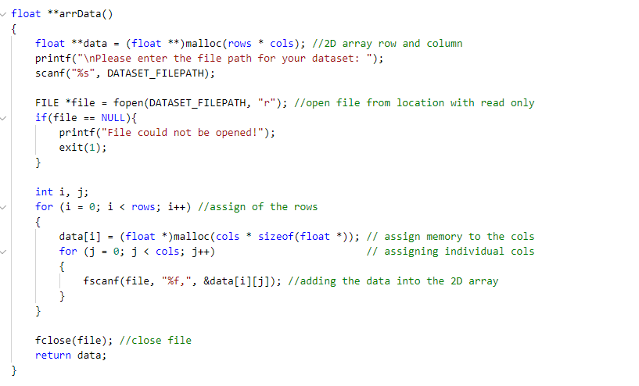
Reading data through filepointer
**Data:
Allow users to input the file path location
Reads the data and checks for its validity
Prints error message if file does not exist
Else, read and store the data onto an array
Ends the file and return the data array

Slide 4
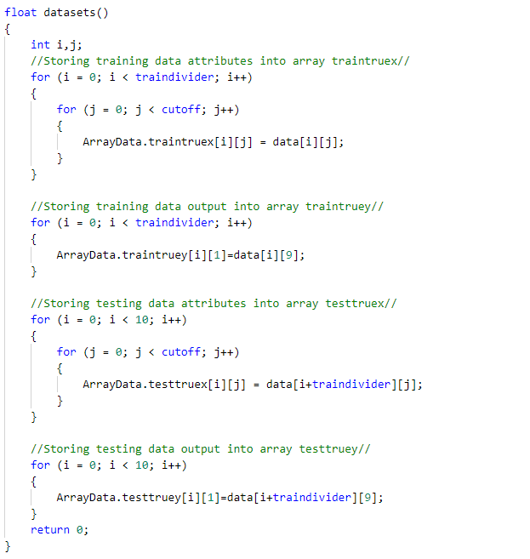
Data Splitting
datasets():
Reads the data array file
Splits the data array file into 4 other arrays (Training Set x, y and Testing Set x, y) which will be used in the calculation functions

Slide 5
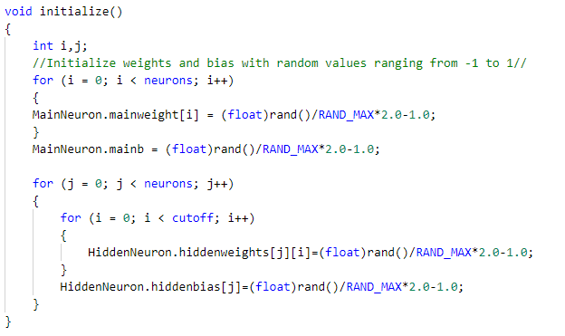
Weight & Bias Initialization
Initialize():
Initialize the weight and bias values for both main neuron and hidden layer.
Calculate them via rand() which will range the values from -1 to 1

Slide 6
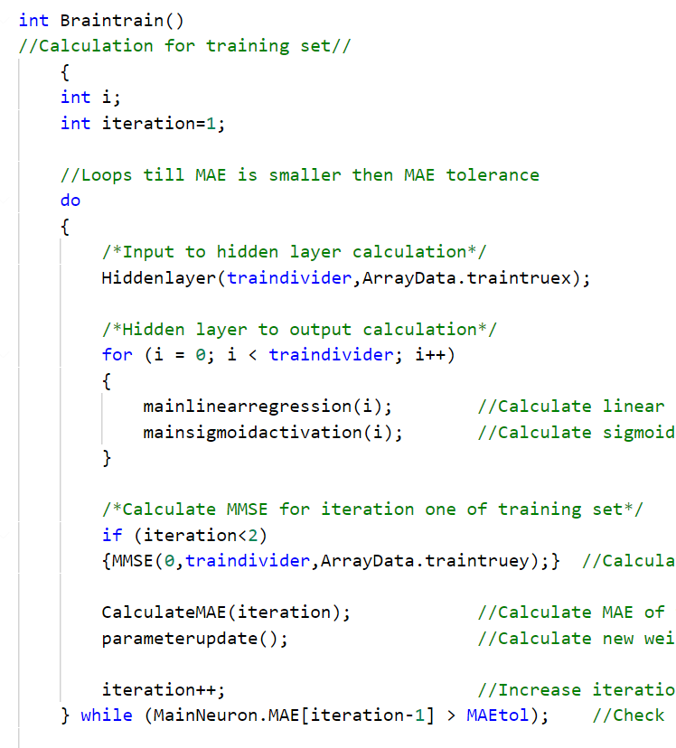
Training set
Braintrain(): Does calculation for training set
Goes through calculation for hidden neurons
Goes through calculation for main neuron
Calculate MMSE for untrained training set
Calculates MAE
Parameter update
Loops till MAE is lower than 0.18
Calculate MMSE for trained training set

Slide 7
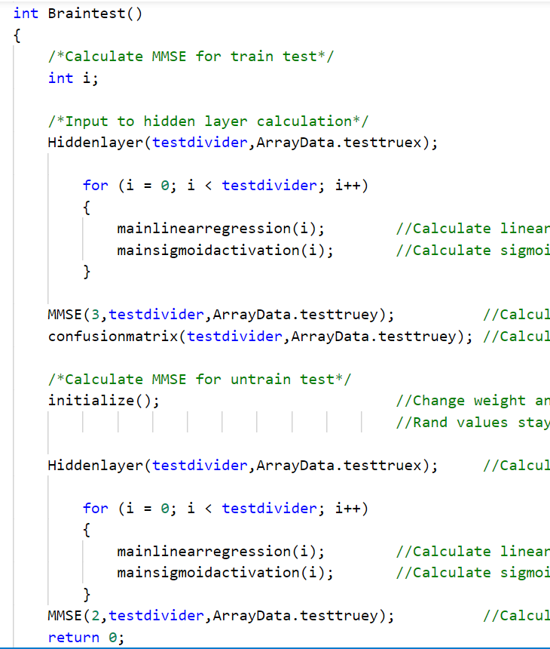
Testing set
Braintest(): Does calculation for testing set
Goes through calculation for hidden neurons
Goes through calculation for main neuron
Calculate MMSE for trained testing set
Revert weight and bias to original value
Goes through calculation for hidden neurons
Goes through calculation for main neuron
Calculate MMSE for untrained testing set

Slide 8
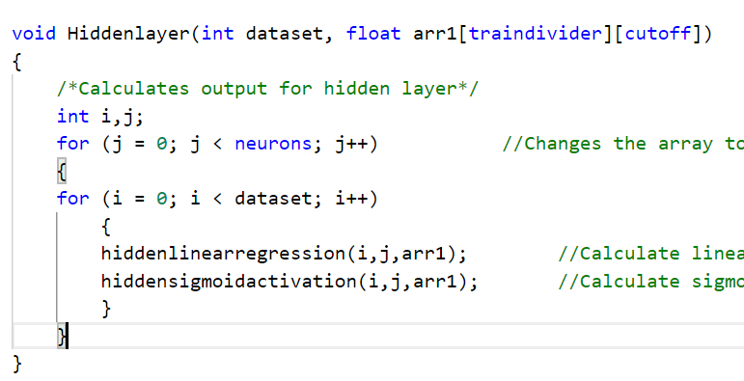
HiddenLayer calculations
Hidden layer()
Does calculation for the hidden neuron. (Input to hidden neuron)
Loops based on the number of datasets and the number of neurons
Contains hiddenlinearregression() and hiddensigmoidactivation().
hiddenlinearregression()
Calculates linear regression calculation for hidden neuron
hiddensigmoidactivation()
Calculates hidden sigmoid activation for hidden neuron

Slide 9
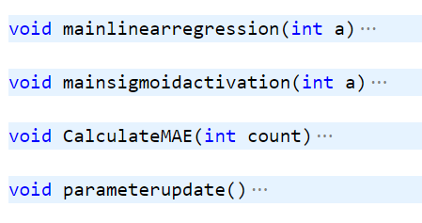
Main neuron calculation
mainlinearregression()
Calculates linear regression for main neuron
mainsigmoidactivation()
Calculates hidden sigmoid activation for main neuron
CalculateMAE()
Calculates MAE and store into an array
parameterupdate()
Calculates error for main neuron
Calculates delta e over w for main neuron
Calculates delta e over b for main neuron
Calculates error for hidden neuron
Calculates delta e over w for hidden neuron
Calculates delta e over b for hidden neuron
Updates weight and bias of main neuron
Updates weight and bias of hidden neuron

Slide 10
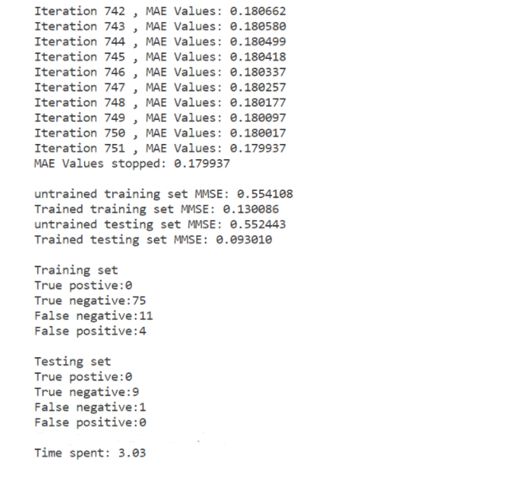
Confusion matrix
& Minimum Mean Square Error
Displaying results from the function printData() where this function takes in the following:
Number of iteration : MAE
Differences between Train & Untrained Sets
MMSE()
MMSE = (Trained Y - True Y)^2
On the side of the MMSE, result are squared as to achieve a positive range of value for confusionMatrix() on the comparison.
confusionMatrix()
To display the comparison based on the value and True Y
Based on the MMSE, we provide a threshold of 0.50 condition if the value from MMSE is more than 0.50 it will return 1 else 0.
Total time spent

Slide 11
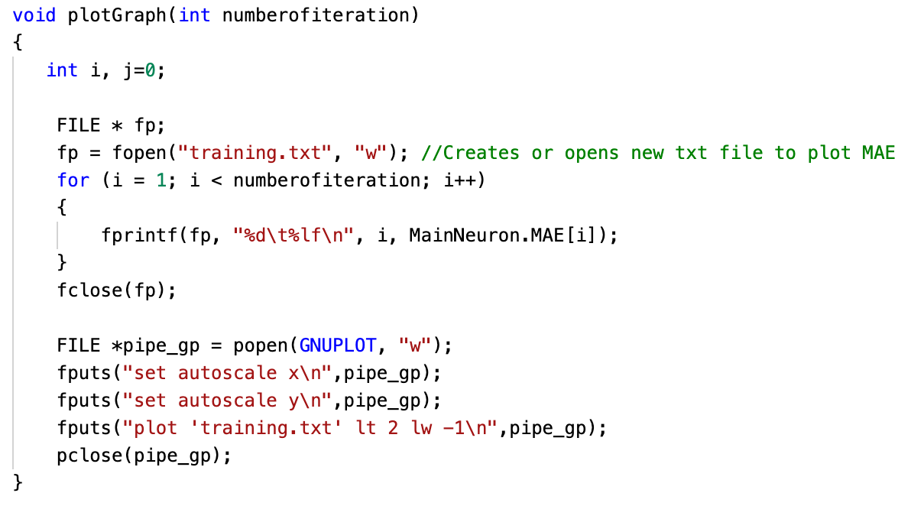
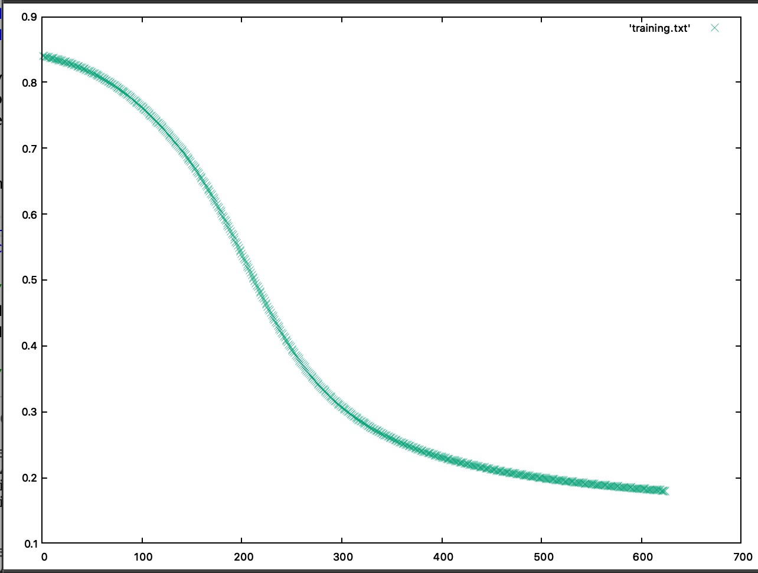
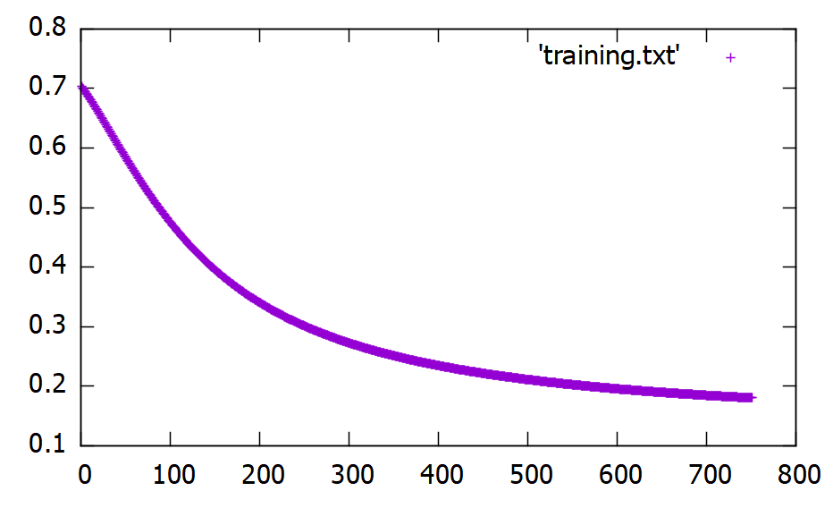
Plotting
The result of plotGraph() produces a different result when running the program on a different software.
The process of getting the plotting result will be that we first create and store the results from MAE to a text file.
Next, we will use GNUPLOT to display the chart.
Things to note, different OS produces different output on the display of chart.

