Slide 1
Title : LOG4J
Authored by : Asfiya Khan Presented by: Asfiya Khan

Slide 2
Agenda
Need Of Logging
Components of Log4J
Levels of logging
Configuration

Slide 3
Logging needs
  Use logging as part of our debugging process
  Use logging to monitor the status of a live application
  Any web application with more than a few screens will have some
  kind of process or data that needs to be monitored.
A good logging technology should take care of both of these
aspects in one simple, lightweight solution
What makes a good logging technology???

Slide 4
What makes a good logging technology???
  Flexibility of output
    A good logging technology allows for logging messages to be output to a variety of destinations and to more than one destination at a time
  Different levels of logging
    A good logging solution can differentiate between message levels and allow for log messages for each level to be selectively turned on or off without touching the source code of the application
  Performance
    Any logging solution we choose to employ should not affect the performance of the application
  Loosely coupled
    it’s ability to stay loosely coupled to the application itself
    Apache log4j is a logging framework which satisfies above points related to a good logging technology

Slide 5
Three main parts of log4j:
  public class Logger
    Logger is responsible for handling the majority of log operations.
  public interface Appender
    Appender is responsible for controlling the output of log operations.
  public abstract class Layout
    Layout is responsible for formatting the output for Appender.

Slide 6
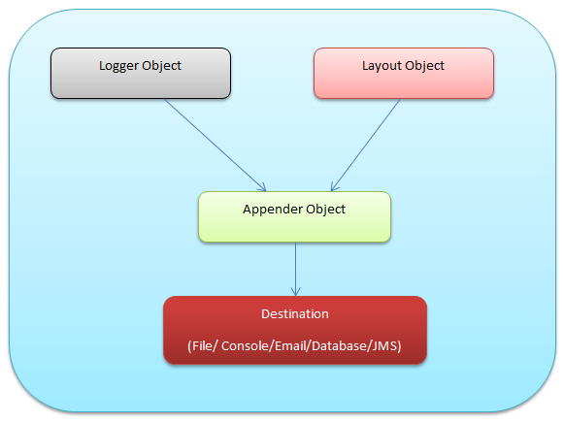
Log4J Architecture

Slide 7
Log4J Levels:
In log4j, there are 5 normal levels :
  Level DEBUG
    Designates fine-grained informational events that are most useful to debug an application.
  Level INFO
    Gives general information about the application such as startup and shutdown messages

Slide 8
Log4J Levels:
  Level WARN
    Designates potentially harmful situations, that are undesirable but not necessarily an error. This can be useful for flagging issues related to performance and security
  Level ERROR
    Designates error events that might still allow the application to continue running.
  Level FATAL
    The FATAL level designates very severe error events that will presumably lead the application to abort.

Slide 9
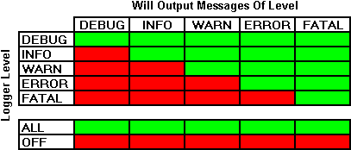
Log4J Levels:

Slide 10
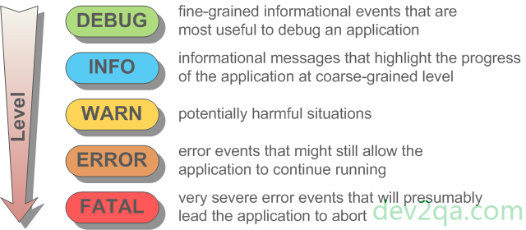
Logger Level

Slide 11
Log4J Levels:
A logger will only output messages that are of a level greater than or equal to it.
If the level of a logger is not set it will inherit the level of the closest ancestor.
If a logger is created in the package com.foo.bar and no level is set for it, it will inherit the level of the logger created in com.foo.
  If no logger was created in com.foo, the logger created in com.foo.bar will inherit the level of the root logger.
  The root logger is always instantiated and available, the root logger is assigned the level DEBUG.

Slide 12
Different ways to create a logger
  Retrieve the root logger:
    Logger logger = Logger.getRootLogger();
  Create a new logger:
    Logger logger = Logger.getLogger("MyLogger");
  Instantiate a static logger globally, based on the name of the class:
    static Logger logger = Logger.getLogger(test.class);
  Set the level with:
    logger.setLevel((Level)Level.WARN);

Slide 13
Appender
Appender controls the output of logging.
Appenders available are :
  ConsoleAppender
    appends log events to System.out or System.err using a layout specified by the user. The default target is System.out.
  DailyRollingFileAppender
    extends FileAppender so that the underlying file is rolled over at a user chosen frequency.
  FileAppender
    appends log events to a file.
  RollingFileAppender
    extends FileAppender to backup the log files when they reach a certain size.

Slide 14
Layouts
The Appender must have an associated Layout so it knows how to format the output.
There are three types of Layout available:
  HTMLLayout
    formats the output as a HTML table.
  PatternLayout
    formats the output based on a conversion pattern specified, or if none is specified, the default conversion pattern.
  SimpleLayout
    formats the output in a very simple manner, it prints the Level, then a dash '-' and then the log message.

Slide 15
Configuration
Log4j is usually used in conjunction with external configuration files so that options do not have to be hard-coded within the software.
The advantage of using an external configuration file is that changes can be made to the options without having to recompile the software.
A disadvantage could be, that due to the io instructions used, it is slightly slower.
There are two ways in which one can specify the external configuration file
  A properties file
  A XML file.

Slide 16
Any Questions?

