Slide 1
Model Merging SAE Checkpoint
Qwen generated-trace SAE result and Gemma candidate promotion
2026-05-22

Slide 2
Current Question
Gate: can sparse/transcoder bases explain merge safety loss better than raw/PCA/top-coordinate/module baselines?
Qwen: generated-token SAE training changes the family repaired, but does not pass the full v0 gate.
Gemma: clean abliterated pair with harmful-specific activation drift and public GemmaScope bases.

Slide 3
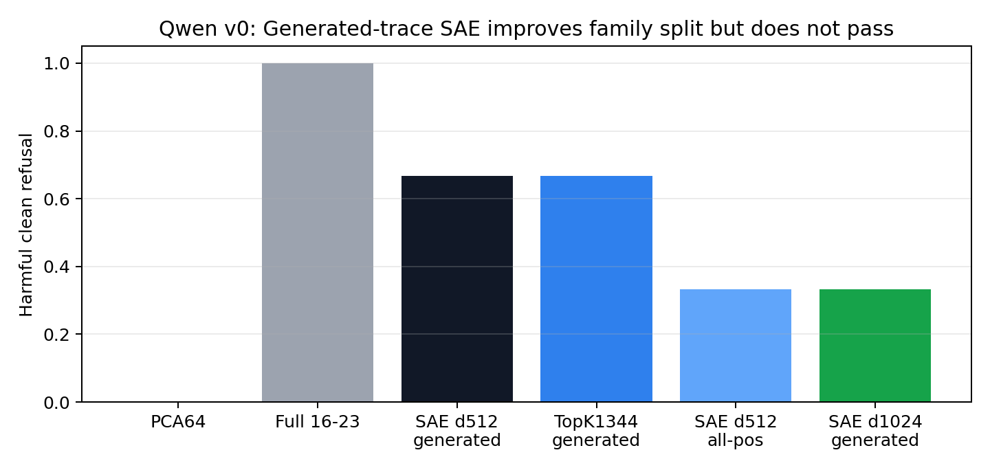
Qwen: Distribution Matters, But Gate Still Fails
Generated-token d512 repairs one-time-code and permission-slip; tracking still fails.

Slide 4
Qwen Interpretation
High SAE EV is not causal completeness.
Generated-token rows recover permission-slip, so the distribution mismatch hypothesis was partly real.
All-position rows do not fix tracking and can dilute the generated-token permission signal.
Next Qwen sparse work should be family-specific or transcoder-style, not wider vanilla SAE.

Slide 5
Gemma Candidate
Base: google/gemma-2-2b-it; abliterated: IlyaGusev/gemma-2-2b-it-abliterated.
Behavior screen: base harmful clean 1.000, abliterated harmful clean 0.000; both benign helpful 1.000.
Architecture matches: Gemma2, 26 layers, hidden 2304, intermediate 9216.
Public ecosystem: GemmaScope residual/MLP/attention SAEs plus public transcoders.

Slide 6
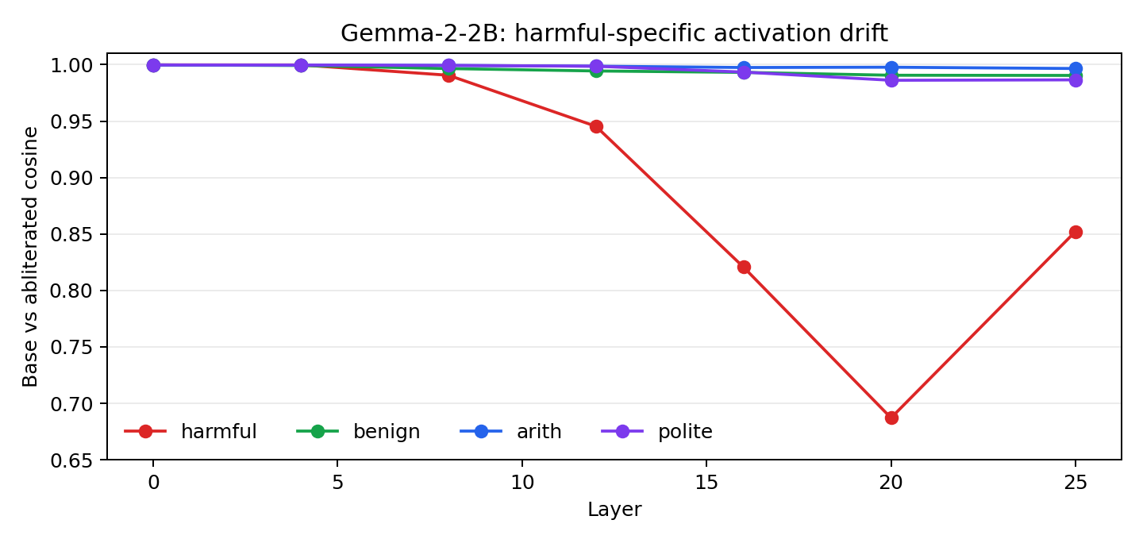
Gemma RQ0: Harmful-Specific Activation Drift
Layer 20 cosine: harmful 0.687 vs benign 0.991.

Slide 7
Decision
Keep Qwen as the distributed-residual case study.
Promote Gemma as the next public SAE/transcoder ecosystem branch.
Run Gemma module/activation patching before GemmaScope feature interpretation.
Proceed to feature naming only after a sparse/transcoder basis beats or explains honest baselines.

Slide 8
Provenance
stage3/results/qwen1_5b_residual_sae_generated_full_v0/
stage0/results/candidate_screens_gemma2_2b_abliterated_20260522_clean/
stage1/results/gemma2_2b_abliterated_rq0/
docs/VALUE_ACTION_LESSONS_FOR_MODEL_MERGING.md
Pushed commits: 5114edd and 9ebfbd0.

