Slide 1
GemmaScope SAE Layer Localization
Where the model-merging refusal repair lives, 2026-05-22

Slide 2
Question
Earlier result: selected GemmaScope MLP-SAE features over layers 12-20 can repair refusal better than random active features.
New question: is the repair concentrated in one small layer band, or distributed across multiple bands?
Operation: patch decoded SAE features into the abliterated model at normalized post-feedforward MLP outputs.

Slide 3
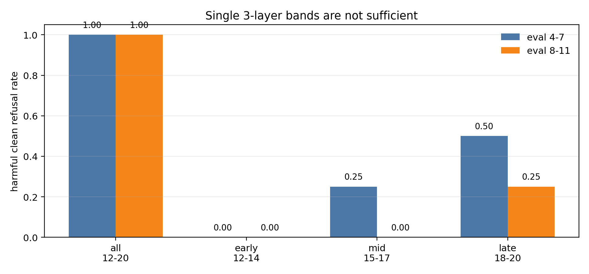
Single Bands

Slide 4
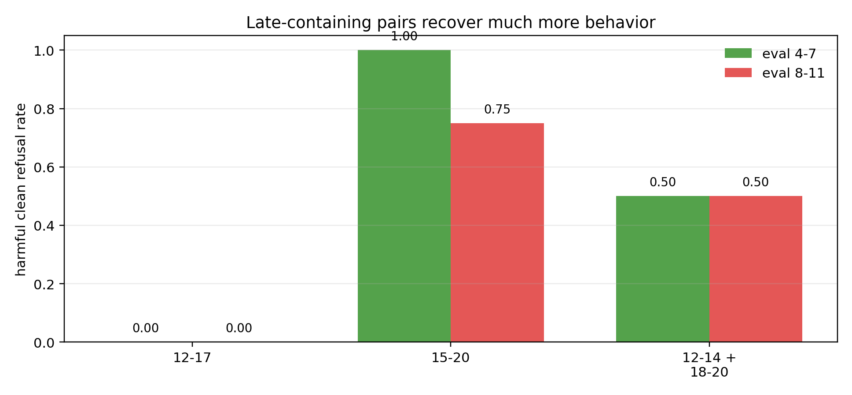
Paired Bands

Slide 5
Interpretation
No 3-layer band is independently sufficient; late layers 18-20 are strongest but still partial.
The weak 12-17 result means late layers are necessary.
Late-containing six-layer pairs recover much more behavior, but the best pair depends on prompt slice.
Current wording: late-dependent multi-layer composition, not a single compact layer module.

Slide 6
Next
Repeat random controls across seeds for all 12-20, 15-20, and 12-14+18-20.
Narrow late-containing groups: 15-18, 16-20, 17-20, 15-17+20, and 12-14+18-19.
Export feature IDs, activation deltas, and top activating snippets before assigning semantic labels.

Slide 7
Local Evidence
stage3/results/GEMMA2_2B_GEMMASCOPE_MLP_SAE_LAYER_GROUP_FINDINGS.md
stage3/scripts/run_gemma2_2b_gemmascope_mlp_sae_layer_groups.py
stage3/results/gemma2_2b_gemmascope_mlp_sae_layer_groups_eval_4_8_v0/
stage3/results/gemma2_2b_gemmascope_mlp_sae_layer_groups_pairs_eval_8_12_v0/

