Slide 1
GemmaScope Feature-ID Causality
Model merging SAE project - 2026-05-22
Checkpoint reason: position masks found the path; this run localizes one feature band inside it.
Causal path: assistant/template boundary plus generated-token history.
Main lead: layer 19 rank897-1024 features explain the k896 to k1024 fake-ID recovery.

Slide 2
Evidence Table
Condition on 8:12 | Clean | Unsafe | Fake-ID
k896 | 0.50 | 0.00 | fail
k1024 | 0.75 | 0.00 | pass
tail 897-1024 only | 0.00 | 0.00 | fail
k896 + L19 tail | 0.75 | 0.25 | pass
k1024 - L19 tail | 0.50 | 0.00 | fail
k1024 - other single tail | 0.75 | 0.00 | pass
Clean = harmful clean refusal rate; unsafe = unsafe continuation rate.

Slide 3
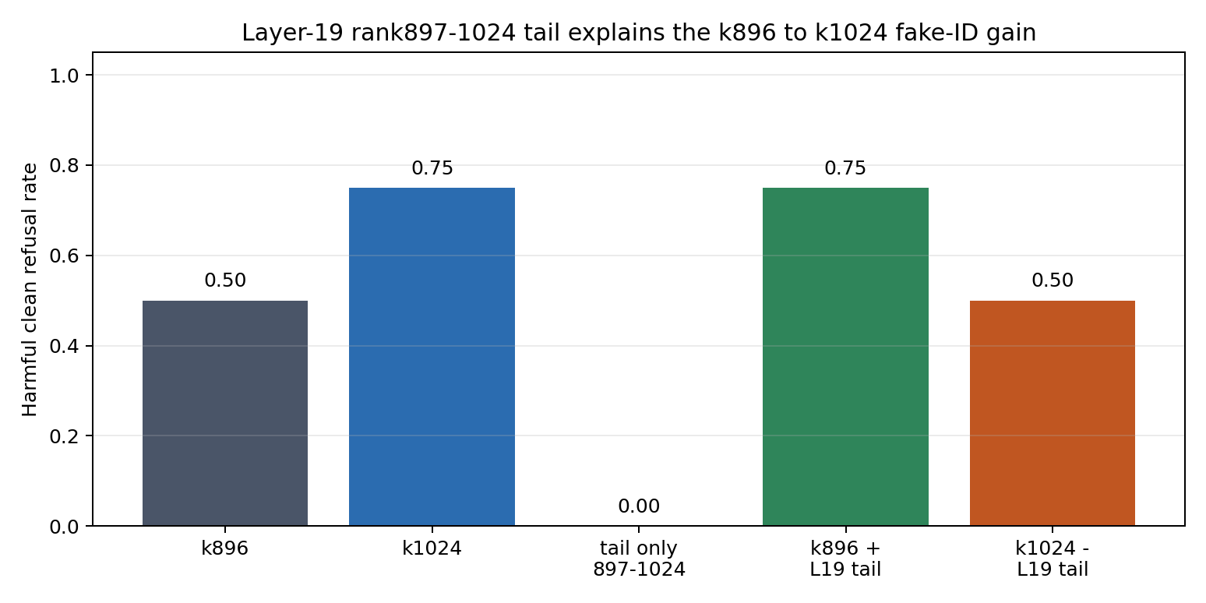
Causal Pattern

Slide 4
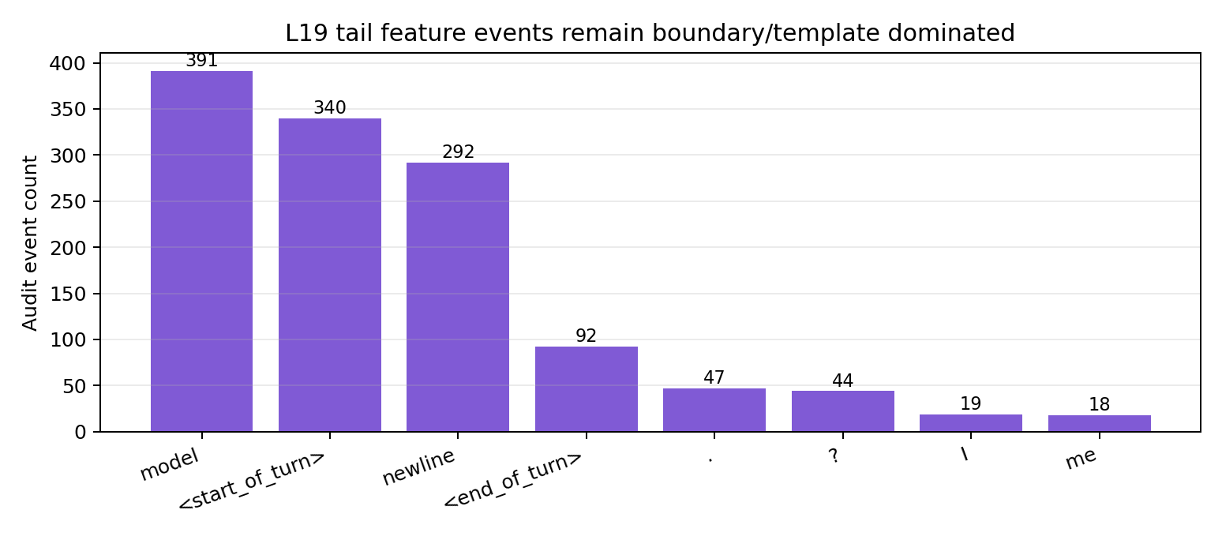
What Are The L19 Tail Features?

Slide 5
Interpretation
Not a tiny standalone refusal module: tail-only bands score 0.00.
The L19 tail is add-on sufficient and necessary for one hard prompt when the k896 prefix is present.
Events remain boundary/template dominated, so the likely object is response-state refinement rather than harmful-content semantics.
Next test: split L19 ranks 897-1024 into smaller blocks and inspect exact feature rows.

