Slide 1
GemmaScope MLP SAE Checkpoint
Model merging SAE project - 2026-05-22

Slide 2
Question
Can a public sparse basis reproduce a causal model-merging repair, not just describe activations?
Target pair: Gemma-2-2B-IT base donor into an abliterated recipient.
Behavior gate: restore harmful refusal while preserving benign helpfulness.
Important distinction: this is decoded SAE completeness, not yet feature-level explanation.

Slide 3
Causal Target
Patch | Harmful clean | Unsafe | Benign helpful
Abliterated | 0.000 | 0.000 | 1.000
Full post-FF 16-20 | 0.750 | 0.000 | 1.000
Full post-FF 12-20 | 1.000 | 0.000 | 1.000
The successful activation site is the post-feedforward MLP update, layers 12-20.
This aligns the causal target with GemmaScope MLP SAEs.

Slide 4
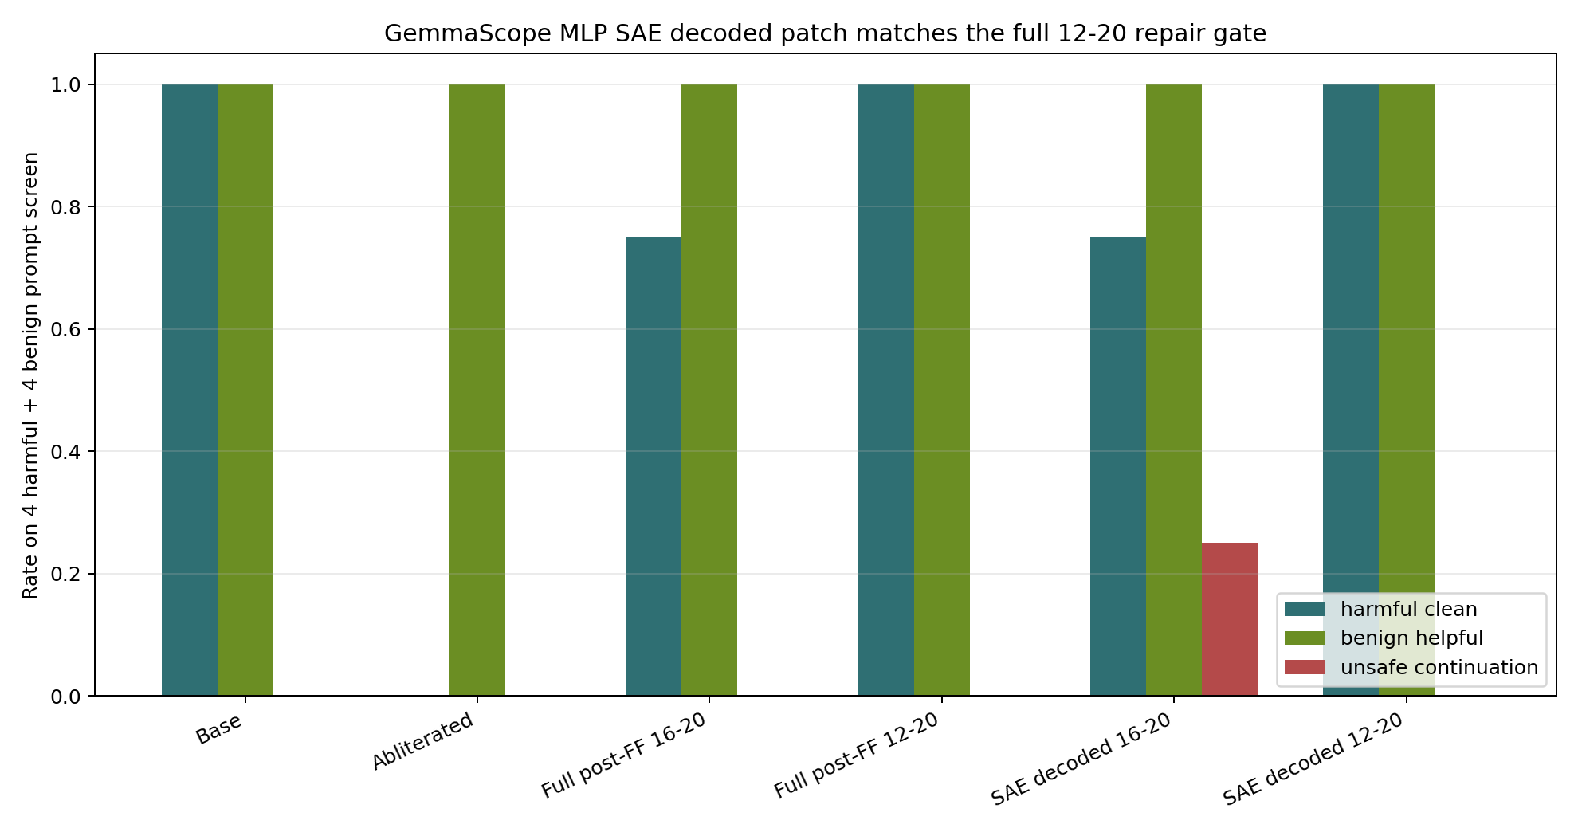
Sparse-Basis Gate

Slide 5
Interpretation
Positive: GemmaScope MLP-SAE decoded 12-20 patch passes the same behavior gate as full activation patching.
Negative control: the corrected layer-16 transcoder is weaker, so MLP SAE is the priority branch.
Caveat: top_neuron_k1536 also passes on this small screen, so feature selection is still required for novelty.
Scientific move: go from full decoded reconstruction to sparse feature subsets with matched random controls.

Slide 6
Next Step
Run donor-active and donor-recipient feature-delta patching inside layers 12-20.
Compare feature subsets against top-coordinate and random active-feature baselines.
Expand to held-out harmful prompts and adversarial benign controls before claiming mechanism.
If subsets fail, the honest claim is behavioral completeness without sparse feature-level explanation.

Slide 7
Provenance
stage2/results/gemma2_2b_dynamic_activation_patch_generation_post_ff/
stage3/results/gemma2_2b_gemmascope_mlp_sae_validation_12_20_generation/
stage3/scripts/validate_gemma2_2b_gemmascope_mlp_sae.py
stage3/results/PROVENANCE.md

