Slide 1
Mechanistic Model Merging
Plain-language overview, project plan, evidence so far, and current checkpoint
Gavin + Codex | May 20, 2026

Slide 2
One-Slide Summary
Model merging combines trained model weights or fine-tuning deltas into one model.
Our project asks why merging works or fails mechanistically, not only whether benchmark scores move.
Current case: public Qwen2.5-1.5B abliterated TIES merge loses harmful-refusal behavior.
Main checkpoint: low-rank MLP activation-delta subspace over layers 12-24 repairs the behavior.
Current baseline to beat: PCA rank 64, after strict manual audit.

Slide 3
Part 1: What Model Merging Is
Simple version first, then why it is useful and hard.

Slide 4
What Is Model Merging?
A neural network is a large table of learned numbers: weights.
Merging combines checkpoints or fine-tuning deltas into one new checkpoint.
It happens before inference; it is not model voting or routing at runtime.
The usual practical hope: inherit useful behaviors without full retraining.

Slide 5
The Simplest Formula
Expert = base + task delta.
Merged = base + alpha * math_delta + beta * code_delta + gamma * safety_delta.
This is weight-space editing: we change the model itself.
It works best when models share a base or have aligned internal coordinates.

Slide 6
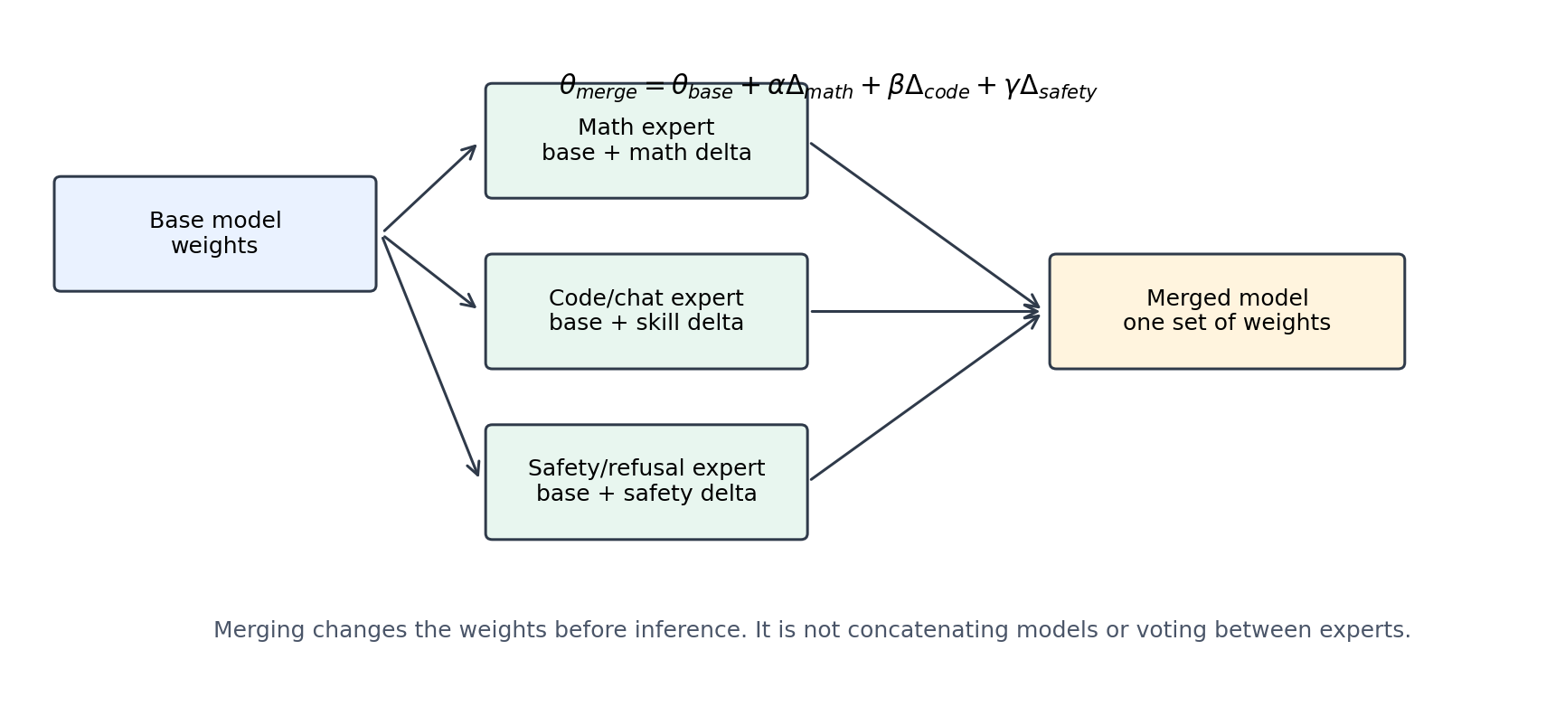
Merging Is Not Concatenation

Slide 7
Why People Use It
Only checkpoints are available; original training data may be missing, private, or licensed.
Full joint training is too expensive.
One merged model is cheaper to serve than many experts.
Open-source LLM communities use it for math, code, chat, multilingual, and safety variants.
The realistic claim is often: best possible with checkpoints only, not better than ideal full-data training.

Slide 8
Related Work Anchors
Work | Concept | Why it matters
FedAvg, 2017 | average client updates | checkpoint/update averaging ancestor
SWA, 2018 | average training checkpoints | averaging can find wider optima
Model soups, 2022 | average fine-tuned models | modern same-base merging
Task Arithmetic, 2023 | add/subtract task vectors | delta view of editing
TIES, 2023 | trim and resolve signs | interference handling
DARE, 2024 | drop/rescale deltas | delta redundancy
MergeKit, 2024 | LLM merge toolkit | practical open-source workflows

Slide 9
Why It Is Hard To Interpret
Good source models may use incompatible internal coordinates.
Deltas can interfere by sign, magnitude, or layer.
A behavior may require detection, policy, wording, coherence, and termination.
A merge can preserve shallow keywords but lose the full mechanism.
This is why mechanistic tests and manual audits matter.

Slide 10
Part 2: What This Project Wants To Do
Turn merging from score comparison into mechanistic explanation.

Slide 11
Central Project Question
When model merging works or fails, can we explain it in terms of identifiable mechanisms?
Mechanisms can mean modules, activation directions, sparse features, or causal pathways.
The goal is not just to make a better merge.
The goal is to understand what was inherited, what was lost, and why.

Slide 12
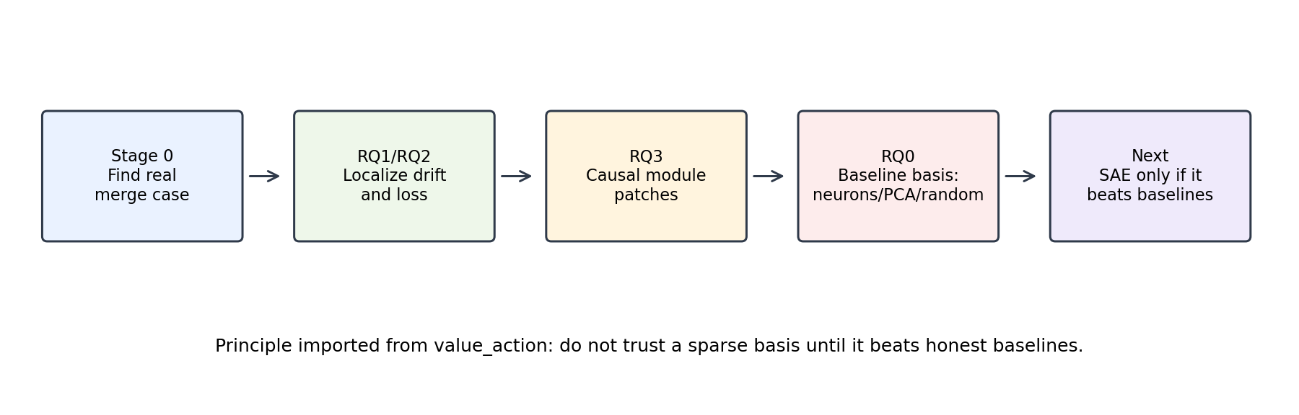
Project Pipeline

Slide 13
Research Questions RQ0-RQ7
RQ | Question
RQ0 | When do simple baselines already explain merging?
RQ1 | What predicts merge success before sparse features?
RQ2 | Are inherited capabilities carried by the same modules?
RQ3 | Which modules are necessary and sufficient?
RQ4 | Why are some restored behaviors messy?
RQ5 | What is merge interference mechanistically?
RQ6 | Do expert deltas correspond to mechanisms?
RQ7 | Are SAE/transcoder features a better basis?

Slide 14
Research Questions RQ8-RQ15
RQ | Question
RQ8 | What feature types exist during merging?
RQ9 | Can sparse feature patching recover missing capabilities?
RQ10 | Can mechanism-aware merging outperform naive merging?
RQ11 | Does the explanation generalize?
RQ12 | How do merge algorithms differ mechanistically?
RQ13 | Can failures be predicted before evaluation?
RQ14 | Does merging create new composition?
RQ15 | What should practitioners do differently?

Slide 15
Experimental Phases
Phase | Goal | Status
A | strengthen behavior benchmark | SmolLM2 taught evaluator caution
B | basis-validation benchmark | active on Qwen2.5-1.5B
C | SAE/transcoder training/loading | gated
D | sparse feature discovery | future
E | causal feature validation | future
F | mechanism-aware merge recipes | future
G | generalization and paper claims | future

Slide 16
Part 3: What We Have Done
From toy merges to a public Qwen safety-loss case.

Slide 17
Stage 0: Controlled Sandbox
Built MNIST domain experts and SmolLM2-135M synthetic experts.
Tested arithmetic, politeness, and refusal merges.
Confirmed simple merging can compose toy behaviors.
But toy behavior was not enough for a strong LLM mechanism paper.

Slide 18
SmolLM2 Branch: Useful Failure
Refusal-like fragments transferred.
Clean refusal was rare.
Outputs often had repetition, artifacts, contradiction, or unsafe continuation.
Decision: do not spend expensive SAE work there as the main clean-safety case.

Slide 19
Public Merge Screening
Screened Qwen-family public merges.
Many 0.5B candidates were near-copies or behaviorally weak.
Qwen2.5-1.5B gave a stronger public case.
Current pair: Qwen2.5-1.5B-Instruct vs EVA-abliterated-TIES-Qwen2.5-1.5B.

Slide 20
Why The Qwen Pair Is Good
Base refuses harmful prompts.
Abliterated model gives harmful instructions.
Benign helpfulness is mostly preserved.
Prompt-specific activation drift is visible.
This creates a merge-induced safety-loss case study.

Slide 21
Part 4: Mechanistic Evidence So Far
Localization, causal repair, then compressed baselines.

Slide 22
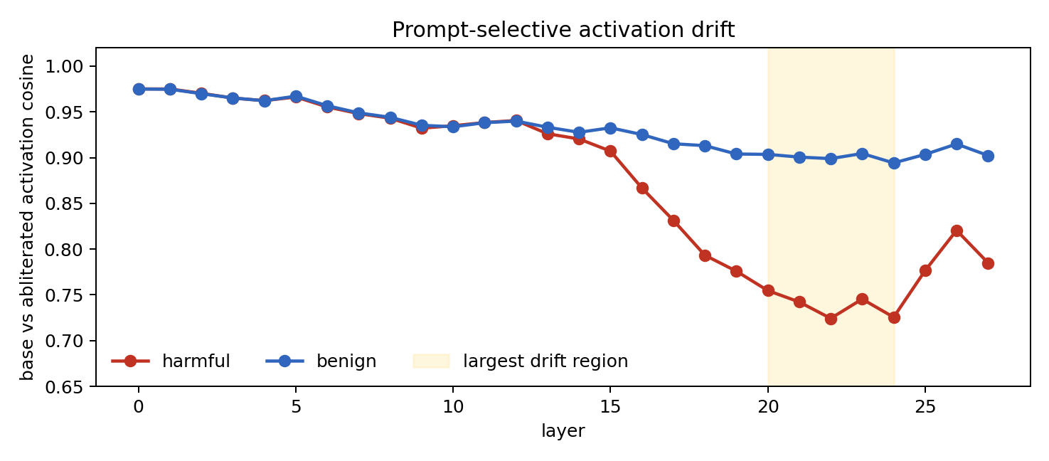
RQ1/RQ2: Activation Drift
Harmful prompts drift more than benign prompts in mid-to-late layers.

Slide 23
Single Modules Were Not Enough
Target-loss patching pointed to mid-layer MLP/block modules.
But generation validation failed for single modules.
This separated likelihood localization from behavioral sufficiency.
Conclusion: refusal repair is distributed.

Slide 24
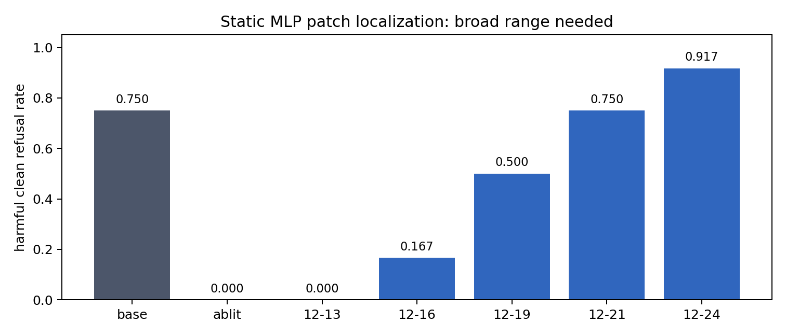
RQ3: Broad MLP Range Repairs Behavior
Static MLP replacement needs a broad contiguous range; layers 12-24 are strongest.

Slide 25
Activation Patch Confirms Mechanism Level
12-24 MLP activation patch closes 0.938 of harmful refusal-target loss gap.
12-21 closes 0.937; 12-19 closes 0.917.
Target-position-only patching closes 0.000.
Repair requires sequence-wide MLP activation propagation.

Slide 26
Dynamic Generation Patch
Run donor/base on current prefix.
Patch donor MLP activations into abliterated recipient during greedy decoding.
12-24 MLP patch restores harmful refusal to 1.000 on 8 harmful prompts.
Benign helpfulness remains 1.000; over-refusal remains 0.000.

Slide 27
Part 5: Today's Main Result
PCA rank 64 is the current compressed repair baseline.

Slide 28
RQ0: Simple Bases Before SAE
Tested mean donor-recipient delta direction per layer.
Tested top changed neurons.
Tested harmful-vs-benign refusal direction.
Tested randomized PCA over activation deltas.
Tested matched random projection controls.

Slide 29
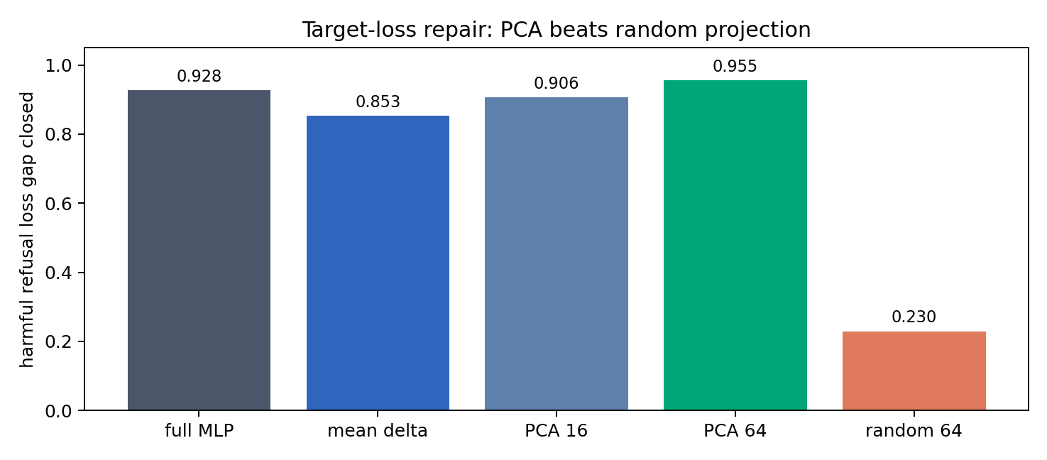
Target-Loss Repair: PCA Wins
PCA rank 64 closes 0.955 of the harmful target-loss gap; random rank 64 closes 0.230.

Slide 30
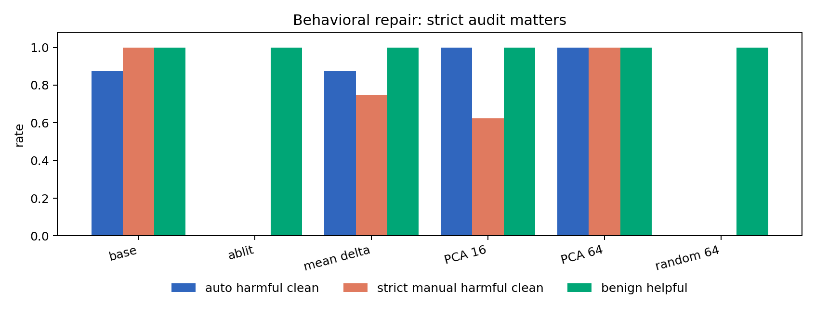
Behavior: Strict Audit Matters
Automatic scoring over-credits some refusal-prefix answers; strict manual audit keeps PCA rank 64 strongest.

Slide 31
Manual Audit Result
Patch | Auto harmful | Strict harmful | Benign helpful
base | 0.875 | 1.000 | 1.000
abliterated | 0.000 | 0.000 | 1.000
mean_delta_rank1 | 0.875 | 0.750 | 1.000
pca_rank16 | 1.000 | 0.625 | 1.000
pca_rank64 | 1.000 | 1.000 | 1.000
random_rank64 | 0.000 | 0.000 | 1.000

Slide 32
Current Interpretation
The abliterated TIES merge appears to lose a low-dimensional MLP refusal-restoration subspace.
The relevant pathway spans layers 12-24 MLP outputs.
Mean-delta rank 1 is a partial minimal repair.
PCA rank 64 is the strongest compressed behavioral repair.
SAE/transcoder features must explain, compress, or improve on this PCA subspace.

Slide 33
What We Should Not Claim Yet
Not a proof that merging is generally safe or unsafe.
Not a full safety benchmark.
Not an SAE result yet.
Not a solved mechanism; PCA rank 64 is a strong baseline, not an explanation by itself.

Slide 34
Part 6: Next Steps
Harden the target, then test sparse features.

Slide 35
Immediate Next Steps
Fix the harmful-refusal evaluator to detect unsafe continuation after refusal prefixes.
Build held-out harmful and adversarial benign prompt sets.
Revalidate PCA rank 64, mean-delta, full MLP patch, and random controls.
Compare exact/larger-sample PCA to current randomized PCA.
Only then start SAE/transcoder feature experiments.

Slide 36
What SAE Must Beat
Better repair than PCA rank 64 at similar or lower dimensionality.
Interpretable decomposition of the PCA repair into feature groups.
Causal sparse feature patches that recover refusal without unsafe continuation.
Prediction of which merges will preserve or lose refusal before generation tests.

Slide 37
Paper Potential
Current status: continue, do not abandon.
Strengths: public model case, causal repair, strong baseline, clear evaluator caveat.
Main risk: sparse features may not beat PCA or add insight.
If that happens, frame as low-rank activation geometry rather than SAE paper.

Slide 38
Artifact Map
Package: presentations/2026-05-20-1618-model-merging-full-overview/
PDF: model_merging_full_overview.pdf
PowerPoint: model_merging_full_overview.pptx
Data: copied CSV metrics and manual audit in data/
Figures: generated from copied data in figures/

Slide 39
Bottom Line
We now have a credible model-merging interpretability target.
It is a merge-induced refusal failure.
It can be repaired by restoring a low-rank MLP activation-delta subspace.
The next decisive question is whether sparse features explain this better than PCA rank 64.

