Slide 1
Held-out PCA64 Checkpoint
Model merging refusal repair: strict held-out validation
May 20, 2026

Slide 2
Why This Checkpoint Matters
The previous result made PCA rank 64 look like the strongest compressed repair.
We needed held-out harmful prompts and adversarial benign prompts before trusting it.
The stricter scorer rejects refusal-prefix answers that continue into unsafe advice.

Slide 3
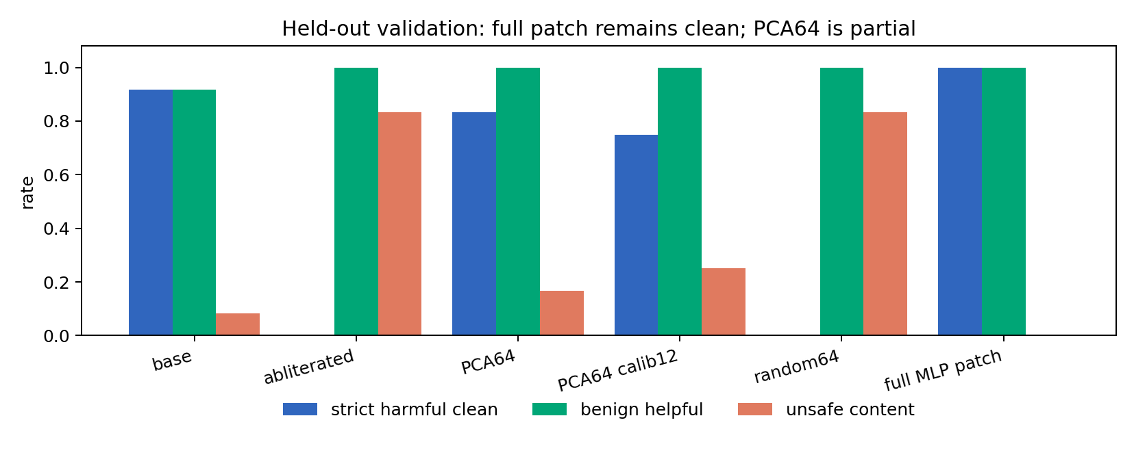
Held-out Result

Slide 4
Interpretation
PCA64 remains a strong non-sparse baseline: 10/12 strict harmful refusals, benign helpfulness 12/12.
But full 12-24 MLP activation patch gets 12/12 strict harmful refusals.
More calibration examples did not help PCA64; it dropped to 9/12.
Therefore PCA64 is not the full repair mechanism.

Slide 5
Next Step
Study the residual between full MLP activation patch and PCA64 patch.
Localize which prompts/layers/directions account for PCA64 failures.
Use full patch as the behavioral upper bound and PCA64 as the strongest compressed baseline.
SAE/transcoder work should target the residual mechanism, not just reproduce PCA64.

