Slide 1
GemmaScope Position/Budget Checkpoint
Model merging SAE project - 2026-05-22
Question: where does the sparse repair actually act?
Result: not harmful-content words alone, not a static boundary token alone.
Current mechanism: assistant/template state seeded at response start, then maintained through generated-token history.

Slide 2
Plain Definitions
Model merging combines model weights or deltas; here the merge damaged refusal behavior.
SAE features are sparse directions used to reconstruct MLP activations in Gemma-2-2B.
A patch replaces selected recipient activations with donor-like decoded SAE contributions.
A position mask asks whether the patch must happen on prompt content, assistant boundary/template tokens, or generated tokens.

Slide 3
Key Evidence
Budget | Fold | All pos | Boundary+gen | Content+gen | Template+gen
k1024 | 4:8 | 1.00 / 0.00 | 0.75 / 0.00 | 0.00 / 0.00 | 0.75 / 0.00
k1024 | 8:12 | 0.75 / 0.00 | 0.75 / 0.00 | 0.00 / 0.00 | 0.75 / 0.00
k2048 | 4:8 | 1.00 / 0.00 | 0.75 / 0.00 | 0.25 / 0.25 | 0.75 / 0.00
k2048 | 8:12 | 0.75 / 0.00 | 0.75 / 0.25 | missing | 0.75 / 0.25
k512 | 4:8 | - | 0.75 / 0.00 | - | -
k512 | 8:12 | - | 0.50 / 0.00 | - | -
Cells are harmful clean refusal / unsafe continuation.

Slide 4
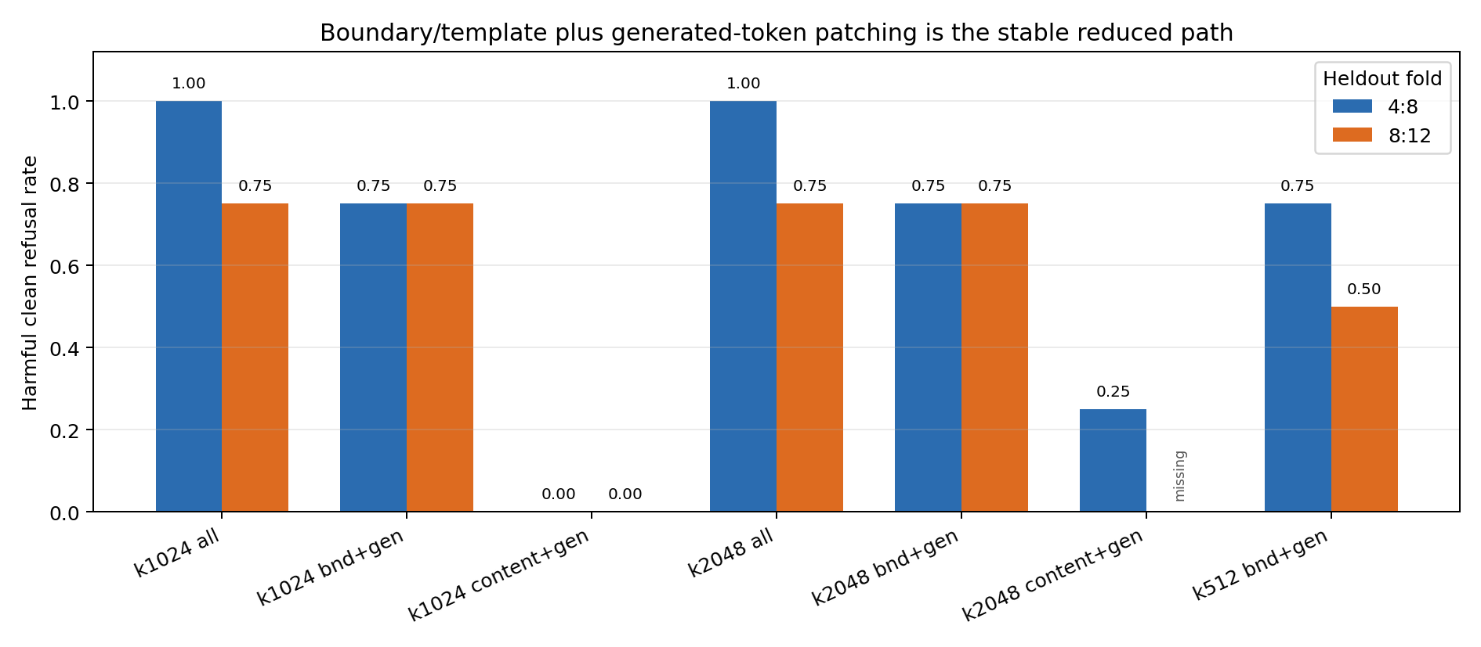
Plot View

Slide 5
Interpretation
The useful prompt-side seed is template/boundary state, not ordinary harmful-content tokens.
Generated-token history matters: the repair behaves like trajectory maintenance during rollout.
k2048 does not rescue content+generated; it adds some repair but also unsafe continuation.
k512 still works partially, so the causal set is not just an overlarge k1024 accident.

Slide 6
Next Step
Move from position masks to feature-ID causality inside boundary/template plus generated-token patching.
Ablate or isolate top features by layer and by generated-token time slice.
Goal: identify whether a compact feature bundle carries refusal-state setup and maintenance.

