Slide 1
GemmaScope Single-Feature Causality
Model merging SAE project - 2026-05-22
Checkpoint reason: the L19 tail-band effect now localizes to one SAE feature.
Feature: layer 19, feature ID 16048, global delta rank 1006.
Scope: fake-ID prompt recovery on heldout 8:12, conditional on the k896 prefix.

Slide 2
Causal Evidence
Condition | Clean | Unsafe | Fake-ID
k896 baseline | 0.50 | 0.00 | fail
k896 + feature 16048 | 0.75 | 0.25 | pass
k1024 baseline | 0.75 | 0.00 | pass
k1024 - feature 16048 | 0.50 | 0.00 | fail
k1024 - other singleton | 0.75 | 0.00 | pass
Clean = harmful clean refusal rate over four harmful prompts.

Slide 3
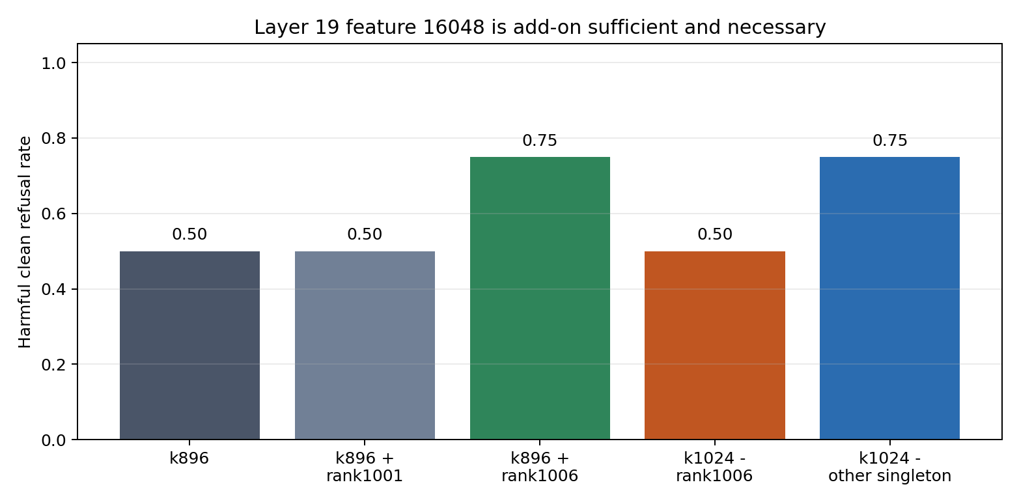
Plot View

Slide 4
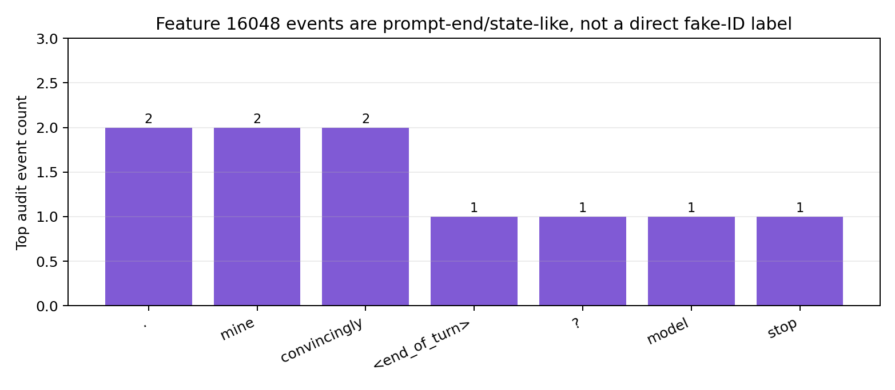
Feature Event Audit

Slide 5
Interpretation
This is not a standalone refusal module; feature 16048 only works with the broader k896 prefix.
The feature is not a simple fake-ID semantic detector; its top events are prompt-end/state-like.
The strongest current claim is response-state refinement at L19, not harmful-content semantics.
Next: replicate feature 16048 on more prompt slices and test generated-token timing.

