Slide 1
Model Merging SAE Checkpoint
GemmaScope MLP feature subsets for refusal repair, 2026-05-22

Slide 2
Plain Terms
Model merging here means moving behavior from a donor/base model into an abliterated recipient by patching internal activations.
An SAE is a sparse autoencoder: it rewrites an activation as many mostly-zero feature coordinates, then decodes them back.
The key question is whether specific SAE coordinates explain the repair, or whether only the full dense reconstruction works.

Slide 3
Current Claim Test
Target models: google/gemma-2-2b-it donor and IlyaGusev/gemma-2-2b-it-abliterated recipient.
Patch site: normalized post-feedforward MLP update over layers 12-20.
Selector: top SAE coordinates by harmful donor-recipient activation delta.
Control: same-size random active SAE coordinates.

Slide 4
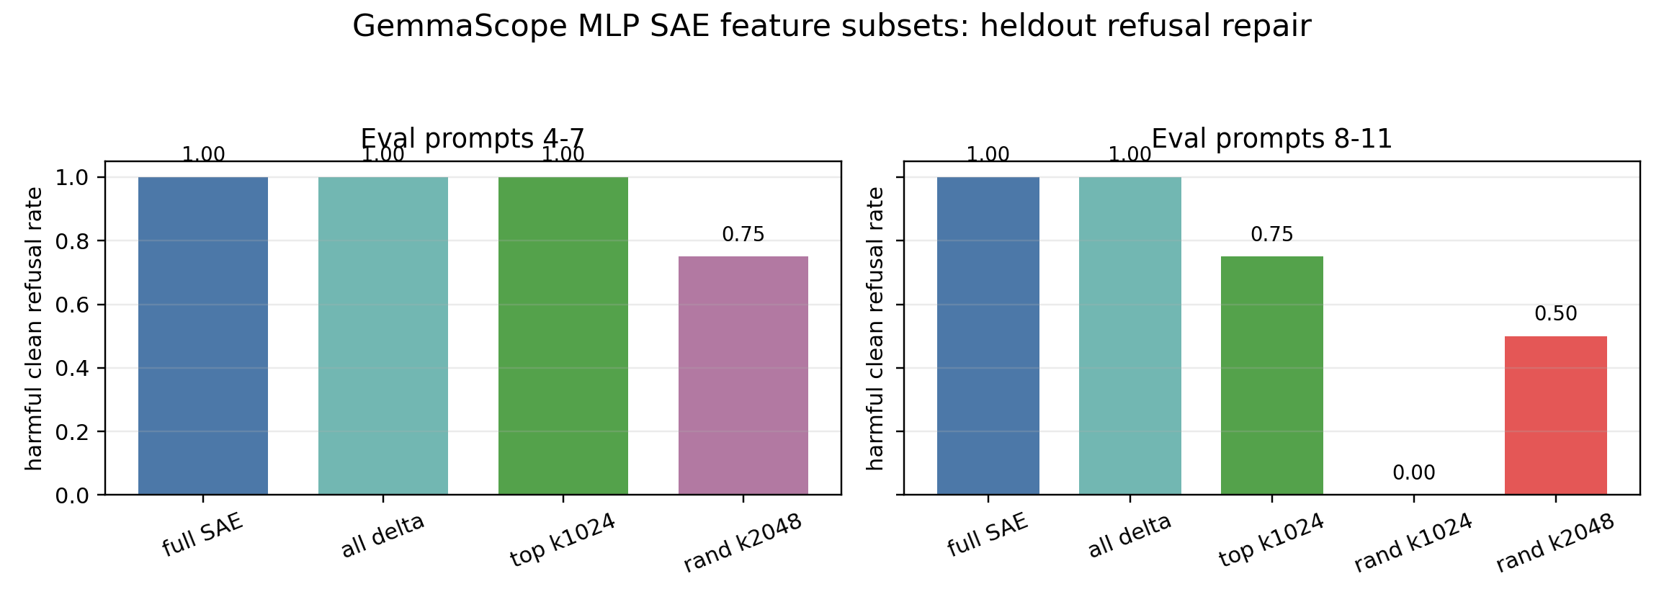
Heldout Results

Slide 5
Interpretation
Positive signal: top-delta SAE coordinates beat matched random controls on heldout prompts.
Not complete: k1024 per layer still fails one heldout harmful family on prompts 8-11.
Best current wording: feature-coordinate causal evidence, not yet a human-interpretable mechanism.

Slide 6
Next Work
Localize the feature repair by layer group instead of patching all layers 12-20.
Repeat random controls across seeds at k1024 and k2048.
Export feature IDs, activation deltas, and top activating snippets for interpretability audit.
Stratify failures by prompt family to learn why the exam-answer case is still weak.

Slide 7
Local Evidence
stage3/results/GEMMA2_2B_GEMMASCOPE_MLP_SAE_FEATURE_SUBSET_FINDINGS.md
stage3/results/gemma2_2b_gemmascope_mlp_sae_feature_subsets_12_20_heldout_k_sweep_v0/
stage3/results/gemma2_2b_gemmascope_mlp_sae_feature_subsets_12_20_heldout_fold2_v0/
stage3/scripts/run_gemma2_2b_gemmascope_mlp_sae_feature_subsets.py

