Slide 1
GemmaScope boundary-vs-content checkpoint
Model-merging SAE project, 2026-05-22
Question: are the successful sparse SAE patches content semantics, or response-start state?
Short answer: current evidence points to response-boundary refusal-state transfer.
This is a reframe, not a dead end: it gives a sharper causal test for the next step.
Source package: presentations/2026-05-22-1525-gemmascope-boundary-content

Slide 2
Plain-language setup
Model merging: combine two or more trained model weight sets without retraining on all original data.
Our pair: a normal Gemma-2-2B-it donor and an abliterated Gemma-2-2B-it recipient.
Patch test: temporarily replace selected internal recipient activations with donor-like SAE reconstructions.
SAE feature: a sparse coordinate in a learned dictionary; useful only if it explains or controls behavior.
Terms are simplified for decision-making; exact artifacts are listed on the provenance slide.

Slide 3
Where this fits in the project
Known: full donor post-FF patch over layers 12-20 repairs harmful refusal while keeping benign helpfulness.
Known: full decoded GemmaScope MLP-SAE patch over 12-20 also repairs behavior.
Recent: top-delta feature subsets beat random active-feature controls, especially all 12-20 and 15-20.
New: the top-delta events mostly occur at the assistant response boundary, not ordinary prompt words.
This changes the proposed mechanism we should test next.

Slide 4
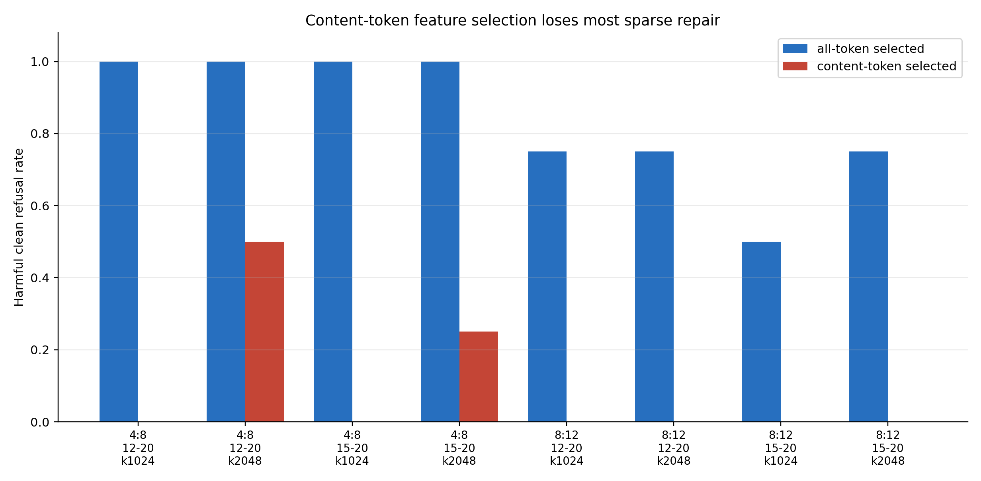
Main quantitative comparison
Y-axis: harmful clean refusal rate on heldout prompts; higher is better.

Slide 5
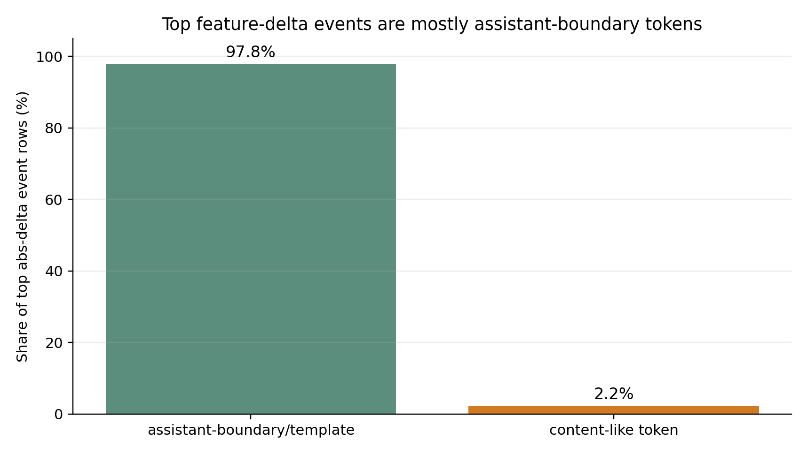
Event audit
All-token audit: 2817 / 2880 top abs-delta rows are boundary/template tokens.
Most frequent top tokens: \\n, model, <end_of_turn>, <start_of_turn>, ..
Content-selected features activate on harmful words, but the causal repair mostly disappears.
Boundary means role/special/newline tokens around the assistant response start.

Slide 6
Interpretation
Result: strongest sparse repair is not yet a clean harmful-content semantic feature story.
Hypothesis: the merge/abliteration weakens a donor-like refusal-mode setup at assistant start.
Speculation: prompt harmfulness features may exist, but they are weak causal handles unless response state is set.
Caveat: current filter changes feature selection; it does not yet prove the runtime patch location.
The caveat is why the next experiment is position-restricted patching.

Slide 7
Next decisive test
Use the same successful all-token selected features.
Patch only assistant-boundary positions, only content positions, and all positions.
If boundary-only works and content-only fails, the paper claim becomes response-boundary state transfer.
If content-only works, the current audit was misleading and semantic prompt features remain viable.
This is the highest-value next branch before broader sweeps.

Slide 8
Provenance
Finding memo: stage3/results/GEMMA2_2B_GEMMASCOPE_MLP_SAE_BOUNDARY_VS_CONTENT_FINDINGS.md
Source metrics: data/all_token_random_seed_metrics.csv and data/content_token_random_seed_metrics.csv
Source events: data/all_token_feature_events.jsonl and data/content_token_feature_events.jsonl
Generated tables: data/boundary_content_comparison.csv and data/all_token_abs_delta_event_categories.csv
Deck source: gemmascope_boundary_content_checkpoint.tex and this PPTX package.
All paths above are local to the repository/package.

