Slide 1
GemmaScope position-restricted checkpoint
Model-merging SAE project, 2026-05-22
Question: where must the same selected SAE features be patched to restore refusal?
Short answer: not content tokens, and not a static assistant boundary alone.
Best reduced mechanism: assistant boundary seed plus generated-token trajectory maintenance.
Package: presentations/2026-05-22-1644-gemmascope-position-restricted

Slide 2
Why this changes the claim
Earlier audit: top feature deltas were concentrated on assistant-boundary/template tokens.
New causal test: boundary-only patching fails, so the audit location alone is not sufficient.
Generated-token history alone also fails, so rollout maintenance needs a prompt-side seed.
Content-token conditions remain weak, including content plus generated history.
Same all-token top-delta k1024 features are used across modes.

Slide 3
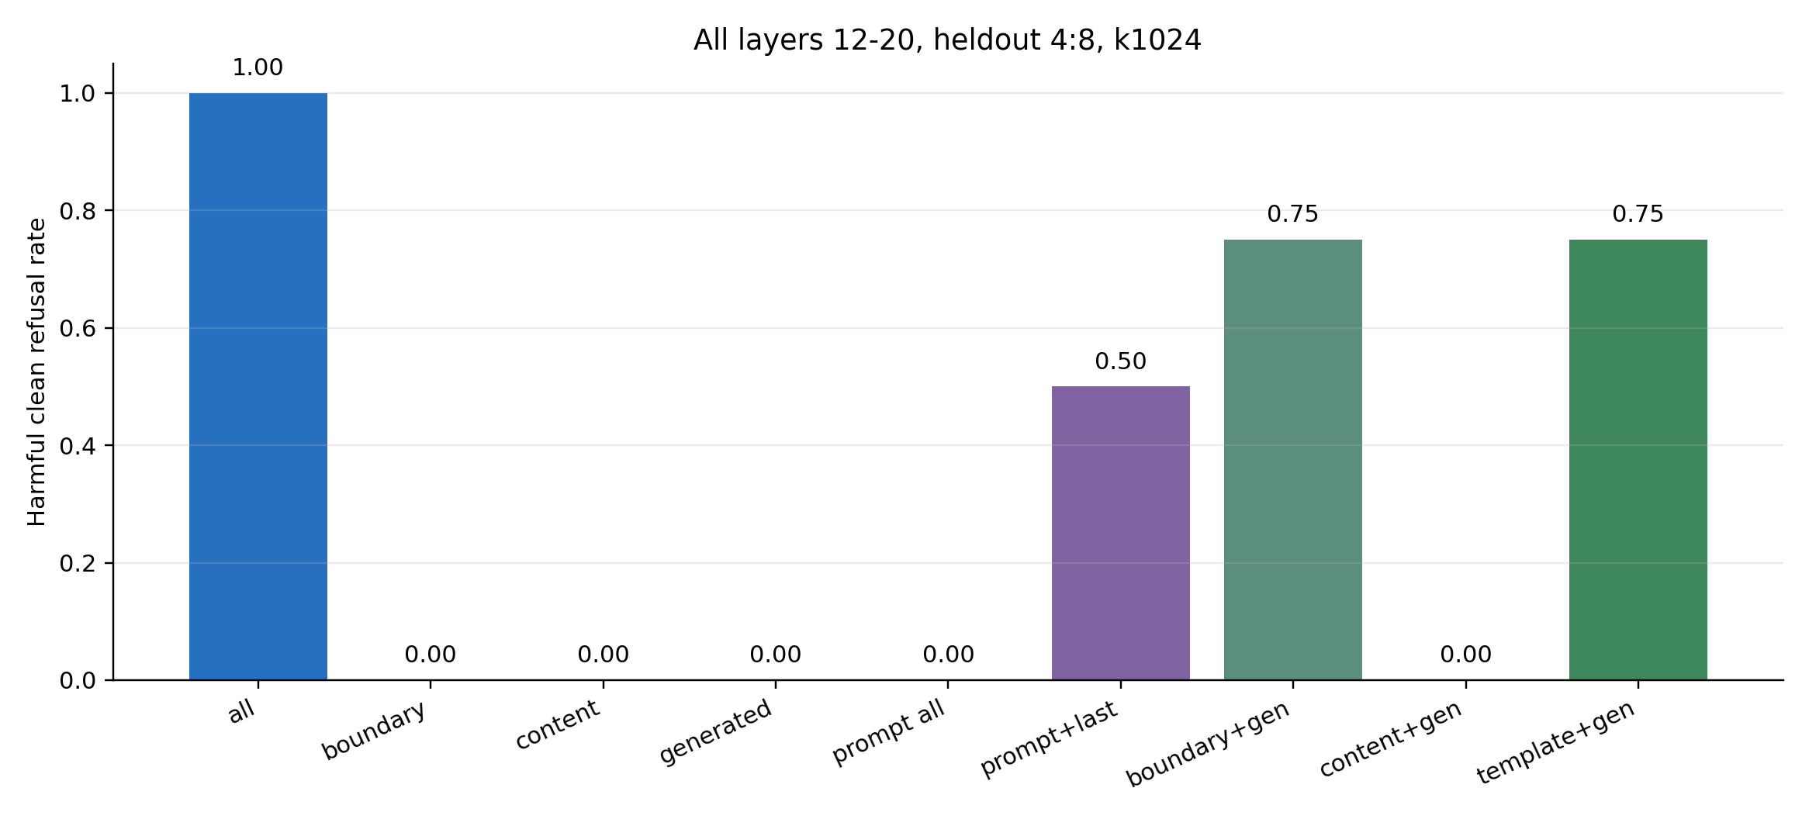
Heldout 4:8
Y-axis: harmful clean refusal rate; benign helpfulness is 1.000 for all rows.

Slide 4
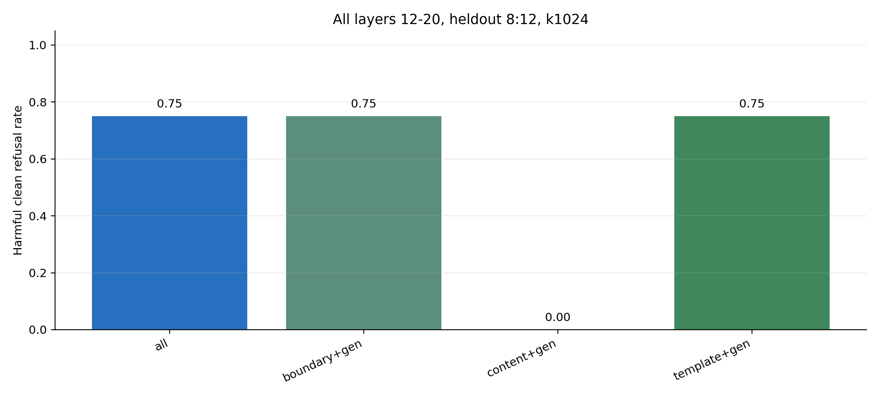
Heldout 8:12
Boundary+generated and template+generated match all-position repair on this fold.

Slide 5
Interpretation
Mechanism candidate: an autoregressive refusal-state trajectory.
Prompt-side seed: assistant/template boundary state, not ordinary harmful-content tokens.
Rollout maintenance: selected donor-like SAE coordinates must continue on generated-token history.
Paper framing: model merging can lose a response-state maintenance process, not only a concept feature.
This is stronger than the previous boundary audit because it is causal.

Slide 6
Next experiment
Repeat the same reduced modes at k2048 to check budget sensitivity.
Audit exact top features that survive boundary+generated repair.
Patch generated-token history by time step to find whether refusal needs early or sustained maintenance.
Then move from position causality to feature-ID causality.
Local summary: data/GEMMA2_2B_GEMMASCOPE_MLP_SAE_POSITION_RESTRICTED_SUMMARY.md

