Slide 1


GitHub is a cloud-based hosting service that lets you manage Git repositories

Slide 2
Benefits of GitHub
It makes it easy to contribute to your open source projects
Documentation
Showcase your work
Track changes in your code across versions
Enable effective collaboration
Easy evaluation of each other’s work

Slide 3
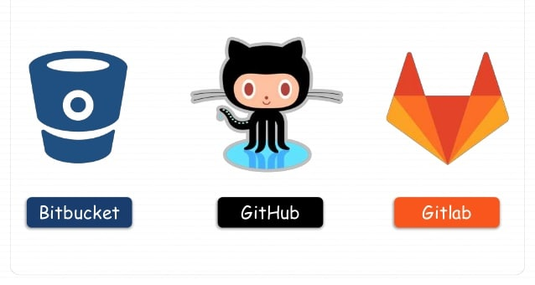
Why GitHub so popular
Powerful community
The largest shared repository
Easy version control
Secure cloud storage

Slide 4

Microsoft is number 1 contributor of GitHub
Google IBM, SAP, PayPal and may companies are also contributing
According to GitHub, Microsoft is in a whole other universe of contributions with their high impact on the open source landscape through their large contributions to projects, estimated to be at around 4,550 contributors.

Slide 5
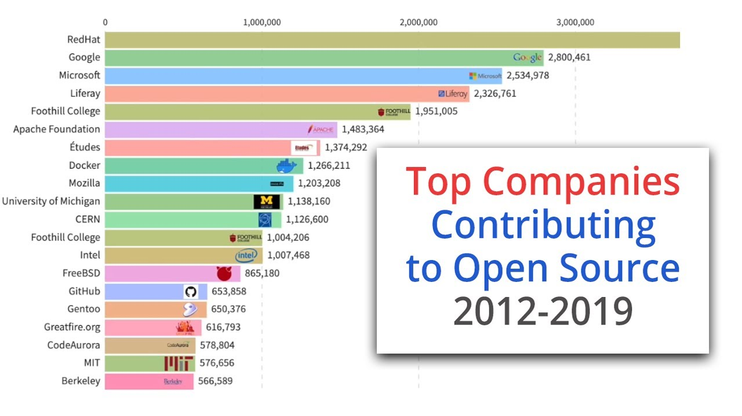

Slide 6

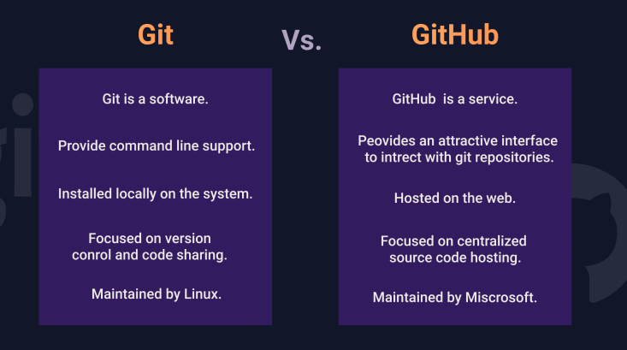
GitHub is a cloud-based hosting service that lets you manage Git repositories
Git is a version control system that lets you manage and keep track of your source code history.

Slide 7
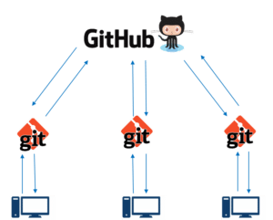
Git pushes or pull data from the central server
GitHub is a core hosting platform for version control collaboration
GitHub is a company that allows you to host a central repository in a remote server

Slide 8

Repository:
Storage space for your project
GitHub is very popular central repository that allows you to share your files
Push your local repo into GitHub and share it with other collaboration via the central repo
Commit:
Records changes to one or more file in your branch
Git Assigns each commit a unique ID, call SHA or hash, that identifies the specific changes

Slide 9


Branch:
Branch allow you to work on other features
They can be included with the main line of your project
The main branch – the one where all changes eventually get merged back into, and it’s called Master Branch
Open & Merge Pull Request
Notifies developers about changes you have pushed to a branch in repository
Acknowledge and Review changes
You can create a pull request on

