Slide 1


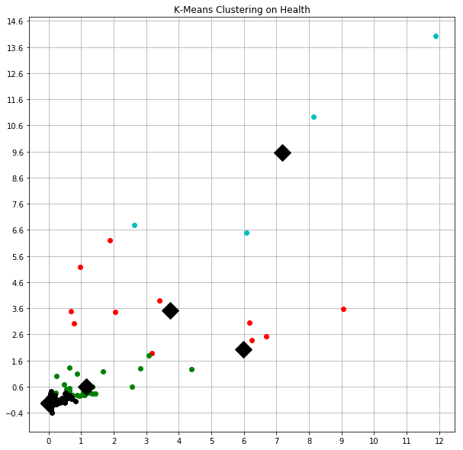
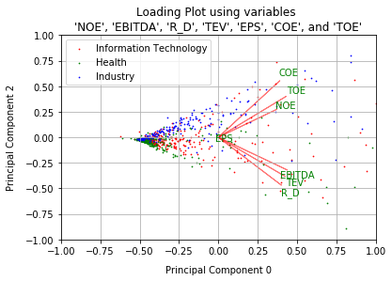
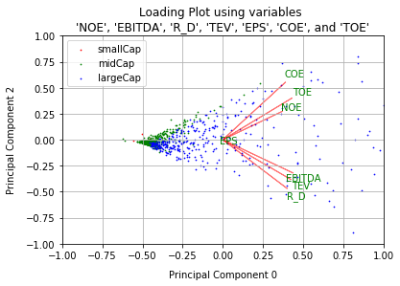
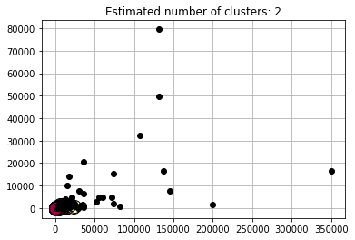
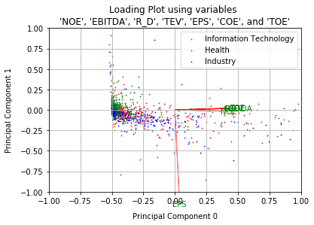
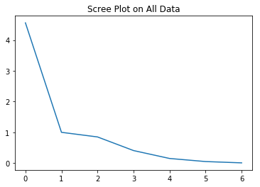
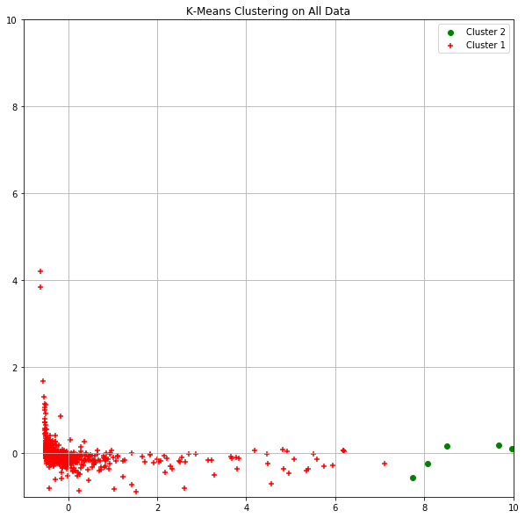
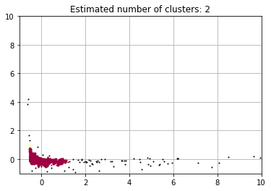
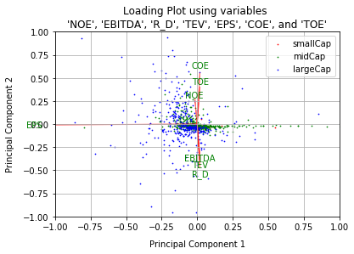
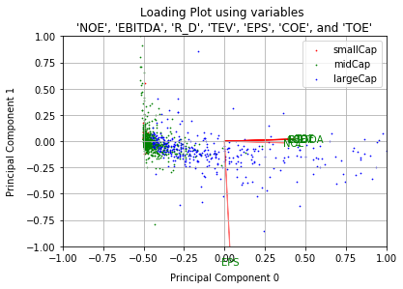
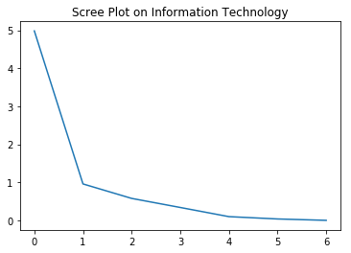
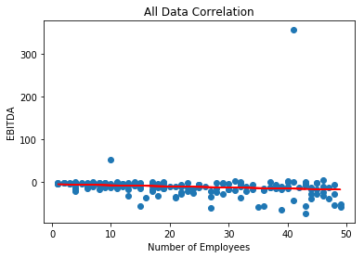
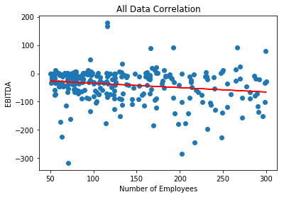
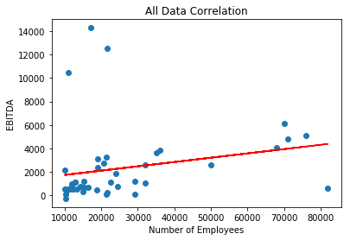
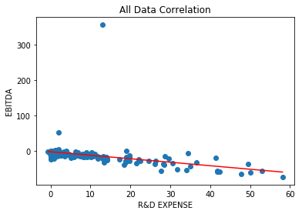
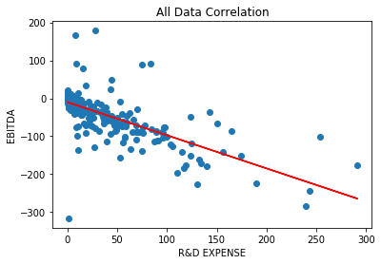
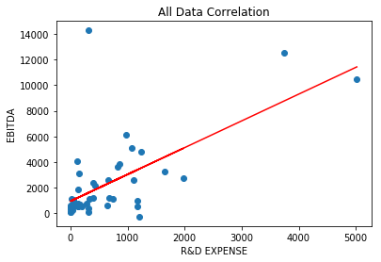
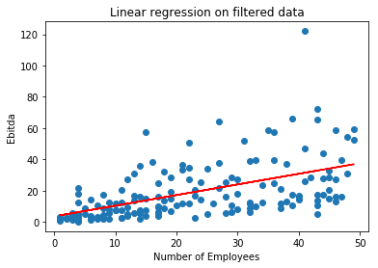
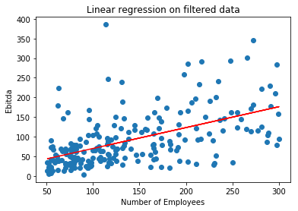
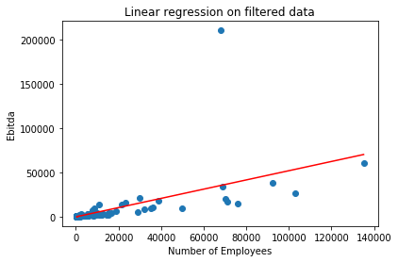
Preparing your poster for printing:
Go to File > Save As. Under Save as type (Windows) or Format (OS X), select PDF.
Open the PDF in Adobe Photoshop. Go to File > Save As. Under Format, select JPEG or TIFF. Choose a location and file name for your file and click Save. Click OK on the default save settings.
DO NOT SAVE TO A JPEG OR TIFF FROM POWERPOINT!
Identifying the Relationship between Business Operations and Success
Aaron Goh, Ritesh Sharma
aaronwgoh5@gmail.com ∙ sharrite@isu.edu
Introduction
Methods
Conclusion
Find a correlation between business operation metrics and business’ operation performance
Investors are always trying to find more metrics to estimate the performance of a business.
Businesses are seeking to determine correlative metrics to better assist their growth
Clustered through DBSCAN/K-means on companies with all its fields
PCA - reduced into 3 dimensions containing 93% of original information
PCA on subset of industries (Health, IT, and Industry)
Used new PCA dimensions and clustered with DBSCAN/K-means
Ran Linear Regression relating EBITDA with R&D, Number of Employees
Ran Linear Regression relating Total Operating Expense with R&D, Number of Employees
Ran Linear Regression on data filtered through DBSCAN/K-means keeping the data tied to original fields
Slightly negative/no correlation between number of employees and EBITDA
Negative correlation between R&D and EBITDA for small-size companies and mid-size companies
Slightly Positive Correlation for Large Companies regarding EBITDA and R&D
Weak/no correlation between EBITDA and Number of Employees for large companies
Weak/no correlation between Expenses and Number of Employees for all company sizes due to high variance
EPS projected through PCA suggests less correlation with all the other fields – May be worth looking into EPS as a separate entity for predictors in the future
Analysis
Initial Clustering
PCA
Data Collection
Data was collected from CapIQ
Rows with missing fields were removed
Initially attempted to collect marketing expense but found most companies did not report it
Analyze Business Success Factors:
NOE = Number of Employees -
Global (Latest)
R_D = R&D Expense [LTM]
($USDmm, Historical rate)
COE = Cost Of Revenues [LTM]
($USDmm, Historical rate)
TOE = Total Operating Expenses [LTM] ($USDmm, Historical rate)
In Relation to Metrics of "success":
EPS = Basic EPS [LTM]
($USD, Historical rate)
TEV = Total Enterprise Value [Latest] ($USDmm, Historical rate)
EBITDA = EBITDA [LTM]
($USDmm, Historical rate)
Final Clustering
Regression
Notes
Small Company
Mid Company
Large Company
Highly spread data with larger companies in most datasets leading to larger variance – Weak Conclusions for larger companies
After filtering/binning, most data reflect small/mid-sized companies
EBITDA vs Number of Employees (Filtered)
 | Small | Mid | Large
Standard Deviation | 14.673 | 55.235 | 13759.149
Mean squared errors | 240.965 | 3327.895 | 185285.079
Coefficient | 0.679 | 0.532 | 0.521
EBITDA vs Number of Employees
 | Small | Mid | Large
Standard Deviation | 23.767 | 50.921 | 2605.306
Mean squared errors | 827.343 | 1811.117 | 56184.003
Coefficient | -0.982 | -0.873 | 2.089
Acknowledgements
R&D Expense vs Number of Employees
 | Small | Mid | Large
Standard Deviation | 23.7666 | 50.921 | 2605.306
Mean squared errors | 827.343 | 1811.117 | 56184.003
Coefficient | -0.982 | -0.873 | 2.089
Prof. Phillips, Data Mining Professor
William Wang, Student Investment Fund

