Slide 1
Project Presentation of Industry Oriented Hands on Experience (22CS422)
On
Voice Activated virtual Assistant (jarvis)
Ritesh Duhan
2211981307
Supervised By
Swati Goel
Department of Computer Science and Engineering,
Chitkara University, Punjab

Slide 2
Introduction
Artificial Intelligence is transforming modern computing systems by enabling machines to perform intelligent tasks such as speech recognition , automation, decision making, and natural language communication.
The objective of this project is to develop an ai-powered virtual assistant named jarvis using python and streamlit. The assistant can interact with through voice commands and perform various real-time tasks such as opening websites, providing weather updates, capturing screenshots, playing music, accessing the camera and interaction with a locally hosted AI model
The assistant operate completely in local environment, ensuring privacy, offline functionality, and faster response times
‹#›

Slide 3
Objectives of the Project
Objective :
The major objectives of the project are:
To design a smart voice-controlled AI assistant.
To implement speech recognition for user interaction.
To integrate local AI processing using Phi-3 through ollama.
To automate daily computer operations.
To provide a user-friendly graphical interface using streamlit.
To perform real-time functionalities such as :
Weather updates
News fetching
Music playback
Screenshot capturing
Camera access
To create a privacy-focused offline assistant system.

Slide 4
Technology Used
Technology Used :
Python : Core programming language
Streamlit : User Interface development
Speech recognition : voice input processing
Ollama : Running local AI models
Phi3 : AI language model
gTTs : Text-to-speech conversion
Pygame : Audio Playback
OpenCv : Camera operations
PyAutoGUI : screenshot automation
PSUtil : System monitoring
Requests API : weather and news fetching

Slide 5
System working/Methodology
System Methodology:
The Jarvis assistant follows the following workflow:
Users initializes the system.
The microphone continuously listens for the wake word jarvis
Speech recognition coverts voice to texts.
The command is processed using python logic.
Depending on the command :
1. websites are opened.
2. system operations are performed.
3. AI responses are generated. 4. APIs are called.
Output is converted into speech using gTTs.
The response is displayed on the Streamlit interface.

Slide 6
Project Features
Features of Jarvis Ai assistant
Core features :
voice command recognition
AI-generated intelligent responses
Wake=word activation(“jarvis”)
Automation features :
open google , Youtube , Linkedin , Facebook
Screenshot Capture
Camera photo capture
Focus mode Activation
Workspace cleaning
Information Services :
Weather updates
Latest news headlines
System status monitoring

Slide 7
Project Features
Entertainment Features :
Music playbook
WhatsApp messaging support
Security & privacy :
Offline Ai model execution
Local data processing
No cloud dependency

Slide 8
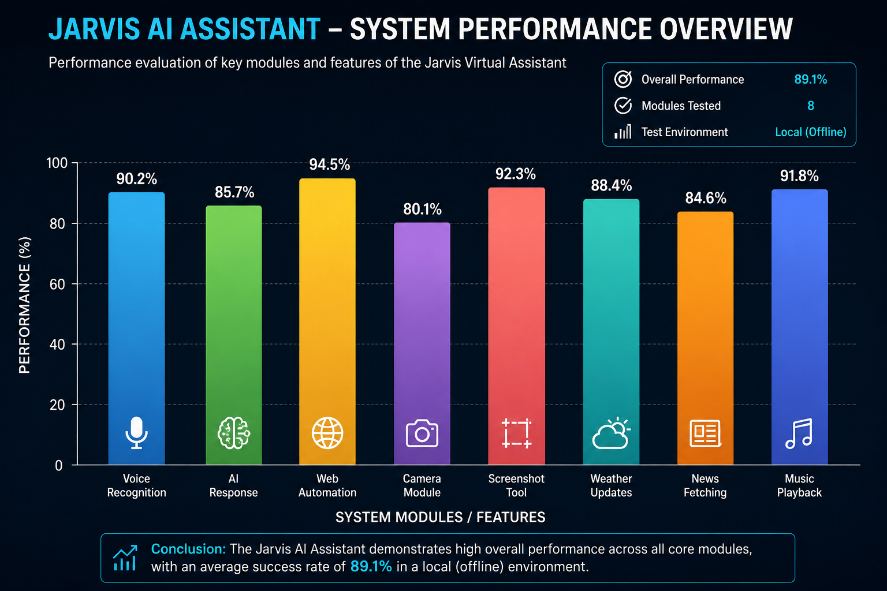
Performance Analysis

Slide 9
Performance Analysis
System Performance Analysis
The performance evaluation demonstrates that the jarvis AI Assistant performs efficiency across multiple modules including voice recognition , AI response generation, web automations, screenshot handling, And multimedia operations. The system achieved high performance scores in local execution environments, indication stable and responsive behavior
Overall performance :
Average Success Rate: 89.1%
Environment: Local (offline)
AI Model: phi-3 ollama
Interface: Streamlit

Slide 10
Challenging Faced
Challenging Faced During development
Integrating speech recognition with Streamlit
managing real-time microphone input
Handling local AI response latency
Audio playback synchronization issues.
APIs connectivity and timeout handling.
managing continuous listening loops.
Resource optimization for local executio.

Slide 11
Future Scope
Future Scope
The project can be enhanced further by implementing:
Facial recognition authentication
smart home device integration
Multi-language support
Advanced conversational memory
Mobile application support
Cloud synchronization
Real-time chatbot integration
AI-based scheduling and reminders
The assistant can also be extended for enterprise Automation and personal productivity applications

Slide 12
Conclusion
The Jarvis AI assistant project successfully demonstrates the practical implementation of artificial intelligence, voice recognition, and automation technologies in a real-world application.
The assistant is capable of perform multiple tasks through voice interaction while maintaining privacy through local AI execution.
The project enhanced understanding of :
AI integration
Automation Systems
Speech recognition
Python Development
User interface design
The project proves that AI-powered assistants can significantly improve productivity, accessibility, user interaction in modern computing environments

Slide 13
Thank You
Presented By :
Ritesh Duhan
Department of Computer Science and Engineering
Chitkara University
‹#›

