Slide 1
Ritesh Kashyap -121163
Case Study – Assignment

Slide 2
Frontend Stack
Core
React JS(16.3)
Redux
Redux Saga
React-JSS(for CSS)
Build Tools
Webpack(No Boilerplate)
ES Lint
Husky (pre commit)
Ritesh Kashyap

Slide 3
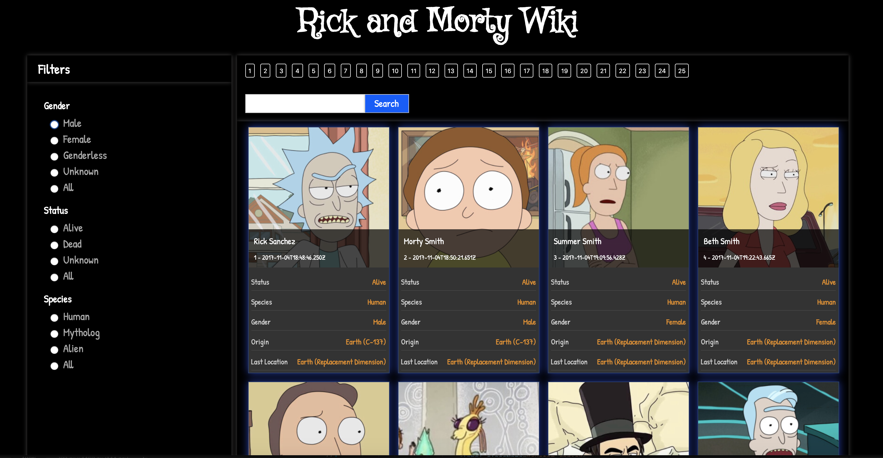
Screens

Slide 4
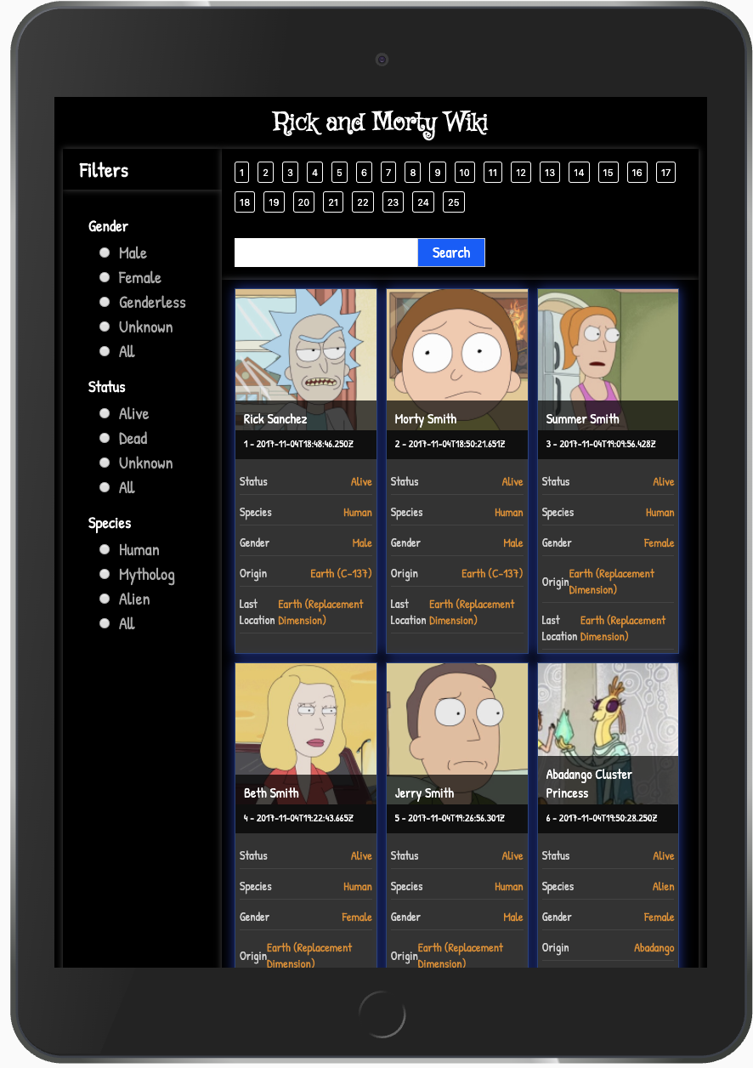
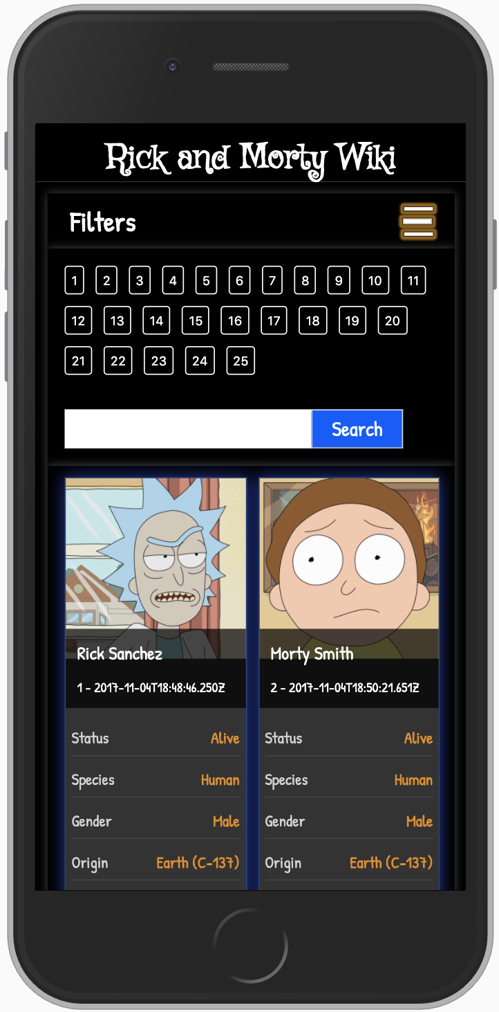
Screens

