Slide 1

A SURVEY ON PREDICTIVE HEALTHCARE ANALYTICS BASED ON AI/ML Presented By: Group No.24IT732 Ritesh Kumar (2100970130093) Udit Maurya (2100970130117) Vishal Yadav(2100970130127) Guide Name: Dr. Javed Miya
Department of Information
Technology

Slide 2
Outline
Department of Information Technology
Introduction
Literature Survey
Problem Statement
Gap Identification
Methodology
Hardware & Software Requirements
Result
Conclusion
References

Slide 3
Introduction
Department of Information Technology
Predictive analytics is indeed a critical discipline in the realm of data analytics, particularly in healthcare, where it holds immense potential to revolutionize patient care, operational efficiency, and disease management.
The concept of autonomic computing, introduced by IBM in 2001, aims to build systems that can operate with minimal human intervention by exhibiting self-management properties.
These properties typically include:
Self-Configuration: Systems should automatically configure and reconfigure themselves based on changing conditions and requirements.
Self-Optimization: Systems should continuously tune and optimize their performance to ensure efficient operation and resource utilization.
Self-Healing: Systems should detect and resolve faults or problems autonomously without requiring human intervention.
Self-Protection: Systems should anticipate, detect, and protect themselves against various security threats and attacks.
The ultimate goal of autonomic computing is to create more robust, reliable, and adaptive computing systems that can handle complexities and changes in their environment without constant human oversight.

Slide 4
Literature Survey
Department of Information Technology
The field of predictive healthcare analytics, empowered by Artificial Intelligence (AI) and Machine Learning (ML) techniques, has witnessed exponential growth and garnered considerable attention in recent years. This literature review aims to provide a comprehensive overview of the current methodologies, applications, challenges, and future directions in predictive healthcare analytics using AI/ML.
The fusion of AI/ML and autonomic computing empowers healthcare analytics. It adapts, self-manages, and learns continuously, improving predictive capabilities. This survey delves into their role in predicting patient outcomes, disease trends, and real-time insights, shedding light on their transformative potential in healthcare decision support systems.

Slide 5
Problem statement
Department of Information Technology
The healthcare industry generates an immense amount of data through patient records, clinical trials, wearable devices, and other sources. However, much of this data remains underutilized due to the complexities involved in its analysis. Predictive healthcare analytics, which leverages Artificial Intelligence (AI) and Machine Learning (ML), offers the potential to transform raw data into actionable insights. Despite the promising capabilities of AI/ML in predictive healthcare, several challenges hinder its widespread adoption and effective implementation.

Slide 6
Gap Identification
Department of Information Technology
Current practices in predictive healthcare analysis primarily lack the integration of autonomic computing with AI/ML. The absence of autonomic computing in healthcare analysis represents a notable gap in the industry. While AI and ML have made significant strides in healthcare data analysis and prediction, the full potential of autonomic computing, which includes self-regulation and adaptability, remains largely untapped.

Slide 7
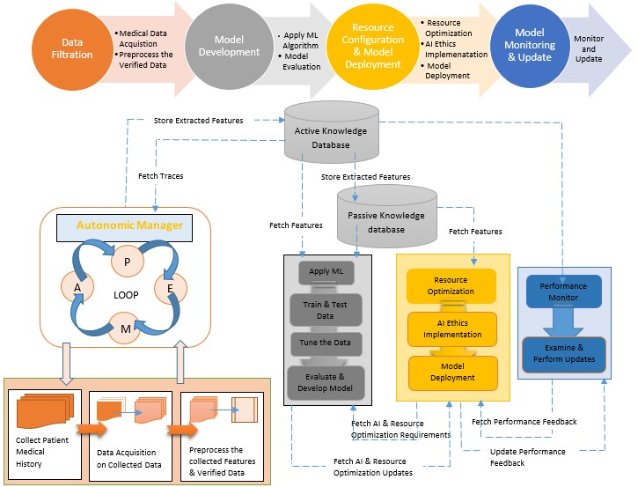
Methodology
Department of Information Technology

Slide 8
Hardware & Software Requirement
Department of Information Technology
Software requirements
Python language
Python Libraries
Tools Required
Jupyter Notebook
Dataset of disease (Health disease)

Slide 9
Result
Department of Information Technology
Algorithm Name | Precision | Accuracy
Logistic Regression | 0.831858407079646 | 0.8532608695652174
Random Forest | 0.8571428571428571 | 0.8804347826086957
SVM | 0.8545454545454545 | 0.8695652173913043
XG Boost | 0.8407079646017699 | 0.8641304347826086
KNN | 0.8958333333333334 | 0.8586956521739131
Naïve Bayes | 0.8636363636363636 | 0.8804347826086957
According to above data we found the Logistic Regression is best suit for this prediction system but we again go through the Algorithms and find that the training and testing score is very much low approximately <80%. So We again perform some algorithms combination and find the finally a collaborative combination of the algorithms is find it is the combination of Support Vector Classifier. The combination of these three classifiers are given the Training and Testing Score is 94%.This Trained Model gives the Perfect Prediction for the predictive Healthcare Analysis.

Slide 10
Conclusion
Department of Information Technology
The autonomic AI/ML model enhances healthcare data analysis by integrating autonomic features to streamline data filtration, ensuring accurate predictions in AI/ML frameworks.
Accurate data is paramount in healthcare prediction analytics. The autonomic module within our model orchestrates data filtration autonomously using the MAPE-K loop, minimizing human intervention and advancing the model's maturity towards achieving autonomic AI/ML systems.
Accurate data is critical in healthcare prediction to prevent unforeseen outcomes. Our proposed model prioritizes dataset completeness and result accuracy for effective healthcare prediction.
In summary, this overview encapsulates the proposed model's workflow, emphasizing the pivotal role of data accuracy and the autonomic module's contribution in automating data filtration to enhance the model's maturity

Slide 11
References
Ben Van Calster, Laure Wynants, Dirk Timmerman, Ewout W Steyerberg, and Gary S Collins (2018): Predictive analysis in healthcare. https://doi.org/10.1093%2Fjamia%2Focz130
Arman Kilic, MD.(2020): Artificial Intelligence and Machine Learning in Cardiovascular Health Care. https://doi.org/10.1016/j.athoracsur.2019.09.042
Battineni Gopi, Sagaro Gamo Getu , Chinatalapudi Nalini and Amenta Francesco(2020): Applications of Machine Learning Predictive Models in the Chronic Disease Diagnosis. https://www.researchgate.net/publication/340297978_Applications_of_Machine_Learning_Predictive_Models_in_the_Chronic_Disease_Diagnosis
Soumyabrata Dev, Hewei Wang, Chidozie Shamrock Nwosu, Nishtha Jain, Bharadwaj Veeravalli, Deepu John (2022) : A predictive analytics approach for stroke prediction using machine learning and neural networks. https://doi.org/10.1016/j.health.2022.100032
Mohammed Badawy, Nagy Ramadan and Hesham Ahmed Hefny (2023): Healthcare predictive analytics using machine learning and deep learning techniques: a survey. https://rdcu.be/dswca

