Slide 1
BANK LOAN CASE STUDY
BY RITESH SINGH RAJPUT

Slide 2
PROBLEM STATEMENT
The client, a consumer finance company, needs to analyse their loan applicants to identify patterns that help in predicting whether an applicant will default on their loan. The analysis aims to :
Approve loans for applicants who are likely to repay.
Reject loans for applicants who are likely to default.

Slide 3
INFORMATION PROVIDED BY CLIENT
application_data.csv
This contains all the information of the client at the time of application. The data is about whether a client has payment difficulties.
previous_application.csv
This contains information about the client’s previous loan data. It contains the data whether the previous application had been Approved, Cancelled, Refused or Unused offer.
columns_descrption.csv
This is data dictionary which describes the meaning of the variables or columns.

Slide 4
CLIENT NEEDS
Exploratory Data Analysis (EDA) :
Identify Missing Data: Find and handle missing data.
Identify Outliers: Detect and explain outliers.
Data Imbalance: Check for imbalances in loan approval status.
Univariate and Bivariate analyses to understand risk factors.
Correlation analysis to find key influencing factors.
Visualizations: Create charts and graphs to highlight key insights.
Machine Learning Model :
Data Preparation: Clean and preprocess data.
Feature Engineering: Develop important features.
Model Selection: Choose the best algorithms for prediction.
Model Training and Evaluation: Train and evaluate model performance.
Deployment: Implement the model for predicting loan defaults.

Slide 5
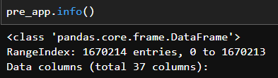
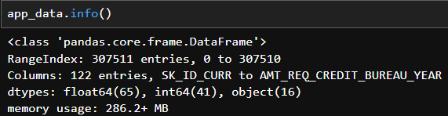
DATA
PREVIOUS APPLICANTS
NEW APPLICANTS
PREVIOUS APPLICANTS HYPERLINK
NEW APPLICANTS HYPERLINK

Slide 6
APPROACH
USING JUPYTER NOTEBOOK &
PYTHON LIBRARIES
DATA CLEANING, IMPUTATIONS &
MERGING DF’S
EDA,
UNIVARIATE &
BIVARIATE ANALYSIS
REMOVING OUTLIERS
&
FINALIZING DATA
FIXING
DATA IMBALANCE
BY
OVERSAMPLING
ML MODELLING
&
OUTCOME PREDICTIONS

Slide 7
DATA CLEANING, IMPUTATIONS & MERGING DF’S

Slide 8
DATA CLEANING STEPS FOR BOTH FILES
Load Data: Reads a CSV file into a Pandas Data Frame.
Remove High-Null Columns: Drops columns with more than 40% missing values to clean the dataset.
Convert Negative Values: Converts negative values to positive for all numeric columns since days cannot be negative.
Drop Unnecessary Columns: Removes specific columns that are not needed for the analysis.
Separate Columns by Type: Distinguishes between numeric and non-numeric columns for tailored imputation.
Impute Numeric Columns: Fills missing values in numeric columns using the mean value of each column.
Impute Non-Numeric Columns: Fills missing values in non-numeric columns using the most frequent value of each column.
Return Cleaned Data Frame: Outputs the cleaned Data Frame ready for further analysis.

Slide 9
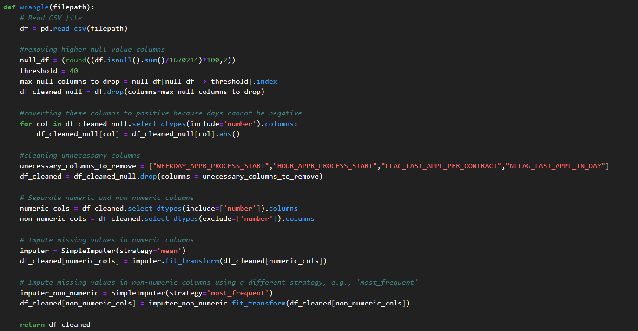
PREV APPLICANTS DATA CLEANING

Slide 10
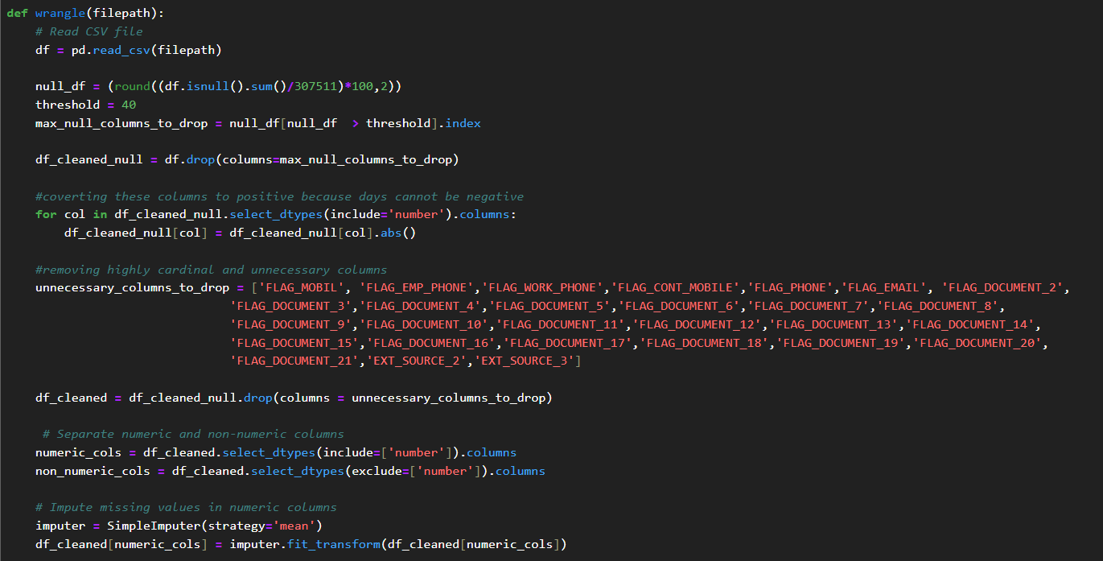
NEW APPLICANTS DATA CLEANING

Slide 11
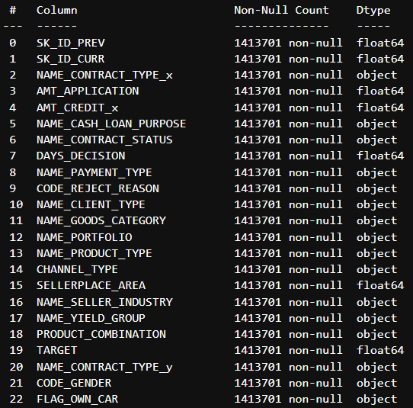
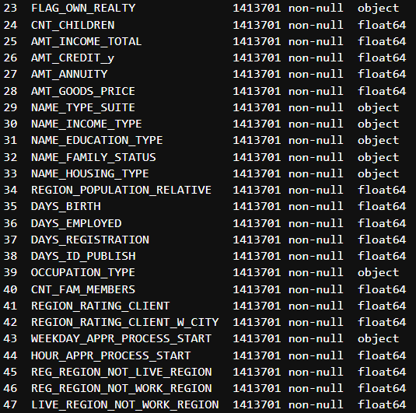
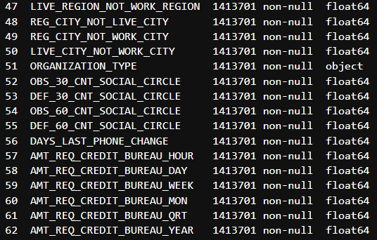
MERGING BOTH DATA FRAMES
After cleaning and imputations of both data we merged both data on the basis of primary key which is “SK_ID_CURR”
MERGED DATA HYPERLINK

Slide 12
EDA, UNIVARIATE & BIVARIATE ANALYSIS

Slide 13
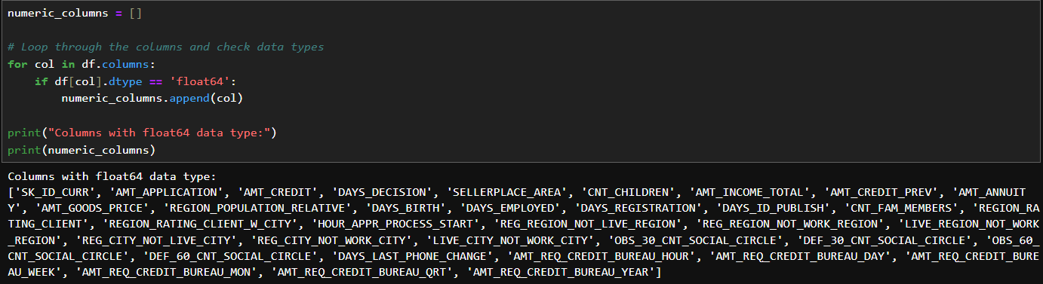
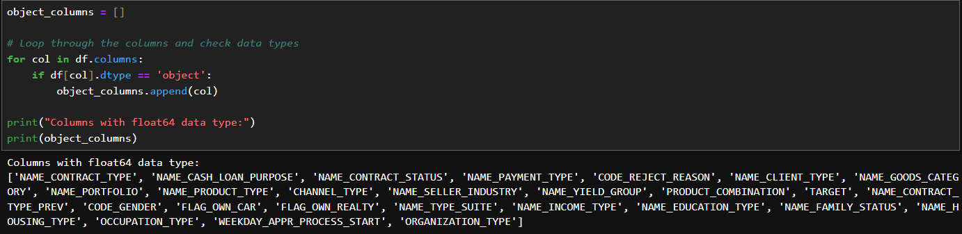
COLUMNS SEPRATION
Separated out the numeric and categorical columns of the dataframe to do further analysis.

Slide 14
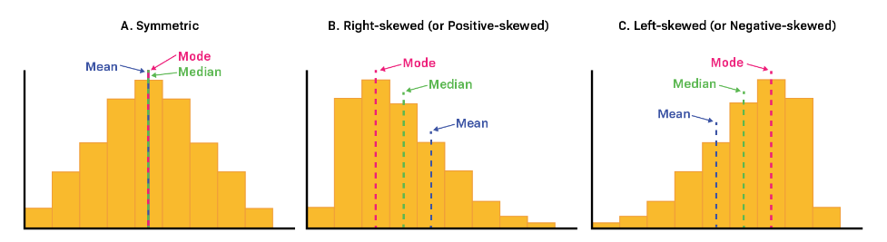
HISTOGRAMS
Histograms are ideal for visualizing the distribution and spread of data.
The images above illustrate the symmetric and skewed nature of the data. If the data is more spread out, it may indicate the presence of outliers.

Slide 15
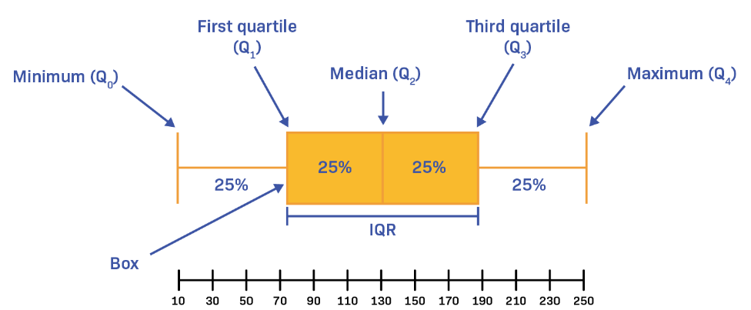
BOXPLOTS
Outliers
The images above illustrate how boxplots can reveal data symmetry and skewness.
A wider spread in the boxplot may suggest the presence of outliers or variability in the data.

Slide 16
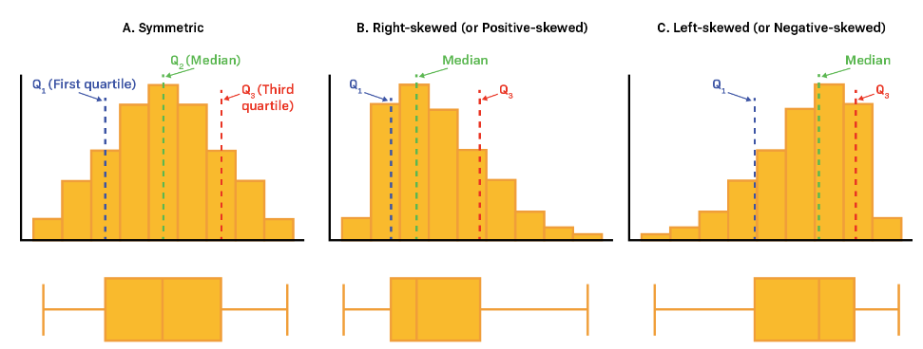
HISTOGRAMS + BOXPLOT

Slide 17
Types of Analysis Done
Univariate Analysis :
This analysis is a type of data analysis that focuses on examining and describing the distribution, central tendency, and variability of a single variable in a dataset. The primary goal of univariate analysis is to understand the underlying patterns and characteristics of the data related to one variable without considering relationships or interactions with other variables.
Bivariate Analysis :
Bivariate analysis is a statistical method used to explore the relationship between two variables. Unlike univariate analysis, which focuses on a single variable, bivariate analysis seeks to understand how two variables relate to each other, whether through correlation, causation, or simple association. This type of analysis is an essential step in exploratory data analysis (EDA) as it helps identify patterns, trends, and potential relationships between variables in a dataset.

Slide 18
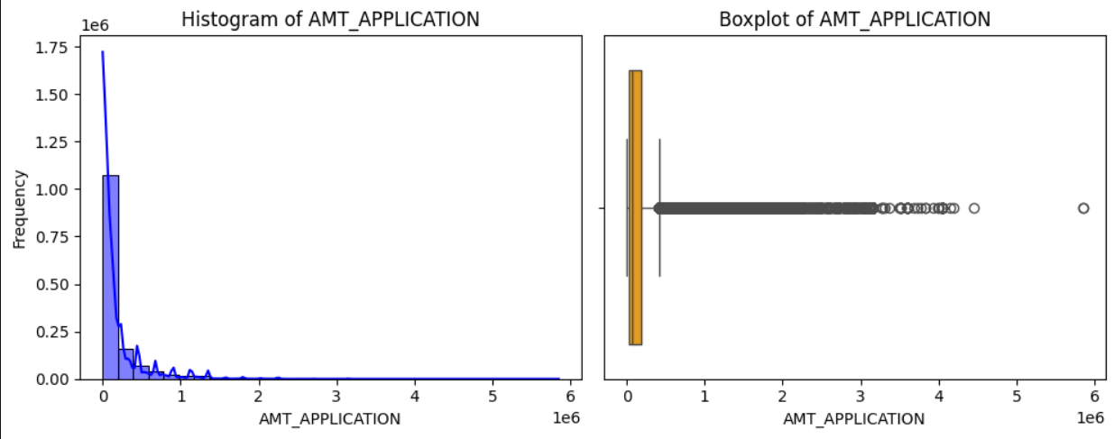
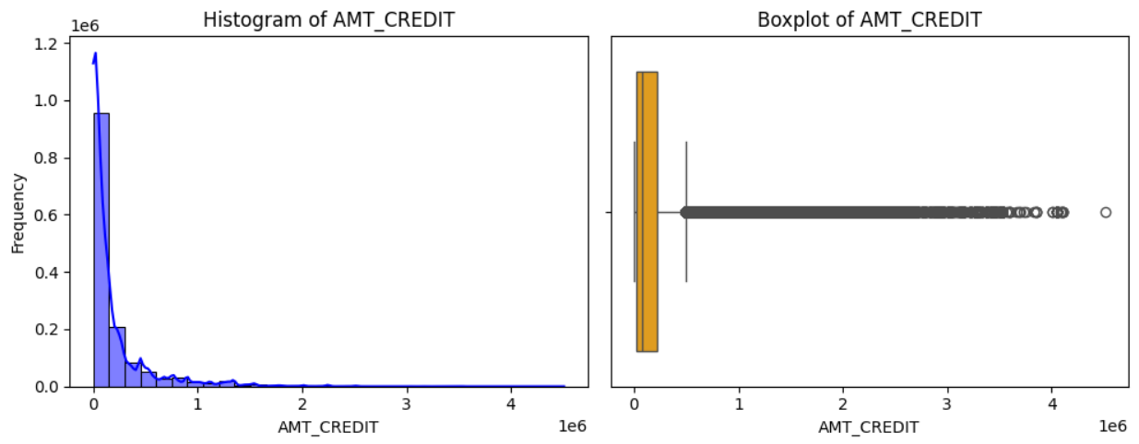
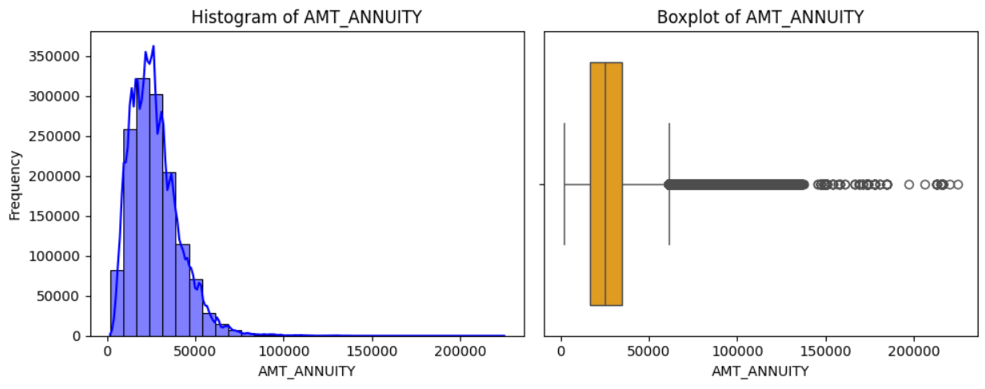
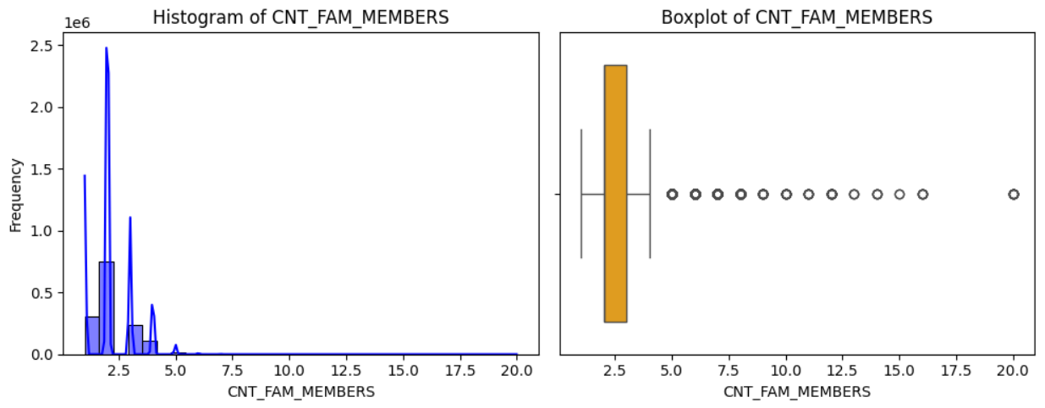
Univariate Analysis (Numerical Features)
Exploring some of the imp features

Slide 19
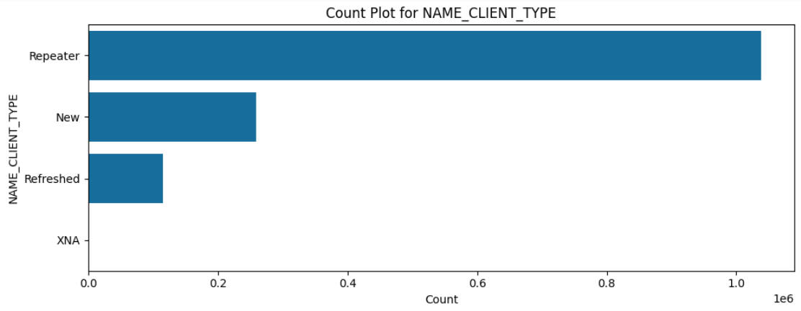
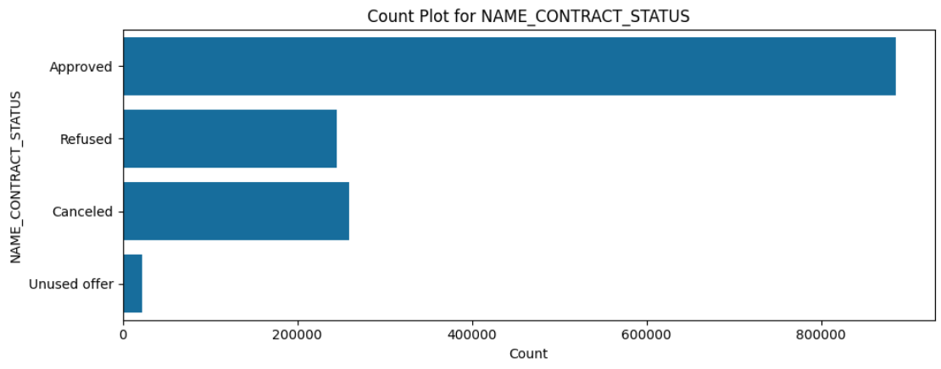
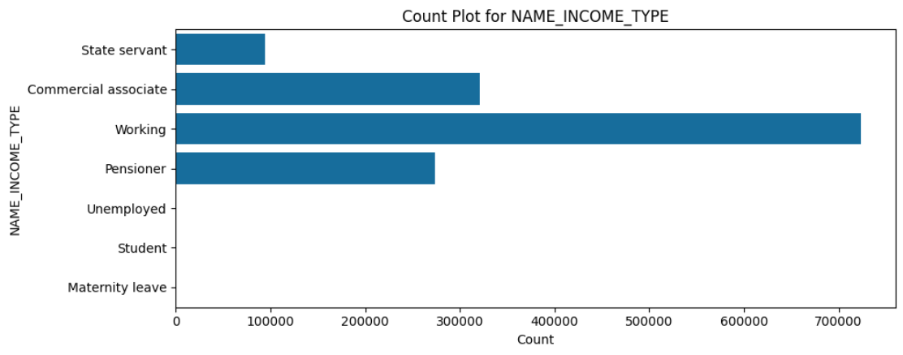
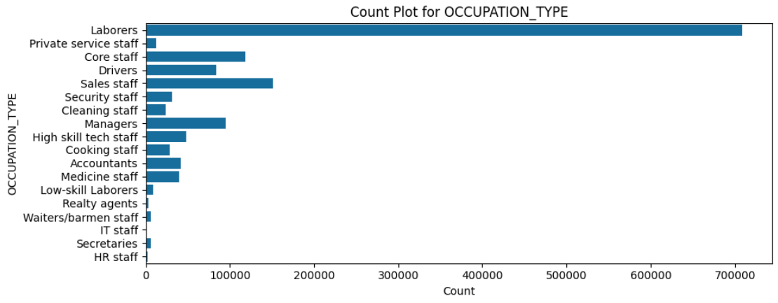
Univariate Analysis (Categorical Features)

Slide 20
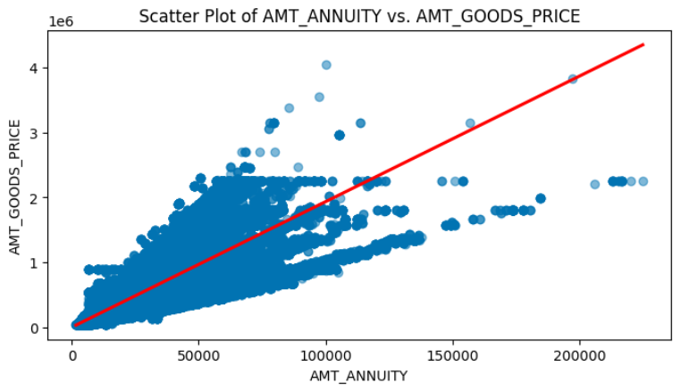
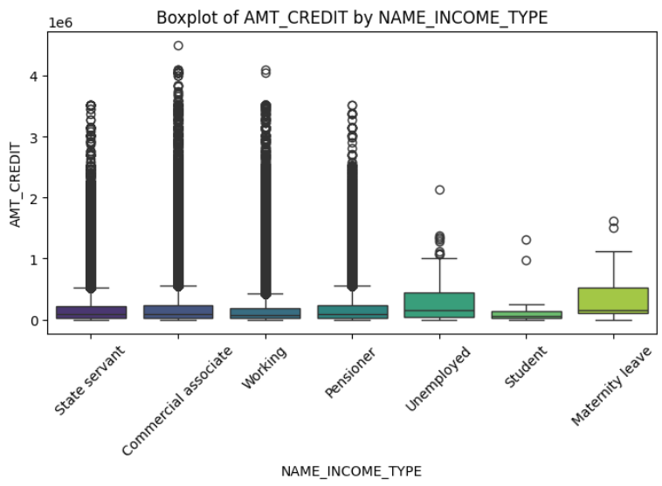
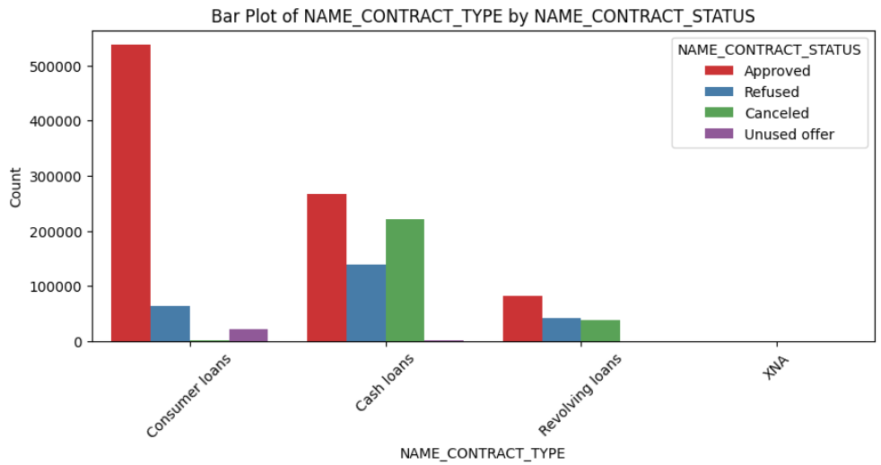
Bivariate Analysis (Multiple Features)

Slide 21
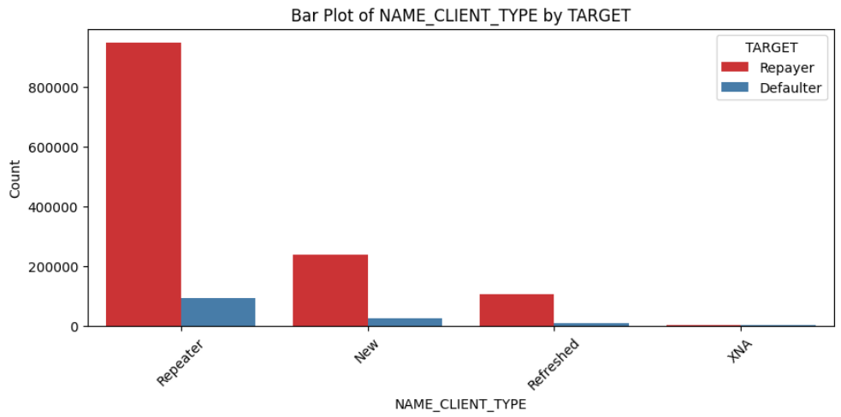
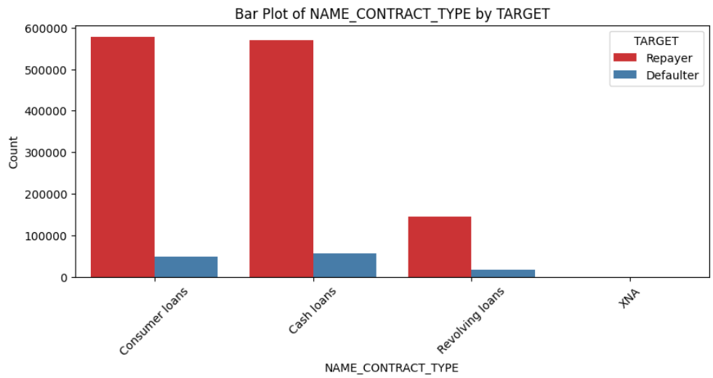
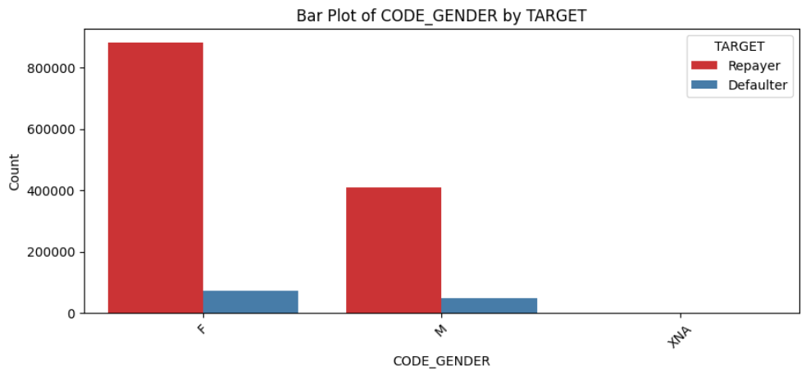
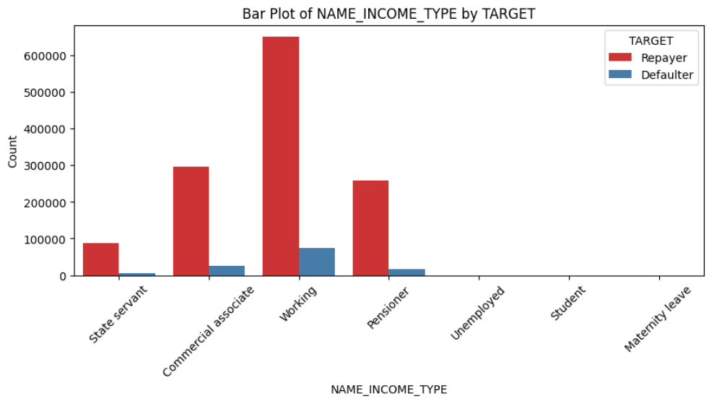
Bivariate Analysis with Target

Slide 22
REMOVING OUTLIERS & FINALIZING DATA

Slide 23
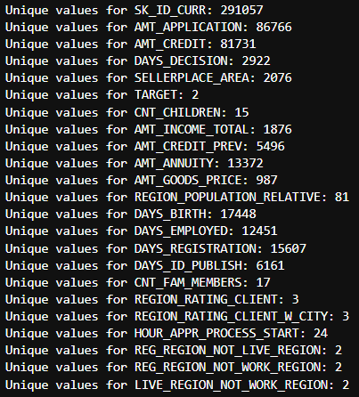
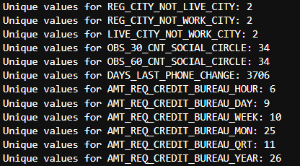
Unique Values In Each Columns
SEE JUPYTER NOTEBOOK

Slide 24
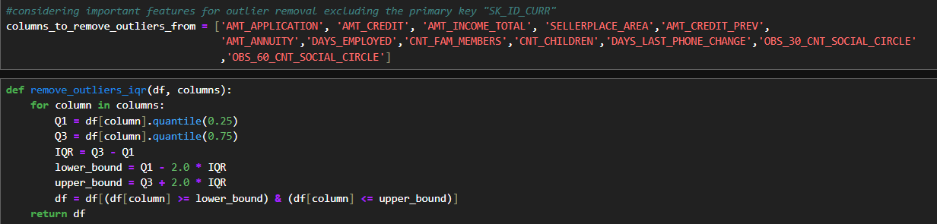
Removing Outliers Using IQR
The Interquartile Range (IQR) is a measure of statistical dispersion, defined as the difference between the 75th percentile (Q3) and the 25th percentile (Q1) of a dataset as shown in the above slide

Slide 25
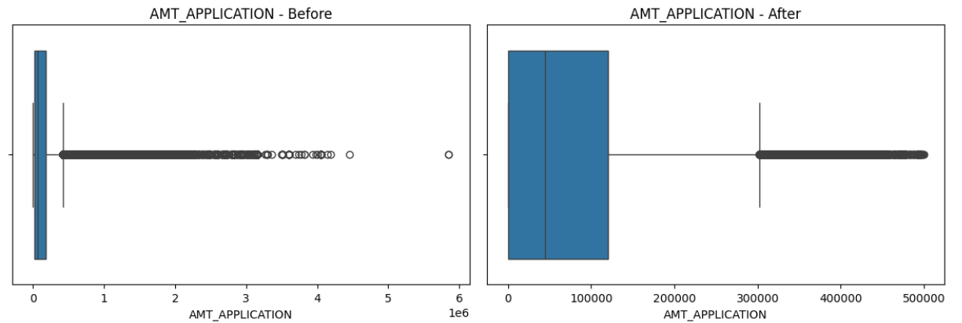
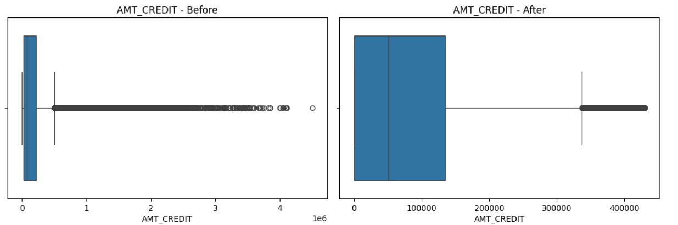
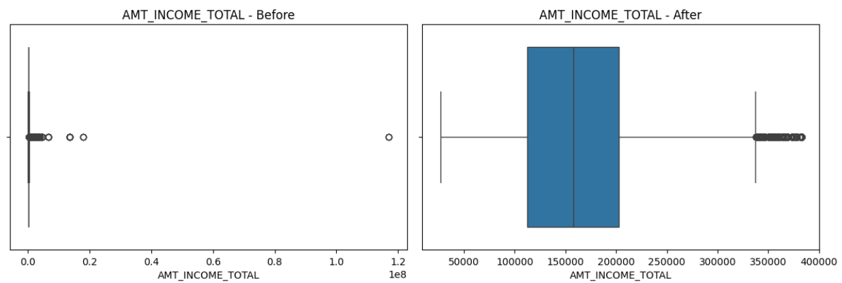
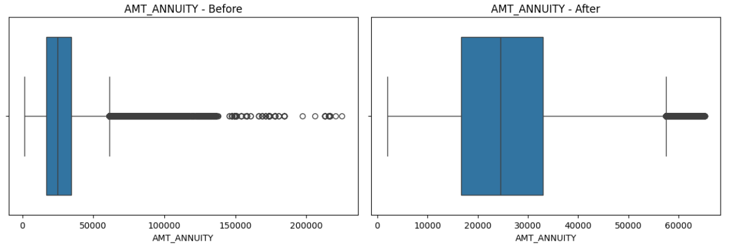
Boxplots (Before & After)

Slide 26
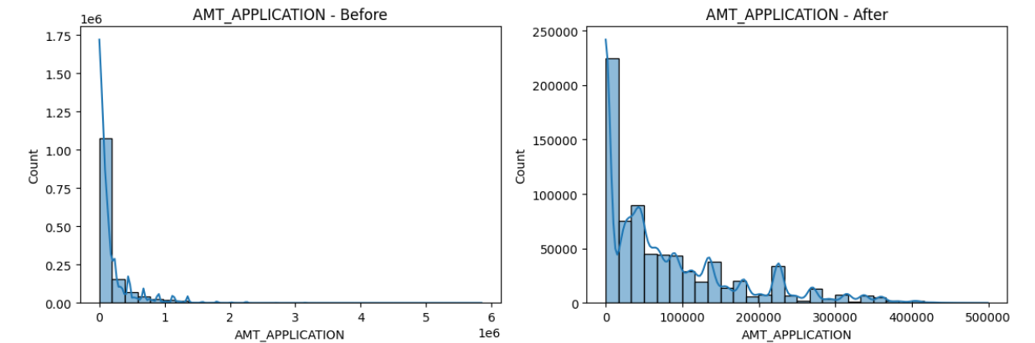
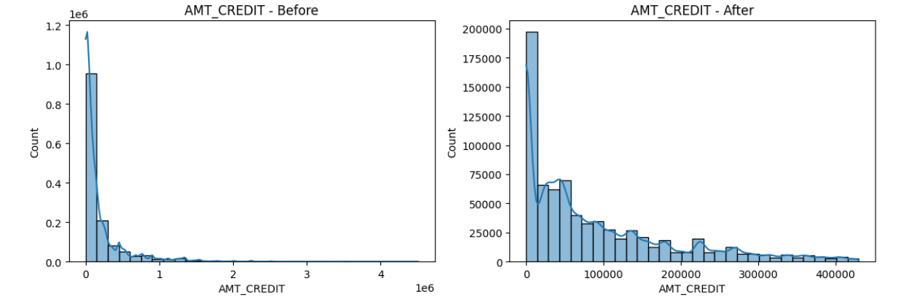
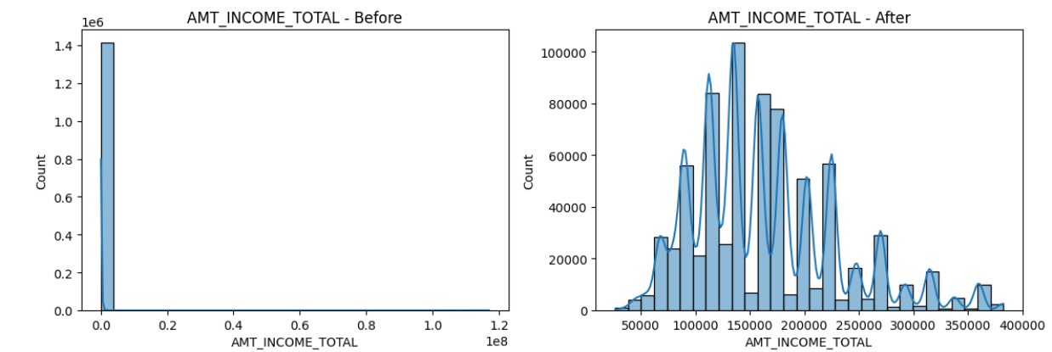
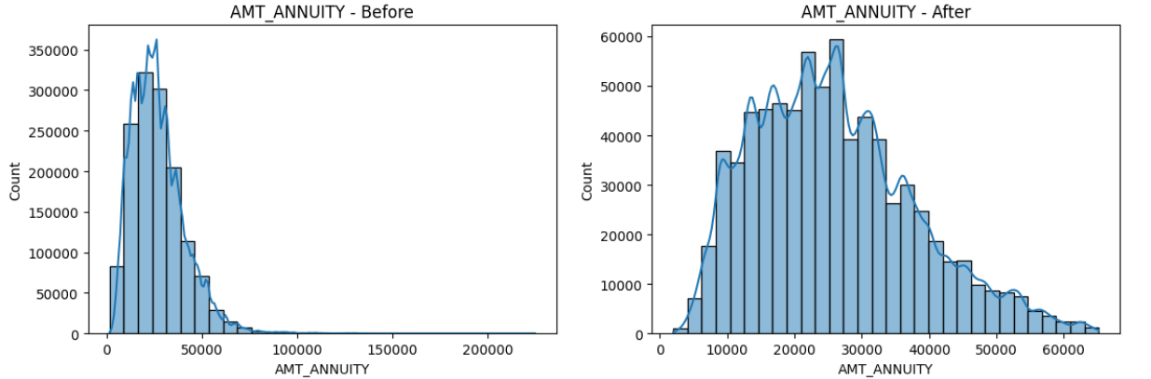
Histograms (Before & After)

Slide 27
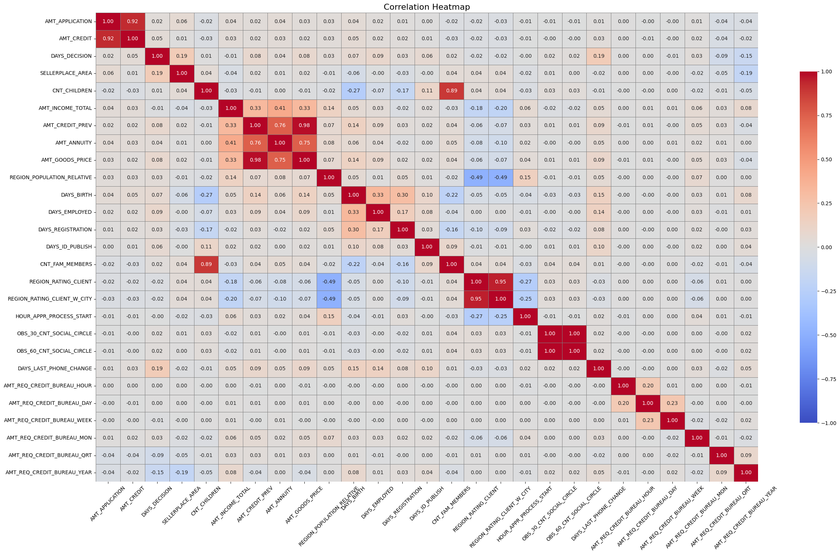
Correlation Of Each Feature

Slide 28
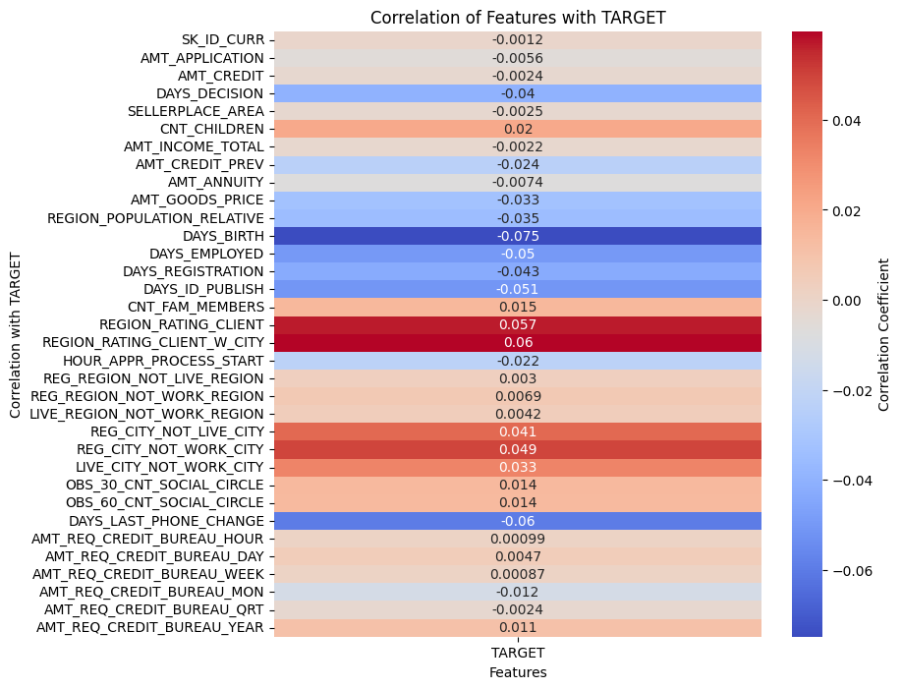
Correlation With Target

Slide 29
FIXING IMBALANCED DATA BY OVERSAMPLING

Slide 30
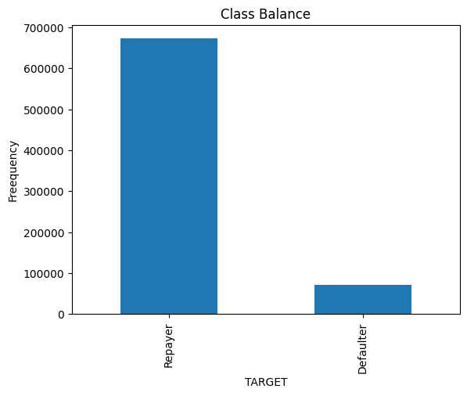
What is imbalanced data ?
Imbalanced data refers to a situation in machine learning where the classes within a dataset are not represented equally.
This is common in classification problems where one class, often the class of interest, is significantly underrepresented compared to other classes.
This imbalance can pose challenges for machine learning models, as they may become biased towards the majority class and fail to accurately predict the minority class.

Slide 31
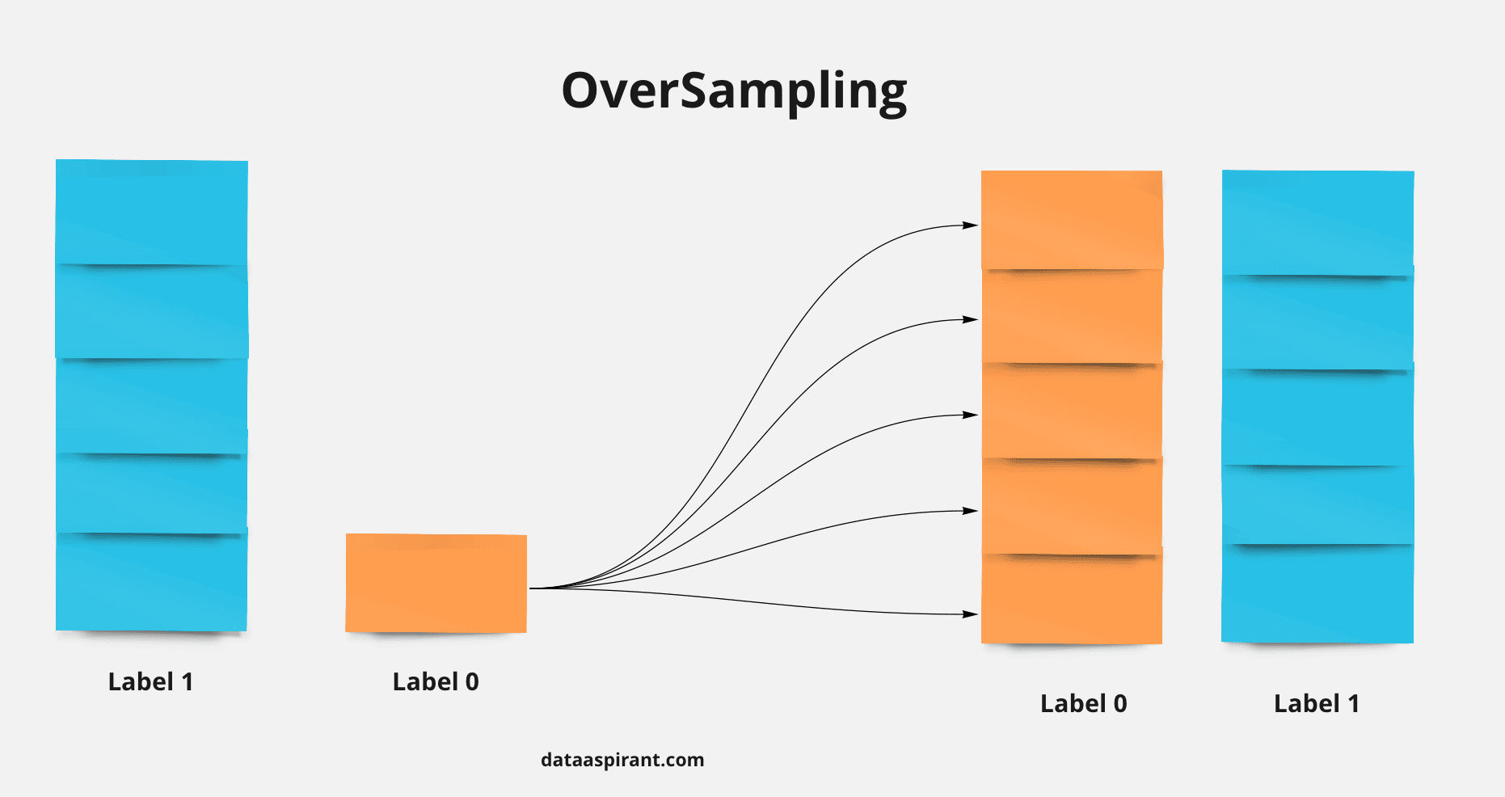
What is Oversampling?
Oversampling is a technique used to address the problem of imbalanced datasets, where one class (usually the class of interest) has significantly fewer samples than the other classes.
Oversampling increases the number of instances in the minority class to balance the class distribution, making it more representative of the entire dataset.
This is done by either duplicating existing instances or generating new synthetic samples.

Slide 32
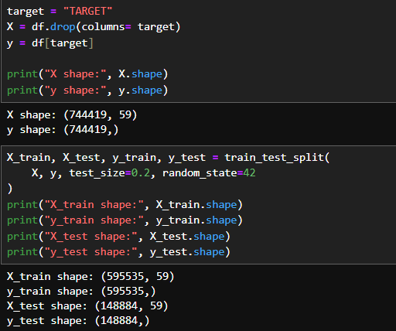
Breaking Data & Oversampling
Breaking the data to X and y format to apply the Random over sampler to the dataset to maintain the class balance
Now we use X_train and y_train datasets to oversample the entire data and build a machine learning model
X_test and y_test are used to test the trained dataset to confirm that the model is actually making true predictions or not.

Slide 33
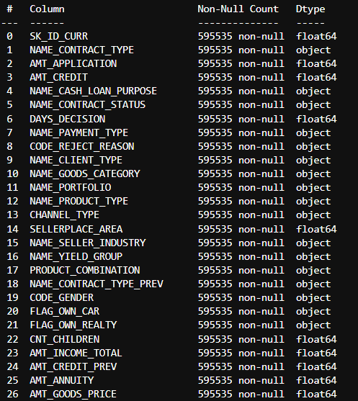
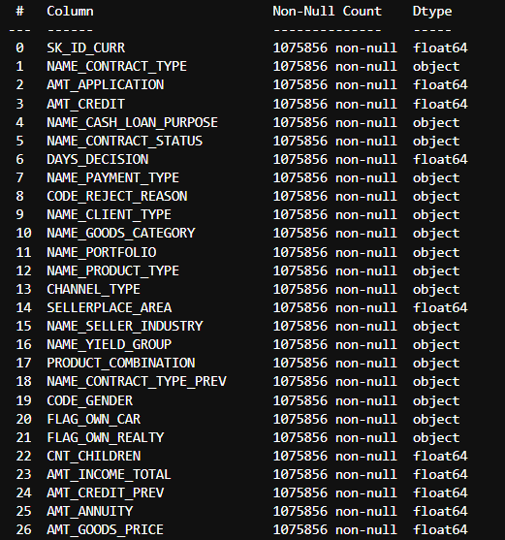
Before & After Oversampling
Before
After

Slide 34

Setting Baseline Accuracy For Model
Baseline accuracy helps you understand whether your machine learning model performs better than a simple heuristic. If your model's accuracy is not significantly higher than the baseline, it may not be capturing meaningful patterns in the data.
Baseline accuracy serves as a simple benchmark for evaluating the performance of machine learning models. It tells us how well a model that predicts only the majority class would perform.
By comparing your model's accuracy to the baseline accuracy, you can assess whether your model is genuinely learning meaningful patterns from the data. If your model's accuracy is not significantly higher than the baseline, it may not be capturing the necessary complexities of the dataset.
Accuracy Baseline for our Oversampled Model

Slide 35
MACHINE LEARNING MODEL & OUTCOME PREDICTIONS

Slide 36
Python & ML Libraries Used
pandas: For data manipulation and analysis.
seaborn: For providing a high-level interface for drawing attractive statistical graphics.
matplotlib.pyplot: For creating static, interactive, and animated visualizations.
imblearn.over_sampling.RandomOverSampler: For balancing class distribution by randomly duplicating examples from the minority class.
imblearn.under_sampling.RandomUnderSampler: For balancing class distribution by randomly removing examples from the majority class.
sklearn.impute.SimpleImputer: For handling missing data by replacing it with a specified value.
sklearn.metrics.ConfusionMatrixDisplay: For visualizing the confusion matrix of a classification model to compare predicted and true values.
sklearn.model_selection.train_test_split: For splitting datasets into training and testing subsets.
sklearn.preprocessing.OneHotEncoder: For converting categorical variables into a format that can be provided to machine learning algorithms to improve predictions.
sklearn.compose.ColumnTransformer: For applying different preprocessing and transformation pipelines to different subsets of features.
sklearn.pipeline.Pipeline: For simplifying the construction of complex machine learning workflows by chaining together a sequence of data processing and modeling steps.
sklearn.tree.DecisionTreeClassifier: For classification tasks that splits data into subsets based on feature values.
sklearn.metrics.classification_report: For generating a text report showing the main classification metrics like precision, recall, and F1-score.
pickle: For the saving and loading of trained models and other data structures.

Slide 37
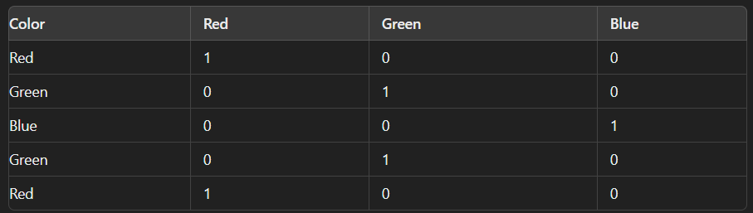
Making Preprocessors
By extracting numerical and categorical features separately, we instantiated two transformers…the work of these transformers is to convert the categorical features into numerical using OHE (OneHotEncoder) and pass out the further numerical features as it is because a machine learning model only works on numerical features and pass out the further numerical features as it is .
How OneHotEncoder works ?

Slide 38
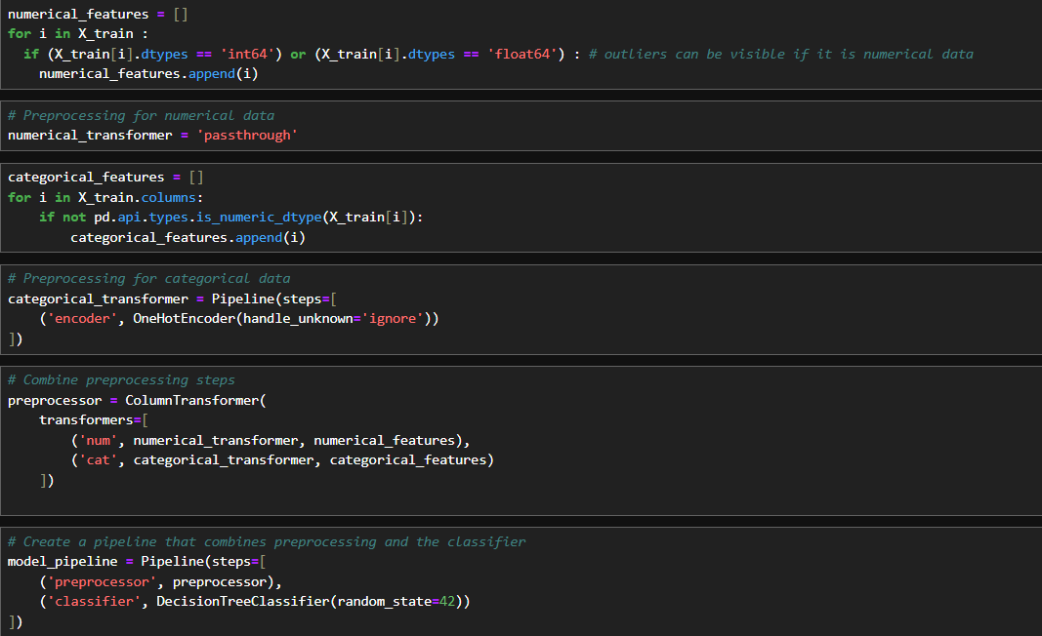
Column Transformers

Slide 39
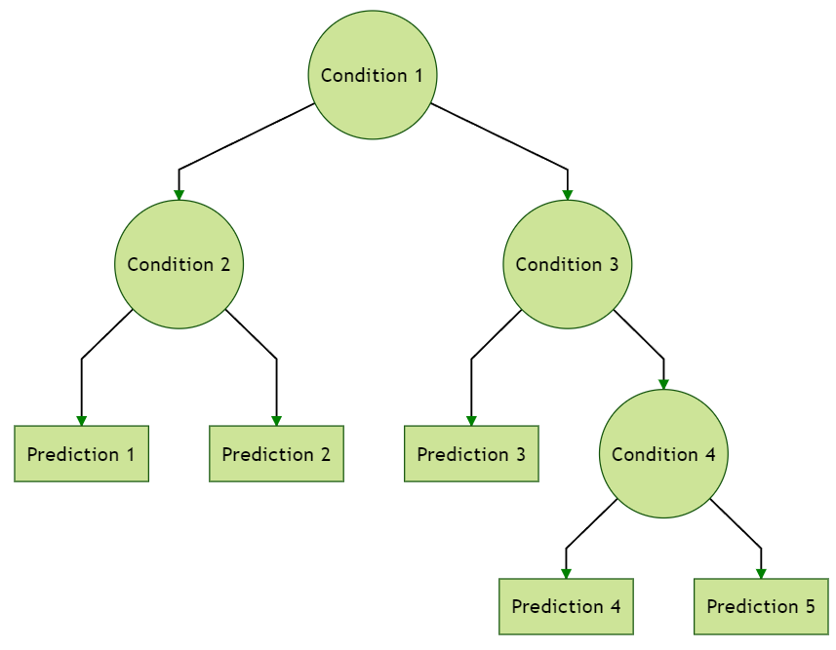
Decision Tree Classification Model
A decision tree is a machine learning model used for classification and regression tasks. It represents decisions and their possible consequences in a tree-like structure, with nodes for decisions, branches for possible outcomes, and leaves for final predictions.

Slide 40
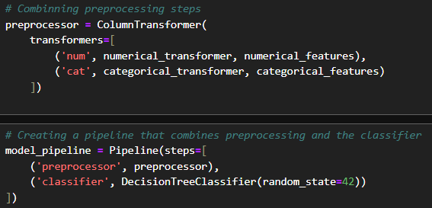
Model Pipeline
A model pipeline is a sequence of data processing and modelling steps in machine learning
that automates the workflow from raw data input to final model predictions.
It consists of a series of steps, such as data preprocessing, feature extraction, model training,
and evaluation, organized in a structured manner to ensure consistency and reproducibility.

Slide 41
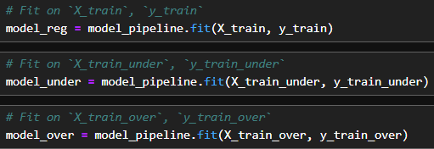

Data Fitting & Model Scores
We built three models to test their performance:
model_reg: This model was trained on the original data without any sampling.
model_under: This model was trained on under-sampled data, where the majority class was reduced to match the size of the minority class.
model_over: This model was trained on over-sampled data, as explained above.
These are the results used to determine the best-performing model.
Since both the regular and oversampled models exceeded the baseline accuracy of 0.90, we can use either model for generating predictions.
However, if there is not much difference between the accuracy scores, we should always choose the more balanced model for making predictions.

Slide 42

Confusion Matrix
The confusion matrix is a useful tool for measuring the accuracy of a model by comparing the predicted labels with the true labels.
It shows the overall performance of the model and helps us understand if the data provided to the model needs further cleaning.
In classification problems, we should always strive to reduce the false negative and false positive values, as these errors can lead to incorrect outputs.

Slide 43

Confusion Matrix of Our Model
In our oversampled model we can see that it predicted
Pretty much true values like
True Positives (TP) : 11,843
The number of "Defaulters" correctly predicted by the model.
False Positives (FP) : 2,603
The number of “Defaulters" incorrectly predicted as “Repayers."
False Negatives (FN) : 2,860
The number of “Repayers" incorrectly predicted as “Defaulters."
True Negatives (TN) : 131,578
The number of "Repayers" correctly predicted by the model.
From the above confusion matrix, it is clear that the model needs cleaner data because it predicted a high number of false negatives (FN), which indicates the number of defaulters incorrectly predicted as repayers.
If the model predicts defaulters as repayers, it can cause significant problems for the bank by approving loans for customers who cannot repay them.

Slide 44

Feature Importances of Model
These are the features extracted by the model that it used to predict the target values. Therefore, these 15 columns or features are important for the model's predictions, while the other features are not as crucial for predicting the target value.
This indicates that providing too many features to the model led to data overfitting, which is why it predicted a high number of false positives and false negatives, as shown in the confusion matrix. Now, by using only these important features from the data, we need to remodel the approach.

Slide 45


Extracting Imp Features
Extracting out the important features from important_features having importance grater than 0.01 and converted them into list.

Slide 46

New Dataframe
Now taking the important features into the new dataframe calling it as new_df.

Slide 47

Remodelling
By splitting the data into X and y, train test split has been done on the size Of 80:20 ratio and remodelled with decision tree classifier and checked the score which is pretty much higher than the previous model.

Slide 48

Confusion Matrix of the Model
As can be clearly seen, we have successfully reduced the number of false positives from 2,603 to 0 and decreased the number of false negatives from 2,860 to 1,855.
This improvement indicates that our model is now better at correctly identifying true defaulters and accurately predicting repayers, which was our primary goal.
Reducing false positives to zero means that the model no longer incorrectly labels repayers as defaulters. This is crucial for minimizing the risk of denying credit to reliable customers, thereby maintaining customer satisfaction and fostering positive business relationships.
Similarly, the reduction in false negatives means that the model has become more proficient at identifying defaulters. This is essential for the bank as it ensures that credit is not extended to individuals who are likely to default, reducing potential financial losses.

Slide 49


Making Predictions
By taking random values from X_train we compared the actual values of our dataset to test that is it predicting correct values or not.
Predicted Values
Actual Values

Slide 50
Conclusion & Project Link
Our predictive model has demonstrated remarkable accuracy in identifying loan applicants
who are likely to repay their loans. By utilizing this model, the bank can enhance its decision-making process, ensuring that loans are approved for reliable applicants while minimizing the risk of defaults.
This strategic tool empowers the bank to optimize its portfolio, improve customer satisfaction, and drive sustainable business growth. By focusing on the right customers, the bank can streamline its operations, reduce financial risk, and foster long-term success in the competitive financial sector.

