Slide 1
Employee Management system using c++
-By RITESH PANDIT

Slide 2
INTRODUCTION TO C++
C++ is a powerful, high-performance programming language that extends the capabilities of C with object-oriented and generic programming features. Developed by Bjarne Stroustrup in 1983, C++ combines low-level memory manipulation with high-level abstraction, making it versatile for a wide range of applications.
Key Features:
Object-Oriented Programming (OOP): Supports classes, inheritance, polymorphism, and encapsulation.
Performance: Offers fine control over hardware and system resources.
Portability: Code can run on various platforms with minimal changes.
Standard Library: Includes data structures, algorithms, and utilities that simplify programming.
Extensibility: Allows custom definitions for complex data types and templates for generic programming.

Slide 3
Key OOP concepts used in the project
Employee Class:The base class containing attributes (id, name, position, salary) and member functions (display(), updateDetails(), etc.).
Admin Class:A derived class that extends the functionality of the Employee class to manage employees (add, remove, update, view).
Object Creation:An object of Admin is created in the main() function to manage the employees.
Inheritance
Admin Class inherits from the Employee class:It gets access to the data members (id, name, etc.) and member functions (display(), updateDetails()).The Admin class adds more specific functionality like addEmployee(), removeEmployee(), and viewEmployees().

Slide 4
Key OOP concepts used in the project
Polymorphism
Polymorphic Behavior:The viewEmployees() function in the Admin class calls the display() function, which behaves polymorphically:When called through the base class pointer (Employee*), it calls the correct display() method based on the actual object type (Employee or derived types).
Encapsulation
In this code, employee details (like id, name, salary) are encapsulated inside the Employee class.

Slide 5
Key Take Aways
Classes and Objects form the backbone of the system.
Inheritance and Polymorphism allow for extending and managing employees efficiently.
Encapsulation hides implementation details and protects employee data.
Dynamic Memory Allocation provides flexibility in managing employee data.
Password Authentication secures the system from unauthorized access.
Input Validation ensures robust error handling and user interaction.
Destructor ensures proper memory management and avoids leaks.

Slide 6
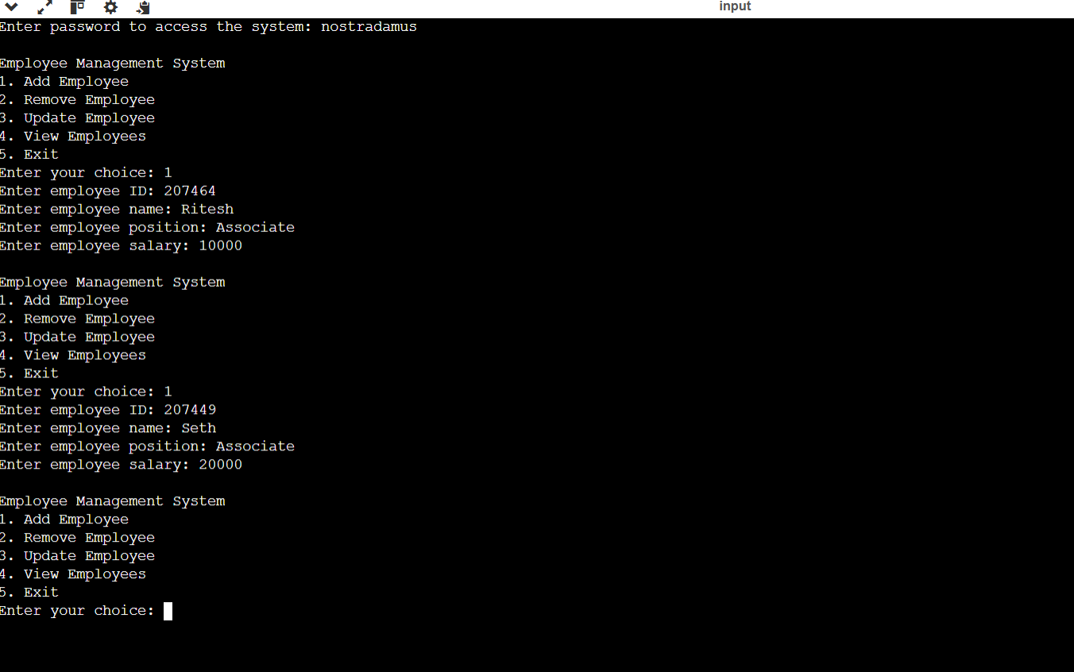
OUTPUTS

Slide 7
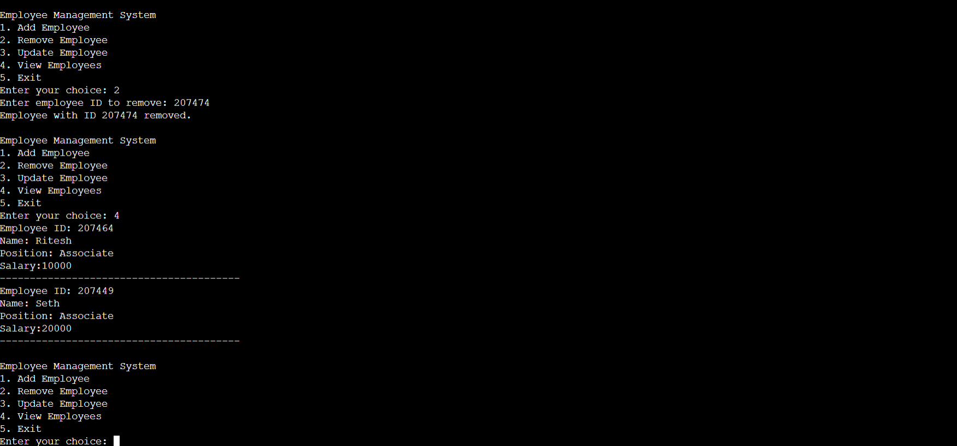
Outputs

Slide 8
THANK YOU!!

