Slide 1
About Me
Oracle Certified Database Administrator
Sun Certified Java Programmer
Certified Ethical Hacker

Slide 2
What is Python?:
Python is a high-level, general-purpose, and very popular programming language. Python programming language (latest Python 3) is being used in web development, and Machine Learning applications, along with all cutting-edge technology in Software Industry. Python language is being used by almost all tech-giant companies like – Google, Amazon, Facebook, Instagram, Dropbox, Uber… etc.

Slide 3
Writing your first Python Program to Learn Python Programming
There are two ways you can execute your Python program:
First, we write a program in a file and run it one time.
Second, run a code line by line.
# Python Program to print Hello World
print("Hello World! I Don't Give a Bug")

Slide 4
Install Python on Windows 10
Step 1: First and foremost step is to open a browser and type https://www.python.org/downloads/windows/
Step 2: Underneath the Python Releases for Windows find the Latest Python 3 Release – Python 3.11.2 (the latest stable release as of now is Python 3.11.2).

Slide 5
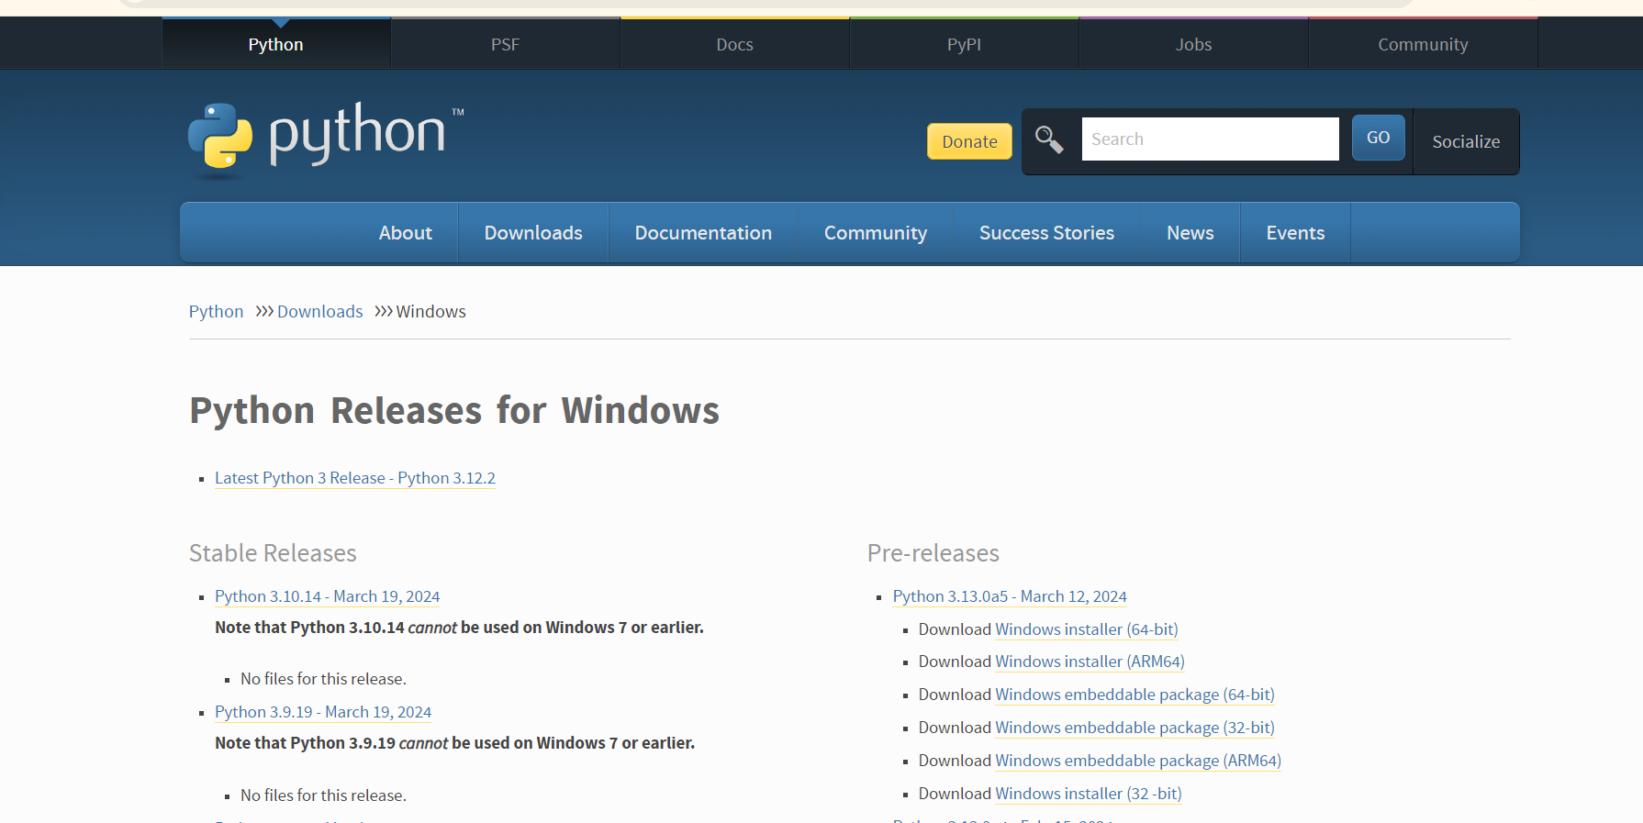
Setting up Python Continue …

Slide 6
Setting up Python Continue …
Step 3: On this page move to Files and click on Windows x86-64 executable installer for 64-bit or Windows x86 executable installer for 32-bit.
Here we are providing the installation process of Python 3.11.2 on Windows
Run the Python Installer for how to install Python on the Windows downloads folder
Make sure to mark Add Python 3.11 to PATH otherwise you will have to do it explicitly. It will start installing Python on Windows.

Slide 7
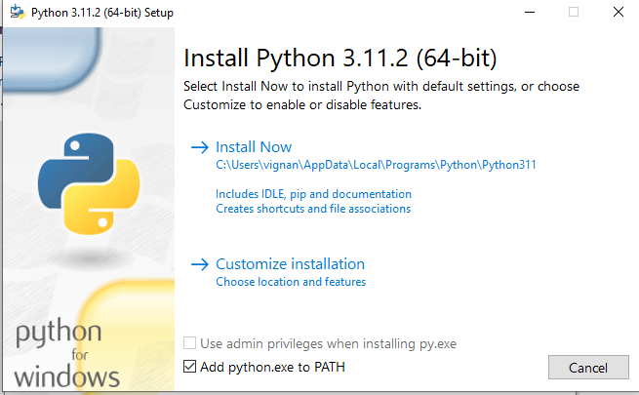
Setting up Python Continue …

Slide 8
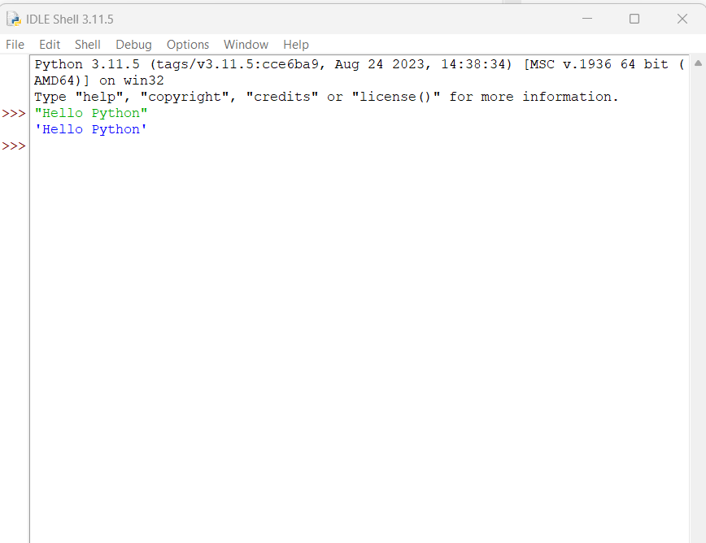
Setting up Python Continue …
After installation is complete click on Close. Bingo..!! Python is installed. Now go to Windows and type IDLE.

Slide 9
Setting up Python Continue …
This is Python Interpreter also called Python Shell. I printed Hello Python, python is working smoothly.
The three greater than >>> sign is called the Python command prompt, where we write our program and with a single enter key, it will give results so instantly.
To check the latest version of Python 3.x.x :
python3 --version

Slide 10
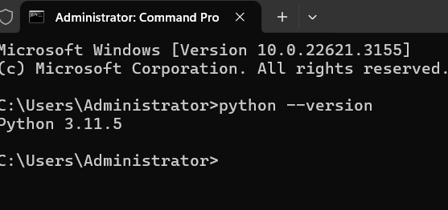
Setting up Python Continue …

Slide 11
Thank You

