Slide 1
About Me
Oracle Certified Database Administrator
Sun Certified Java Programmer
Certified Ethical Hacker

Slide 2
What is Python?:
Python is a high-level, general-purpose, and very popular programming language. Python programming language (latest Python 3) is being used in web development, and Machine Learning applications, along with all cutting-edge technology in Software Industry. Python language is being used by almost all tech-giant companies like – Google, Amazon, Facebook, Instagram, Dropbox, Uber… etc.

Slide 3
Writing your first Python Program to Learn Python Programming
There are two ways you can execute your Python program:
First, we write a program in a file and run it one time.
Second, run a code line by line.
# Python Program to print Hello World
print("Hello World! I Don't Give a Bug")

Slide 4
Understanding the Execution of Python Program
a = 10
b = 10
print("Sum ", (a+b))
Suppose the above python program is saved as first.py. Here first is the name and .py is the extension. The execution of the Python program involves 2 Steps:

Slide 5
Compilation
Interpreter

Slide 6
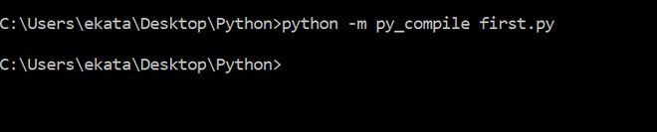
Compilation
The program is converted into byte code. Byte code is a fixed set of instructions that represent arithmetic, comparison, memory operations, etc. It can run on any operating system and hardware. The byte code instructions are created in the .pyc file. The .pyc file is not explicitly created as Python handles it internally but it can be viewed with the following command:

Slide 7
-m and py_compile represent module and module name respectively. This module is responsible to generate .pyc file. The compiler creates a directory named __pycache__ where it stores the first.cpython-38.pyc file.

Slide 8
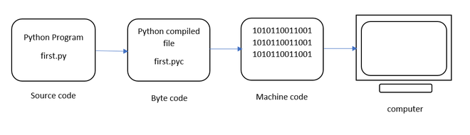
Interpreter
he next step involves converting the byte code (.pyc file) into machine code. This step is necessary as the computer can understand only machine code (binary code). Python Virtual Machine (PVM) first understands the operating system and processor in the computer and then converts it into machine code. Further, these machine code instructions are executed by processor and the results are displayed.

Slide 9
However, the interpreter inside the PVM translates the program line by line thereby consuming a lot of time. To overcome this, a compiler known as Just In Time (JIT) is added to PVM. JIT compiler improves the execution speed of the Python program. This compiler is not used in all Python environments like CPython which is standard Python software.
To execute the first.cpython-38.pyc we can use the following command:

Slide 10
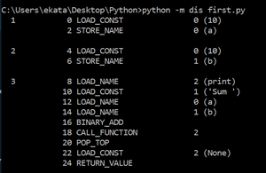
To view the byte code of the file – first.py we can type the following command as :

Slide 11
The dis command is known as “disassembler” that displays the byte code in an understandable format. The code represents 5 columns:
Line Number
offset position of byte code
name of byte code instruction
instruction’s argument
constants or names (in brackets)

Slide 12
Comments in Python
Comments in Python are the lines in the code that are ignored by the interpreter during the execution of the program. Also, Comments enhance the readability of the code and help the programmers to understand the code very carefully.
# sample comment
# This is Python Comment
name = “RAM SINGH"
print(name)

Slide 13
Keywords in Python
Keywords in Python are reserved words that can not be used as a variable name, function name, or any other identifier.

Slide 14
Keywords in Python
Keywords
and | False | nonlocal
as | finally | not
assert | for | or
break | from | pass
class | global | raise
continue | if | return
def | import | True
del | is | try
elif | in | while
else | lambda | with
except | None | yield

Slide 15
Python Variable
Python Variable is containers that store values. Python is not “statically typed”. An Example of a Variable in Python is a representational name that serves as a pointer to an object. Once an object is assigned to a variable, it can be referred to by that name.

Slide 16
Rules for Python variables
A Python variable name must start with a letter or the underscore character.
A Python variable name cannot start with a number.
A Python variable name can only contain alpha-numeric characters and underscores (A-z, 0-9, and _ ).
Variable in Python names are case-sensitive (name, Name, and NAME are three different variables).
The reserved words(keywords) in Python cannot be used to name the variable in Python.

Slide 17
Example
# An integer assignment
age = 45
# A floating point
salary = 1456.8
# A string
name = "John"
print(age)
print(salary)
print(name)

Slide 18
Python Data Types
Data types are the classification or categorization of data items. It represents the kind of value that tells what operations can be performed on a particular data. Since everything is an object in Python programming, data types are classes and variables are instances (objects) of these classes.

Slide 19
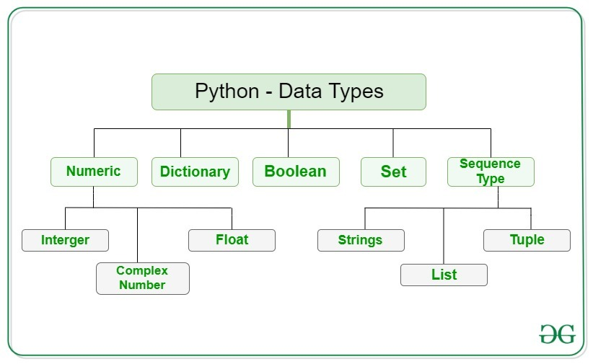
Data Types:

Slide 20
Example:
This code assigns variable ‘x’ different values of various data types in Python.
x = "Hello World" # string
x = 50 # integer
x = 60.5 # float
x = 3j # complex
x = ["geeks", "for", "geeks"] # list
x = ("geeks", "for", "geeks") # tuple
x = {"name": "Suraj", "age": 24} # dict
x = {"geeks", "for", "geeks"} # set
x = True # bool
x = b"Geeks" # binary

Slide 21
Python Input/Output
This function first takes the input from the user and converts it into a string. The type of the returned object always will be <class ‘str’>. It does not evaluate the expression it just returns the complete statement as String, and will print it.
# Python program show input and Output
val = input("Enter your value: ")
print(val)

Slide 22
Python Operators
In Python programming, Operators in general are used to perform operations on values and variables. These are standard symbols used for the purpose of logical and arithmetic operations. In this article, we will look into different types of Python operators.

Slide 23
Arithmetic Operators
Python Arithmetic operators are used to perform basic mathematical operations like addition, subtraction, multiplication, and division.
The precedence of Arithmetic Operators in Python is as follows:
P – Parentheses
E – Exponentiation
M – Multiplication (Multiplication and division have the same precedence)
D – Division
A – Addition (Addition and subtraction have the same precedence)
S – Subtraction

Slide 24
Example
a = 9
b = 4
add = a + b
sub = a - b
mul = a * b
mod = a % b
p = a ** b
print(add)
print(sub)
print(mul)
print(mod)
print(p)

Slide 25
Output:
13
5
36
1
6561

Slide 26
Logical Operators
Python Logical operators perform Logical AND, Logical OR, and Logical NOT operations. It is used to combine conditional statements.
a = True
b = False
print(a and b)
print(a or b)
print(not a)

Slide 27
Output:
False
True
False

Slide 28
Bitwise Operators
Python Bitwise operators act on bits and perform bit-by-bit operations. These are used to operate on binary numbers.
a = 10
b = 4
print(a & b)
print(a | b)
print(~a)
print(a ^ b)
print(a >> 2)
print(a << 2)

Slide 29
Output:
0
14
-11
14
2
40

Slide 30
Assignment Operators
Python Assignment operators are used to assign values to the variables.
a = 10
b = a
print(b)
b += a
print(b)
b -= a
print(b)
b *= a
print(b)
b <<= a
print(b)

Slide 31
Output:
10
20
10
100
102400

Slide 32
Python If Else
The if statement alone tells us that if a condition is true it will execute a block of statements and if the condition is false it won’t. But if we want to do something else if the condition is false, we can use the else statement with the if statement to execute a block of code when the if condition is false.

Slide 33
Example 1: Python IF-Else
i = 20
if (i < 15):
print("i is smaller than 15")
print("i'm in if Block")
else:
print("i is greater than 15")
print("i'm in else Block")
print("i'm not in if and not in else Block")

Slide 34
Output:
i is greater than 15
i'm in else Block
i'm not in if and not in else Block

Slide 35
Example 2: Python if-elif-else ladder
i = 20
if (i == 10):
print("i is 10")
elif (i == 15):
print("i is 15")
elif (i == 20):
print("i is 20")
else:
print("i is not present")

Slide 36
Output:
i is 20

Slide 37
Python For Loop
Python For loop is used for sequential traversal i.e. it is used for iterating over an iterable like String, Tuple, List, Set, or Dictionary. Here we will see a “for” loop in conjunction with the range() function to generate a sequence of numbers starting from 0, up to (but not including) 10, and with a step size of 2. For each number in the sequence, the loop prints its value using the print() function.

Slide 38
Python For loop
for i in range(0, 10, 2):
print(i)

Slide 39
Output:
0
2
4
6
8

Slide 40
Python While Loop
# Python program to illustrate while loop
count = 0
while (count < 3):
count = count + 1
print("Hello Geek")

Slide 41
Output:
Hello Geek
Hello Geek
Hello Geek

Slide 42
Break, continue and pass in Python
Using loops in Python automates and repeats the tasks in an efficient manner. But sometimes, there may arise a condition where you want to exit the loop completely, skip an iteration or ignore that condition. These can be done by loop control statements. Loop control statements change execution from their normal sequence. When execution leaves a scope, all automatic objects that were created in that scope are destroyed. Python supports the following control statements:

Slide 43
Break Statement in Python
The break statement in Python is used to terminate the loop or statement in which it is present. After that, the control will pass to the statements that are present after the break statement, if available. If the break statement is present in the nested loop, then it terminates only those loops which contain the break statement.

Slide 44
Syntax of Break Statement
The break statement in Python has the following syntax:
for / while loop:
# statement(s)
if condition:
break
# statement(s)
# loop end

Slide 45
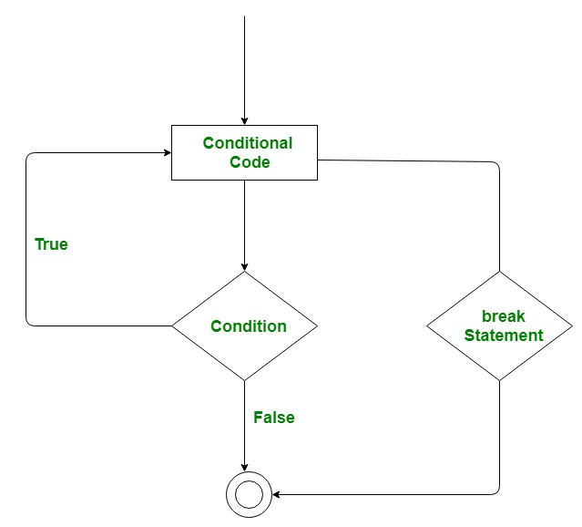
Working on Python Break Statement

Slide 46
Example:
# Python program to demonstrate
# break statement
s = 'geeksforgeeks'
# Using for loop
for letter in s:
print(letter)
# break the loop as soon it sees 'e'
# or 's'
if letter == 'e' or letter == 's':
break

Slide 48
Python Functions
Python Functions is a block of statements that return the specific task. The idea is to put some commonly or repeatedly done tasks together and make a function so that instead of writing the same code again and again for different inputs, we can do the function calls to reuse code contained in it over and over again.

Slide 49
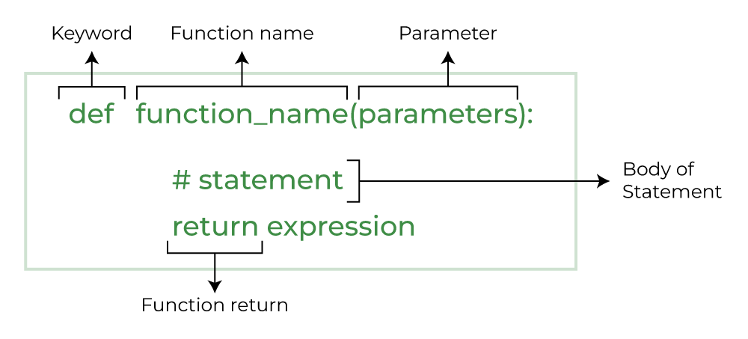
Function Continue …

Slide 50
Note: There are mainly two types of functions in Python.
Built-in library function: These are Standard functions in Python that are available to use.
User-defined function: We can create our own functions based on our requirements.

Slide 51
Example :
# Python program to demonstrate
# break statement
s = 'geeksforgeeks'
# Using for loop
for letter in s:
print(letter)
# break the loop as soon it sees 'e'
# or 's'
if letter == 'e' or letter == 's':
break
print("Out of for loop")
print()

Slide 52
i = 0
# Using while loop
while True:
print(s[i])
# break the loop as soon it sees 'e'
# or 's'
if s[i] == 'e' or s[i] == 's':
break
i += 1
print("Out of while loop")

Slide 53
Output:
g
e
Out of for loop
g
e
Out of while loop

Slide 54
Example 2 : Break in Nested Loop:
# Python program to demonstrate
# break statement with nested
# for loop
# first for loop
for i in range(1, 5):
# second for loop
for j in range(2, 6):
# break the loop if
# j is divisible by i
if j%i == 0:
break
print(i, " ", j)

Slide 55
Output:
3 2
4 2
4 3

Slide 56
Continue Statement in Python
Continue is also a loop control statement just like the break statement. continue statement is opposite to that of the break statement, instead of terminating the loop, it forces to execute the next iteration of the loop. As the name suggests the continue statement forces the loop to continue or execute the next iteration. When the continue statement is executed in the loop, the code inside the loop following the continue statement will be skipped and the next iteration of the loop will begin.

Slide 57
Syntax of Continue Statement
for / while loop:
# statement(s)
if condition:
continue
# statement(s)

Slide 58
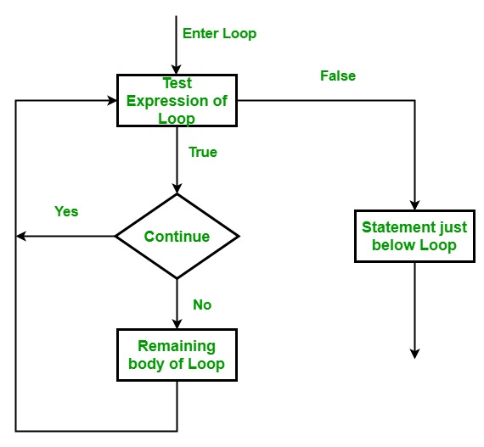
Working of Python Continue Statement

Slide 59
Example:
# Python program to
# demonstrate continue
# statement
# loop from 1 to 10
for i in range(1, 11):
# If i is equals to 6,
# continue to next iteration
# without printing
if i == 6:
continue
else:
# otherwise print the value
# of i
print(i, end = " ")

Slide 60
Ouput:
1 2 3 4 5 7 8 9 10

Slide 61
Pass Statement in Python
As the name suggests pass statement simply does nothing. The pass statement in Python is used when a statement is required syntactically but you do not want any command or code to execute. It is like a null operation, as nothing will happen if it is executed. Pass statements can also be used for writing empty loops. Pass is also used for empty control statements, functions, and classes.

Slide 62
Syntax of Pass Statement
function/ condition / loop:
pass

Slide 63
Example :
# Python program to demonstrate
# pass statement
s = "geeks"
# Empty loop
for i in s:
# No error will be raised
pass

Slide 64
# Empty function
def fun():
pass
# No error will be raised
fun()
# Pass statement
for i in s:
if i == 'k':
print('Pass executed')
pass
print(i)

Slide 65
Output:
g
e
e
Pass executed
k
s

Slide 66
Indentation in Python
Indentation is a very important concept of Python because without properly indenting the Python code, you will end up seeing IndentationError and the code will not get compiled.

Slide 67
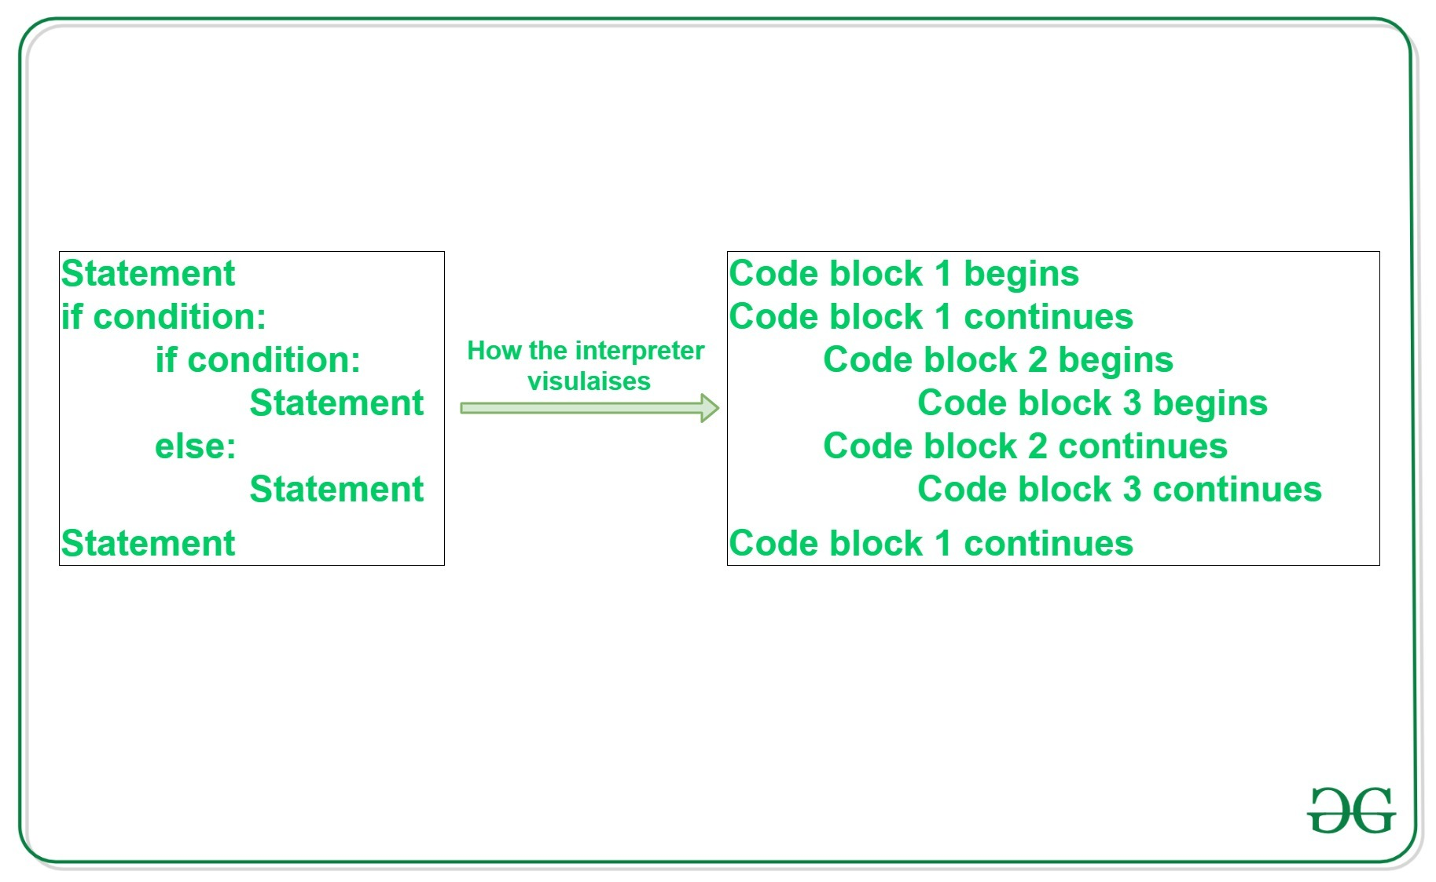
Python Indentation
Python indentation refers to adding white space before a statement to a particular block of code. In another word, all the statements with the same space to the right, belong to the same code block.

Slide 68
Example 1
# Python program showing
# indentation
site = 'gfg'
if site == 'gfg':
print('Logging on to geeksforgeeks...')
else:
print('retype the URL.')
print('All set !')

Slide 69
Output:
Logging on to geeksforgeeks...
All set !

Slide 70
Explanation:
The lines print(‘Logging on to geeksforgeeks…’) and print(‘retype the URL.’) are two separate code blocks. The two blocks of code in our example if-statement are both indented four spaces. The final print(‘All set!’) is not indented, so it does not belong to the else block.

Slide 71
Example 2
To indicate a block of code in Python, you must indent each line of the block by the same whitespace. The two lines of code in the while loop are both indented four spaces. It is required for indicating what block of code a statement belongs to. For example, j=1 and while(j<=5): is not indented, and so it is not within the Python while block. So, Python code structures by indentation.

Slide 72
j = 1
while(j<= 5):
print(j)
j = j + 1

Slide 73
Output:
1
2
3
4

Slide 74
Note: Python uses 4 spaces as indentation by default. However, the number of spaces is up to you, but a minimum of 1 space has to be used.

Slide 75
Thank You

