Slide 1
6
1
Physical Database Node: 1
Associated Virtual Nodes: 256
Hash Value Range:
0 – 65535
5
2
4
3

Slide 2
D₃
Physical Database Node: 1
Associated Virtual Nodes: 32
D₃
Hash Value Range:
0 – 65535

Slide 3
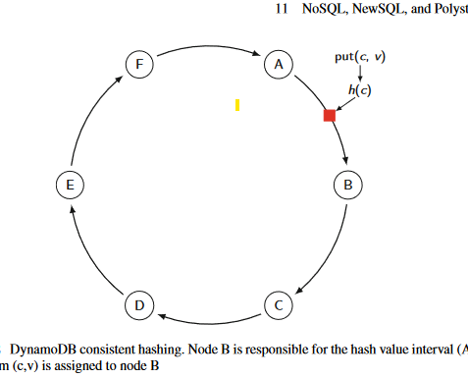
D₃
D₃
Hash Value Range:
0 – 65535

