Slide 1











An Introduction to AWS CloudWatch
Your Eyes on the AWS Cloud

Slide 2















What is AWS CloudWatch?
Amazon CloudWatch is a comprehensive monitoring and management service designed to provide data and actionable insights for AWS, on-premises, hybrid, and other cloud applications and infrastructure resources.
Unified Platform
Real-time Monitoring
Automated Actions
Collects and accesses performance and operational data from a single platform
Monitors AWS resources and applications in real-time for immediate insights
Enables automated responses based on metrics and events to reduce MTTR
Primary Purposes:
Operational Visibility
Application Performance Monitoring
Infrastructure Monitoring
Log Collection & Analysis

Slide 3














The Pillars of Observability
Observability in modern systems is built upon three fundamental pillars, each providing unique insights into application and infrastructure health.
Metrics
Logs
Traces
Time-ordered measurements of system performance
Structured records of events
Request flow through distributed systems
Numerical data points collected over time
Event information for troubleshooting
End-to-end view of requests
Provide insights into system performance
Enable analysis of application behavior
Help identify performance bottlenecks

Slide 4

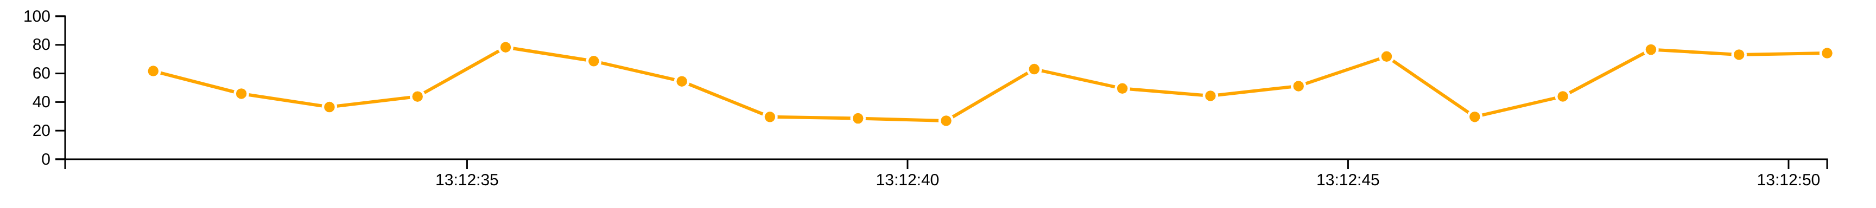









CloudWatch Metrics
CloudWatch Metrics are time-ordered data points representing variables to monitor. They show values over time and are published to CloudWatch by AWS services and custom applications.
Namespaces
Dimensions
Containers for CloudWatch metrics, ensuring isolation between metrics from different applications or services
Name/value pairs forming part of a metric's identity, helping categorize characteristics and allowing filtering (up to 30 dimensions per metric)
Resolution
Statistics
Refers to granularity of metric data (standard: 1-minute, high-resolution: 1-second)
Aggregations of metric data over specified periods (average, sum, minimum, maximum, and percentile)

Slide 5








CloudWatch Logs
CloudWatch Logs enables you to collect, monitor, and analyze log files from AWS resources and applications, providing insights into system operation and application performance.
Log Collection
Log Analysis
Visualization
Gathers log data from various AWS resources and applications automatically
Searches and filters log data for specific patterns and errors
Creates charts and graphs from log data for better understanding

Slide 6










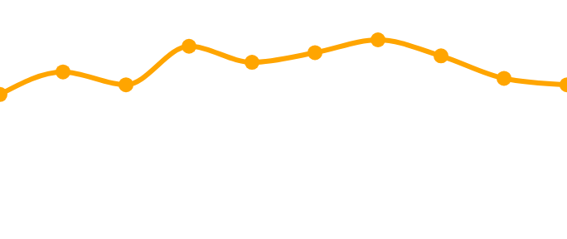
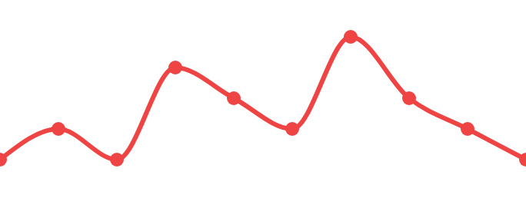

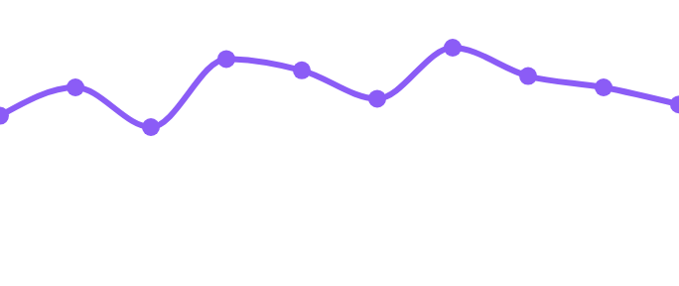








CloudWatch Dashboards & Visualization
What are CloudWatch Dashboards?
Dashboard Overview
24h
Actions
Customizable home pages for monitoring resources across AWS Regions
CPU Utilization
Error Rates
Unified view combining metrics and alarms for comprehensive operational health
AWS provides automatic dashboards for various services to simplify setup
Network I/O
Disk Operations
Key Benefits
Customizable Layout
Multi-Region Support
Integrated Alarms
Real-time Updates
Data refreshes every 5 minutes
Metrics
Alarms

Slide 7













CloudWatch Logs Insights
Query Example
Interactive Query Service
Logs Insights is an interactive query service designed for efficient analysis of log data. It uses a powerful query language to help you quickly search, filter, and visualize logs.
// Basic query to view recent log messages
fields @timestamp, @message
| sort @timestamp desc
| limit 20
1
Fields Selection
Key Benefits
Select timestamp and message fields
Rapid identification of patterns and errors
Sorting
2
Sort by timestamp in descending order
Quick visualization of log data
Search and filter capabilities
Efficient analysis of large log volumes
3
Limiting
Limit to 20 most recent entries
Pro Tip: Logs Insights integrates with CloudWatch Dashboards for a complete monitoring solution.

Slide 8










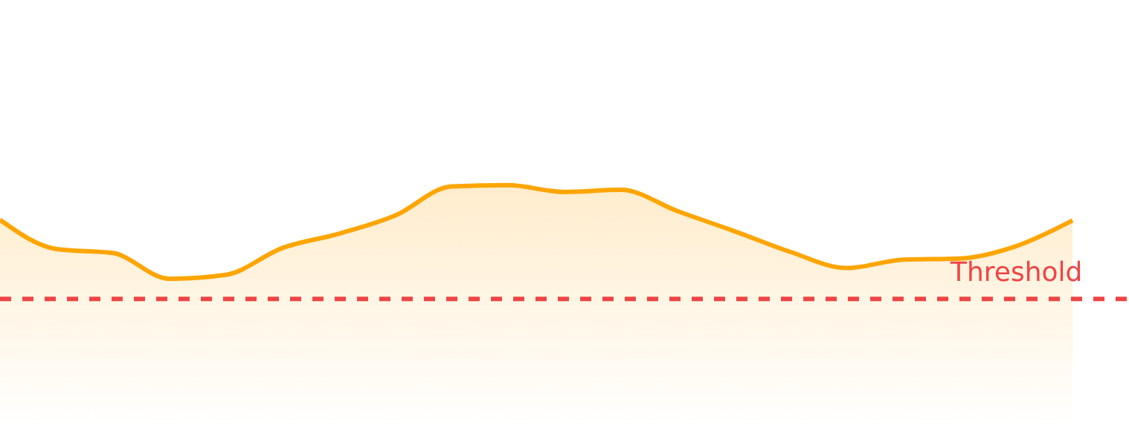






CloudWatch Alarms
What are CloudWatch Alarms?
CloudWatch Alarms monitor metrics and trigger automated actions when values cross predefined thresholds, enabling proactive issue detection and response.
OK
ALARM
INSUFFICIENT
Within threshold
Below threshold
No data
How Alarms Work
Key Features
Notify via SNS when thresholds are crossed
Trigger Auto Scaling to adjust resources
Invoke Lambda functions for automated remediation
Metric Data
Threshold

Slide 9
















CloudWatch Agent
The CloudWatch Agent extends CloudWatch's monitoring capabilities by collecting system-level metrics and logs from Amazon EC2 instances and on-premises servers, providing a unified approach to data collection.
System-Level Metrics
Unified Agent
Collects memory usage, disk space, process lists, and other system-level metrics for performance monitoring
Simplified installation and configuration for consistent monitoring across diverse environments
Log Collection
Hybrid Monitoring
Gathers log files from both Amazon EC2 instances and on-premises servers into a unified platform
Bridges on-premises infrastructure with AWS CloudWatch for consistent operational visibility
Key Benefits:
Simplified Data Collection
Consistent Monitoring
Reduced Configuration Effort

Slide 10

























Service Integration
CloudWatch seamlessly integrates with over 120 AWS services, providing native logging and metrics publishing capabilities for comprehensive monitoring.
EC2 Monitoring
Lambda Monitoring
CPU utilization
Invocation counts
Network I/O
Errors and throttles
Disk operations
RDS Monitoring
S3 Monitoring
Database connections
Request counts
CPU utilization
Data transfer
Read/write latency
Key Benefit: Unified monitoring across your AWS environment with consistent metrics and logging

Slide 11



















CloudWatch Best Practices
Monitor What Matters
Implement Early
Focus on critical metrics that impact business objectives to avoid alert fatigue and concentrate on actionable insights.
Integrate observability into the development lifecycle from day one to reduce rework and accelerate development.
Correlate Data
Set Appropriate Alarms
Combine metrics, logs, and traces to gain a comprehensive view and quickly pinpoint root causes of issues.
Configure alarms with thoughtful thresholds to ensure they are meaningful and actionable, preventing excessive notifications.
Leverage Automation
Utilize Tagging
Use CloudWatch Events and AWS Lambda to automate responses to alerts, scaling actions, and incident management.
Apply consistent tagging to AWS resources to help organize resources, filter monitoring data, and allocate costs effectively.

Slide 12
















Question 1
What are the possible states of a CloudWatch alarm?
A
ACTIVE, INACTIVE, PENDING
B
ON, OFF, PAUSED
C
OK, ALARM, INSUFFICIENT_DATA
D
NORMAL, WARNING, CRITICAL

Slide 13










Correct Answer:
C) OK, ALARM, INSUFFICIENT_DATA
OK
ALARM
INSUFFICIENT_DATA
The metric is within the defined threshold.
The metric is outside the defined threshold.
The alarm has just started or not enough data is available.
A CloudWatch metric alarm monitors a specific metric or a math expression based on metrics and can be in one of these three states. When an alarm transitions to the ALARM state, it can perform configured actions like sending notifications or invoking Lambda functions.

Slide 14
Question 2
What is a composite alarm in CloudWatch?
A
An alarm that monitors multiple metrics across different AWS regions
B
An alarm that includes a rule expression taking into account the alarm states of other alarms
C
An alarm that triggers multiple actions simultaneously
D
An alarm that combines both metric and log data for evaluation

Slide 15









Correct Answer: B
What is a composite alarm in CloudWatch?
An alarm that includes a rule expression taking into account the alarm states of other alarms.
Alarm 1
+
Alarm 2
=
Composite Alarm
Metric Alarm
Metric Alarm
Rule: ALL
More Information
A composite alarm includes a rule expression that considers the alarm states of other alarms you've created. It goes into an ALARM state only if all conditions of its rule are met, helping to reduce alarm noise.

Slide 16




Question 3
What is the difference between standard resolution and high-resolution metrics?
A
Standard resolution metrics are free, while high-resolution metrics incur charges
B
Standard resolution metrics are stored for 15 months, while high-resolution metrics are stored for 30 days
C
Standard resolution metrics have a one-minute granularity, while high-resolution metrics can have up to one-second granularity
D
Standard resolution metrics can't be used for alarms, while high-resolution metrics can

Slide 17


Correct Answer: C
Standard resolution metrics have a one-minute granularity, while high-resolution metrics can have up to one-second granularity.
Explanation:
Standard resolution metrics are stored for 15 months with one-minute granularity, meaning data points are collected every minute. High-resolution metrics, on the other hand, are stored for 30 days with up to one-second granularity, providing more detailed and immediate insights into your resources' behavior.
Metric Granularity Comparison:

Slide 18

















Stay Connected with Our Cloud Computing Journey!
Dive deeper into the cloud world! Check out our specialized playlists for your continuous learning journey!
Like this video if you found it helpful!
Subscribe for cloud tech updates!
Comment below which cloud topic you want to see next like:
Cloud Security Tips
Cost Optimization Strategies
Multi-Cloud Management
Serverless Computing
Cloud Migration Steps
Anything you'd like 🙂

