Slide 1

Introduction to Amazon CloudTrail

Slide 2
What is Amazon CloudTrail?
Amazon CloudTrail is a governance, compliance, and auditing service for AWS.
It records AWS API calls and user activity across your AWS account.
Provides visibility into who did what, when, and from where.
Helps ensure account security and operational transparency

Slide 3
Why CloudTrail
Audit user activity for security and compliance.
Detect unusual API calls or unauthorized access.
Track resource changes for troubleshooting.
Support incident investigations.
Enable compliance with standards like PCI-DSS, HIPAA, and ISO.

Slide 4
How CloudTrail Works
Every action in AWS is an API call (via Console, CLI, SDK, or Service).
CloudTrail records these calls as events.
Events are delivered to an S3 bucket or sent to CloudWatch Logs/EventBridge.
You can analyze logs, set alerts, or automate responses.

Slide 5
Types of Events in CloudTrail
Management Events:
Actions on AWS resources (e.g., CreateBucket, StartInstances).
Logged by default for all trails.
Data Events:
High-volume, object-level actions.
Example: S3 GetObject, Lambda InvokeFunction.
Insights Events:
Detect unusual behavior such as increased API failures or volume spikes.

Slide 6
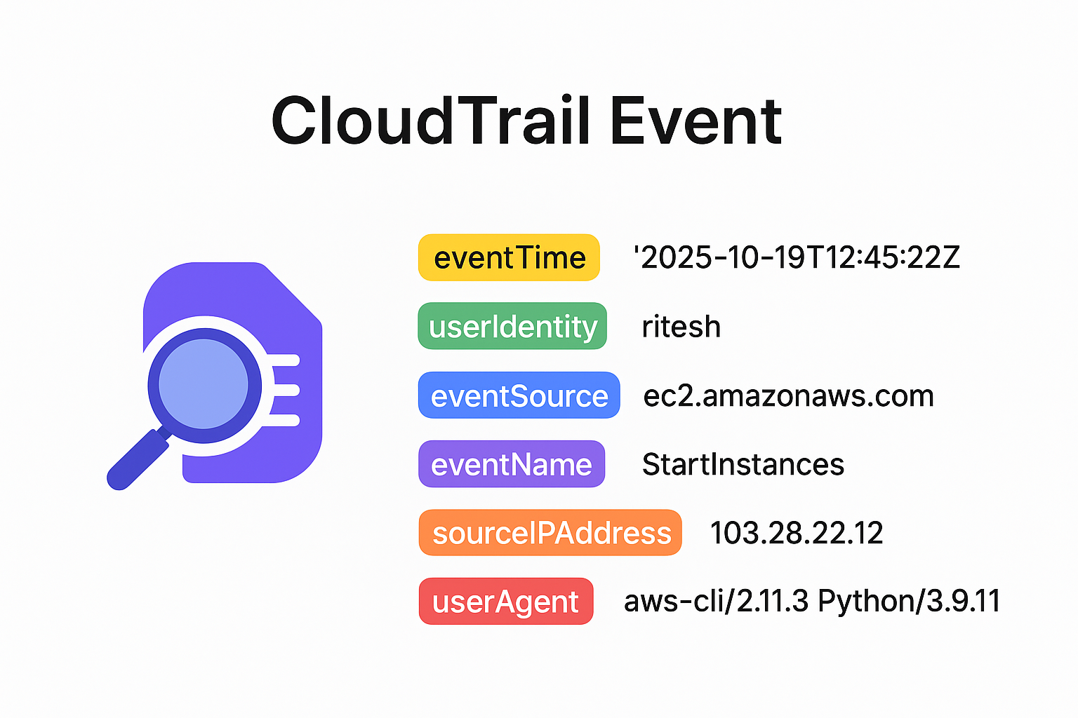
CloudTrail Event Structure
Each event is in JSON format, containing:
EventTime: When the action happened.
EventSource: Service name (e.g., ec2.amazonaws.com).
EventName: Action (e.g., StartInstances).
UserIdentity: Who performed the action.
SourceIPAddress: Where it came from.
RequestParameters / ResponseElements: Details of the request.

Slide 7

Thank you
Explore my other Cloud Computing Playlists for more learning

