Slide 1

Global Infrastructure AWS

Slide 2
Region
Each AWS Region is designed to be isolated from the other AWS Regions. This design achieves the greatest possible fault tolerance and stability.
When you view your resources, you see only the resources that are tied to the AWS Region that you specified. No replication by default.
Examples: - Region Name | Region Code
US East (N. Virginia) | us-east-1
US West (Oregon) | us-west-2
Asia Pacific (Mumbai) | ap-south-1
Europe (Frankfurt) | eu-central-1
Asia Pacific (Tokyo) | ap-northeast-1
South America (São Paulo) | sa-east-1

Slide 3

Availability Zone
An Availability Zone (AZ) is one or more discrete data centers with redundant power, networking, and connectivity in an AWS Region.
AZs are physically separated by a meaningful distance, many kilometers, from any other AZ, although all are within 100 km (60 miles) of each other.

Slide 4

Data Center
A data center is a physical location that stores computing machines and their related hardware equipment. It contains the computing infrastructure that IT systems require, such as servers, data storage drives, and network equipment. It is the physical facility that stores any company’s digital data.

Slide 5
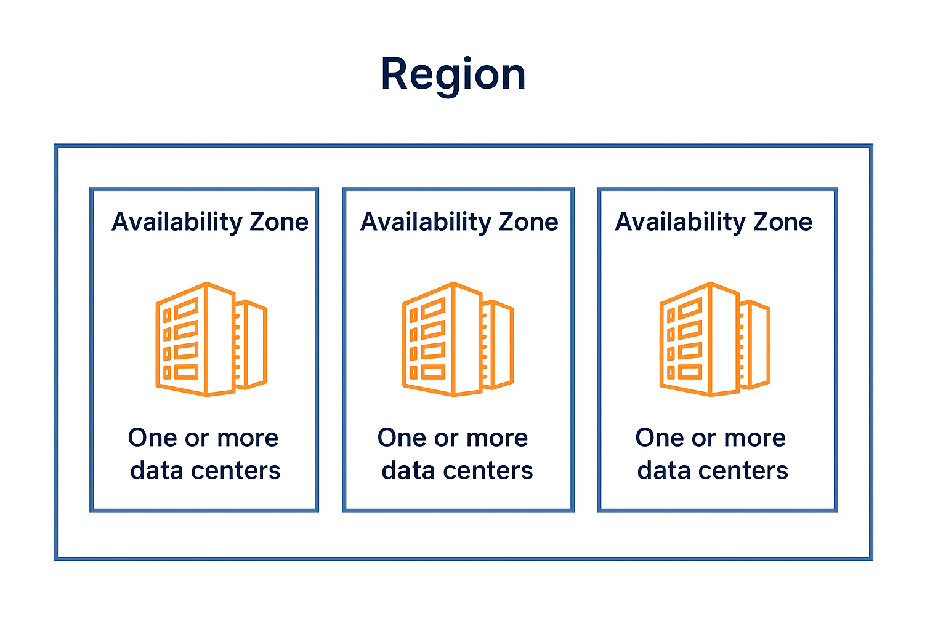
Notes:
Each Region is designed to be isolated from the other Regions. This achieves the greatest possible fault tolerance and stability.
Most AWS services support regional resources. A regional resource is specific to the Region in which you create it. When you view your AWS resources, you must specify a Region, and then you see only the resources that are tied to that Region. You can replicate some types of resources across Regions, but we don't automatically replicate them for you.
https://aws.amazon.com/about-aws/global-infrastructure/
Explain Region Codes
Where to See region in User interface
Where to see Availability Zone in User Interface

Slide 6
Region Selection
Latency
Data compliance
Pricing
Service availability
Notes:
When determining the right Region for your services, data, and applications, consider these four business factors:
Latency: When possible, select a Region that is close to your customers so you can deliver content to them quickly. For example, if your customers are in Japan, you might select the Asia Pacific (Tokyo) Region for your applications.
Data compliance: Depending on your company and location, you might need to run your data out of specific locations. For example, if your company requires all of its data to reside within the boundaries of the UK, you will choose the London Region. Not all companies have location-specific data regulations or compliance requirements.
Pricing: Costs vary by Region. For example, if you run an application in the United States and Brazil, Brazil’s tax structure might result in your company paying 50% more to run the same workload out of the São Paulo Region compared to the Oregon Region.
Service availability: Some AWS services are available in only a select number of Regions. You should always check the service availability before selecting a Region.

Slide 7
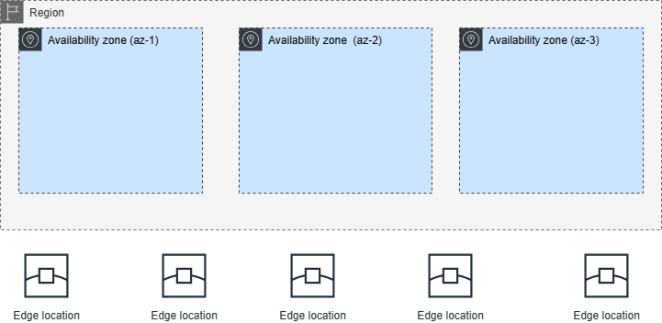
Edge Locations
AWS Edge Locations are data centers distributed across the world that deliver content to users with low latency meaning faster performance.

Slide 8
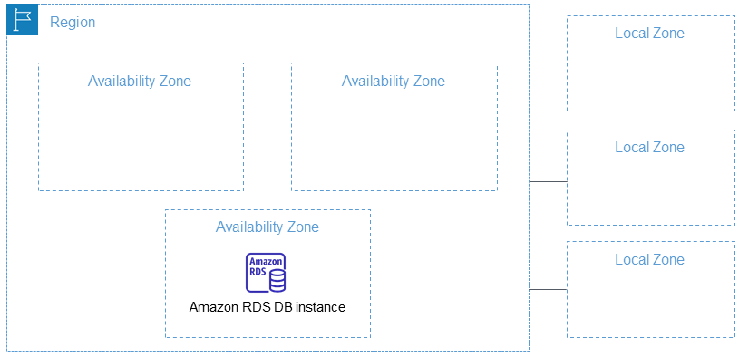
AWS Local Zones
AWS Local Zones places compute, storage, database, and other select AWS resources close to large population and industry centers. You can use Local Zones to provide your users with low-latency access to your applications.

Slide 9

Thank you
Explore my other Cloud Computing Playlists for more learning

