Slide 1
Identity and Access Management
Notes:
Whenever we talk about AWS security, the very first service that comes into play is IAM. IAM is like the security guard of AWS — it decides who can enter, what they can access, and what actions they can perform. Without IAM, managing access in AWS would be impossible

Slide 2
Identity and Access Management
Securely control access to AWS resources.
Managing access permissions for AWS resources.
Control Authentication and Authorization.
IAM is a global service.
Notes:
IAM helps us securely control access to AWS resources. It basically answers who can access what inside AWS. Using IAM, we control two things — authentication, which is about signing in, and authorization, which is about what actions are allowed. One more key point is that IAM is a global service, so it’s not limited to a region like EC2 or S3.

Slide 3

Root user
Created automatically when AWS account is created
Has unrestricted access to all AWS resources
Should not be used for daily tasks
Protect with MFA and strong password
Use IAM Users/Roles instead for operations
Notes:
The root user is the account that gets created when you first set up AWS. It has full, unrestricted access to everything in AWS, including billing and account settings. Because of this power, AWS best practice is never to use the root user for day-to-day tasks. Instead, we create IAM users and roles for regular operations. The root user should only be used for very specific activities, like changing billing info or closing the account. Also, always secure the root user with multi-factor authentication

Slide 4

IAM Users 👤
Individual identities in AWS
Have credentials: username/password or access keys
Assigned permissions using policies
Best practice: assign users to Groups, not policies directly
Used for developers, admins, or applications (programmatic access)
Notes:
IAM Users represent individual identities inside an AWS account. They can sign in with a username and password, or access programmatically using access keys. Permissions for users are managed through policies, but the best practice is to assign them to a group and give policies to the group instead of attaching policies directly to each user. Typically, IAM users are created for developers, administrators, or applications that need direct AWS access

Slide 5
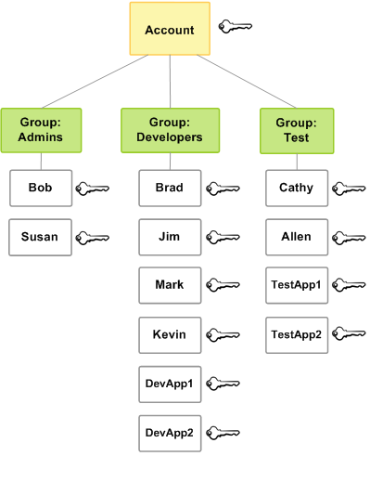
IAM Groups 👥
Collection of IAM Users
Simplifies permission management
A user can belong to multiple groups
Best practice: manage access through groups

Slide 6
IAM Roles
Role Type | Description
Service Role | Used by AWS services (e.g., EC2 accessing S3)
Cross-Account Role | Allow access between AWS accounts
Federated Role | Used with SSO or identity providers (e.g., Okta, Google)
Task/Function Role | Used by Lambda functions or ECS tasks
IAM Role = Temporary access to AWS resources
Similar to users, but no long-term credentials (password or access keys)
Used by AWS services, applications, or users to assume permissions dynamically

