Slide 1
What is Cloud Computing
Notes:
Hello everyone and welcome to AWS Cloud Fundamentals! In this course, we’ll start from the very basics of cloud computing and move step by step into Amazon Web Services. Even if you have zero background in cloud, don’t worry — by the end of this course you’ll be confident in using AWS services with hands-on practice

Slide 2

Module Agenda
What is Cloud Computing?
Benefits of Cloud Computing
Notes:
In this module, we’ll build the foundation of our entire cloud learning journey.
We’ll start by understanding what cloud computing really is, why businesses are shifting from traditional IT to the cloud, and the advantages like scalability, flexibility, and cost savings.
Next, we’ll explore the Cloud Service Models. Infrastructure as a Service, Platform as a Service, and Software as a Service and understand how each one is used in the real world.
We’ll also cover the Cloud Deployment Models . Public, Private, Hybrid, and Multi-Cloud and learn when organizations choose each model.
Then, we’ll move into Amazon Web Services, the leading cloud provider with over 200 services trusted by companies of all sizes from startups to enterprises like Netflix and NASA.
Finally, we’ll go deeper into the AWS Global Infrastructure Regions, Availability Zones, and Edge Locations and see how this architecture delivers global reach, low latency, and hiModulegh availability.
So let’s get started with Introduction to Cloud & AWS.”

Slide 3
Cloud Computing
Cloud Computing is the delivery of computing services such as servers, storage, databases, networking, software, and analytics over the internet.
Instead of buying and maintaining physical hardware, organizations can rent resources from cloud providers like AWS
Notes:
Cloud Computing is the delivery of computing services such as servers, storage, databases, networking, software, and analytics over the internet. Instead of buying and maintaining physical hardware, organizations can rent resources from cloud providers like AWS, Azure or GCP.
The key benefit is that you only pay for what you use, without upfront investments. It’s highly scalable, meaning you can increase or decrease resources as per demand. Plus, it gives global accessibility you can access your applications and data from anywhere, anytime.
This shift allows businesses to innovate faster, reduce costs, and improve agility compared to traditional on-premises IT

Slide 4
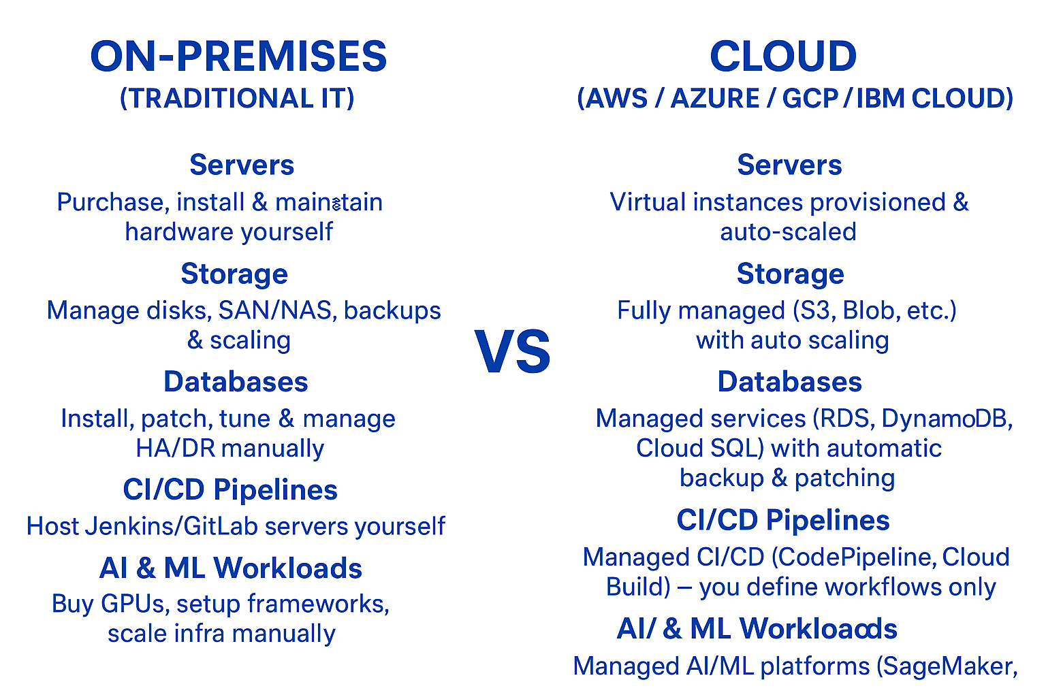
On-premises vs Cloud

Slide 5
Cloud Computing Benefits
On-demand delivery of IT resources.
Pay-as-you-go
Provides scalability
Offers global access
No upfront hardware cost
Ensures high availability & disaster recovery options.
Notes:
Cloud computing is simply the delivery of computing services over the internet. These services include servers, storage, databases, networking, software, analytics, and more.
Instead of buying and maintaining expensive physical datacenters and servers, you can rent IT resources from a cloud provider like AWS, Azure and GCP.
The key advantages are:
On-demand access – You can launch resources anytime, from anywhere.
Pay-as-you-go – You only pay for what you use, just like your electricity bill.
No upfront investment – No need to spend millions/billions on hardware, cooling, or maintenance.
Scalability & Flexibility – You can instantly scale up when demand increases and scale down when demand decreases.
For example, if a company wants to launch a website, instead of buying servers, they can quickly create a virtual server on AWS within minutes.

Slide 6
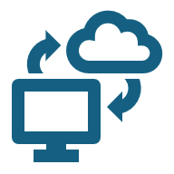
AWS Use cases
Website Hosting
Application Hosting
Data Analytics & Big Data
Machine Learning & Artificial Intelligence
DevOps & CI/CD Automation
Game Development
Enterprise IT Applications (SAP, Oracle, etc.)
IoT (Internet of Things)
Database Hosting (RDS, DynamoDB, Aurora)

Slide 7
Thank you
Explore my other Cloud Computing Playlists for more learning

