Slide 1
Amazon Virtual Private Cloud (Amazon VPC)

Slide 2
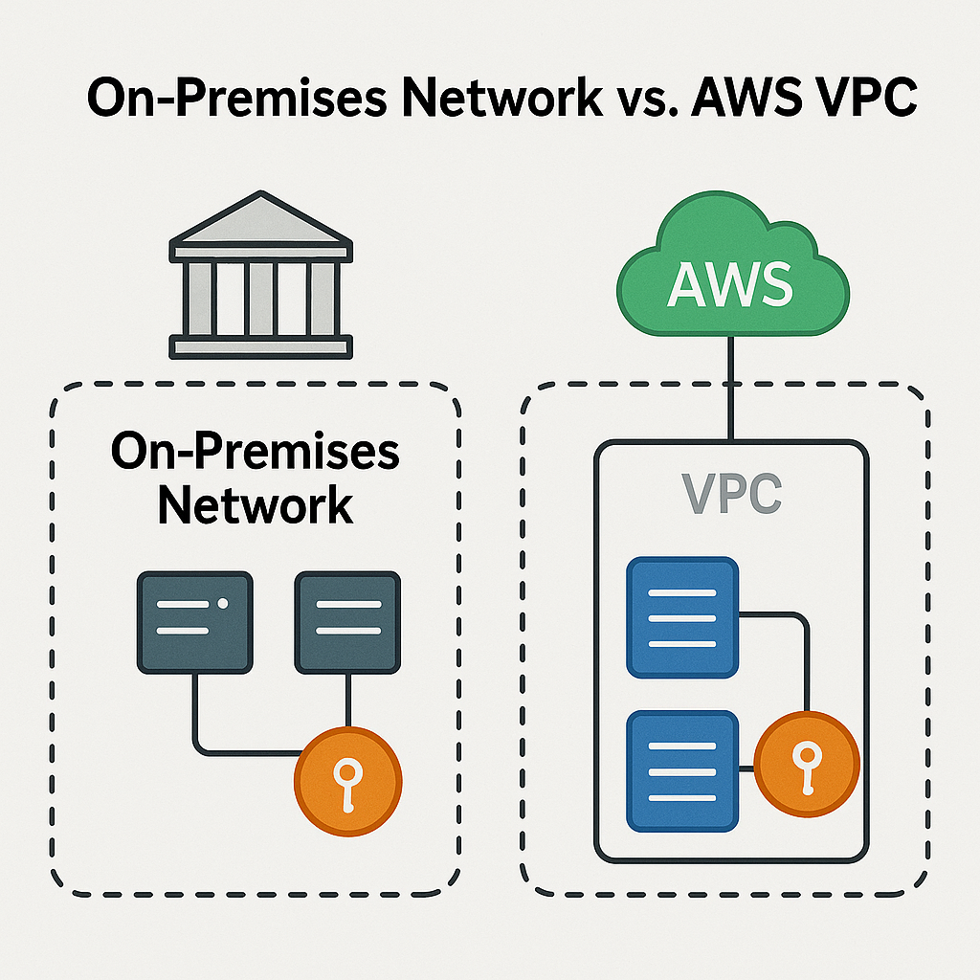
What do you get with a VPC?
Private isolated network space
Custom setup
Internet access control
Notes:
Private space: Only you control who gets in and out.
Custom setup: You decide how many servers, where they go (subnets), and who can talk to whom (firewalls/security groups).
Internet access control: You choose which parts of your roomc an connect to the internet and which should stay isolated.

Slide 3
Notes:
Think of a VPC as a virtual version of your traditional on-premises data center. Just like in a physical setup, you have control over your servers, network layout, firewalls, and access policies. The difference is, with a VPC, all of this is hosted in the cloud, so you get the same level of control and security — but without the need to manage physical hardware or worry about power, cooling, and space

Slide 4
Classless Inter-Domain Routing (CIDR)
Classless Inter-Domain Routing (CIDR) is a method for allocating IP addresses on the internet. It improves efficiency by allowing for variable-length subnet masks and flexible address allocation, enabling better use of IP address space
Notes:
Prefix and Suffix:
A CIDR address is written as an IP address followed by a slash "/" and a number (the suffix), which indicates the number of bits used for the network portion of the address.
Example:
192.168.1.0/24 means that the first 24 bits of the IP address are used to define the network, and the remaining 8 bits are used for host addresses.

Slide 5
Public IP Address
Assigned by your Internet Service Provider (ISP) and is accessible over the internet.
Used for communication between devices over the internet.
Must be globally unique.
Example: 203.0.113.5
Routers, servers, or any device that needs to be accessible from outside a local network.

Slide 6
Private IP Address
An IP address that is used within a private network (like your home, office, or cloud VPC).
Used for communication between devices within the same network.
Must be unique within the local network but can be reused across different networks.
Example Ranges:
10.0.0.0 – 10.255.255.255
172.16.0.0 – 172.31.255.255
192.168.0.0 – 192.168.255.255
Computers, printers, IoT devices inside a local network.

Slide 7
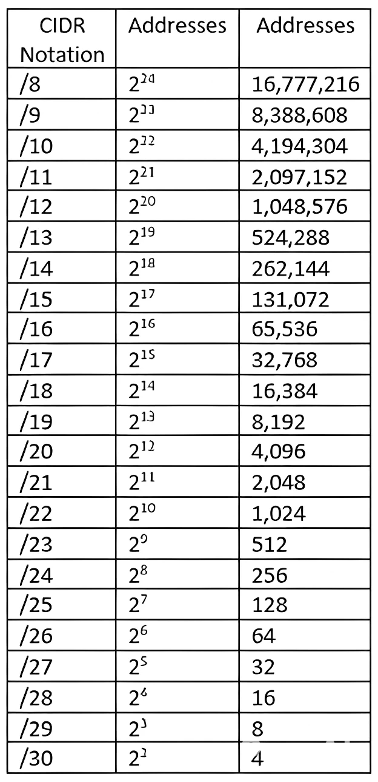
CIDR Chart

Slide 8
Features
Virtual private clouds (VPC)
Subnets
IP addressing
Routing
Internet Gateway
NAT Gateway
Peering connections
Notes:
Virtual private clouds (VPC)A VPC is a virtual network that closely resembles a traditional network that you'd operate in your own data center. After you create a VPC, you can add subnets.
Subnets A subnet is a range of IP addresses in your VPC. A subnet must reside in a single Availability Zone. After you add subnets, you can deploy AWS resources in your VPC.
IP addressing You can assign IP addresses, both IPv4 and IPv6, to your VPCs and subnets. You can also bring your public IPv4 addresses and IPv6 GUA addresses to AWS and allocate them to resources in your VPC, such as EC2 instances, NAT gateways, and Network Load Balancers.
Routing Use route tables to determine where network traffic from your subnet or gateway is directed.
Gateways and endpoints A gateway connects your VPC to another network. For example, use an internet gateway to connect your VPC to the internet. Use a VPC endpoint to connect to AWS services privately, without the use of an internet gateway or NAT device.
Peering connections Use a VPC peering connection to route traffic between the resources in two VPCs.
Traffic Mirroring Copy network traffic from network interfaces and send it to security and monitoring appliances for deep packet inspection.
Transit gateways Use a transit gateway, which acts as a central hub, to route traffic between your VPCs, VPN connections, and AWS Direct Connect connections.
VPC Flow Logs A flow log captures information about the IP traffic going to and from network interfaces in your VPC.
VPN connections Connect your VPCs to your on-premises networks using AWS Virtual Private Network (AWS VPN).

Slide 9
Amazon VPC
Isolated Environment for Your Resources
Required for Most AWS Services
Security Control
Controlled Internet Access
Full Network Customization
Connect With On-Prem
Notes:
Why Do We Need a VPC in AWS?
🏡 Isolated Environment for Your Resources
VPC gives you a private, secure space in the AWS cloud — like your own virtual data center.
💡 Required for Most AWS Services
Services like EC2, RDS etc., run inside a VPC — it’s the foundation for most AWS networking.
🔐 Security Control
You can set who can access what using firewalls (Security Groups & NACLs), private/public subnets, etc.
🌐 Controlled Internet Access
You decide if resources can connect to the internet (via Internet Gateway, NAT, etc.) or stay internal.
🧩 Full Network Customization
Choose your own IP ranges, create subnets, route traffic how you want — just like on-prem networking, but in the cloud.
🔄 Connect With On-Prem
You can connect your VPC to your physical data center using VPN or Direct Connect for hybrid cloud setups.

Slide 10
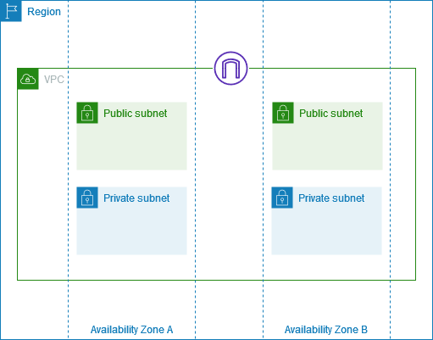
Subnets
Each subnet must have its own unique IP range – no two subnets can share the same addresses
Each subnet must reside entirely within one Availability Zone and cannot span zones
Notes:
Definition: A subnet is a range of IP addresses in your VPC (Virtual Private Cloud).
Types of Subnets:
Public Subnet: Connected to the internet via an Internet Gateway.
Private Subnet: No direct access to the internet (can access via NAT Gateway).
Isolated Subnet: No internet access, used for internal services.
Subnet Association: Subnets must be associated with a single Availability Zone (AZ).
CIDR Block: Each subnet is assigned a subset of the VPC’s CIDR block.
Routing:
Controlled by Route Tables.
Route Tables determine how traffic is directed (e.g., to internet, NAT gateway, peering connections).
Security:
Controlled via Network ACLs and Security Groups.
Subnets can have different security configurations even within the same VPC.
Auto-assignment of Public IPs: Can be enabled/disabled per subnet.
Resource Placement: AWS resources like EC2 instances must be launched within a specific subnet.
IPv4 & IPv6 Support: Subnets can support both IP versions.
Subnet Sizing:
Must be at least a /28 netmask (16 IPs).
AWS reserves 5 IP addresses per subnet.

Slide 11
Public subnets
Typically used for public-facing resources like:
EC2 instances running web servers
Load balancers
Instances have public IP or Elastic IP
Has a route to the Internet Gateway (IGW)
Notes:
|Instructor notes
|This simple overview explains the components that are required of a public subnet. The following slides discuss each of the three components in more detail. You only need to focus on the purpose of each component and establish the narrative. Traffic enters and exits the VPC through the internet gateway, and resources on the network use a public IP when communicating with the internet. A route table directs network traffic and can direct traffic through the internet gateway.
|
|Student notes
Your public subnet configuration acts as a two-way door — which allows traffic to flow in either direction, invited or not invited. Because it has no automatic outbound routing, you must configure a subnet to be public.
A public subnet requires the following:
Internet gateway: The internet gateway allows communication between resources in your VPC and the internet.
Route table: A route table contains a set of rules (routes) that are used to determine where network traffic is directed. It can direct traffic to the internet gateway.
Public IP addresses: These addresses are accessible from the internet. Public IP addresses obscure the private IP addresses, which are only reachable within the network.

Slide 12
Internet gateways
Internet gateways permit communication between instances in your VPC and the internet.
They provide a target in your subnet route tables for internet-routable traffic.
It protects IP addresses on your network by performing network address translation (NAT).
Notes:
|Student notes
An internet gateway is a horizontally scaled, redundant, and highly available VPC component that permits communication between instances in your VPC and the internet. It imposes no availability risks or bandwidth constraints on your network traffic. An internet gateway supports IPv4 and IPv6 traffic.
An internet gateway serves two purposes:
It provides a target in your route table for internet-routable traffic.
It protects IP addresses on your network by performing NAT.
Provides a target in your route table for internet-routable traffic
A subnet does not allow outbound traffic by default. Your VPC uses route tables to determine where to route traffic. To allow your VPC to route internet traffic, you create an outbound route in your route table with an internet gateway as a target, or destination.
Protects IP addresses on your network by performing NAT
Resources on your network that connect to the internet should use two kinds of IP addresses:
Private IP: Use private IPs for communication within your private network. These addresses are not reachable over the internet.
Public IP: Use public IP addresses for communication between resources in your VPC and the internet. A public IP address is reachable over the internet.

Slide 13
Private subnets
No Direct Internet Access
Secure Communication
NAT for Outbound Access
Used in Multi-Tier Architectures
Notes:
|Student notes
Private subnets allow indirect access to the internet. Traffic stays within your private network. A private IP address assigned to an Amazon Elastic Compute Cloud (Amazon EC2) instance will never change unless you manually assign a new IP address on the network interface of the EC2 instance.
You can put web-tier instances into a public subnet. However, we recommend that you put web-tier instances inside private subnets behind a load balancer placed in a public subnet. Elastic Load Balancing is discussed later in this course.

Slide 14
Route tables
A route table contains a set of rules, called routes, that are used to determine where network traffic from your VPC is directed.
Each route in a route table specifies the range of IP addresses where you want the traffic to go (the destination) and the gateway, network interface, or connection through which to send the traffic (the target).
Notes:
|Instructor notes
|It is worth mentioning the use of the 0.0.0.0/0 CIDR range in the public route table
|
|Student notes
A route table contains a set of rules (routes) that the VPC uses to determine where to direct network traffic. When you create a VPC, it automatically has a main route table. Initially, the main route table (and every route table in a VPC) contains only a single route. This local route permits communication for all the resources within the VPC. You can't modify the local route in a route table. Whenever you launch an instance in the VPC, the local route automatically covers that instance. You can create additional custom route tables for your VPC.
Each subnet in your VPC must be associated with a route table. If you don't explicitly associate a subnet with a particular route table, the subnet is implicitly associated with and uses the main route table. A subnet can be associated with only one route table at a time, but you can associate multiple subnets with the same route table. Use custom route tables for each subnet to permit granular routing for destinations.
In this example, both route tables direct network traffic locally, but the public route table includes routes to the internet gateway.
For more information, see “Configure route tables” in the Amazon Virtual Private Cloud User Guide at https://docs.aws.amazon.com/vpc/latest/userguide/VPC_Route_Tables.html.

Slide 15

Default Amazon VPCs
Comes Pre-Configured
Includes 1 Subnet per Availability Zone
Has an Internet Gateway
Default Route Table
Security Groups & NACLs
Public IP Assignment Enabled
Notes:
|Student notes
Each AWS account comes with a default Amazon VPC that is preconfigured for you to use immediately. The default Amazon VPC is suitable for getting started quickly and for launching public instances, such as a blog or simple website.
This diagram is a default Amazon VPC. The CIDR block for the default VPC is always a /16 subnet mask. In this example, the CIDR block of 172.31.0.0/16 means that this VPC can provide up to 65,536 IP addresses. It includes one public subnet in each Availability Zone in the Region. These subnets use a /20 subnet mask, which provides 4,096 addresses per subnet. It also includes an internet gateway. The VPC uses a main route table to connect the subnets to the internet gateway.
For more information about how to modify the IPv4 address range, see “How do I modify the IPv4 CIDR block of my Amazon VPC?” at https://aws.amazon.com/premiumsupport/knowledge-center/vpc-ip-address-range/.

