Slide 1
What is Amazon RDS?

Slide 2
Amazon RDS (Relational Database Service)
Amazon RDS (Relational Database Service) is a fully managed database service from AWS.
Makes it easy to set up, operate, and scale a relational database in the cloud.
AWS automates:
Database provisioning
Patch management
Backup and restore
Monitoring and scaling

Slide 3

Supported Database Engines
Amazon Aurora (MySQL/PostgreSQL compatible)
MySQL
PostgreSQL
MariaDB
Oracle Database
Microsoft SQL Server

Slide 4
DB instance classes
A DB instance class determines the computation and memory capacity of a DB instance.
General purpose – db.m*
Memory optimized – db.z*, db.x*, db.r*
Compute optimized – db.c*
Burstable performance – db.t*

Slide 5
DB instance storage
Amazon EBS provides durable, block-level storage volumes that you can attach to a running instance.
Examples : -
General Purpose (SSD)
Provisioned IOPS (PIOPS)
Magnetic

Slide 6
Why Use Amazon RDS?
Fully managed service — no manual DB administration.
Automatic backups and patching.
High availability with Multi-AZ deployments.
Automatic failover and read replicas for performance.
Scalability — easily increase compute/storage.
Integrated with CloudWatch for monitoring.

Slide 7
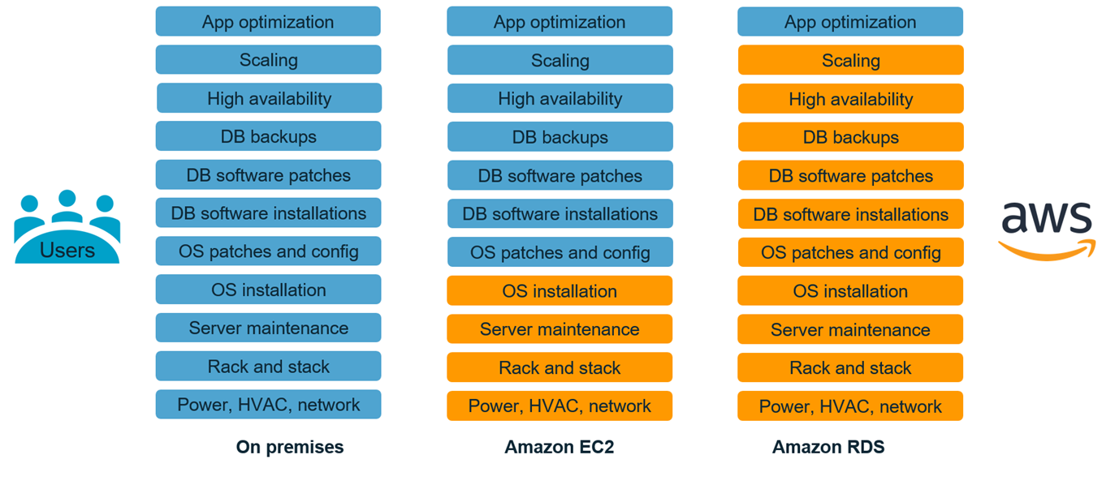
Database hosting options

Slide 8

Thank you
Explore my other Cloud Computing Playlists for more learning

