Slide 1

Shared Responsibility Model

Slide 2
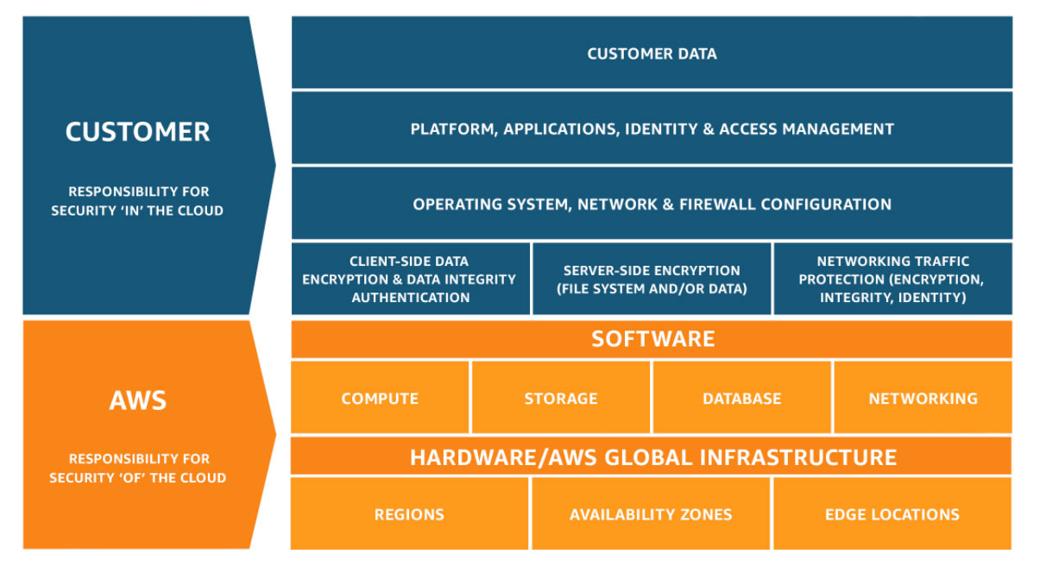

Slide 3
AWS is Responsible for: “Security of the Cloud”
AWS manages and secures the infrastructure that runs all the services offered in the AWS Cloud.
AWS Responsibilities:
Physical security of data centers (guards, access control, surveillance)
Hardware, network, and facility infrastructure
Storage devices and networking equipment
Virtualization layer (like hypervisors)
Managed service components (for services like RDS, DynamoDB, Lambda, etc.)
Example:
AWS ensures that EC2 servers, data centers, and network devices are patched, redundant, and secure.

Slide 4
Customer is Responsible for: “Security in the Cloud”
You manage and secure everything you put on or configure within AWS.
Customer Responsibilities:
Configuring access (IAM users, roles, and permissions)
Managing OS patches, firewall rules, and antivirus (for EC2 instances)
Encrypting your data (at rest and in transit)
Managing application code and data security
Setting up network controls (Security Groups, NACLs, etc.)
Compliance with laws and governance (e.g., GDPR, HIPAA)
Example:
If you run a web app on EC2, AWS secures the server hardware, but you must patch the OS, configure IAM

Slide 5
Responsibility Varies by Service Type
Service Type | Who Manages More? | Examples
Infrastructure (IaaS) | Customer has more control & responsibility | EC2, VPC, EBS
Platform (PaaS) | AWS manages infrastructure & runtime | RDS, Elastic Beanstalk
Software (SaaS) | AWS manages almost everything | WorkMail, Chime

