Slide 1
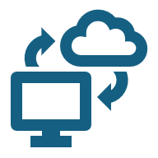
VPC (Virtual Private Cloud)
Notes:
A VPC is a logically isolated section of the cloud where we can launch and manage resources like servers, databases, and storage in a secure environment.”
Why VPC is Needed:

Slide 2
What is a VPC?
Isolated virtual network in AWS
01
launch AWS resources in your own private network
02
Gives full control over Network
03
Can be connected to the Internet or kept fully private
04
Notes:
A VPC is a logically isolated virtual network in AWS. Think of it as your own private data center in the cloud where you have full control over networking.
“Isolated virtual network in AWS”. Resources inside a VPC are isolated from other VPCs by default. This means EC2 instances or databases in your VPC cannot communicate with other VPCs unless you explicitly allow it.
Example: You can have one VPC for your production environment and another VPC for testing, fully separate.
“Lets you launch AWS resources in your own private network”
You can launch EC2 instances, RDS databases, Lambda functions, and other AWS services inside your VPC. The network is fully configurable according to your needs.
Example: Place your web servers in a public subnet and your database in a private subnet to secure it.
“Gives full control over networking: IPs, subnets, route tables, gateways”
You define:
CIDR blocks → the IP address range of your VPC
Subnets → public and private subdivisions of your VPC
Route tables → rules for traffic flow between subnets and the Internet
Gateways → Internet Gateway for internet access, NAT Gateway for private subnet outbound traffic
Example:
Public subnet with Internet Gateway → web server accessible from Internet
Private subnet with NAT Gateway → database can access updates on Internet but is not directly exposed

Slide 3
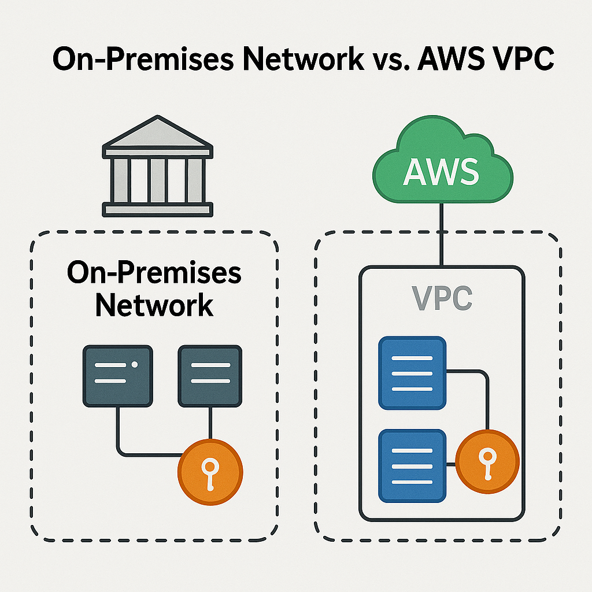
What do you get with a VPC?
Private isolated network space
Custom setup
Internet access control
Notes:
Private space: Only you control who gets in and out.
Custom setup: You decide how many servers, where they go (subnets), and who can talk to whom (firewalls/security groups).
Internet access control: You choose which parts of your roomc an connect to the internet and which should stay isolated.

Slide 4
Public IP vs Private IP
Public IP:
Reachable over the Internet
Private IP:
Only reachable within the VPC or connected networks
Notes:
Public Ip: -
Assigned by AWS automatically or manually (Elastic IP)
Used for internet-facing resources like web servers
Private Ip: -
Assigned automatically to EC2 instances in subnets
Used for internal communication between servers, databases, or private apps

Slide 5
IPV4 and IPV6
IPv4:
32-bit address → e.g., 192.168.1.1
~4.3 billion addresses
Most commonly used in AWS VPCs today
IPv6:
128-bit address → e.g., 2001:0db8:85a3::8a2e:0370:7334
Huge address space → almost unlimited addresses
Used for future-proofing and global Internet connectivity

Slide 6
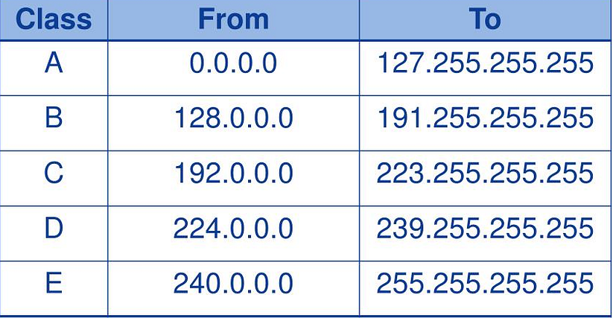
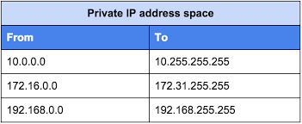
IP Addresses classes
CIDR (Classless Inter-Domain Routing)

Slide 7
CIDR (Classless Inter-Domain Routing)
CIDR / Prefix | Number of IPs
/16 | 65,536
/17 | 32,768
/18 | 16,384
/19 | 8,192
/20 | 4,096
/21 | 2,048
/22 | 1,024
/23 | 512
/24 | 256
/25 | 128
/26 | 64
/27 | 32
/28 | 16
/29 | 8
/30 | 4
/31 | 2
/32 | 1
Defines IP address range for VPC or subnet
Format: IP_address / prefix (e.g., 1 0.0.0.0/16)
Prefix (/16, /24, etc.) determines number of IP addresses:
/16 → 65,536 IPs
/24 → 256 IPs
Helps divide VPC into subnets(public/private)

Slide 8
What is a Subnet?
Subnet = Subnetworks
A smaller segment of a VPC IP address range
Helps organize resources and control traffic flow
Example:
VPC = 10.0.0.0/26 (64 IPs)
Public Subnet = 10.0.0.0/27 (32 IPs)
Private Subnet = 10.0.0.32/27 (32 IPs)
Notes:
Separation of resources → public vs private
Security → apply different Security Groups and NACLs
High availability → spread subnets across multiple Availability Zones
Traffic control → route tables manage inbound/outbound traffic

Slide 9
Reserved IP Addresses
10.0.0.0: Network address.
10.0.0.1: Reserved by AWS for the VPC router.
10.0.0.2: Reserved by AWS. The IP address of the DNS server is the base of the VPC network range plus two.
10.0.0.3: Reserved by AWS for future use.
10.0.0.255: Network broadcast address. We do not support broadcast in a VPC, therefore we reserve this address.

Slide 10
Internet Gateway (IGW)
A horizontally scaled, redundant AWS managed gateway that allows communication between your VPC and the Internet.
Connects public subnets to the Internet
Enables inbound and outbound traffic for Internet-facing resources
Must be attached to a VPC to function
Route tables must have a 0.0.0.0/0 route via IGW for public subnets
Notes:
An Internet Gateway is like a door to the Internet for your VPC. It allows resources in public subnets to send and receive traffic from the Internet.
Key Features to Highlight:
Horizontally scaled & redundant → no single point of failure
Can be attached only once per VPC, but supports multiple subnets
Only affects public subnet traffic; private subnets still need NAT Gateway for outbound Internet
How it Works:
Attach IGW to your VPC
Update route table of public subnet:
Destination 0.0.0.0/0 → Target = IGW
Resources in the subnet now have Internet access if security groups allow it

Slide 11
Route Table
A Route Table is a set of rules (routes) that determine where network traffic from your subnets or gateways is directed
Each subnet must be associated with a route table
Routes define traffic flow inside VPC and to the Internet or other networks
Default route table is created automatically with every VPC
Notes:
A Route Table is a set of rules, called routes, that determine where network traffic is directed within your VPC.
Key Points to Explain:
“Each subnet in a VPC must be associated with a route table.”
“By default, there’s a main route table that automatically applies to new subnets unless you explicitly associate them with another one.”
“A route specifies a destination (CIDR block) and a target (like an internet gateway, NAT gateway, VPN, or another VPC).”
Why It’s Important:
“Controls communication between subnets within the VPC.”
“Enables or restricts internet access for workloads.”
“Defines how private and public subnets behave in terms of routing.”

