Slide 1
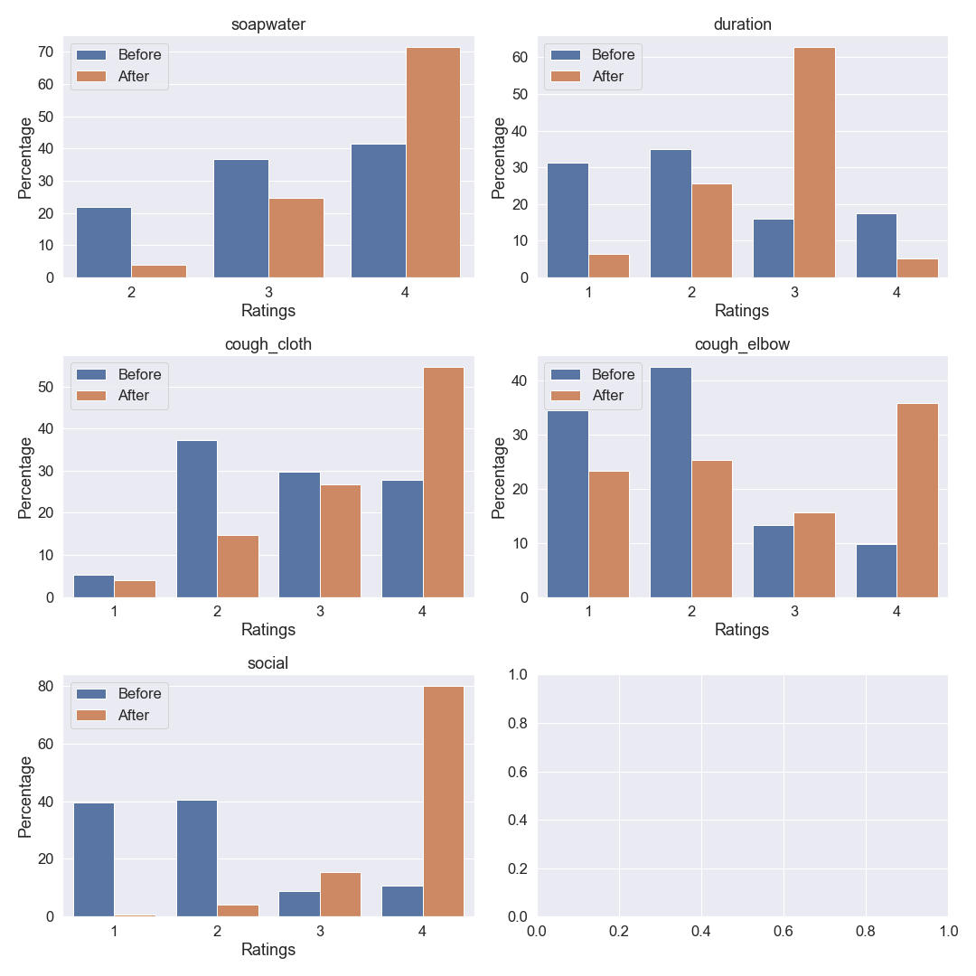
Washed with soap water
Duration of handwash
1-> never
2-> sometimes
3-> often
4-> always
Sometimes Often Always
<10 11-19 >20 Do not know
Coughed in cloth
Coughed in elbow
<10 | 1
11-19 | 2
>20 | 3
do not know | 4
did not wash hand with soap water | 5
Never Sometimes Often Always
Never Sometimes Often Always
Social distance
Never Sometimes Often Always

Slide 2
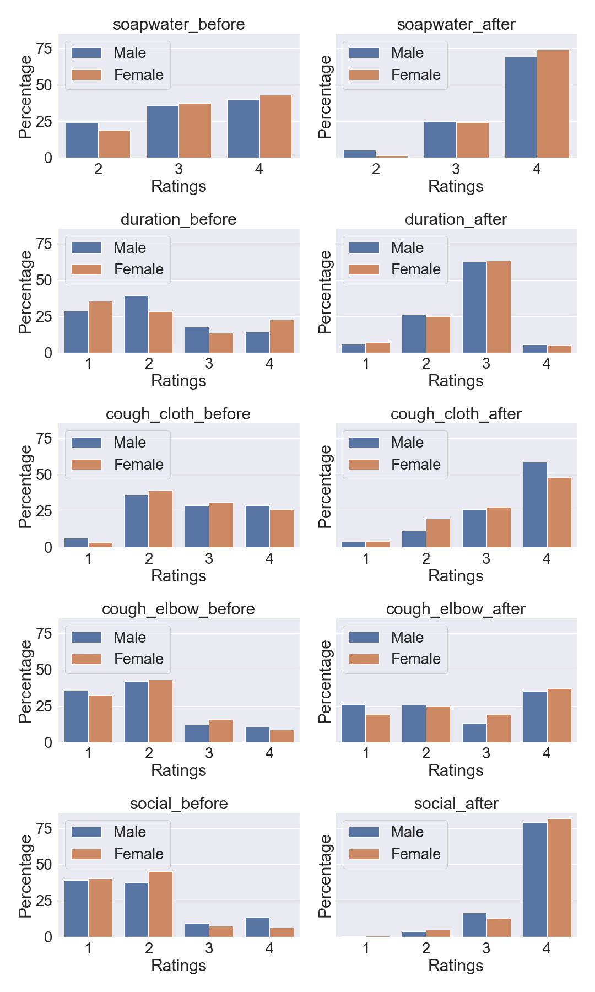
Washed with soap water
Before After
Sometimes Often Always
Sometimes Often Always

