Slide 1
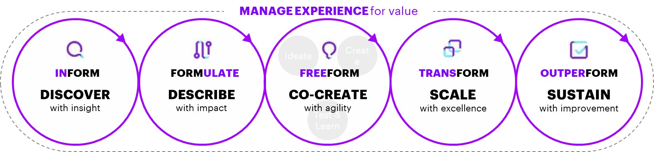

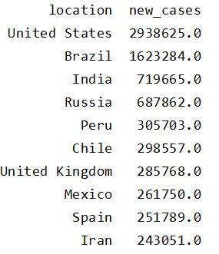

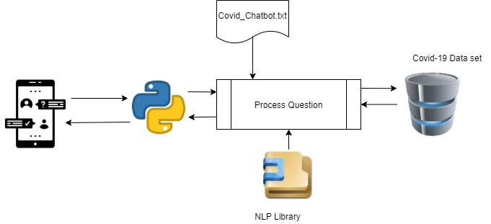
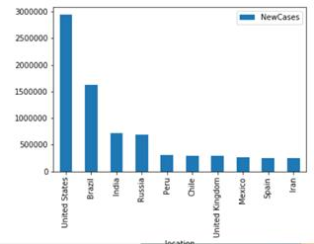

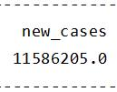
Prototype Solution – Chatbot with the user answers in text based with the information provide in the dataset
Overview of the solution
Current Prototype – Covid-Bot 0.1
Design Thinking
+
Process Flow

Slide 2
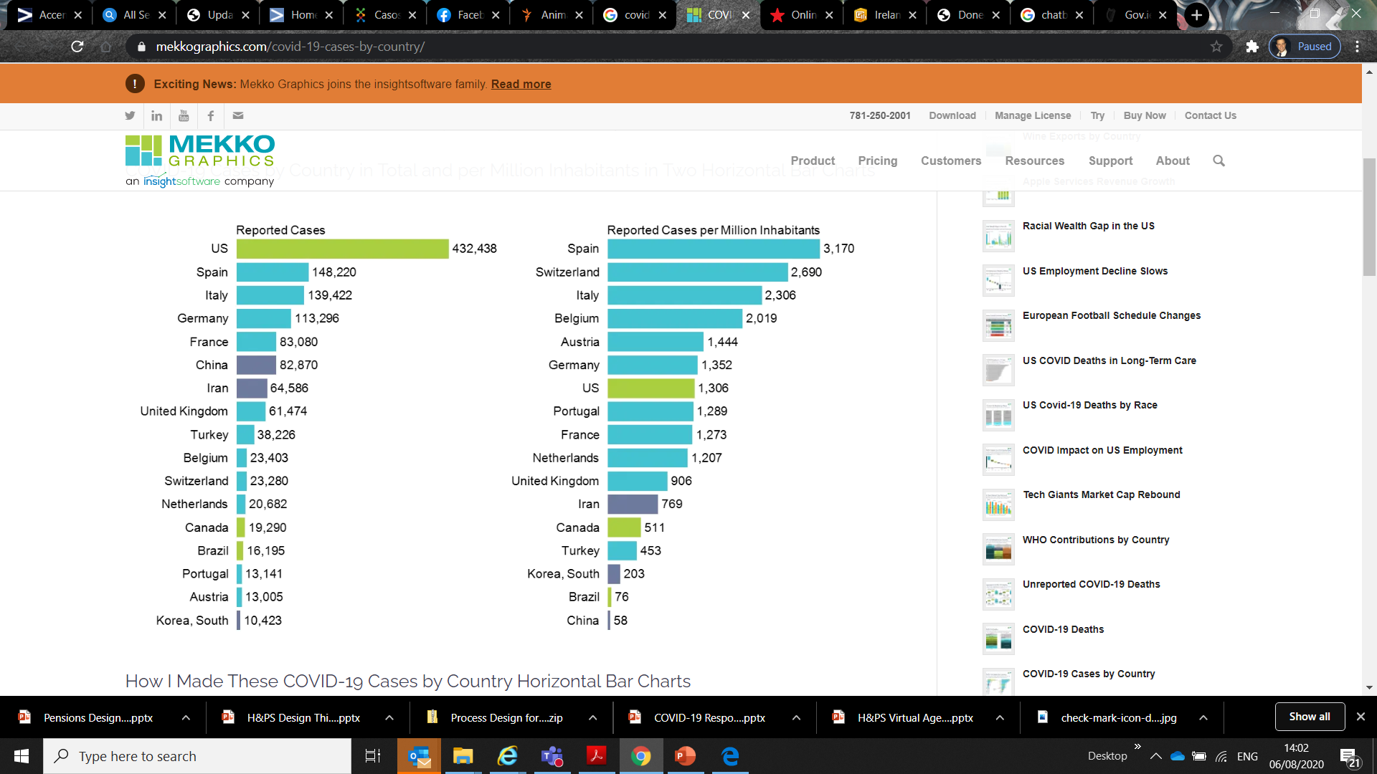

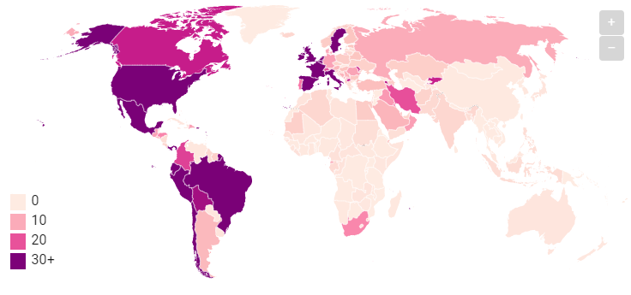

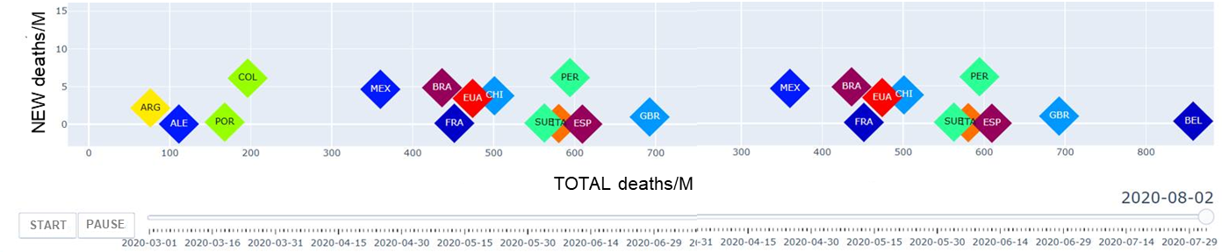
Future Solution – visualise the data in dynamic layout depending on the user request/question
Totalization related to the question
Classification related to the topic
15.5 m
Cases
0.9 m
Deaths
3.5 m
Still Sick
Covid-Bot 3.1
What country is the highest cases?
Maps related to the question
United States 2,938,625 cases
How many deaths in United Kingdom?
United Kingdom 44,236 deaths
New Cases per million
0
100
200
300+
What are the 10 countries with most cases?
Animation around the topic requested
United States 2,938,625
Brazil 1,623,284
India 719,665
Russia 687,862
Peru 305,703
Chile 298,557
UK 285,768
Mexico 261,750
Spain 251,789
Iran 243,051

