Slide 1

A PRESENTATION
ON
“ IoT Based Secure Access Control System with Intrusion Alert ”
Submitted for the fulfillment of Mini-Project-Phase-II BE-CSE(III), 2026
A. G. Patil Institute of Technology, Solapur by
GROUP MEMBER NAMES
(Ritesh Ekbote)
(Muskan Mulani, Bhagyashri Koli, Chetan Dhumal)
Under the Guidance of
Project Co-Ordinator
Prof. A. P. Hosale
(Computer Engineering)
A. G. Patil Institute of Technology, Solapur
2026, March
1

Slide 2

CONTENTS
PROBLEM STATEMENT
OBJECTIVES
EXISTING SYSTEM
PROPOSED SYSTEM
SYSTEM ARCHITECTURE
TECHNOLOGIES USED
METHODOLOGIES
APPLICATIONS
ADVANTAGES
LIMITATIONS.
AGPIT, SOLAPUR
2

Slide 3
PROBLEM STATEMENT
●
Admin login pages often do not detect repeated wrong password attempts, allowing attackers to try multiple passwords without alerting owner/admin.
●
The owner/admin often does not know that someone is trying to break in.
●
A system is needed that tracks login activity, identifies failed attempts, sends an instant IoT alert, and blocks further login tries to prevent unauthorized access.
AGPIT, SOLAPUR
3

Slide 4
OBJECTIVES
To monitor all login attempts and identify repeated wrong password entries.
To detect failed attempts and treat it as a possible intrusion.
To send an instant IoT-based alert to the owner/admin when suspicious activity occurs.
To block further login attempts and the intruder’s IP temporarily to prevent unauthorized access.
AGPIT, SOLAPUR
4

Slide 5
EXISTING SYSTEM
In the existing system, most admin login pages only check whether the username and password are correct. If someone enters the wrong password many times, the system still allows them to keep trying. It does not count how many times the password was entered incorrectly.
There is no warning or message sent to the owner/admin when someone is trying to log in again and again. Because of this, the owner does not know if someone is trying to guess the password.
Also, the existing system does not block the user or stop further login attempts, even if the activity looks suspicious. This makes the admin account easy to attack and less secure.
AGPIT, SOLAPUR
5

Slide 6
PROPOSED SYSTEM
●
The system keeps a close watch on all login activities.
●
Continuous wrong password entries trigger an intrusion warning.
●
An immediate IoT notification is sent to the owner/admin to inform them of the suspicious login.
●
The system then stops any more login attempts and temporarily blocks the IP to avoid further misuse.
AGPIT, SOLAPUR
6

Slide 7
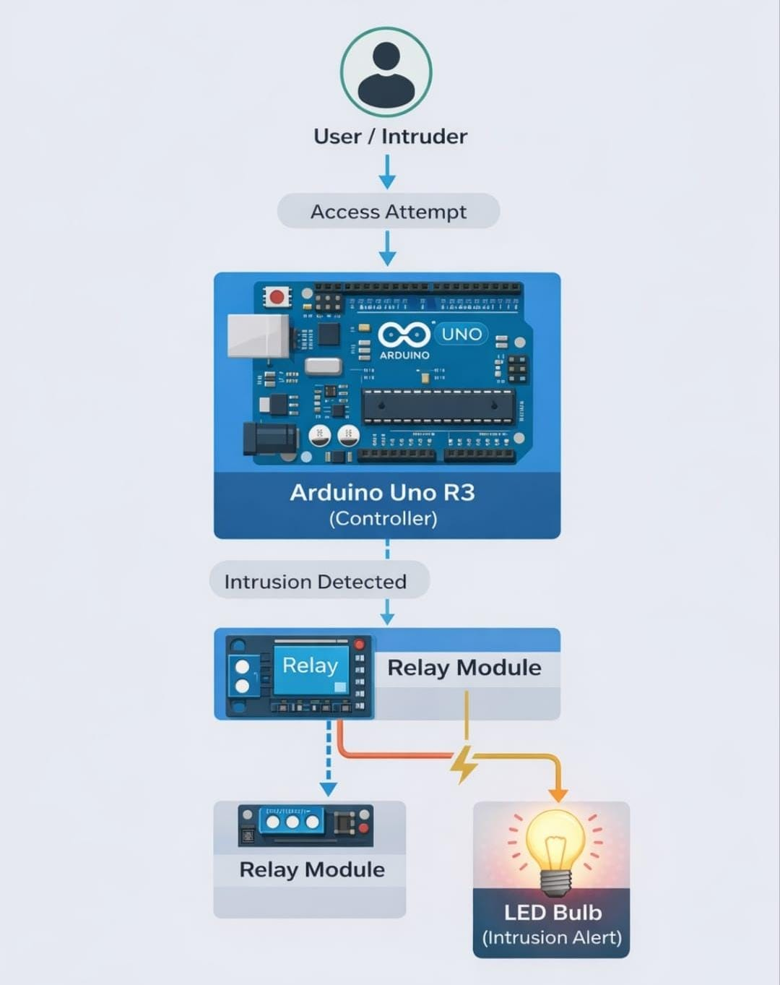
SYSTEM ARCHITECTURE
AGPIT, SOLAPUR
7

Slide 8
TECHNOLOGIES USED
Web Technologies (HTML, CSS, PHP)
These are used to create the admin login page and the backend logic. HTML/CSS help design the login interface.
PHP handle login verification, checking attempts, and sending data to the Laptop or Computer System.
2. Relay Module
An electronic switch that is controlled by the Arduino.
It powers the intrusion alert device when an intrusion is detected. The relay allows the low-power Arduino signal to control high power
devices.
3.IoT Platform (PHPMailer / Gmail SMTP / TLS Port 587)
Used to send instant alerts to the owner.
After detecting intrusion, the system sends a notification through an IoT service like PHPMailer, Gmail SMTP SMTP, or a email alert
system.
4.MySQL Database
Stores login details, usernames, passwords, and a record of failed attempts.
The Computer System checks this database to verify credentials and track intrusion activity.
AGPIT, SOLAPUR
8

Slide 9
METHODOLOGY
Design the Admin Login System-
Create a web-based login page and Connect it to a backend that verifies the entered credentials.
2. Track Login Attempts-
The System keeps count of how many times the password is entered incorrectly.
3. Detect Intrusion Attempt-
When the system notices wrong password attempts in a row, it marks this as suspicious activity then switches the system into
“intrusion alert mode.”
4. Send Intrusion Signal to Arduino-
Computer System sends a digital signal to the Arduino whenever an intrusion is detected.
5. Activate IoT Alert-
The Arduino receives the signal and activates the connected relay module. The relay turns ON a bulb or alert device to indicate
unauthorized access.
6. Notify the Owner Through IoT Platform-
At the same time, the system sends an instant notification to the owner through an IoT platform (like email, app, or message).
7. Block Further Login Attempts-
After sending alerts, the system temporarily blocks the login page or the IP address.
AGPIT, SOLAPUR
9

Slide 10
APPLICATIONS
Office Admin Panels – Protects employee or manager login accounts from unauthorized access.
Laboratory Systems – Secures sensitive data and prevents intruders from accessing lab records.
College/School Portals – Adds extra security for admin dashboards and staff login pages.
Small Business Websites – Helps business owners protect their website’s admin section.
Home or Personal Systems – Useful for personal login pages where users want intrusion alerts and extra protection.
AGPIT, SOLAPUR
10

Slide 11
ADVANTAGES
Improves Security – Tracks wrong attempts and quickly detects intrusion.
Instant Alerts – Owner gets immediate notification through IoT.
Prevents Brute-Force Attacks – Blocks login after repeated wrong attempts.
Real-Time Monitoring – Continuously watches all login activity.
Easy to Use – Simple design makes it easy to understand and operate.
Low-Cost Implementation – Uses affordable hardware like Arduino , Relay.
AGPIT, SOLAPUR
11

Slide 12
LIMITATIONS
1) Internet Dependency – IoT alerts will not work if the internet connection is weak or unavailable.
2)Single admin system – System is currently designed for one administrator .
3) Hardware Failure – Arduino, relay, or bulb malfunction can stop the physical alert system.
4) Maintenance Required – System needs regular updates and monitoring to ensure smooth functioning.
AGPIT, SOLAPUR
12

Slide 13

….
"This project strengthens admin account protection by closely monitoring login activity and responding quickly to suspicious attempts. With immediate IoT notifications and automated blocking, it delivers a smart and efficient security layer for sensitive systems. ."
AGPIT, SOLAPUR
13

