Slide 1
E-Commerce Sales &
Customer Behaviour Analysis
Exploratory Data Analysis of the UCI Online Retail Dataset
Prepared by: Student Name
Python | Pandas | NumPy | Matplotlib | Seaborn
E-Commerce EDA | UCI Online Retail • 1/8

Slide 2
01 Problem Statement & Objectives
Understand sales performance, customer behaviour, product demand and geographic distribution.
Which products and countries generate the most revenue?
How does revenue change over time?
What do order value and quantity patterns reveal?
Which customer segments contribute most to revenue?
Where are data quality issues that affect interpretation?
£10.64m
524,878
Gross sales revenue*
Positive sales lines
4,338
5.57m
Identified customers
Units sold*
*Figures shown from supplied KPI summary; see reconciliation note in report.
E-Commerce EDA | UCI Online Retail • 2/8

Slide 3
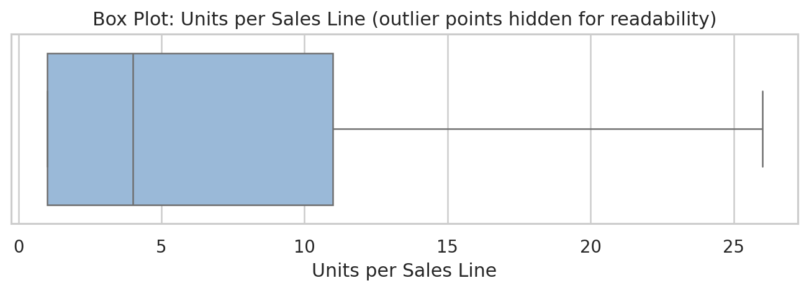
02 Dataset & Data Preparation
Prepared transaction extracts and summary tables supplied in the project ZIP.
Original rows reported: 541,909
Exact duplicates removed: 5,268
Cleaned master rows reported: 536,641
Positive sales lines: 524,878
Return/cancellation-related lines: 10,587
Missing CustomerID on 132,186 sales lines (25.2%)
Cleaning decisions: separate positive sales from returns/cancellations; parse dates and numeric fields; retain extreme values for analysis and use readable chart scales.
E-Commerce EDA | UCI Online Retail • 3/8

Slide 4
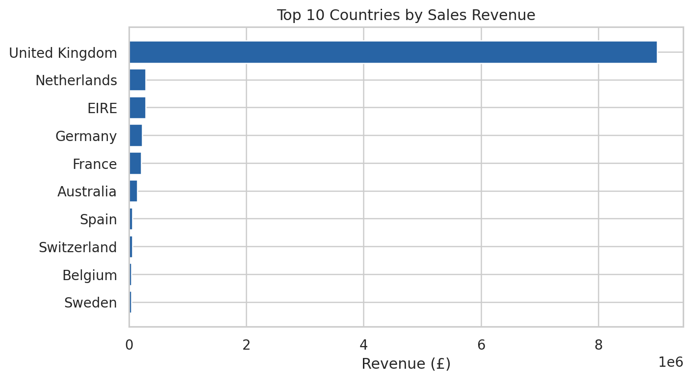
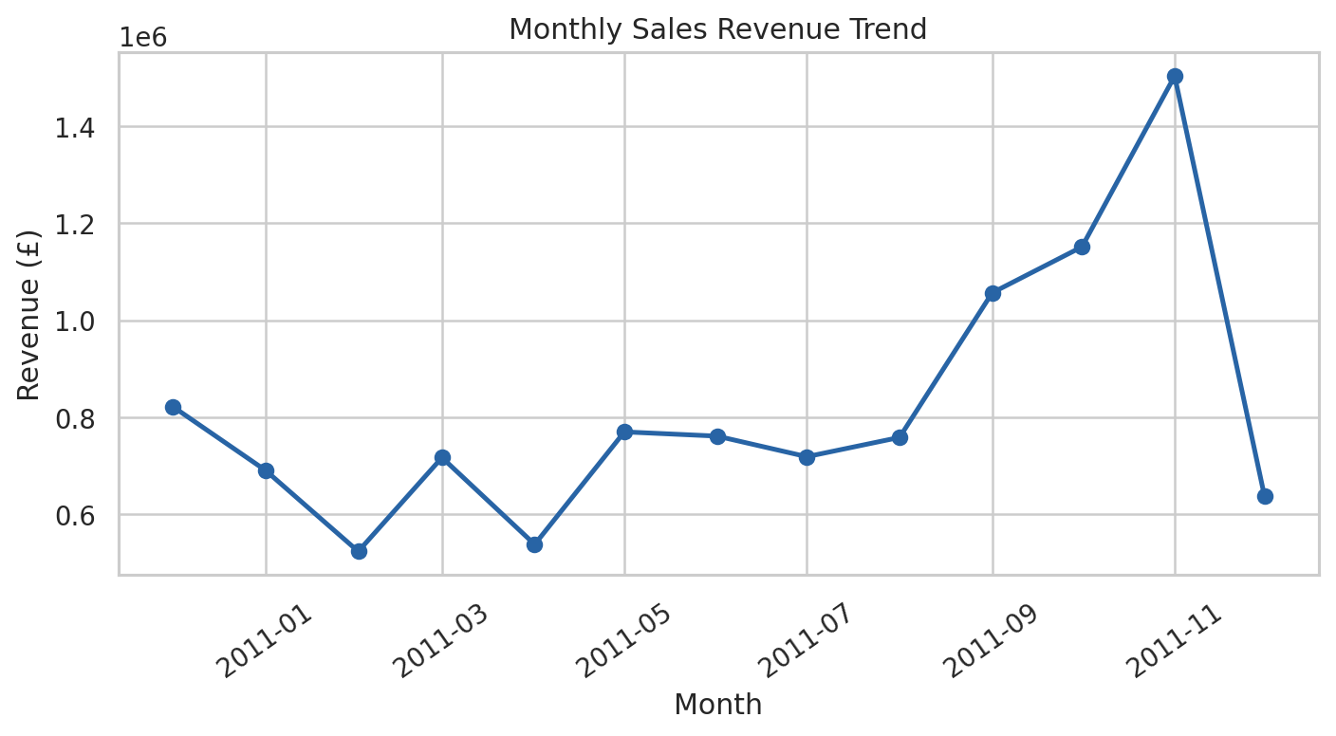
03 Sales Performance & Geography
Revenue is concentrated in the United Kingdom and peaks in November 2011.
E-Commerce EDA | UCI Online Retail • 4/8

Slide 5
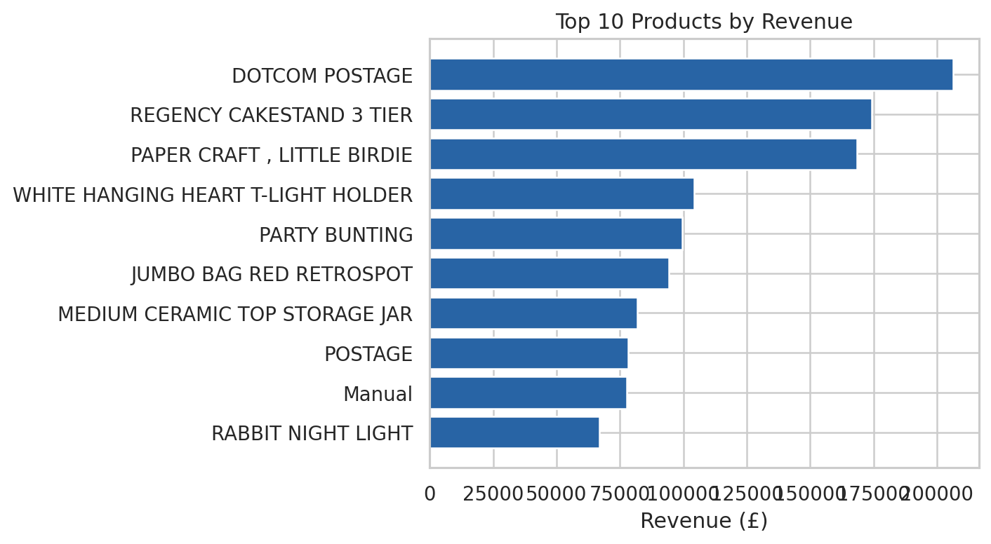
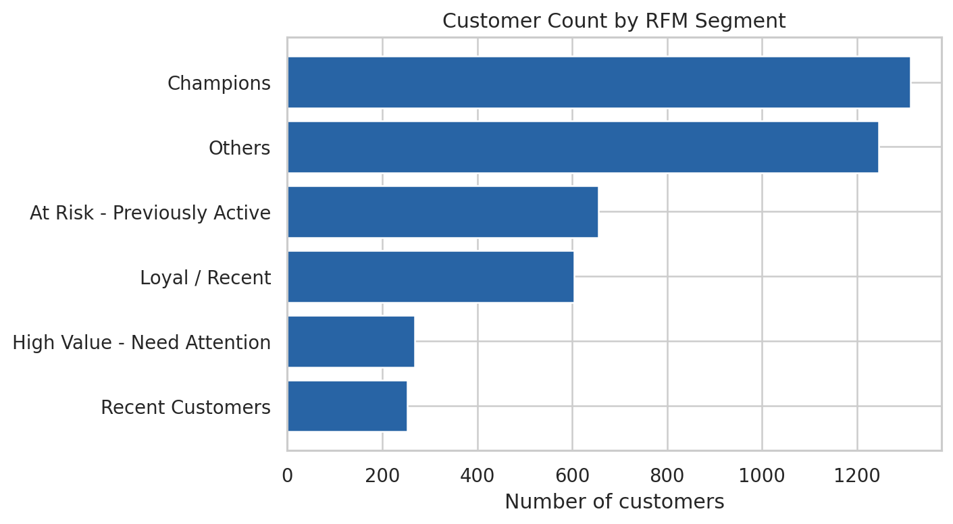
04 Product Demand & Customer Value
Revenue leaders, unit-volume leaders and high-value customer segments provide different views of performance.
E-Commerce EDA | UCI Online Retail • 5/8

Slide 6
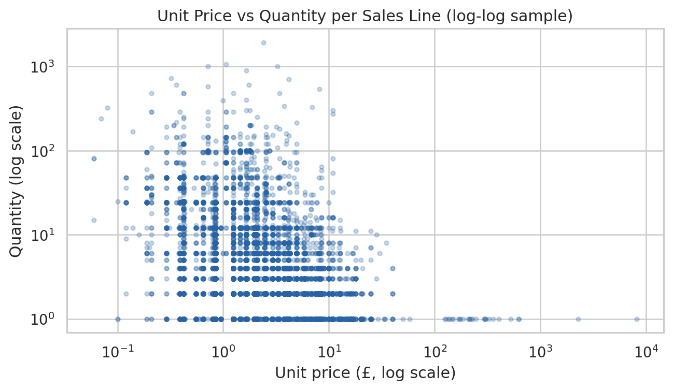
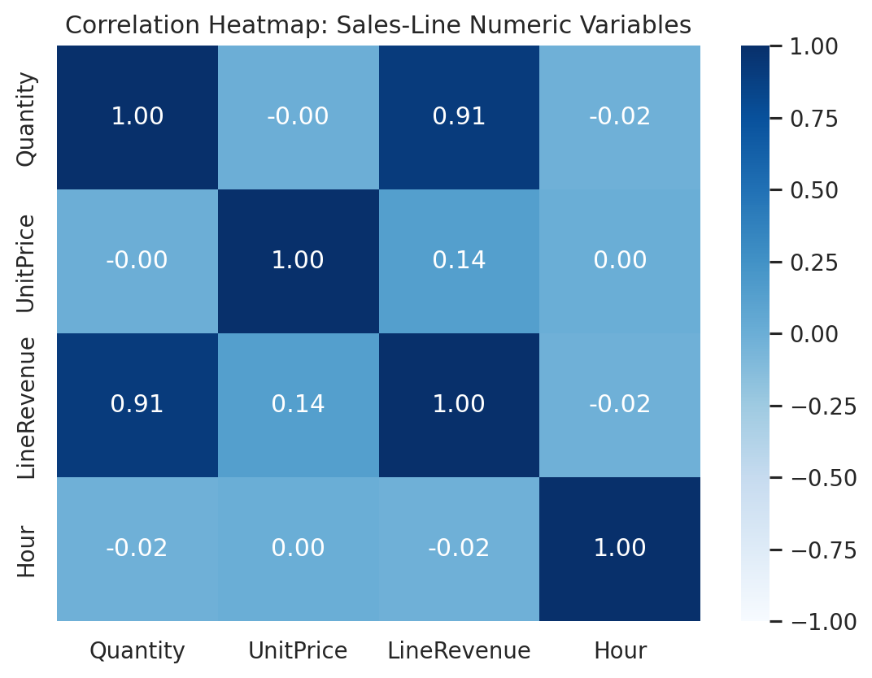
05 Behavioural Patterns & Relationships
Distribution and relationship charts show skew, variation and the need for careful interpretation.
Most line-level distributions are right-skewed.
Price–quantity association is descriptive, not causal.
Large values may be valid bulk orders or exceptional items.
E-Commerce EDA | UCI Online Retail • 6/8

Slide 7
06 Key Findings & Recommendations
Translate descriptive patterns into focused operational actions.
UK contributes approximately 84.6% of country-summary revenue → protect the core market and test selected international opportunities.
November 2011 is the peak month (£1.50m) → plan stock and fulfilment ahead of peak demand; validate with more years.
Champions: 1,312 customers and ~£6.48m segment revenue → prioritise retention and loyalty experiments.
At Risk segment: 655 customers and ~£1.05m segment revenue → test measured win-back campaigns.
Top revenue and volume products differ → plan assortment using both revenue and unit demand.
E-Commerce EDA | UCI Online Retail • 7/8

Slide 8
07 Conclusion, Limitations & Thank You
The project identifies actionable patterns and makes data quality transparent.
The supplied outputs show strong geographic concentration, a November revenue peak and customer-value segments.
CustomerID is missing on 25.2% of positive sales lines.
KPI summary: 19,960 invoices; positive-sales extract: 19,962 invoice identifiers.
Cleaned master rows (536,641) exceed the two supplied extracts combined (535,465) by 1,176 rows.
The supplied data cover about one year; findings are descriptive and cannot establish causation.
Thank you | Questions
E-Commerce EDA | UCI Online Retail • 8/8

