Slide 1





THE PYTHON DATA STACK
NumPy, Pandas, Matplotlib, Scikit-learn & Seaborn
...and how they power Decision360, an end-to-end Business
Analytics & Decision Intelligence Platform
Name: Dipanshu Garg
Ritesh Ghosh
Reg no.: 12508450
12521887

Slide 2





What We'll Cover
Twelve slides, two halves: the toolkit, then the platform it builds.
PART 1
PART 2
The Python Toolkit
Decision360 in Action
NumPy — numerical foundations
What the platform does
Pandas — tabular data & aggregation
Architecture & tech stack
Matplotlib — static visualization
A glimpse of the dashboard
Scikit-learn — forecasting model
Results & key findings
Seaborn — statistical plotting
Takeaways
Decision360 | Python Data Stack
2

Slide 3
Key Capabilities
Fast, memory-efficient n-dimensional arrays (ndarray)
Vectorized math — operations run without explicit Python loops
Broadcasting rules for combining arrays of different shapes
NumPy
Underpins pandas, scikit-learn, and Matplotlib internally
The numerical foundation everything else is built on
USED IN DECISION360 FOR
Elasticity calculations in the What-If Simulator and the z-score math behind Anomaly Detection both rely on NumPy's vectorized array operations for speed and precision.
Decision360 | Python Data Stack
3

Slide 4
Key Capabilities
DataFrame / Series structures built on top of NumPy arrays
groupby(), pivot, and merge operations for aggregation
Built-in date/time handling for period-over-period comparisons
Pandas
Reads/writes CSV, Excel, SQL, and more with one line of code
The workhorse for tabular business data
USED IN DECISION360 FOR
Every module — KPI computation, driver analysis, RFM segmentation, and inventory monitoring — is built on pandas groupby and aggregation operations over the orders dataset.
Decision360 | Python Data Stack
4

Slide 5
Key Capabilities
Full control over every element of a chart — axes, colors, labels
Produces publication- and report-ready static image exports
Forms the low-level rendering engine many other libraries build on
Matplotlib
Ideal for reproducible, scriptable chart generation
The standard for static, publication-quality charts
USED IN DECISION360 FOR
Every chart embedded in the Decision360 project report — revenue trends, forecasts, anomaly plots, the discount-sweep curve — was generated with Matplotlib for crisp, print-ready output.
Decision360 | Python Data Stack
5

Slide 6
Key Capabilities
Consistent fit() / predict() API across dozens of algorithms
Linear and regularized regression, classification, clustering
Built-in tools for model evaluation and train/test splitting
Scikit-learn
Interoperates directly with NumPy arrays and pandas DataFrames
The standard toolkit for classical machine learning
USED IN DECISION360 FOR
The Forecasting module uses scikit-learn's LinearRegression to project revenue — chosen deliberately for explainability, since its coefficients can be inspected directly rather than treated as a black box.
Decision360 | Python Data Stack
6

Slide 7
Key Capabilities
High-level API for statistical plots — distributions, correlations
Attractive default themes and color palettes out of the box
Built-in support for grouping and faceting by category
Seaborn
Works directly with pandas DataFrames as its native input
Statistical visualization built on top of Matplotlib
USED IN DECISION360 FOR
Not required for this build's core charts, but a natural next step for correlation heatmaps and distribution plots when extending the Customer Intelligence and RFM analysis modules.
Decision360 | Python Data Stack
7

Slide 8
PART 2 · DECISION360
From Data to Decisions
Decision360 is an end-to-end Business Intelligence platform that goes beyond dashboards — it explains why metrics changed, forecasts what happens next, and recommends what to do about it.
What happened?
Why?
What's next?
What to do?
Simulate it
Built entirely in Python — Streamlit, pandas, NumPy, scikit-learn, and Plotly — as a single, coherent, demonstrable application.
Decision360 | Python Data Stack
8

Slide 9





Eight Modules, One Pipeline
Descriptive → Diagnostic → Predictive → Prescriptive, each mapped to a working screen.
Executive Dashboard
Sales Analytics
Customer Intelligence
Inventory Intelligence
KPIs + auto 'why' driver analysis
Filterable revenue breakdowns
RFM segmentation
Stock vs. lead-time monitoring
Forecasting
Anomaly Detection
Decision Center
What-If Simulator
Linear-trend revenue projection
Z-score deviation alerts
Prioritized recommendations
Price/discount elasticity modeling
Decision360 | Python Data Stack
9

Slide 10
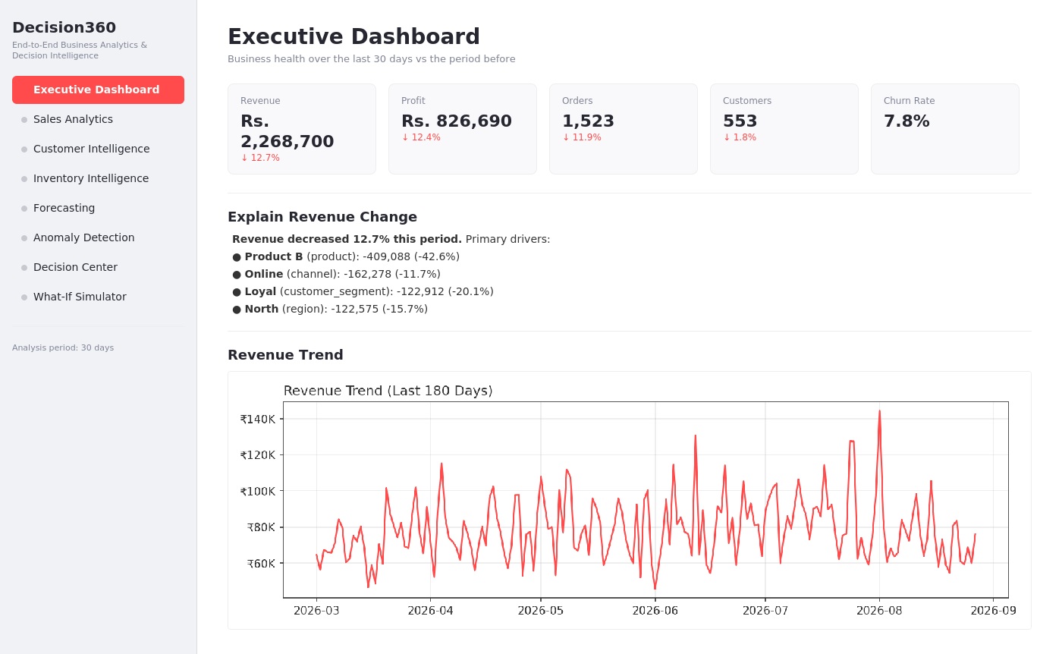
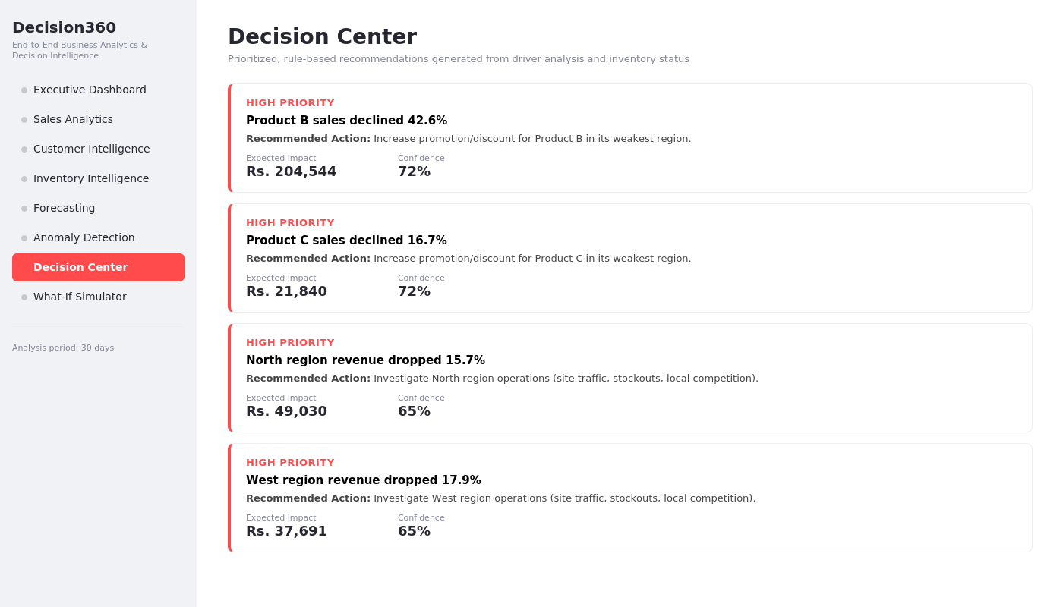
A Glimpse of the Dashboard
Executive Dashboard (left) and Decision Center (right) — live screens from the running application.
The dashboard doesn't just report that revenue fell — it names the product and region responsible, then queues a prioritized, actionable recommendation.
Decision360 | Python Data Stack
10

Slide 11
Results That Held Up
Validated against two patterns deliberately injected into the test dataset.
42.6%
33
Product B decline correctly identified as the #1 revenue driver
Anomalies detected automatically, including the injected regional crash
15%
8
Optimal discount level found by the What-If Simulator's discount sweep
Fully functional modules, from KPIs to price simulation
Decision360 | Python Data Stack
11

Slide 12

Thank You
Five libraries. One pipeline. A platform that turns data into a decision — and lets you test that decision before you make it.
Questions welcome.
Decision360 | Python Data Stack
12

