Slide 1
Cloth Recommendation
System
BY: RITESH KUMAR GUPTA
EMAIL: Riteshgupta7355@gmail.com

Slide 2
Dataset Link:-
https://www.kaggle.com/paramaggarwal/fashion-product-images-small
About Data:-
Data is Scrapped from the Various E-commerce site, its consist of
Images of Fashion Cloths for Men, Women, kids etc..

Slide 3
Libraries used:-
joblib==1.0.1
keras==2.6.0
Keras-Preprocessing==1.1.2
matplotlib-inline==0.1.3
numpy==1.19.5
python==3.6
pandas==1.3.3
pandocfilters==1.5.0
pickle4==0.0.1
pickleshare==0.7.5
Pillow==8.3.2
requests==2.26.0
scikit-learn==1.0
scipy==1.7.1
streamlit==0.89.0
tensorflow==2.6.0
tqdm==4.62.3

Slide 4
Model Used:-
RESNET50 that have already been trained on vast amounts of data
(e.g. the popular ImagNet dataset, containing millions of annotated
images), is one of the reasons why it has become much easier to build
state-of-the-art deep learning applications. Using such pre-trained
models as a basis, one can often sucessfully make use of
transfer-learning techniques to adapt the model to our specific needs,
even with very limited amounts of data (or no data at all).

Slide 5
Neural network as a feature extractor
A neural network image classifier works through converting images
(which are points in high-dimensional pixel space) to low dimensional
“feature vectors” representing characteristic “features” learned by the network
We can then take a trained neural network, remove its last high-level layers
originally used to classify objects, and use the dissected model to convert
our images into feature vectors.

Slide 6
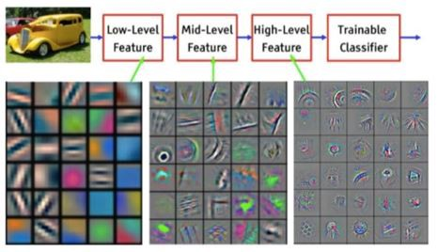
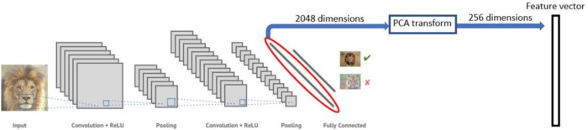
Architecture:-

Slide 7
Step to Run this Project:-
Download the Project Zipfile
Install all the Libraries mentioned in Requirement.txt file
Open Command prompt/ Anaconda prompt
Enter “Streamlit run main.py” in command prompt and press Enter

Slide 8
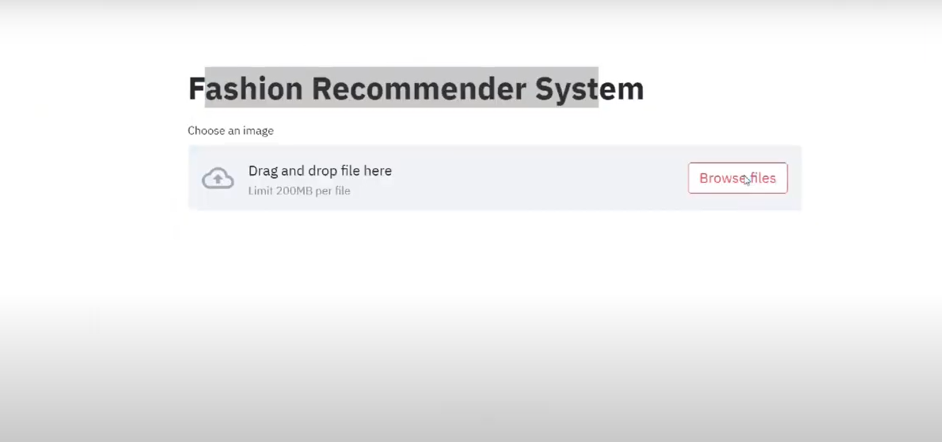
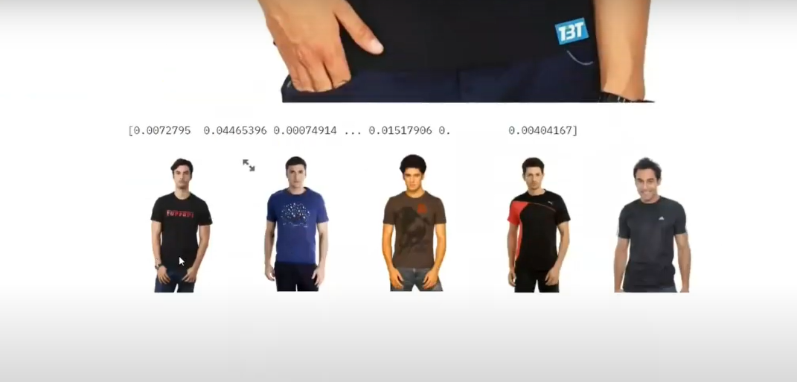
Screenshots from the project

