Slide 1
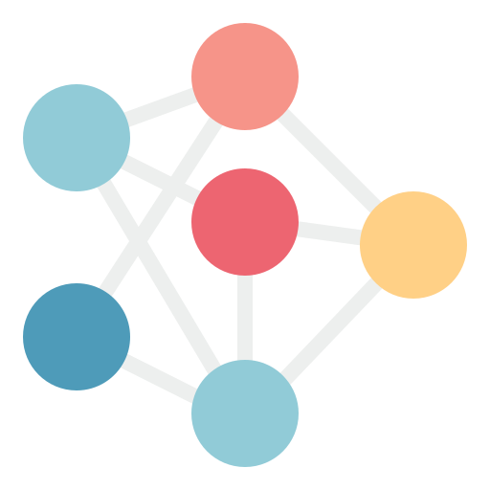

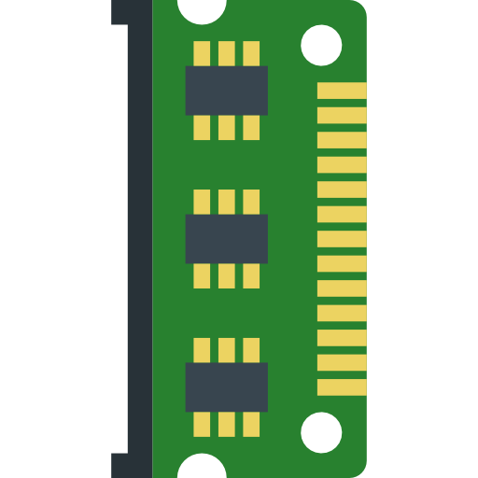




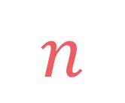
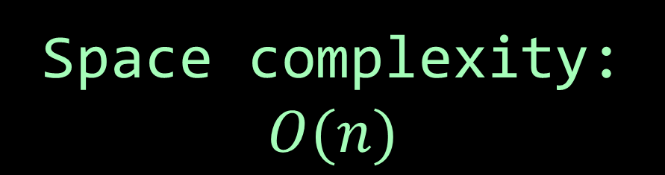
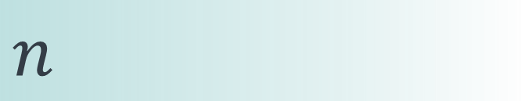

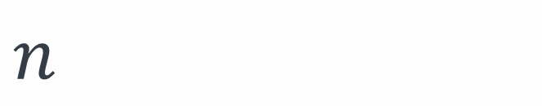
left
[4, 5, 1, 7, 2, 6, 3, 8]
no margin
Space complexity:
$$O(n)$$
list
list
list
list
mid
no margin
"string"
4 | 5 | 1 | 7 | 2 | 6 | 3 | 8
Space complexity:
$$O(n)$$
5
5
$
5
rec(n)
$$n$$
5
$$n$$
$$⇒$$
$$n$$
Time complexity:
$$O(n)$$
text
text
 |  |  | a
$$n$$
text
text
no margin
no margin
no margin
no margin
no margin
no margin
no margin
no margin

Slide 2
{ 0: [1, 4, 3], 1: [0, 2, 5, 4], 2: [1], 3: [0, 6], 4: [0, 1, 5], 5: [1, 4], 6: [3, 7], 7: [6], 8: [] }
 | 0 | 1 | 2 | 3 | 4 | 5 | 6 | 7 | 8
0 | 0 | 1 | 0 | 1 | 1 | 0 | 0 | 0 | 0
1 | 1 | 0 | 1 | 0 | 1 | 1 | 0 | 0 | 0
2 | 0 | 1 | 0 | 0 | 0 | 0 | 0 | 0 | 0
3 | 1 | 0 | 0 | 0 | 0 | 0 | 1 | 0 | 0
4 | 1 | 1 | 0 | 0 | 0 | 1 | 0 | 0 | 0
5 | 0 | 1 | 0 | 0 | 1 | 0 | 0 | 0 | 0
6 | 0 | 0 | 0 | 1 | 0 | 0 | 0 | 1 | 0
7 | 0 | 0 | 0 | 0 | 0 | 0 | 1 | 0 | 0
8 | 0 | 0 | 0 | 0 | 0 | 0 | 0 | 0 | 0
VS

Slide 3


We want to measure time and space resources needed by each one of them

Slide 4

We want to measure time and space resources needed by each one of them
These resources are affected by $|V|$, the number of vertices, and $\left|E\right|$, the number of edges

Slide 5
{ 0: [3], 1: [0, 2, 4], 2: [4], 3: [1, 5], 4: [5], 5: [] }
1
2
0
5
3
4

Slide 6
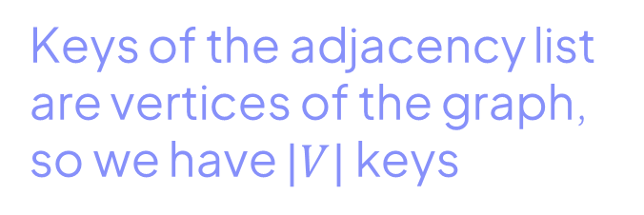
{ 0: [3], 1: [0, 2, 4], 2: [4], 3: [1, 5], 4: [5], 5: [] }
1
2
0
5
3
4
Keys of the adjacency list are vertices of the graph, so we have $|V|$ keys

Slide 7

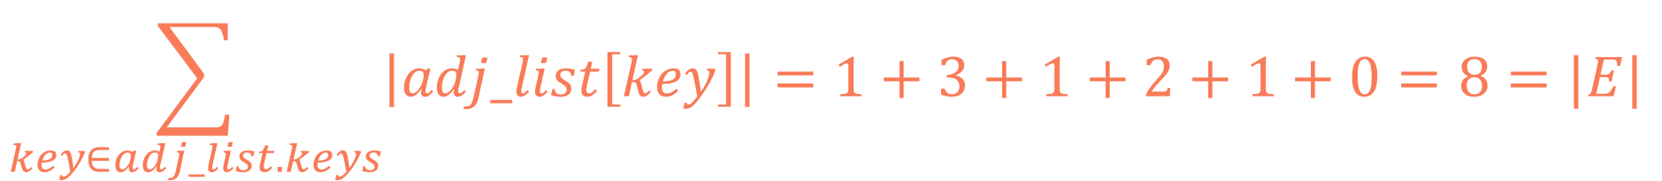
{ 0: [3], 1: [0, 2, 4], 2: [4], 3: [1, 5], 4: [5], 5: [] }
1
2
0
5
3
4
sum of lengths of values of the adjacency list is $|E|$
$$\sum_{key∈adj_list.keys}{\left|adj_list\left[key\right]\right|}=1+3+1+2+1+0=8=|E|$$

Slide 8
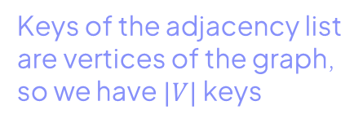
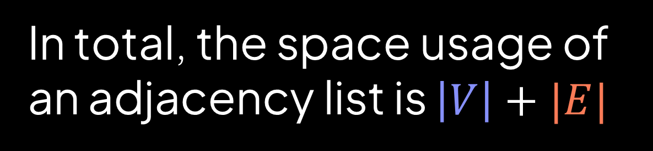
{ 0: [3], 1: [0, 2, 4], 2: [4], 3: [1, 5], 4: [5], 5: [] }
1
2
0
5
3
4
sum of lengths of values of the adjacency list is $|E|$
Keys of the adjacency list are vertices of the graph, so we have $|V|$ keys
In total, the space usage of an adjacency list is $\left|V\right|+|E|$

Slide 9
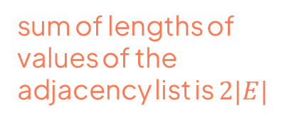
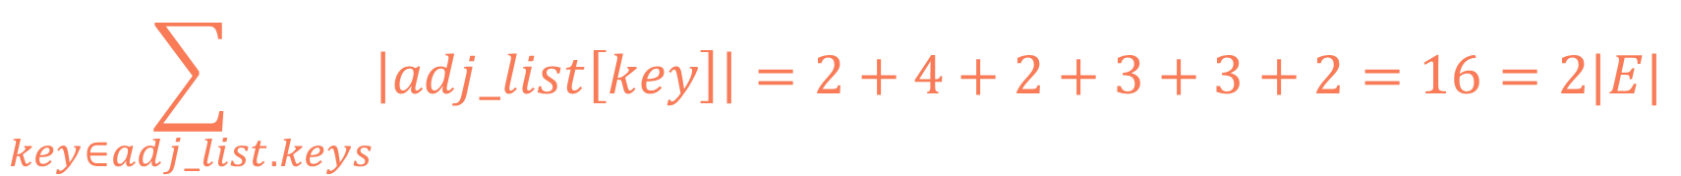
For undirected graphs:
{ 0: [3, 1], 1: [0, 2, 3, 4], 2: [1, 4], 3: [0, 1, 5], 4: [1, 2, 5], 5: [3, 4] }
1
2
0
5
3
4
sum of lengths of values of the adjacency list is $2|E|$
Keys of the adjacency list are vertices of the graph, so we have $|V|$ keys
$$\sum_{key∈adj_list.keys}{\left|adj_list\left[key\right]\right|}=2+4+2+3+3+2=16=2|E|$$

Slide 10
For undirected graphs:
{ 0: [3, 1], 1: [0, 2, 3, 4], 2: [1, 4], 3: [0, 1, 5], 4: [1, 2, 5], 5: [3, 4] }
1
2
0
5
3
4
sum of lengths of values of the adjacency list is $2|E|$
Keys of the adjacency list are vertices of the graph, so we have $|V|$ keys
directed graphs: $S\left(V,E\right)=\left|V\right|+\left|E\right|=O\left(\left|V\right|+\left|E\right|\right)$
undirected graphs: $S\left(V,E\right)=\left|V\right|+2\left|E\right|=O\left(\left|V\right|+\left|E\right|\right)$

Slide 11
1
2
 | 0 | 1 | 2 | 3 | 4 | 5
0 | 0 | 1 | 0 | 1 | 0 | 0
1 | 1 | 0 | 1 | 1 | 1 | 0
2 | 0 | 1 | 0 | 0 | 1 | 0
3 | 1 | 1 | 0 | 0 | 0 | 1
4 | 0 | 1 | 1 | 0 | 0 | 1
5 | 0 | 0 | 0 | 1 | 1 | 0
0
5
3
4

Slide 12


$$|V|$$
1
2
 | 0 | 1 | 2 | 3 | 4 | 5
0 | 0 | 1 | 0 | 1 | 0 | 0
1 | 1 | 0 | 1 | 1 | 1 | 0
2 | 0 | 1 | 0 | 0 | 1 | 0
3 | 1 | 1 | 0 | 0 | 0 | 1
4 | 0 | 1 | 1 | 0 | 0 | 1
5 | 0 | 0 | 0 | 1 | 1 | 0
0
5
$$|V|$$
3
4
$$S\left(V,E\right)=\left|V\right|∗\left|V\right|={\left|V\right|}^{2}=O\left({\left|V\right|}^{2}\right)$$

Slide 13

Which one is better?
$O\left(\left|V\right|+\left|E\right|\right)$ or $O\left({\left|V\right|}^{2}\right)$
adjacency list
adjacency matrix

Slide 14
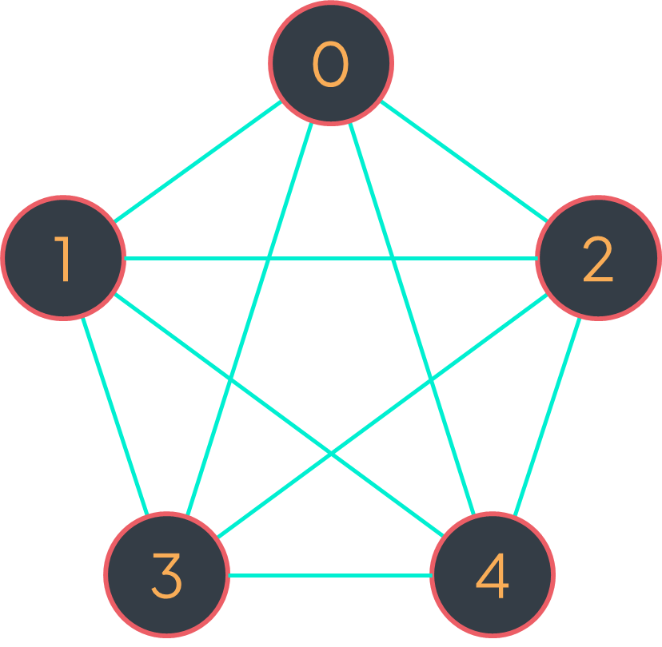
Which one is better?
$O\left(\left|V\right|+\left|E\right|\right)$ or $O\left({\left|V\right|}^{2}\right)$
adjacency list
adjacency matrix
Worst case for adjacency list:
$$\left|E\right|=\left|V\right|∗\left(\left|V\right|−1\right)={\left|V\right|}^{2}−\left|V\right|$$
$$⇒\left|V\right|+\left|E\right|=\left|V\right|+{\left|V\right|}^{2}−\left|V\right|={\left|V\right|}^{2}=O\left({\left|V\right|}^{2}\right)$$
It happens with the complete graph
{ 0: [1, 2, 3, 4], 1: [0, 1, 3, 4], 2: [0, 1, 3, 4], 3: [0, 1, 2, 4], 4: [0, 1, 2, 3] }
$$\left|E\right|=5∗4=\left|V\right|∗\left(\left|V\right|−1\right)$$

Slide 15
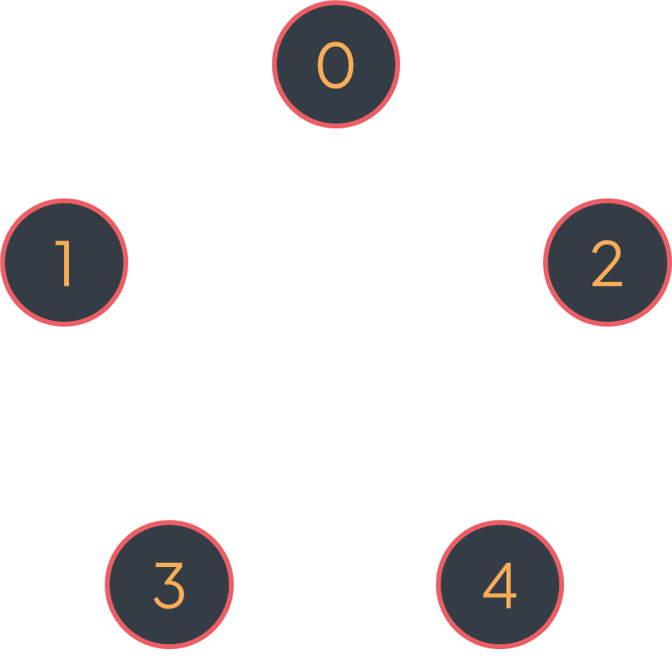

Which one is better?
$O\left(\left|V\right|+\left|E\right|\right)$ or $O\left({\left|V\right|}^{2}\right)$
adjacency list
adjacency matrix
Best case for adjacency list:
$$\left|E\right|=0$$
$$⇒\left|V\right|+\left|E\right|=\left|V\right|=O\left(\left|V\right|\right)$$
It happens with the edgeless graph
{ 0: [], 1: [], 2: [], 3: [], 4: [] }
$$\left|E\right|=5∗0=0$$

Slide 16
Which one is better?
$O\left(\left|V\right|+\left|E\right|\right)$ or $O\left({\left|V\right|}^{2}\right)$
adjacency list
adjacency matrix
Worst case for adjacency list:
$$\left|E\right|=\left|V\right|∗\left(\left|V\right|−1\right)={\left|V\right|}^{2}−\left|V\right|$$
$$⇒\left|V\right|+\left|E\right|=\left|V\right|+{\left|V\right|}^{2}−\left|V\right|={\left|V\right|}^{2}=O\left({\left|V\right|}^{2}\right)$$
Best case for adjacency list:
$$\left|E\right|=0$$
$$⇒\left|V\right|+\left|E\right|=\left|V\right|=O\left(|V|\right)$$

Slide 17
{ 0: [1, 4, 3], 1: [0, 2, 5, 4], 2: [1], 3: [0, 6], 4: [0, 1, 5], 5: [1, 4], 6: [3, 7], 7: [6], 8: [] }
 | 0 | 1 | 2 | 3 | 4 | 5 | 6 | 7 | 8
0 | 0 | 1 | 0 | 1 | 1 | 0 | 0 | 0 | 0
1 | 1 | 0 | 1 | 0 | 1 | 1 | 0 | 0 | 0
2 | 0 | 1 | 0 | 0 | 0 | 0 | 0 | 0 | 0
3 | 1 | 0 | 0 | 0 | 0 | 0 | 1 | 0 | 0
4 | 1 | 1 | 0 | 0 | 0 | 1 | 0 | 0 | 0
5 | 0 | 1 | 0 | 0 | 1 | 0 | 0 | 0 | 0
6 | 0 | 0 | 0 | 1 | 0 | 0 | 0 | 1 | 0
7 | 0 | 0 | 0 | 0 | 0 | 0 | 1 | 0 | 0
8 | 0 | 0 | 0 | 0 | 0 | 0 | 0 | 0 | 0

Slide 18
requires 1 bit
{ 0: [1, 4, 3], 1: [0, 2, 5, 4], 2: [1], 3: [0, 6], 4: [0, 1, 5], 5: [1, 4], 6: [3, 7], 7: [6], 8: [] }
 | 0 | 1 | 2 | 3 | 4 | 5 | 6 | 7 | 8
0 | 0 | 1 | 0 | 1 | 1 | 0 | 0 | 0 | 0
1 | 1 | 0 | 1 | 0 | 1 | 1 | 0 | 0 | 0
2 | 0 | 1 | 0 | 0 | 0 | 0 | 0 | 0 | 0
3 | 1 | 0 | 0 | 0 | 0 | 0 | 1 | 0 | 0
4 | 1 | 1 | 0 | 0 | 0 | 1 | 0 | 0 | 0
5 | 0 | 1 | 0 | 0 | 1 | 0 | 0 | 0 | 0
6 | 0 | 0 | 0 | 1 | 0 | 0 | 0 | 1 | 0
7 | 0 | 0 | 0 | 0 | 0 | 0 | 1 | 0 | 0
8 | 0 | 0 | 0 | 0 | 0 | 0 | 0 | 0 | 0

Slide 19
requires 1 bit
{ 0: [1, 4, 3], 1: [0, 2, 5, 4], 2: [1], 3: [0, 6], 4: [0, 1, 5], 5: [1, 4], 6: [3, 7], 7: [6], 8: [] }
 | 0 | 1 | 2 | 3 | 4 | 5 | 6 | 7 | 8
0 | 0 | 1 | 0 | 1 | 1 | 0 | 0 | 0 | 0
1 | 1 | 0 | 1 | 0 | 1 | 1 | 0 | 0 | 0
2 | 0 | 1 | 0 | 0 | 0 | 0 | 0 | 0 | 0
3 | 1 | 0 | 0 | 0 | 0 | 0 | 1 | 0 | 0
4 | 1 | 1 | 0 | 0 | 0 | 1 | 0 | 0 | 0
5 | 0 | 1 | 0 | 0 | 1 | 0 | 0 | 0 | 0
6 | 0 | 0 | 0 | 1 | 0 | 0 | 0 | 1 | 0
7 | 0 | 0 | 0 | 0 | 0 | 0 | 1 | 0 | 0
8 | 0 | 0 | 0 | 0 | 0 | 0 | 0 | 0 | 0
requires 32 bits

Slide 20
In terms of space, an adjacency list is more efficient if the
graph is sparse enough, otherwise the adjacency
matrix is better.

Slide 21

Time complexity of main operations:
 | adding a vertex |  | removing a vertex |  | adding an edge | checking if there is an edge $(u,v)$ | removing an edge | traversing the neighbors of a vertex | building the structure
adjacency list (hash table of label/array implementation)
adjacency matrix

Slide 22
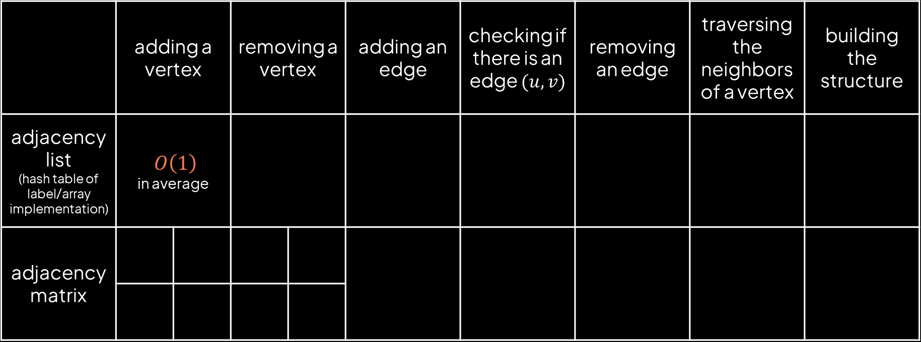
Time complexity of main operations:
 | adding a vertex |  | removing a vertex |  | adding an edge | checking if there is an edge $(u,v)$ | removing an edge | traversing the neighbors of a vertex | building the structure
adjacency list (hash table of label/array implementation) | $$O\left(1\right)$$ in average
adjacency matrix

Slide 23
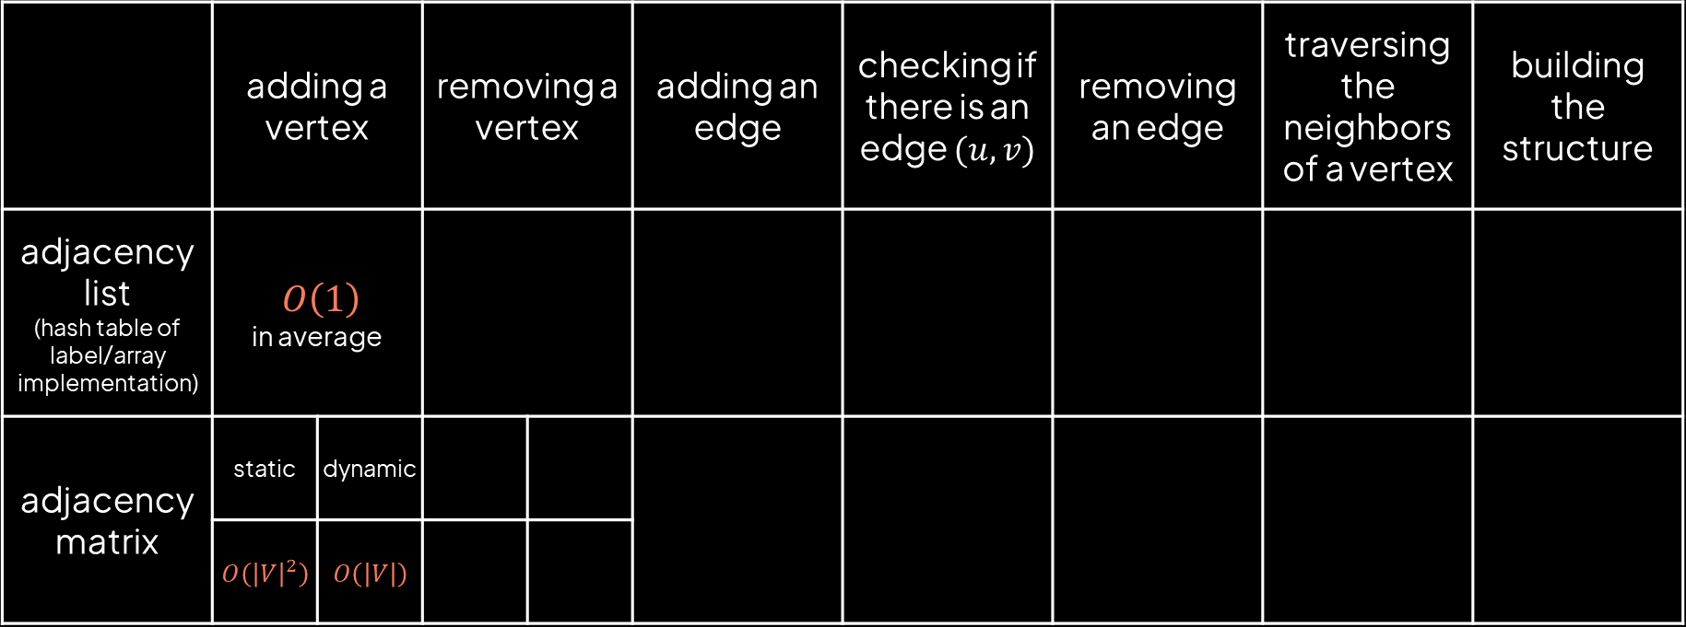
Time complexity of main operations:
 | adding a vertex |  | removing a vertex |  | adding an edge | checking if there is an edge $(u,v)$ | removing an edge | traversing the neighbors of a vertex | building the structure
adjacency list (hash table of label/array implementation) | $$O\left(1\right)$$ in average
adjacency matrix | static | dynamic
 | $$O\left({\left|V\right|}^{2}\right)$$ | $$O\left(\left|V\right|\right)$$

Slide 24
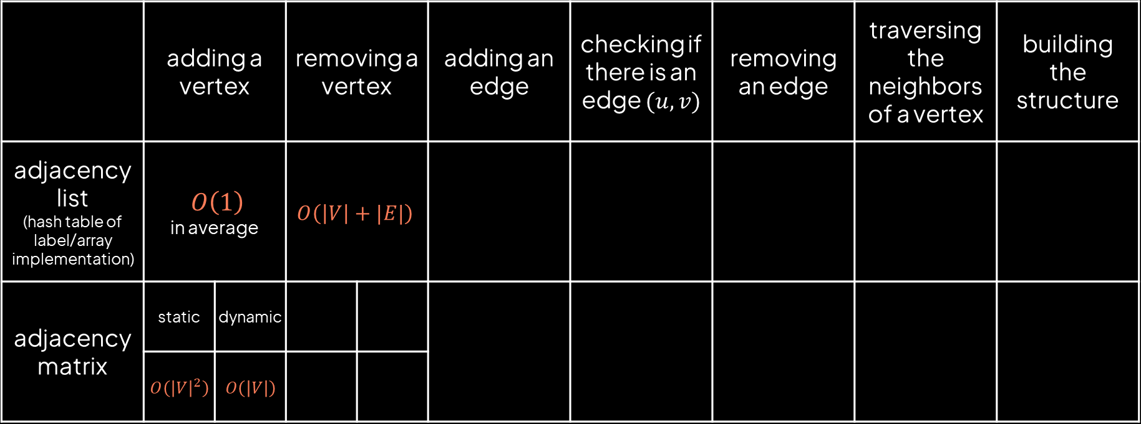
Time complexity of main operations:
 | adding a vertex |  | removing a vertex |  | adding an edge | checking if there is an edge $(u,v)$ | removing an edge | traversing the neighbors of a vertex | building the structure
adjacency list (hash table of label/array implementation) | $$O\left(1\right)$$ in average |  | $$O\left(\left|V\right|+|E|\right)$$
adjacency matrix | static | dynamic
 | $$O\left({\left|V\right|}^{2}\right)$$ | $$O\left(\left|V\right|\right)$$

Slide 25
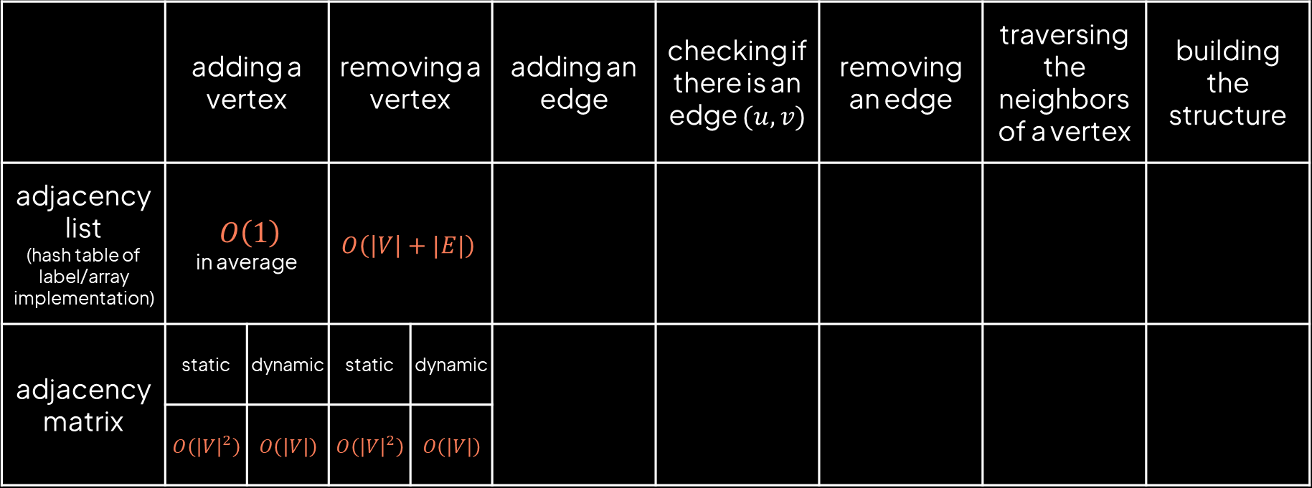
Time complexity of main operations:
 | adding a vertex |  | removing a vertex |  | adding an edge | checking if there is an edge $(u,v)$ | removing an edge | traversing the neighbors of a vertex | building the structure
adjacency list (hash table of label/array implementation) | $$O\left(1\right)$$ in average |  | $$O\left(\left|V\right|+|E|\right)$$
adjacency matrix | static | dynamic | static | dynamic
 | $$O\left({\left|V\right|}^{2}\right)$$ | $$O\left(\left|V\right|\right)$$ | $$O\left({\left|V\right|}^{2}\right)$$ | $$O\left(\left|V\right|\right)$$

Slide 26
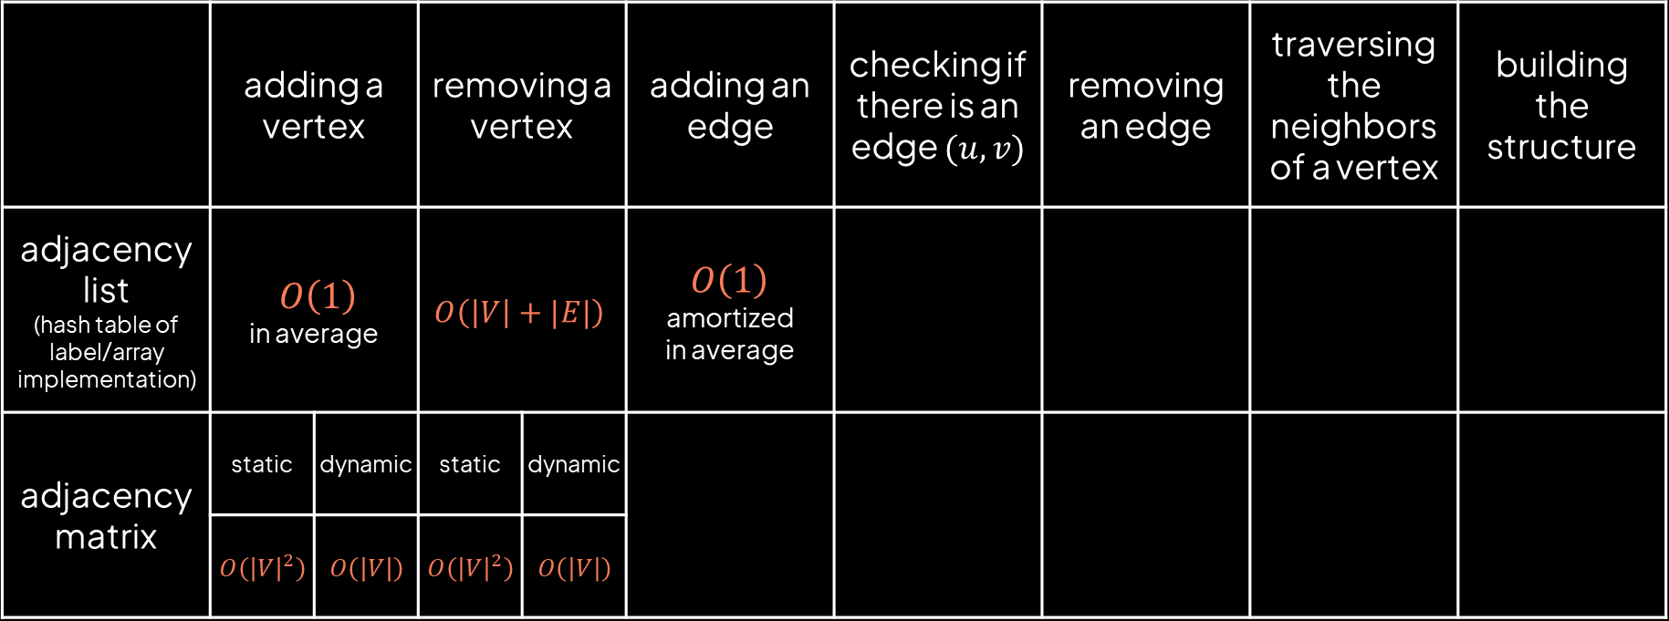
Time complexity of main operations:
 | adding a vertex |  | removing a vertex |  | adding an edge | checking if there is an edge $(u,v)$ | removing an edge | traversing the neighbors of a vertex | building the structure
adjacency list (hash table of label/array implementation) | $$O\left(1\right)$$ in average |  | $$O\left(\left|V\right|+|E|\right)$$ |  | $O\left(1\right)$ amortized in average
adjacency matrix | static | dynamic | static | dynamic
 | $$O\left({\left|V\right|}^{2}\right)$$ | $$O\left(\left|V\right|\right)$$ | $$O\left({\left|V\right|}^{2}\right)$$ | $$O\left(\left|V\right|\right)$$

Slide 27
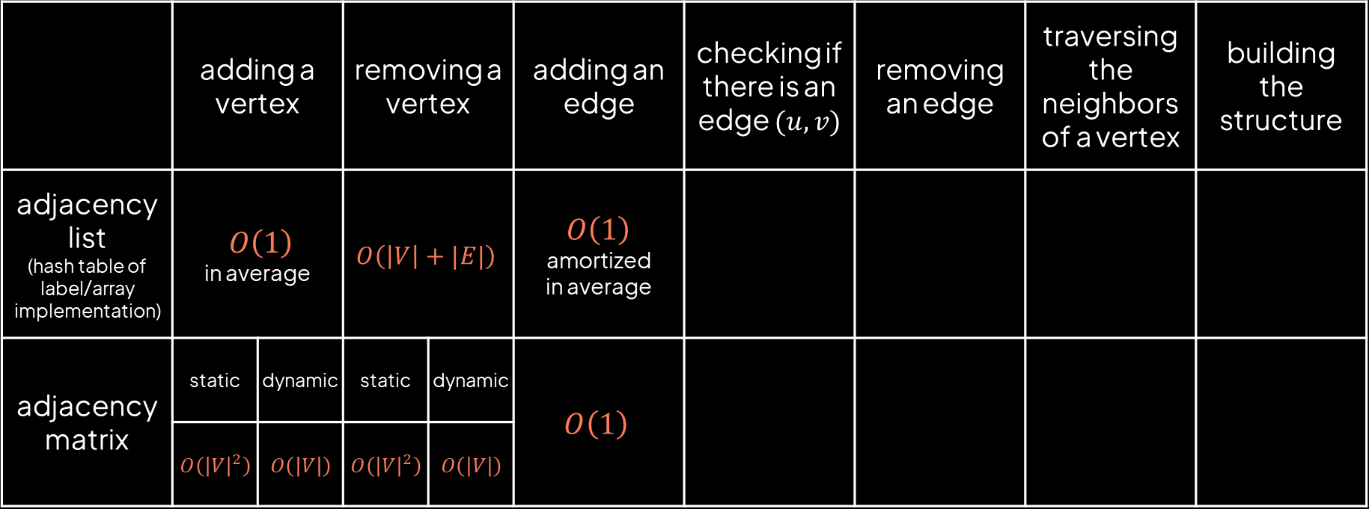
Time complexity of main operations:
 | adding a vertex |  | removing a vertex |  | adding an edge | checking if there is an edge $(u,v)$ | removing an edge | traversing the neighbors of a vertex | building the structure
adjacency list (hash table of label/array implementation) | $$O\left(1\right)$$ in average |  | $$O\left(\left|V\right|+|E|\right)$$ |  | $O\left(1\right)$ amortized in average
adjacency matrix | static | dynamic | static | dynamic | $$O\left(1\right)$$
 | $$O\left({\left|V\right|}^{2}\right)$$ | $$O\left(\left|V\right|\right)$$ | $$O\left({\left|V\right|}^{2}\right)$$ | $$O\left(\left|V\right|\right)$$

Slide 28
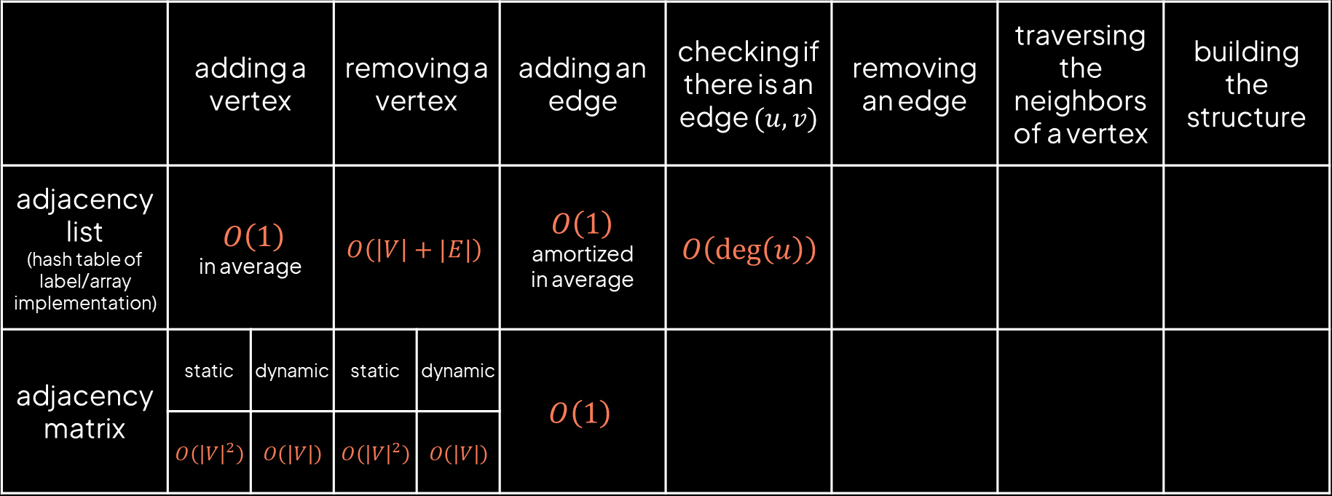
Time complexity of main operations:
 | adding a vertex |  | removing a vertex |  | adding an edge | checking if there is an edge $(u,v)$ | removing an edge | traversing the neighbors of a vertex | building the structure
adjacency list (hash table of label/array implementation) | $$O\left(1\right)$$ in average |  | $$O\left(\left|V\right|+|E|\right)$$ |  | $O\left(1\right)$ amortized in average | $$O\left(\deg\left(u\right)\right)$$
adjacency matrix | static | dynamic | static | dynamic | $$O\left(1\right)$$
 | $$O\left({\left|V\right|}^{2}\right)$$ | $$O\left(\left|V\right|\right)$$ | $$O\left({\left|V\right|}^{2}\right)$$ | $$O\left(\left|V\right|\right)$$

Slide 29
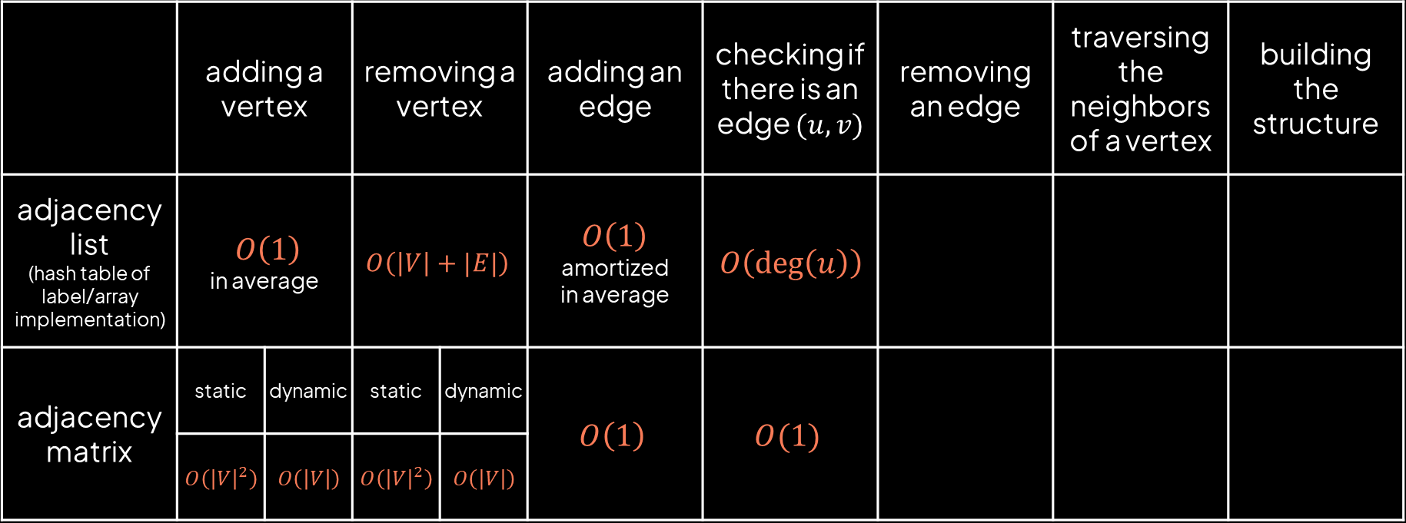
Time complexity of main operations:
 | adding a vertex |  | removing a vertex |  | adding an edge | checking if there is an edge $(u,v)$ | removing an edge | traversing the neighbors of a vertex | building the structure
adjacency list (hash table of label/array implementation) | $$O\left(1\right)$$ in average |  | $$O\left(\left|V\right|+|E|\right)$$ |  | $O\left(1\right)$ amortized in average | $$O\left(\deg\left(u\right)\right)$$
adjacency matrix | static | dynamic | static | dynamic | $$O\left(1\right)$$ | $$O(1)$$
 | $$O\left({\left|V\right|}^{2}\right)$$ | $$O\left(\left|V\right|\right)$$ | $$O\left({\left|V\right|}^{2}\right)$$ | $$O\left(\left|V\right|\right)$$

Slide 30
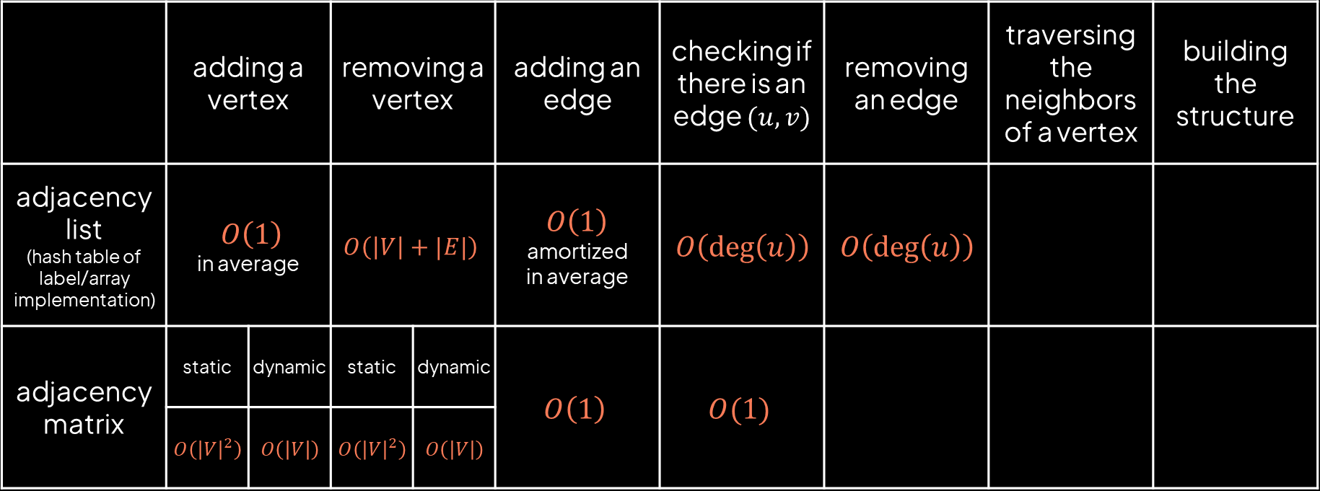
Time complexity of main operations:
 | adding a vertex |  | removing a vertex |  | adding an edge | checking if there is an edge $(u,v)$ | removing an edge | traversing the neighbors of a vertex | building the structure
adjacency list (hash table of label/array implementation) | $$O\left(1\right)$$ in average |  | $$O\left(\left|V\right|+|E|\right)$$ |  | $O\left(1\right)$ amortized in average | $$O\left(\deg\left(u\right)\right)$$ | $$O\left(\deg\left(u\right)\right)$$
adjacency matrix | static | dynamic | static | dynamic | $$O\left(1\right)$$ | $$O(1)$$
 | $$O\left({\left|V\right|}^{2}\right)$$ | $$O\left(\left|V\right|\right)$$ | $$O\left({\left|V\right|}^{2}\right)$$ | $$O\left(\left|V\right|\right)$$

Slide 31
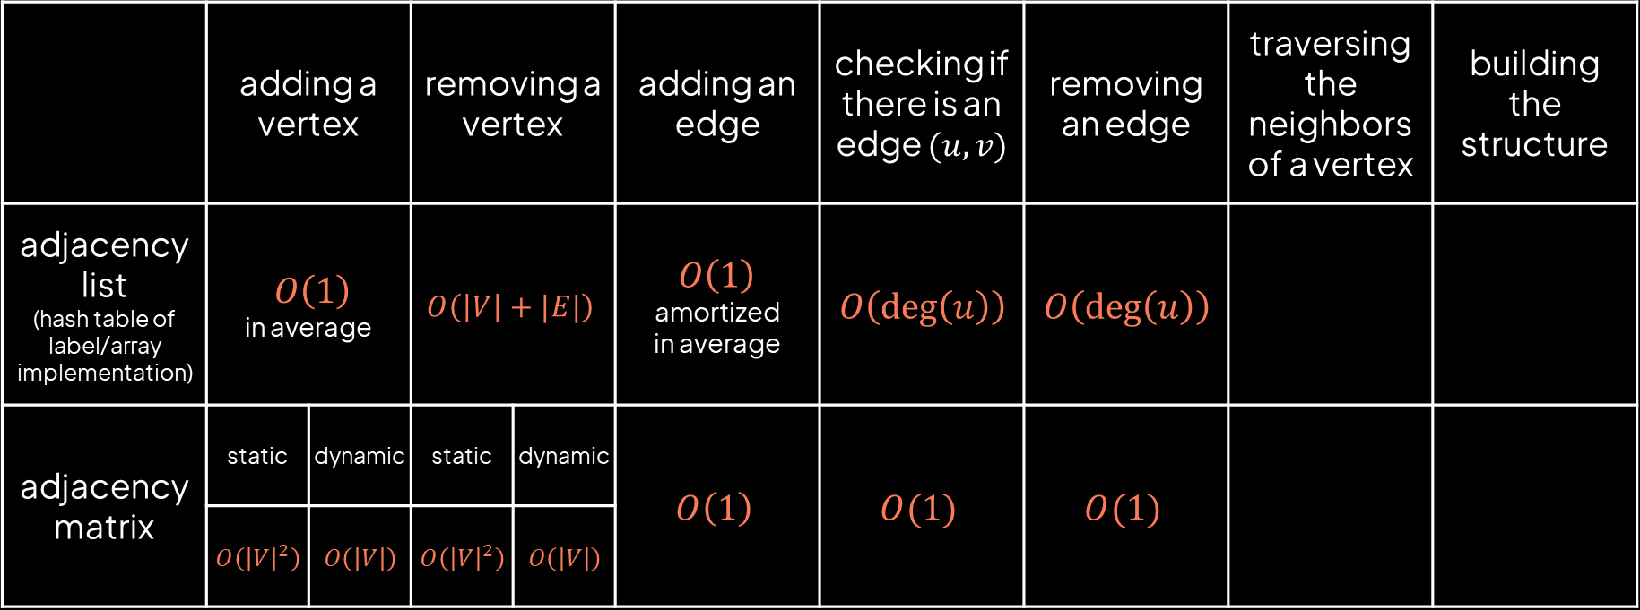
Time complexity of main operations:
 | adding a vertex |  | removing a vertex |  | adding an edge | checking if there is an edge $(u,v)$ | removing an edge | traversing the neighbors of a vertex | building the structure
adjacency list (hash table of label/array implementation) | $$O\left(1\right)$$ in average |  | $$O\left(\left|V\right|+|E|\right)$$ |  | $O\left(1\right)$ amortized in average | $$O\left(\deg\left(u\right)\right)$$ | $$O\left(\deg\left(u\right)\right)$$
adjacency matrix | static | dynamic | static | dynamic | $$O\left(1\right)$$ | $$O(1)$$ | $$O(1)$$
 | $$O\left({\left|V\right|}^{2}\right)$$ | $$O\left(\left|V\right|\right)$$ | $$O\left({\left|V\right|}^{2}\right)$$ | $$O\left(\left|V\right|\right)$$

Slide 32
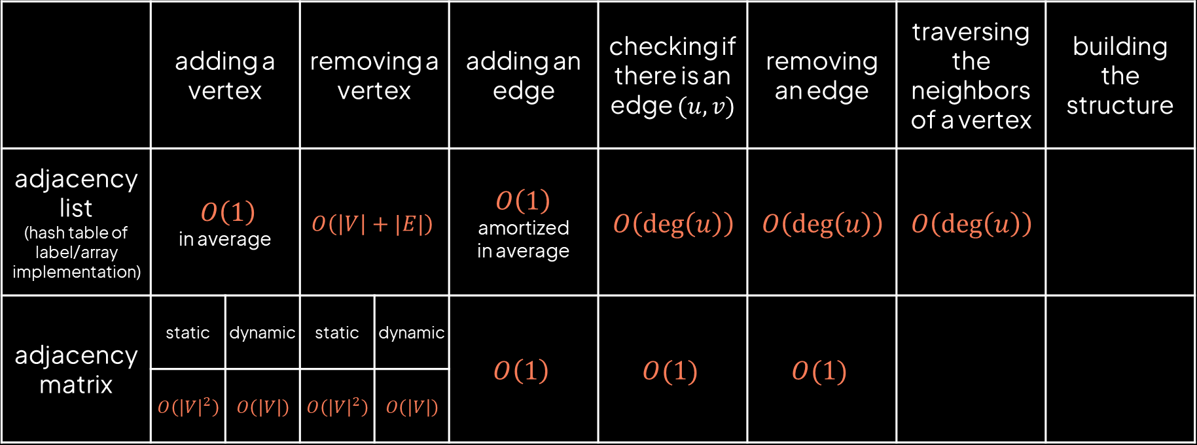
Time complexity of main operations:
 | adding a vertex |  | removing a vertex |  | adding an edge | checking if there is an edge $(u,v)$ | removing an edge | traversing the neighbors of a vertex | building the structure
adjacency list (hash table of label/array implementation) | $$O\left(1\right)$$ in average |  | $$O\left(\left|V\right|+|E|\right)$$ |  | $O\left(1\right)$ amortized in average | $$O\left(\deg\left(u\right)\right)$$ | $$O\left(\deg\left(u\right)\right)$$ | $$O\left(\deg\left(u\right)\right)$$
adjacency matrix | static | dynamic | static | dynamic | $$O\left(1\right)$$ | $$O(1)$$ | $$O(1)$$
 | $$O\left({\left|V\right|}^{2}\right)$$ | $$O\left(\left|V\right|\right)$$ | $$O\left({\left|V\right|}^{2}\right)$$ | $$O\left(\left|V\right|\right)$$

Slide 33
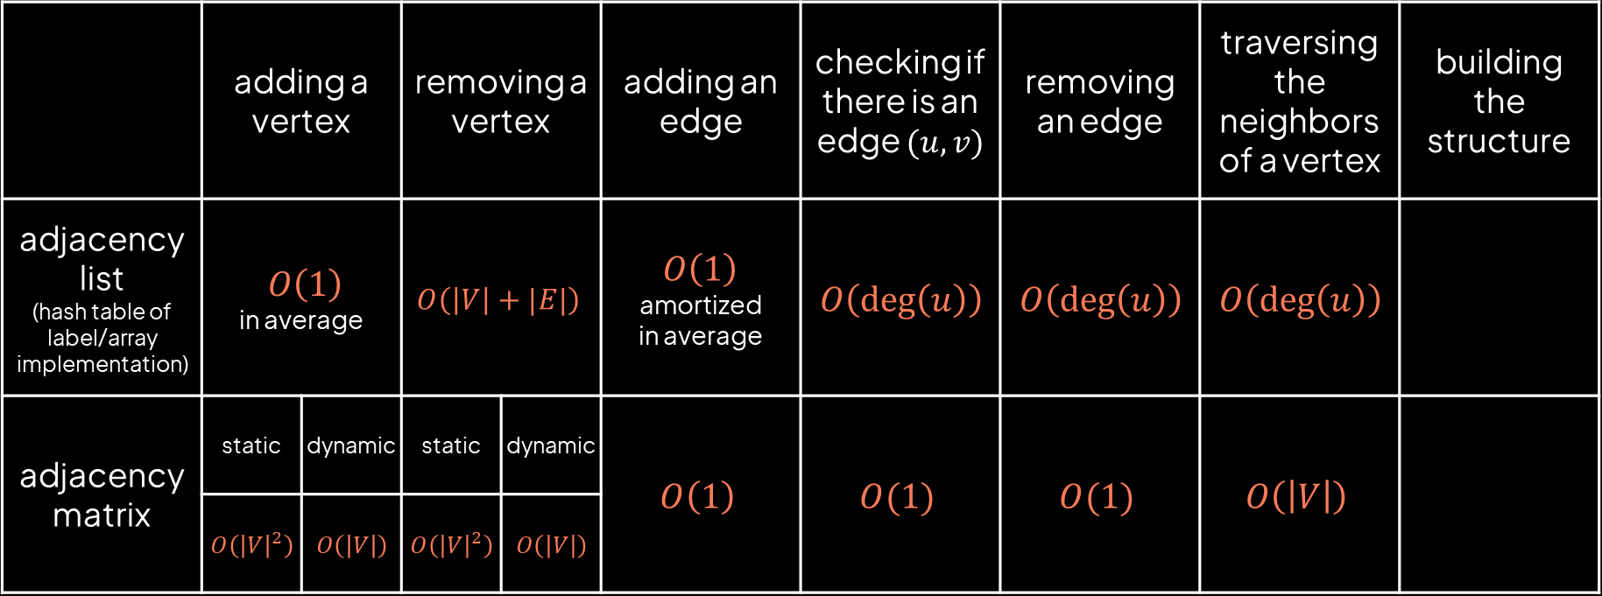
Time complexity of main operations:
 | adding a vertex |  | removing a vertex |  | adding an edge | checking if there is an edge $(u,v)$ | removing an edge | traversing the neighbors of a vertex | building the structure
adjacency list (hash table of label/array implementation) | $$O\left(1\right)$$ in average |  | $$O\left(\left|V\right|+|E|\right)$$ |  | $O\left(1\right)$ amortized in average | $$O\left(\deg\left(u\right)\right)$$ | $$O\left(\deg\left(u\right)\right)$$ | $$O\left(\deg\left(u\right)\right)$$
adjacency matrix | static | dynamic | static | dynamic | $$O\left(1\right)$$ | $$O(1)$$ | $$O(1)$$ | $$O\left(\left|V\right|\right)$$
 | $$O\left({\left|V\right|}^{2}\right)$$ | $$O\left(\left|V\right|\right)$$ | $$O\left({\left|V\right|}^{2}\right)$$ | $$O\left(\left|V\right|\right)$$

Slide 34
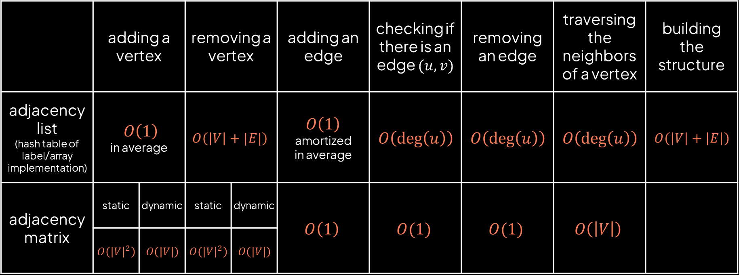
Time complexity of main operations:
 | adding a vertex |  | removing a vertex |  | adding an edge | checking if there is an edge $(u,v)$ | removing an edge | traversing the neighbors of a vertex | building the structure
adjacency list (hash table of label/array implementation) | $$O\left(1\right)$$ in average |  | $$O\left(\left|V\right|+|E|\right)$$ |  | $O\left(1\right)$ amortized in average | $$O\left(\deg\left(u\right)\right)$$ | $$O\left(\deg\left(u\right)\right)$$ | $$O\left(\deg\left(u\right)\right)$$ | $$O\left(\left|V\right|+\left|E\right|\right)$$
adjacency matrix | static | dynamic | static | dynamic | $$O\left(1\right)$$ | $$O(1)$$ | $$O(1)$$ | $$O\left(\left|V\right|\right)$$
 | $$O\left({\left|V\right|}^{2}\right)$$ | $$O\left(\left|V\right|\right)$$ | $$O\left({\left|V\right|}^{2}\right)$$ | $$O\left(\left|V\right|\right)$$

Slide 35
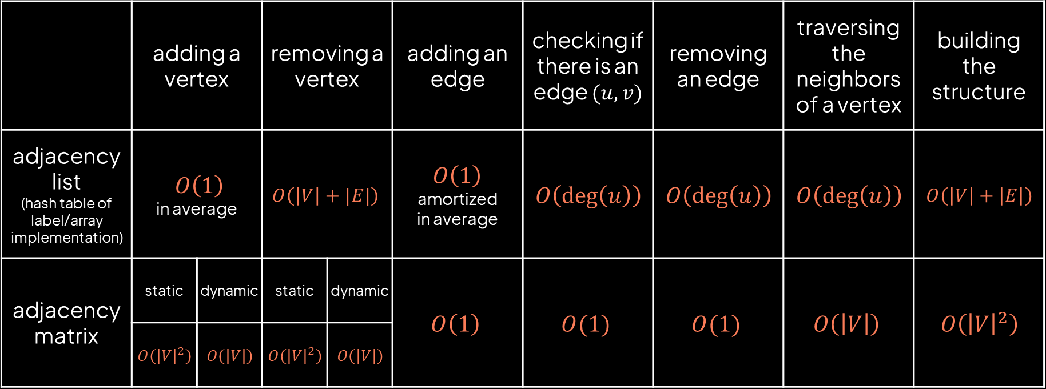
Time complexity of main operations:
 | adding a vertex |  | removing a vertex |  | adding an edge | checking if there is an edge $(u,v)$ | removing an edge | traversing the neighbors of a vertex | building the structure
adjacency list (hash table of label/array implementation) | $$O\left(1\right)$$ in average |  | $$O\left(\left|V\right|+|E|\right)$$ |  | $O\left(1\right)$ amortized in average | $$O\left(\deg\left(u\right)\right)$$ | $$O\left(\deg\left(u\right)\right)$$ | $$O\left(\deg\left(u\right)\right)$$ | $$O\left(\left|V\right|+\left|E\right|\right)$$
adjacency matrix | static | dynamic | static | dynamic | $$O\left(1\right)$$ | $$O(1)$$ | $$O(1)$$ | $$O\left(\left|V\right|\right)$$ | $$O\left({\left|V\right|}^{2}\right)$$
 | $$O\left({\left|V\right|}^{2}\right)$$ | $$O\left(\left|V\right|\right)$$ | $$O\left({\left|V\right|}^{2}\right)$$ | $$O\left(\left|V\right|\right)$$

